Slide 1
407440
70%
172861
TEENAGERS
LIVE IN THE CITY
FEMALES
Notes:
So if you’re a parent or teenager finally discovering a little bit more about themselves than I’d like to know, listen up, because today we’ll see if

Slide 2
CHAN JIE HO
LIVING IN CITIES AFFECTS TEENAGERS’
EMOTIONAL AND SEXUAL HEALTH
CONCERNING
BEHAVIOURS
STI
RATES
FAMILY STRESS LEVELS
FERTILITY
RATES
EMOTIONAL
DIFFICULTIES

Slide 3
PCA
2 MAIN CLUSTERS WITH
SIMILAR ATTRIBUTES
FIRST PRINCIPAL COMPONENT
SPLITS CLUSTERS BETWEEN
POSITIVE AND NEGATIVE
Notes:
80 regions but why so few dots?
Null values
Even so, we can see a distinct clustering split between negative and positive of the first principal component, so maybe decrease of something means city?

Slide 4
DECISION TREE
STI MEAN HAD THE DEFINING CONDITION
HIGHER
STI MEAN
RURAL
AREA
Notes:
Turns out it is STI means!!
It’s not SOLELY dependent on it – small tree
Because of pruning, we do not want our tree to overestimate the test data
But why STI?

Slide 5
Notes:
STI not family stress perhaps due to lack of data to create a robust enough tree
Looking at family stress, we can see 2011 has highest

Slide 6
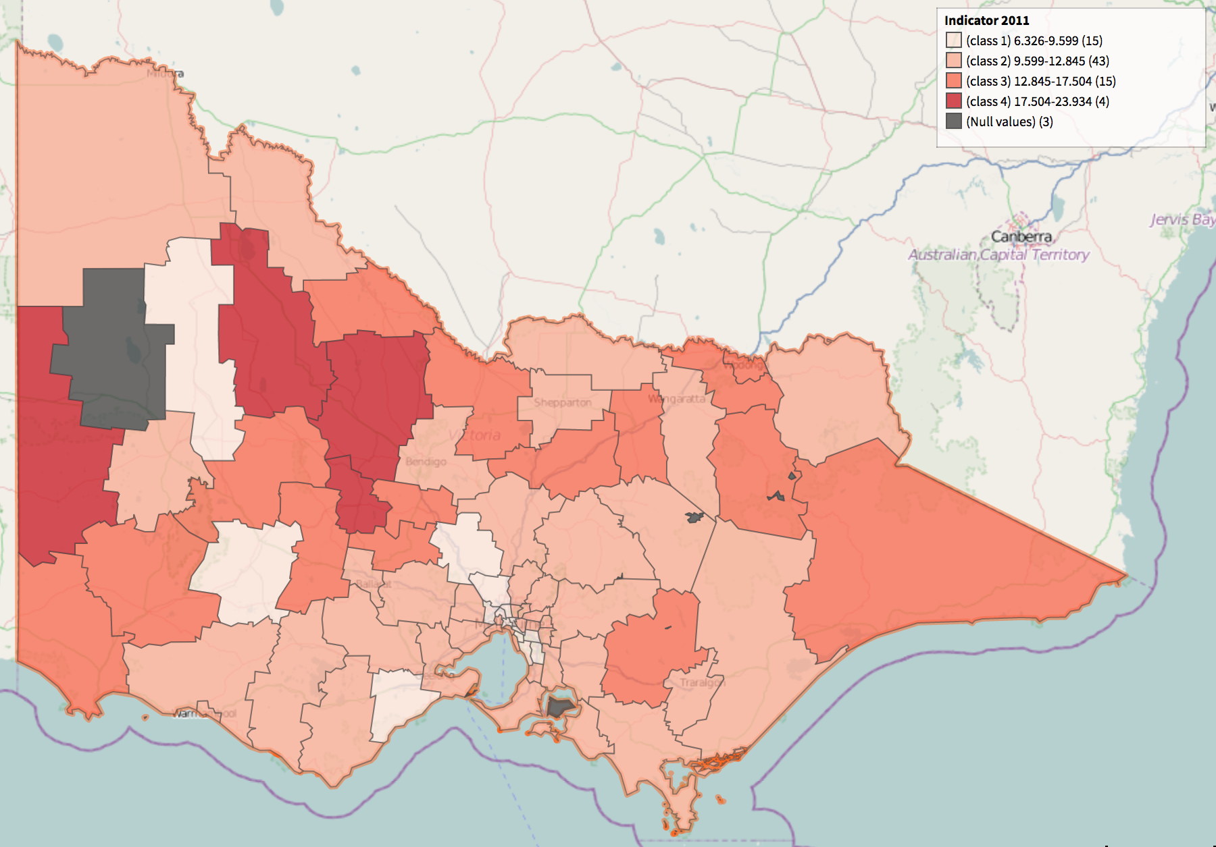
Notes:
Cities mostly have lighter colours

Slide 7
CORRELATION
DIRECTION OF CORRELATION IS NEGATIVE
HIGHER ATTRIBUTES
RURAL
AREA
Notes:
Closely correlated to one another with concerning and emotional being significantly correlated with one another
Notice some differences in what we got from nmi and these correlations

Slide 8
NMI
PEARSON
STRONG
STI
WEAKEST
STRONGEST
STRESS
STRONG
WEAK
FERTILITY
STRONGEST
WEAKEST
CONCERNING
WEAK
MIDDLE
MIDDLE
EMOTIONAL
Notes:
This may be due to the distributions underlying these datasets

Slide 9
BELL SHAPED
STRESS • CONCERNING • EMOTIONAL
NOT BELL SHAPED
STI • FERTILITY

Slide 10
♛ CONCLUSION ♛
Sex is a great way to relieve stress! So to play it safe; have sex in the city!
Notes:
Sex is a great way to relieve stress! So to play it safe, have sex in the city! ☺

