Slide 1

Cluster and Cloud Computing
Team 45
Notes:
Hello we are team 45, and I’m Chengze. I am very glad to be here to share our project.

Slide 2
Team
FrontEnd - AKSHAY YOGESH GOHIL, Chengze Guan
Angular
Google Map API
BackEnd – Chan Jie, Yilin Xu
Ansible
CouchDB
Restful API
Notes:
Group
Individually:
AK – spearheaded creating the app and visualising the data provided by the rest apis
Chengze – colouring the map and working with the google api – integrating the aurin data shape files with our map – report
Yilin – worked on the automation of the setting up and maintenance of the servers and volumes using ansible and mrc – tweet harvesting and sentiment analysis of the tweets
Cj – getting the aurin data – worked on the map reductions of the tweets in the database – creating and updating all the rest apis

Slide 3
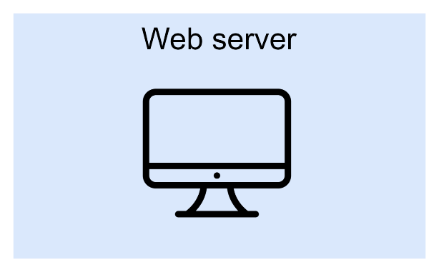

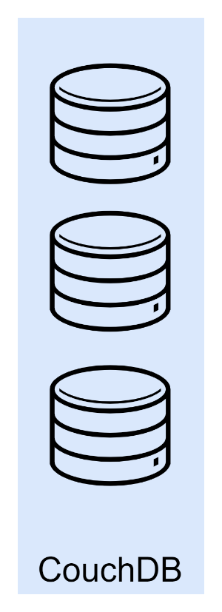


System Architecture
Restful API Request
MapReduce
Data
Twitter API
Tweets
Stores
Notes:
For the system architecture, we have one server to hold our web application. (click) Then we have three instance for backend, each server has deployed CouchDB and also perform as twitter harvester. And for the flow of data, how our application runs. Firstly, the twitter harvester post request to twitter through API, the twitter would response a groups of tweets. Then the data is replicated and stored in the CouchDB.
In CouchDB, we predefined some views, when user access our website, the webserver would send a request to CouchDB, and the group of tweets are aggregated through MapReduce algorithm and sent back to web server. Finally, the server get the result and display it to user.

Slide 4
Scenarios in Five Major Cities
Sentiments
Citizen’s happiness
Population Density
Does population density affects happiness of citizens?
Income
Demonstration!
Does money make people happy?
Homeless Rate
Does average income affect the homeless rate?
Others correlation?
Notes:
Lets talk about the scenarios. We investigated in 5 major cities including Melbourne, Sydney, Brisbane, Perth and Adelaide. Actually at the start we investigated in the whole Australia but we found that we can only harvest a limit number of tweets so the data could be insufficient. So finally we chose do scenario in five major cities.
The first thing we want to looked at is the sentiment. How happy is it for the citizens.
Secondly, I want to find whether there is a correlation between the population density and the people’s sentiment. For example, will live in an area with less people makes you happier. I think there should be correlations because I am currently living in city. At night, especially Friday night I found lots of people hanging on the street until very late. But in some other place with less people, going out at night is not wise at all.
Then, another topic we are interested in is that does money makes people happier?
Lastly, we are going to explore relationship between richness and homeless rate. From empiricism perspective, richer place would have less homeless people, is that true?
Are there any other correlation between these ?
Actually we did found some relationship between sentiment and population, income and homeless rate, let me demonstrate it in our website and just a quick notes, all of the number is a average number or rate, so the population would not make the comparison unfair.

Slide 5
Thank you

