Slide 1
GraphQL API vulnerabilities
Hochedlinger, Jellinger, Kaufmann, Kneidinger, Kreuzer

Slide 2
GraphQL introduction
Graph Query Language by Facebook
query exactly what you want
prevent over- and underfetching
all operations on one endpoint (usually POST)
/graphql
/api
/api/graphql
/graphql/api
/graphql/graphql

Slide 3
Agenda
GraphQL introduction
Lab 1 – Zap
Lab 2 – Insomnia
Lab 3 – Python Script
Custom GraphQL application

Slide 4
GraphQL - Schema
defines structure of types, fields and operations
type BlogPost { author: BlogUser content: String id: BigInteger title: String } type BlogUser { blogPosts: [BlogPost] id: BigInteger userName: String }
type Query { "Retrieve all blog posts" allPosts: [BlogPost]
"Get your user by username and password"
logIn(password: String, userName: String): BlogUser
"Retrieve blog posts by specific user IDs" postsByUserIds(userIds: [BigInteger]): [BlogPost] }

Slide 5
GraphQL - Operations
three types of operations
queries
mutations
subscriptions
one endpoint
type and name of operations define handling
response generally JSON object

Slide 6
GraphQL - Queries
Definition
Request
Response
type BlogPost { author: BlogUser content: String id: BigInteger title: String } type BlogUser { blogPosts: [BlogPost] id: BigInteger userName: String }
query GetAllPosts { allPosts {
title,
content,
author {
userName
}
}
}
{
"data": {
"allPosts": [
{
"title": "Cyber Offense and Defense",
"content": "This is a very good
course! I learned a lot
about cyber security.",
"author": {
"userName": "Michael J"
}
},
…
]
}
}

Slide 7
GraphQL - Queries
Aliases
Arguments
query GetAllPosts { posts: allPosts {
id
header: title
author {
userName
}
}
}
query GetPostsByUsers { postsByUserIds (userIds: [1, 2, 3]) {
title
content
author {
userName
}
}
}

Slide 8
GraphQL - Mutations
can be compared with POST, PUT and DELETE
type Mutation { "Create a new blog post" createPost(authorId: BigInteger, content: String, title: String): BlogPost
"Create a new user" createUser(password: String, userName: String): BlogUser
"Delete a blog post by ID" deletePost(postId: BigInteger): Boolean! }

Slide 9
GraphQL - Mutations
Request
mutation { createPost(
authorId: 1,
title: "COD"
content: "cyber offense and defense",
) {
id,
title,
content
}
}
Response
{
"data": {
"createPost": {
"id": 7,
"title": "COD",
"content": "cyber offense and defense"
}
}
}

Slide 10
GraphQL - Introspection
built-in function to query for schema
regular query -> specify request fields
learn how to interact with API
disable in production
template for full introspection query
Example request
query { __schema {
queryType {
name
fields {
name
}
}
}
}

Slide 11

Lab 1 – ZAP
GraphQL support via Plugin

Slide 12
Lab 1 – Zap
Look for GraphQL Endpoints in history
Introspect
Poke through methods

Slide 13

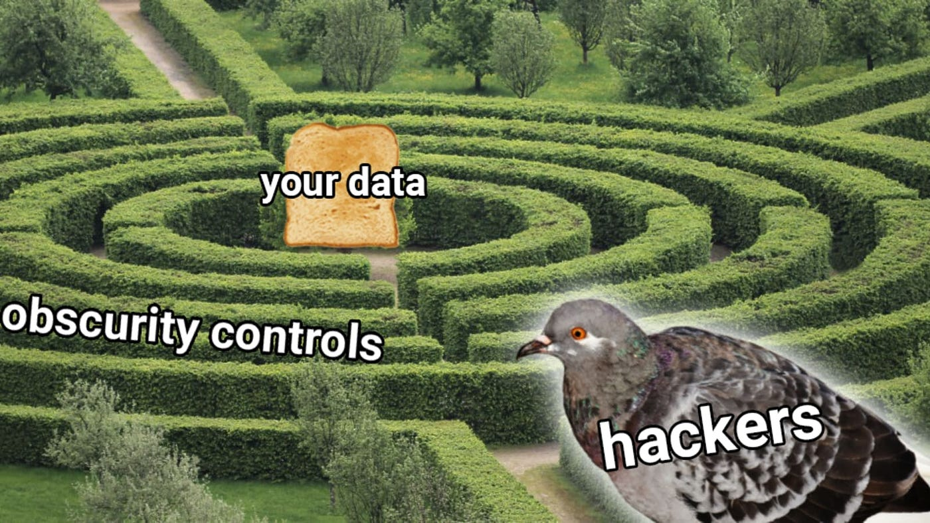
Lab 2 – Insomnia REST client
Finding a hidden GraphQL endpoint
Bypassing introspection defenses
Security through obscurity is never a good option!

Slide 14
Lab 2 – Insomnia REST client
Try out different endpoint names
Try different HTTP-Methods
Try introspection with different encodings
NEVER expose endpoints to the outside world! They WILL be found.

Slide 15

Lab 3 – Bypass brute force protections
mutation { ​ bruteforce0:login(input:{username:"carlos",password:"<pass1>"}) {success} ​ bruteforce1:login(input:{username:"carlos",password:"<pass2>"}) {success} ​ ... ​ }​
Avoids rate limiter by putting all attempts into one request
Solution: limit GraphQL operations

Slide 16

Building a GraphQL application
Using Quarkus (Kubernetes-native Java framework)
Smallrye-GraphQL library
Schema and Introspection available by default
Github Link
Demo Time

Slide 17
Disable Introspection in Production
application.properties
# disable schema generation in prod mode %prod.quarkus.smallrye-graphql.schema-available=false
# disable introspection in prod mode %prod.quarkus.smallrye-graphql.field-visibility=no-introspection
Lets try it!

Slide 18
Using rate limits
@RateLimit( value = 1, // 1 request window = 1 // per second ) public BlogUser logIn(…) {…}
Lets try it!

