Slide 1


Slide 2
《史記》名稱的由來
The Origin of the Title of Shiji
(Why Is It Called Shiji?)
「史記」一詞本是古史通稱，司馬遷編撰《史記》，最初無固定書名，司馬遷在自序中稱之為《太史公書》。班固在《漢書·藝文志》中稱為《太史公記》，省稱《太史記》。
西晉陳壽《魏志》始稱之為《史記》，唐代《隋書·經籍志》標立史部，首列史記130卷，「史記」才由史書通稱逐漸成為「太史公書」的專稱。
Sima Qian (司馬遷) originally called his work The Records of the Grand Historian (太史公書), a title based on his official position. At that time, “shiji” (史記) was a general term for historical records. The work later became known as Shiji, and this gradually became its standard title.
Notes:
https://www.bilibili.com/s/video/BV1CS4y1o7NY

Slide 3
《史記》的內容
Brief Introduction to Shiji
《史記》記載自上古傳說的黃帝時代，至漢武帝元狩元年，計2500餘年史事。全書包含十二本紀、三十世家、七十列傳、十表、八書，共一百三十篇，五十二萬六千五百餘字，為中國第一部紀傳體通史。
The Records of the Grand Historian (太史公書), now commonly known as Shǐjì (史記), is a monumental history of ancient China, completed around 91 BC during the Han dynasty. It covers a period of about 2,500 years, from the age of the legendary Yellow Emperor to the reign of Emperor Wu of Han, who ruled during the author’s lifetime.
The work consists of 130 chapters and approximately 526,500 Chinese characters. It is China’s first comprehensive history organised around annals and biographies.

Slide 4
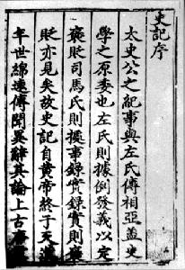
私修的史書
Personal Historian
班固《漢書·司馬遷傳》：「然自劉向、揚雄，博極群書，皆稱遷有良史之才，服其善序事理，辨而不華，質而不俚。其文直，其事核。不虛美，不隱惡，故謂之『實錄』。」
This work reflects the historian’s personal perspective and judgement. Compared with official court histories, it offers a more candid account of emperors’ lives and the political circumstances of their times. It neither exaggerates their virtues nor conceals their faults.

Slide 5
史識：考察歷史的方式
Historical Perspective:
How Sima Qian Examines History
原始察終，見盛觀衰：考察事物的開始、終結，且從盛世中觀察衰敗的徵兆。
Examine how events begin and end, and look for signs of decline even in times of prosperity.
究天人之際：「天」是歷史中不能以人類思維理解的事物，而「人」又如何在不可預測的天命中，創造成敗禍福。
“Heaven” refers to forces in history that people cannot fully understand or predict. The focus is on how people’s actions shape success and failure, happiness and disaster, within the limits of fate.
Notes:
《史記的讀法》作者楊照詮釋得很好：他說，讀歷史，不是要了解 what，而是要掌握 how、why。要釐清這個 how 與 why 的問題，就必須要有「究天人之際、通古今之變」的功夫。
例如：「看歷史，不只是知道事情怎麼開始、怎麼結束，還要問：為什麼會走到這個結果？一個人或國家看起來最成功的時候，是不是已經出現日後衰敗的原因？」

Slide 6
通古今之變：在歷史中找到人類前進的大方向，以及王朝盛衰成敗之理。
Explore the general direction of human progress through history and understand why dynasties rise and fall.
成一家之言：創建獨特的史觀與體例。
Develop a unique view of history and a distinctive way of organising historical writing.

Slide 7
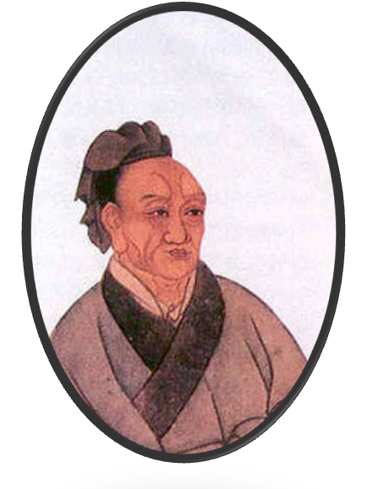
體例 Structure of Shiji
Shiji is divided into five sections.
12本紀：記錄帝王的事蹟。
30世家：記錄重要封建侯王或貴族事蹟。
8書：專述典章制度。
10表：採表格方式，排列帝王、將相年代事件次序
或歷史動態。
70列傳：誌人物。
劉勰《文心雕龍．史傳》：「故本紀以述皇王，列傳以總侯伯，八書以鋪政體，十表以譜年爵。」

Slide 8
12 Basic Annals (běnjì 本紀)
The “Basic Annals” form the first 12 chapters of Shiji. They follow the tradition of ancient Chinese court chronicles, such as the Spring and Autumn Annals (春秋).
In this section, Sima Qian focused on figures who held real power in China, such as Xiang Yu and Empress Dowager Lü. He did not give separate annals to rulers who had little or no real power, such as Emperor Yi of Chu (楚義帝) and Emperor Hui of Han (漢惠帝).

Slide 9
10 Tables (biǎo 表) 事件次序按表排列
The “Tables” cover chapters 13–22 and include one genealogical table and nine chronological tables.
8 Treatises (shū 書) 典章制度
The “Treatises” form the shortest of the five sections of Shiji. These eight chapters (23–30) trace the development of rituals (禮), music (樂), pitch pipes (律), calendars (曆), astronomy (天官), imperial sacrifices to Heaven and Earth (封禪), rivers and waterways (河渠), and financial administration (平準).
30 Hereditary Houses (shìjiā 世家)
The “Hereditary Houses” cover chapters 31–60 and mainly record the histories of noble families. Most of these chapters focus on the various feudal states of pre-Qin China (先秦).
Notes:
《律書》：「王者制事立法，物度規則，壹稟於六律，六律為萬事根本焉」。律，比率。三分損益法。

Slide 10
70 Ranked Biographies (lièzhuàn 列傳)
列傳共七十篇，主要記述不同人物的生平事蹟，呈現他們的性格、抉擇與歷史地位。除了個人傳記，也有將相關人物合寫（依共同身分、職業分類）如〈刺客列傳〉、〈循吏列傳〉與〈儒林列傳〉。
The “Ranked Biographies”, usually shortened to “Biographies”, form the largest section of Shiji. They cover chapters 61–130 and account for about 42% of the work’s total length.
These 70 chapters mainly tell the life stories of about 130 notable men in ancient China, from Boyi (伯夷), known for his moral integrity at the end of the Shang dynasty, to figures who lived around Sima Qian’s own time.
About 40 chapters focus on a single person. Some describe two related figures, while others discuss groups with similar roles, such as assassins, upright officials, or Confucian scholars.

Slide 11
本紀、世家中的三個例外
Three exceptions from Basic Annals, Hereditary Houses
以三個例外為證，觀察司馬遷的獨特史觀。
項羽本紀
  夫秦失其政，陳涉首難，豪傑蜂起，相與並爭，不可勝數。然羽非有尺寸（無尺寸之地），乘勢起隴畝（田野）之中，三年，遂將五諸侯滅秦，分裂天下而封王侯，政由羽出，號為「霸王」。位雖不終，近古以來，未嘗有也。
孔子世家
  天下君王至於賢人眾矣，當時則榮，沒則已焉。孔子布衣，傳十餘世，學者宗之。自天子王侯，中國言六藝者折中於夫子，可謂至聖矣。
陳涉世家
  陳涉雖已死，其所置遣侯王將相竟亡秦，由涉首事也。
Notes:
以三個例外為證，觀察司馬遷的史觀。
From three exceptions, we could observe Sima Qian's unique historical view .
He didn’t receive any financial support form the government, therefore, he can use his point of views to write this book because he sponsor himself.

Slide 12
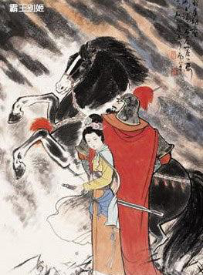
項羽本紀 (項羽Basic Annals) （羋姓，項氏，名籍，字羽）
夫秦失其政，陳涉首難，豪傑蜂起，相與並爭，不可勝數。然羽非有尺寸（無尺寸之地），乘勢起隴畝（田野）之中，三年，遂將五諸侯滅秦，分裂天下而封王侯，政由羽出，號為「霸王」。位雖不終，近古以來，未嘗有也。
Xiang Yu (項羽) came from an ordinary family, but he raised an army and successfully defeated the Qin in a very short time. Although he was not the emperor, he held the real power to rule the country.
Notes:
家族背景：他的祖父是楚國著名的抗秦名將項燕。
姓氏由來：項氏世世代代擔任楚國的將領，因為被封在「項」地，所以族人便以「項」為姓。

Slide 13
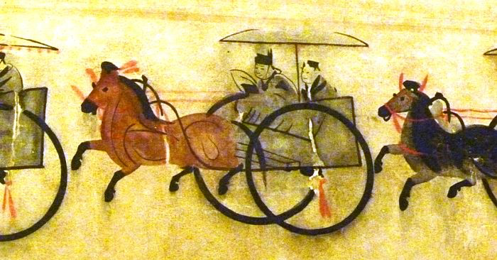
孔子世家（子姓，孔氏，名丘，字仲尼）
天下君王至於賢人眾矣，當時則榮，沒則已焉。孔子布衣，傳十餘世，學者宗之。自天子王侯，」中國言六藝者折中於夫子，可謂至聖矣。
Confucius was a commoner, but he became a great educator and philosopher and had a major influence on China. Confucianism is still followed and respected today. Therefore, Confucius was included in the “Hereditary Houses” (shìjiā 世家).
Notes:
莊子首先將詩書禮樂易春秋合稱為六經，漢代以來，詩書禮樂易春秋稱為六經，也稱六藝。兩者混稱。多半不指稱禮樂射御書數的貴族學科技能。
姓（子）：代表血緣關係，主要用來「別婚姻」（同姓不婚）。孔子的先祖是殷商王室後裔，而商朝王室的國姓就是「子」姓。
氏（孔）：代表家族分支，主要用來「辨貴賤」。隨着子孫繁衍，同一個「姓」底下會分出不同的「氏」。孔子的六世祖叫孔父嘉（宋國大夫），孔父嘉在宮廷內亂中被殺後，他的子孫為了紀念他，便以他的字「孔父」中的「孔」字作為家族的「氏」。

Slide 14
姓：同一個祖先的「大血緣」
起源：多源自原始社會的母系氏族（所以「姓」這個字是「女」加「生」），例如：姬、姜、嬴、子、姚，這些古老的姓都帶有女字旁。
功能：別婚姻。先秦時期嚴格規定「同姓不婚」，因為當時的人已經知道同姓結婚（近親通婚）後代容易生病或夭折。因此，只要「姓」相同，不管隔了多少代、分家到了哪裡，法律上都算是同一個血緣集團，不能結婚。
氏：大血緣底下的「小分家」
起源：隨着子孫繁衍，一個大宗族人口越來越多，就會分家。男子會因為封地、官職、居住地或者祖先的字，另外給自己這一個分支取一個名號，這就是「氏」。
功能：辨貴賤。有「氏」的人代表是有封地或當官的貴族，平民通常只有名，沒有氏。

Slide 15
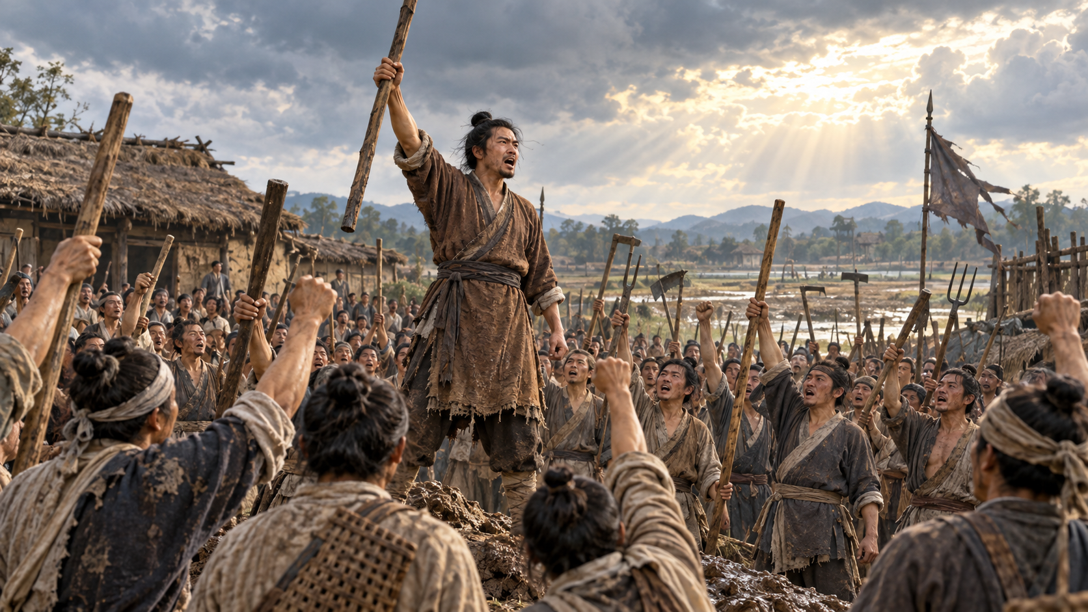
陳涉世家
陳涉雖已死，其所置遣侯王將相竟亡秦，由涉首事也。
Chen She came from a farming background and was the first to lead a revolt against the Qin (秦). Although he failed and died, those who followed him continued the uprising and eventually overthrew the Qin.

Slide 16
司馬遷生平(145B.C.-86B.C.)
The Life of Sima Qian
司馬遷，字子長，西漢人。生於景帝中元五年(西元
前145)，約卒於昭帝始元元年(西元前86)，年約60。
祖先是世代的歷史學家與天文家。父親司馬談，為
西漢初年著名的學者，武帝時仕太史令。(家學淵源)
太史令為掌管天文曆法與編載史書的官吏。
His ancestors were historians and astronomers. His father, Sima Tan, was a well-known scholar and served as Grand Historian during the reign of Emperor Wu of Han. In this role, he was responsible for astronomy, calendars, and historical records.

Slide 17
年少時，從孔安國治《尚書》，從董仲舒治《春秋》。 (從師問學)
In his youth, he studied under leading scholars such as Kong Anguo and Dong Zhongshu.
20歲開始漫遊天下，考察各地、訪故耆、蒐羅史料，舉凡屈原、大禹、韓信、孔子故舊之地，皆有探訪。後因職位之故，常隨從武帝出巡。(史記撰寫的準備階段)
At the age of 20, he began travelling to different regions, visiting historical sites, collecting historical information, and interviewing local elders. These experiences laid the foundation for his Records of the Grand Historian.

Slide 18
史家職責
The responsibility of historian
其父司馬談任太史令， 「太史令」原是俸祿六百石的小官，職責僅在於管理圖籍，掌管星象天文，記錄上代及當時之事，並無著述之責。然而，司馬談不滿足於僅整理記錄的工作，早有撰寫通史，成一家之言的計劃。
The Grand Historian was a minor official responsible for managing books and records, observing the stars, and recording past and present events. However, his father, Sima Tan, was not satisfied with simply organising records. He planned to write a comprehensive history and develop his own view of history.

Slide 19
遺命著史
His Father’s Final Wish:
To Complete a General History
武帝元封元年(-110)，司馬談病逝洛陽，遺命著史。父親遺命告訴他，身為太平盛世的史官，迫切需要對過往的歷史作出記述與總結。
Before his death, Sima Tan asked his son to complete a general history. He stressed that, as a historian living in a time of peace and prosperity, his son had an urgent duty to record and review the events of the past.
太史公執遷手而泣曰 ：「…今漢興，海內一統，明主賢君忠臣死義之士，余為太史而弗論載， 廢天下之史文，余甚懼焉，汝其念哉！」

Slide 20
著手撰史
Beginning to Write History
元封三年(-108)，繼父業為太史令。並於元封四年(-107)逐步著手《史記》的著述工作。
In 108 BC, he succeeded his father as Grand Historian.
In 107 BC, he began writing Shiji.

Slide 21
陷入生命的絕境
Stuck in Desperate Straits
武帝天漢二年(-99)，因李陵投降匈奴，為李陵辯護，遭下蠶室，判腐刑。此時約47歲。
In 99 BC, after working on Shiji for about eight years, he faced the most difficult time of his life when he was sentenced to castration for defending Li Ling (李陵), a general who had surrendered to the enemy.
太上不辱先，其次不辱身，其次不辱理色，其次不辱辭令，其次詘體受辱，其次易服受辱，其次關木索被箠楚受辱，其次剔毛髮嬰金鐵受辱，其次毀肌膚斷支體受辱，最下腐刑，極矣。
詘體：匍匐跪拜。
易服：古時刑徒著赭衣。

Slide 22
北海
(今貝加爾湖)
今俄羅斯
居
水
4) 漢軍連鬥8日，死者過半
，李陵乃引兵且戰且退
郅
余
今外蒙古
吾
單于庭
(今烏蘭巴托)
5) 在距離居延百餘里時，
漢軍退路遭匈奴截斷，
李陵糧盡援絕，乃降匈
奴，散歸者僅4百餘人
水
漢匈國界
匈
奴
2) 漢武帝又遣騎都尉李陵，率
屯衛於酒泉、張掖之丹陽楚
兵 5千人，出居延以分匈奴
之勢，使貳師將軍作戰有利
河
(今烏魯木齊)
4
3
祈連天山
(白山)
3) 李陵出居延千餘里，
遭匈奴8萬騎兵包圍
西域
5
居延澤
長城
1) 天漢 2年(前 99)秋，漢武帝
遣貳師將軍李廣利率 3萬騎
，擊匈奴右賢王於祈連天山
1
弱
2
燉煌
水
酒泉
張掖

Slide 23
北海
(今貝加爾湖)
今俄羅斯
在距離居延百餘里時，
漢軍退路遭匈奴截斷，
李陵糧盡援絕，乃降匈
奴，散歸者僅4百餘人
居
水
李陵出居延千餘里，
遭匈奴8萬騎兵包圍
漢武帝又遣李陵，率屯衛酒泉、
張掖 5千人，徒步出居延，以分
匈奴之兵，使貳師將軍作戰有利
漢軍苦戰8日，死者過半
，李陵乃引兵且戰且退
郅
天漢 2年(前 99)秋，漢武帝
遣貳師將軍李廣利率 3萬騎
，擊匈奴右賢王部
余
今外蒙古
吾
單于庭
(今烏蘭巴托)
漢匈國界
水
匈
奴
匈奴右賢王
駐牧之地
河
(今烏魯木齊)
漢騎都尉 李陵，
以5千丹陽楚兵，
屯衛酒泉、張掖
祈連天山
(白山)
西域
居延澤
長城
弱
燉煌
水
酒泉
張掖

Slide 24
發憤著史以承擔生命的責任
Endure the Shame and Continue His Duty
本欲輕生，但想到「人固有一死，死有重於泰山，或輕於鴻毛，用之所趨異也。」
決定忍辱負重完成《史記》。
At first, he wanted to take his own life in prison. However, he believed it was his destiny to complete Shiji and pass it down from generation to generation. His duty was not yet fulfilled. Therefore, he endured the shame and continued writing for another eight years.

Slide 25
完成史記 Completed Shiji
過程中以「孔子六藝傳世」為效法對象自我勉勵：
所以隱忍苟活，函(陷入)糞土之中而不辭者，恨私心有所不盡，鄙沒世(ㄇㄛ^{ˋ} ㄕ^{ˋ，}死亡)而文采不表於後也。
從〈報任安書〉的寫作時間推測，征和二年(-91)，《史記》130篇完成，司馬遷於數年後卒。
In 91 BC, Shiji was completed with 130 chapters. After Sima Qian finished the book, little is known about his later life. However, he made his dream come true by completing Shiji, which has been passed down from generation to generation to this day.
Notes:
沒，結束。

Slide 26
由生到死,由死入生
From Life to Death, and from Death Back to Life
敢於不死的英雄。
人間的恥辱並不可怕，可怕的是自己死於恥辱，喪失一種創造未來的生命信念，喪失一種弘揚自我的頑強意志。
程世和《史記-偉大人格的凝聚》
It is easy to die, but choosing to live and face shame is difficult. What is truly frightening is letting shame destroy our hope for the future. True courage means living on and showing the value of our lives through what we create.

Slide 27
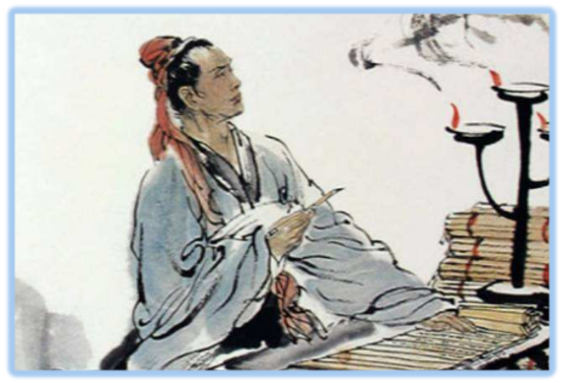
忍辱而走完尊嚴的一生
Live Out a Life of Dignity While Enduring Shame
僕竊不遜，近自託於無能之辭，網羅天下放失舊聞 ，略考其行事，綜其終始，稽其成敗興壞之紀 ，上計軒轅，下至於茲，為十表，本紀十二，書八章，世家三十，列傳七十，凡百三十篇。亦欲以究天人之際，通古今之變，成一家之言。草創未就，會遭此禍。惜其不成，是以就極刑而無慍色。僕誠以著此書，藏之名山，傳之其人，通邑大都，則僕償前辱之責，雖萬被戮，豈有悔哉！然此可為智者道，難為俗人言也！ 〈報任安書〉
Notes:
After the punishment, he went back to the court to work with shame. He believed that his has the fate to complete Shiji, therefore, this Records could be pass on the generation to generation. This Records could be spread out to every corner of China, so everyone can read about it. (Qian to his friend Ren An)

Slide 28
司馬遷的牢獄經歷
Sima Qian’s Experience in Prison
猛虎處深山，百獸震恐，及其在阱檻(ㄐ一ㄢˋ)之中，搖尾而求食，積威約之漸也。故士有畫地為牢勢不入，削木為吏議不對，定計於鮮也。今交手足，受木索，暴肌膚，受榜箠，幽於圜牆之中，當此之時，見獄吏則頭槍地，視徒隸則心惕息。何者？積威約之勢也。 〈報任安書〉
His experience in prison helped him understand the difference between humane officials and harsh officials.定計於鮮:不以壽終為先，即定計自裁。
積威約之勢:由於威力的長期施壓所造成的。

Slide 29
循吏與酷吏
Reasonable Officials / Harsh Officials
古代政治中，對不同性質官員的稱呼，
不只《史記》，後代正史中亦有記載循吏與酷吏的相關列傳。
Harsh Officials and Reasonable Officials are two different types of officials in ancient politics. Biographies of both types appear not only in Shiji, but also in many later official histories.

Slide 30
循吏與酷吏
Reasonable Officials / Harsh Officials
酷吏代表法家，著重嚴刑峻法。
強調奉行朝廷法令，以貫徹君主旨意。
Harsh Officials: used harsh punishments to carry out the emperor’s wishes.
循吏代表儒家，著重倫理制度。
強調禮樂教化，以化民成俗為要務。
Reasonable Officials: used rituals, music, and moral education to build a peaceful society.

Slide 31
酷吏，古代稱呼使用嚴刑峻法的官吏。其中包括嚴格執法的正直官員，也包括利用酷刑草菅人命的官吏。《史記》中記載的酷吏較為聞名的是張湯。
Harsh Officials were officials who used harsh laws and punishments to govern people. Some enforced the law strictly and fairly. Others used cruel punishments with no regard for human life.
張湯：
喜讀律法，後來任長安吏和茂陵尉，在審理陳皇后巫蠱案和謀反事件中辦事得力，受到武帝器重。
張湯執行法律過於嚴酷，甚至發明「腹誹罪」。因執法過嚴而遭忌，時人有盜發孝文園瘞(ㄧˋ)錢，張湯遭陷，乃被迫自殺以自清。

Slide 32
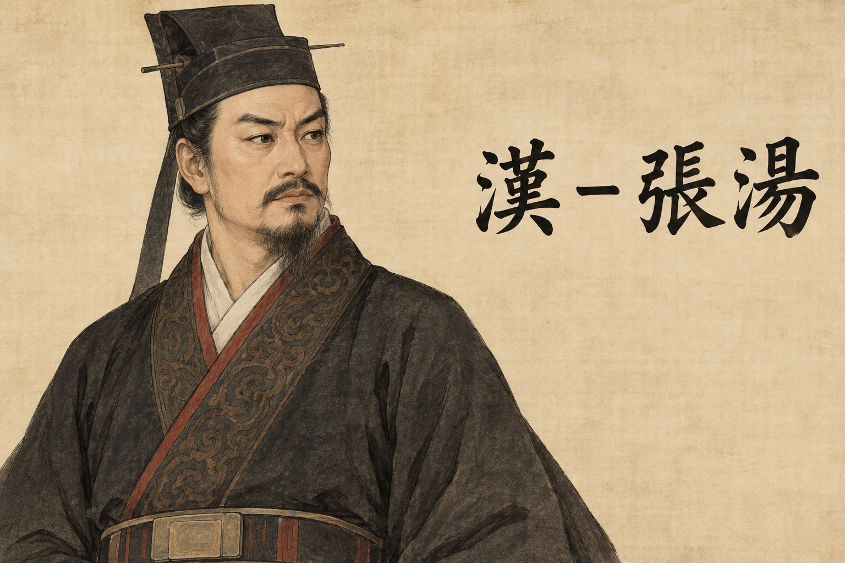
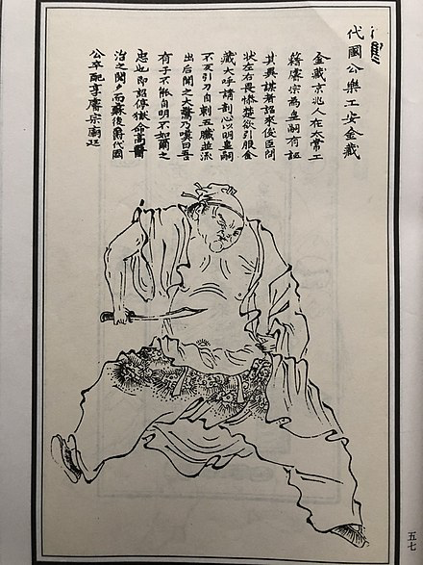
腹誹罪The Crime of Silent Criticism
在肚腹之中「誹謗」皇帝。
漢武帝時，張湯審理顏異一案。顏異聽見客人批評新法令，沒有回答，只略微撇動嘴唇。張湯便以他身為大臣，對法令不滿卻不進諫，反而在心中非議為由，奏請判處死刑。此為「腹誹」論罪的先例，反映皇權對臣下思想與言論的壓制。
Zhang Tang was a famous harsh official during the reign of Emperor Wu of Han. He accused Yan Yi of silently criticising imperial policies, even though Yan Yi had said nothing and had only slightly moved his lips. Yan Yi was sentenced to death, setting a precedent for punishing unspoken criticism.
唐-來俊臣與安金藏
Notes:
來俊臣與安金藏

Slide 33
什麼是循吏？
What is Reasonable Officials
循吏，是二十四史中稱呼奉職守法、清廉賢能、以民為本、造福一方的官員。
Reasonable Officials followed the law, were honest, capable, and kind, listened to the people, and worked for their welfare.
司馬遷〈循吏列傳〉中記載了如孫叔敖、子產等仁厚愛民，善施教化，以政寬得人和，國泰而民安的官員事跡。
公儀休、石奢、李離，皆清廉自正，嚴守法紀，當公私利益發生尖銳衝突時，選擇以身殉法，維護國家綱紀的尊嚴。

Slide 34
司馬遷同時為酷吏與循吏立傳的用意
《史記》中同時記載了循吏與酷吏的事跡，古今學者都曾指出〈循吏列傳〉與〈酷吏列傳〉乃是有意為之的姊妹篇。
〈循吏列傳〉記敘了春秋戰國時期五位賢良官吏的事跡。〈酷吏列傳〉卻全寫漢代人，且其中除景帝時的郅都外，其餘九人都是漢武帝時的官員。
漢代官吏雖有仁厚廉正守法之人，但〈循吏列傳〉只表彰歷史人物，全不言及當朝，雙傳互見下，更可體會司馬遷寫 〈循吏列傳〉時所言：「奉職循理，亦可以為治，何必威嚴哉？」的用心了。

Slide 35
循吏列傳的主旨
Main Theme of the Biographies of Reasonable Officials
奉職循理，亦可以為治，何必威嚴哉？
循順正道，奉行職守以讓人民敬愛信服，也能實踐倫理制度，妥善的治理一方，何必一定要用嚴刑峻法威服百姓呢？
If you can govern well through moral education and by faithfully carrying out your duties, why are harsh laws and punishments necessary?

