Slide 1


Vietnam Tourism Web
Ho Chi Thanh B2110058
College of ICT, Can Tho University
04/2024
www.ctu.edu.vn

Slide 2

1. INTRODUCTION
Vietnam Tourism Web
A website where tourist can booking tour easily and know more about beautiful lanscapes of Vietnam
Implemented by Vue.js – Tailwind CSS – Spring Boot
Database: MySQL
www.ctu.edu.vn

Slide 3
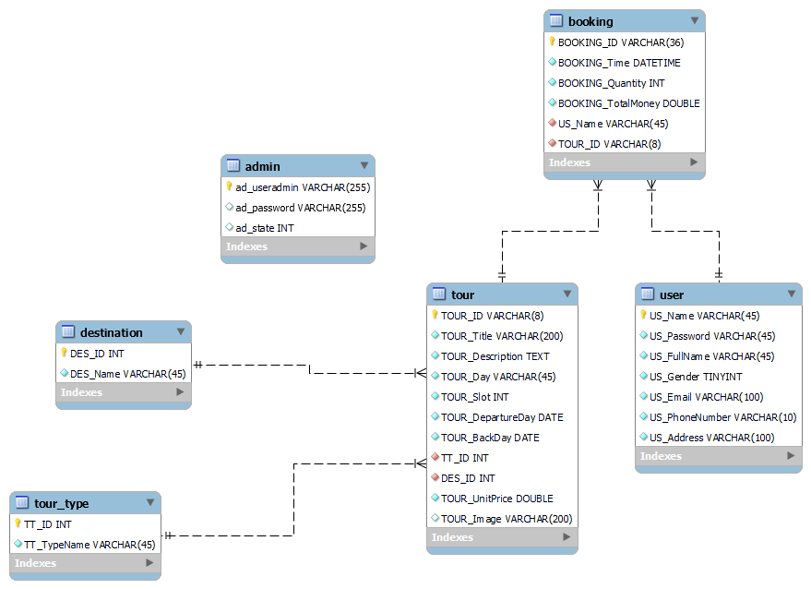
2. DESIGN AND IMPLEMENTATION
www.ctu.edu.vn

Slide 4
MAIN FUNCTIONS
ADMIN
CLIENT
- Log in
- Tour addition, editing, deletion
- Register
- Log in
- Searching tours
- Booking tours
www.ctu.edu.vn

Slide 5
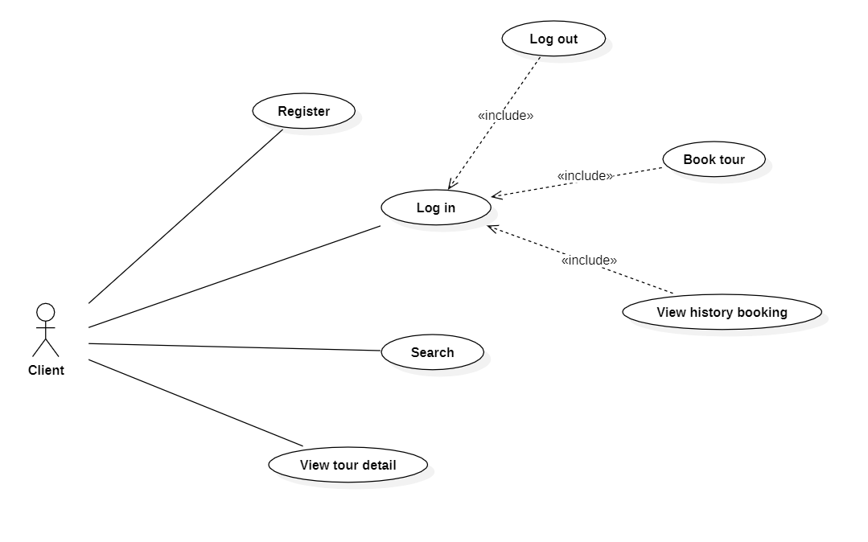
USE CASE DIAGRAM
CLIENT
www.ctu.edu.vn

Slide 6
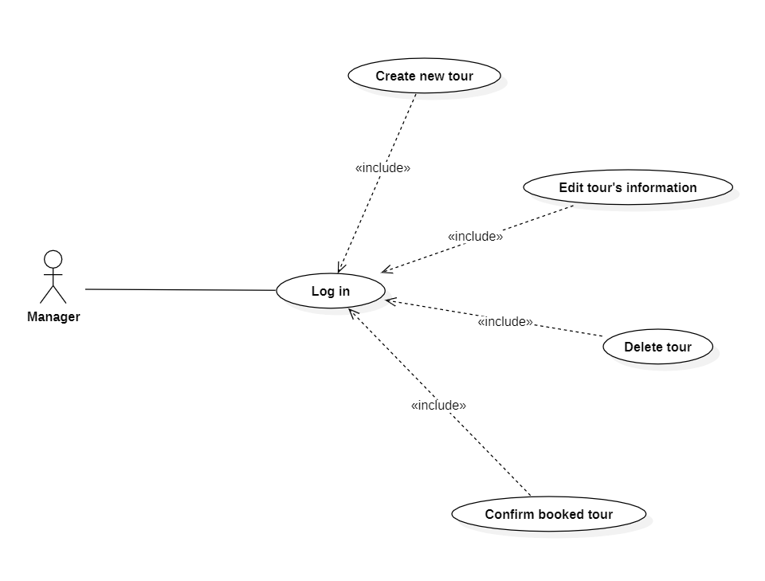
USE CASE DIAGRAM
ADMIN
www.ctu.edu.vn

Slide 7
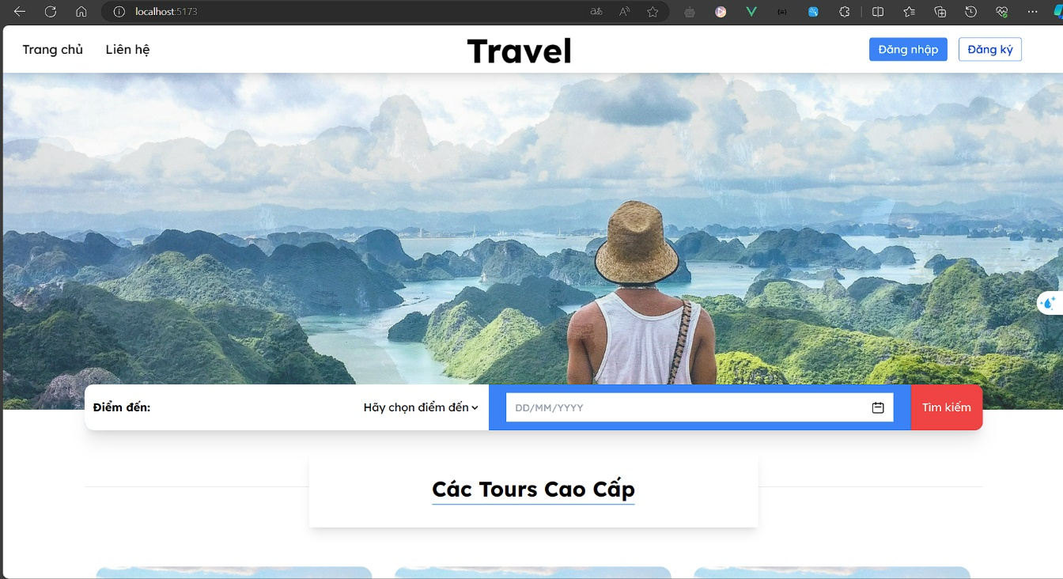
INTERFACE
Homepage
www.ctu.edu.vn

Slide 8
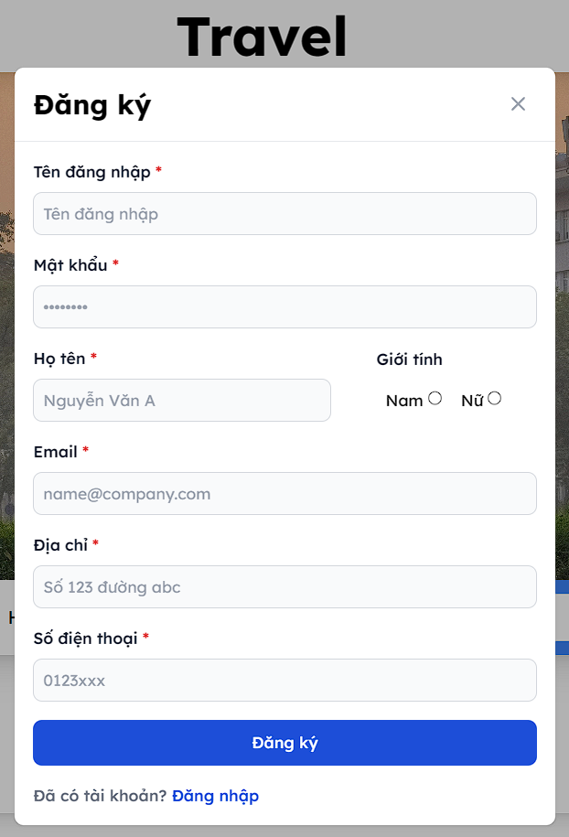
INTERFACE
Register
www.ctu.edu.vn

Slide 9
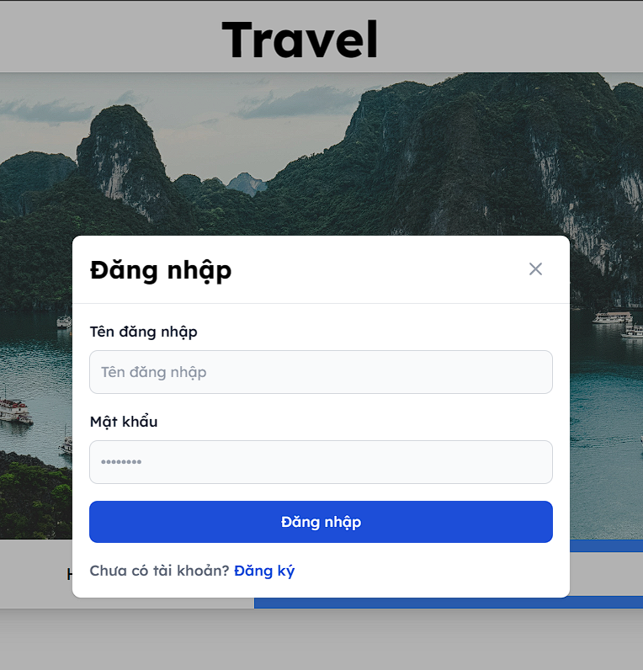
INTERFACE
Login
www.ctu.edu.vn

Slide 10
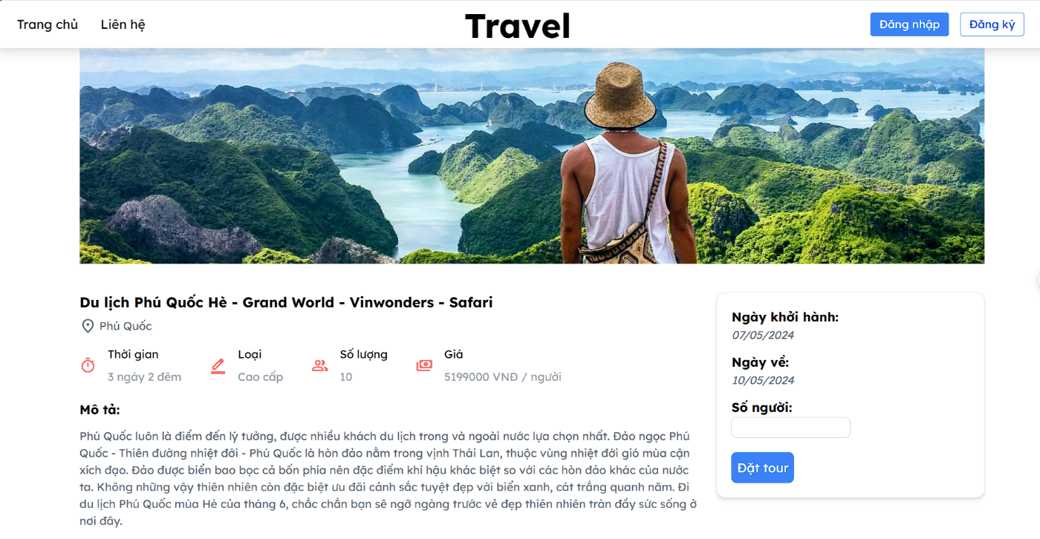
INTERFACE
Tour detail
www.ctu.edu.vn

Slide 11
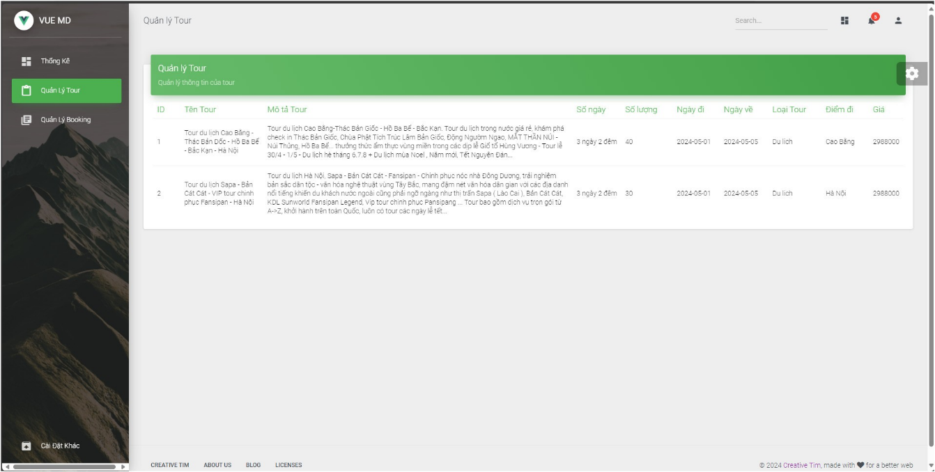
INTERFACE: ADMIN
Tour Management
www.ctu.edu.vn

Slide 12
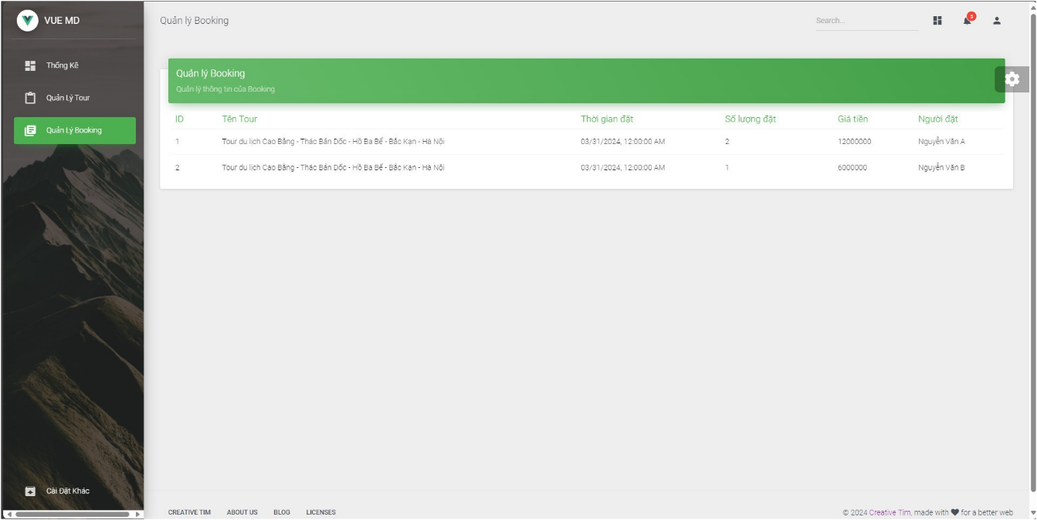
INTERFACE: ADMIN
Booking Management
www.ctu.edu.vn

Slide 13
3. CONCLUSION AND FUTURE DIRECTIONS
PHONE2D
Future Work
Provide user-friendly, intuitive, and easy-to-use interface
Meets most of the initially outlined requirements as a simple tourism website
Add additional features
Disadvantages
Incorporating a guide system
Not sufficient to meet all the needs of tourists
Messaging interface will facilitate communication with travel advisors and tour guides.
Website is not optimized for other devices such as phones, tablets, and does not support multiple languages.
www.ctu.edu.vn

Slide 14
THANKS
THANK YOU
THANK YOU
www.ctu.edu.vn

