Slide 1


Narcotics overdose alert
Fraser Health Hackathon January 22, 2017
Prepared by: Team Narcos

Slide 2

The opioid crisis news
Fentanyl crisis: Drug overdoses claim unprecedented 914 lives in B.C. in 2016
Notes:
Problem - Vancouver is making worldwide news“Fentanyl crisis: Drug overdoses claim unprecedented 914 lives in B.C. in 2016… representing an increase of nearly 80 percent from the previous year”QuestionWhat can be done? Unfortunately, overdoses will continue. Perhaps we can support users and front line workers with a quick OD buttonDecrease response timeIncrease survival ratesIdea – we checked what already exists in other countries. Various health emergency applications with beacon and response logistics have been created.Solution – Opioid Ovedose Button appFirst person(s) to see the overdose, press RED button – hold up phone and map shows red blinkingEveryone in immediate 1 KM radius is notified, map shows up with exact emergency location and calculates distanceResponder, press GREEN button – hold up phone and show green arrows moving towards red dotOvertime, database of overdose details is compiled for analytics

Slide 3

Blabla

Slide 4
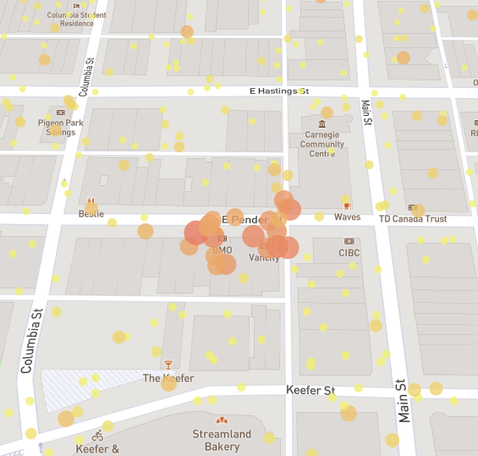

Visual Analytics

Slide 5
Color Palette
Notice that the chip colors to the right also show up as the top row of colors in any pull down menu that offers color choices
White & Black
Subdue & Highlight
Primary Accent Colors

Slide 6
Chapter Title
Copy and Paste these tables to add topics to each chapter title
Topic Two placement
Topic Three that could be a clickable link
Topic Four that could be a clickable link
Topic Five that could be a clickable link
Topic Six that could be a clickable link
You may delete as many of these as necessary
They are set up as a table and easy to delete

Slide 7
Charting Data
Bar charts and column charts are useful to compare data points in one or more data series
Data that is arranged in columns or rows on a worksheet can be plotted in a column chart. Column charts are useful for showing data changes over a period of time or for illustrating comparisons among items.
Source: http://office.microsoft.com/en-us/excel-help/present-your-data-in-a-column-chart-HA010218663.aspx

Slide 8



Graphics with Columns of Content
Placing text in columns gives you a natural way to associate graphics at the top of a text field.
The first rule of formatting like a pro is staying consistent. Laying out your text isn’t just about making it fit or making it pretty; it’s about making it consumable.
The ideal line length for text is based on the physiology of the human eye. At normal reading distance the arc of
the visual field is only a few inches. Research shows that reading slows and retention rates fall as line length begins to exceed the ideal width.*
This may be caused by having columns that are too wide. If lines of text are too long, your readers get lost when their eyes return to the left side. The long length makes it difficult to determine when the text starts and ends.
Do not use the full length of your slide; break your pages into columns.
On the flip side, if lines of text are too short, the eye has to travel back and forth too often. This is tiring on the eye and frustrating to readers who are unable to read a complete thought.

