Slide 1

AI in Software
Test Automation
Realities, Limitations & Practical Strategies from the Field
  Er Hock Chiye
https://github.com/hockchiyeer
Practitioner Insights | Vibe Coding Experience | LLMs

Slide 2
Two Paradigms of AI — Know Which One You're Using
The optimal prompting strategy depends entirely on whether the AI is a Language Generator or a Task Executor
Language Generators
Task Executors
Conversation-Based Chatbots
Task-Based Agentic AI
ChatGPT
Google Gemini
Claude AI
chatgpt.com
gemini.google.com
claude.ai / API
How It Works:
How It Works:
Generates rich, long-form text output
Orchestrates tools, APIs & applications
to complete multi-step workflows
Best suited for reports, narratives,
analysis, commentary & brainstorming
Conversational/verbose prompts reduce
output quality — avoid rambling context
Interprets and expands on conversational
context across a dialogue thread
Concise but clearly-defined task prompts
maximise and optimise output quality
Prompt tip: Precise, detailed, conversational prompts → richer output
Prompt tip: Concise, task-focused prompts → maximum agentic output

Slide 3
Practical AI Tool Selection: Before You Start
Use ChatGPT or Gemini for brainstorming, ideation & long-form writing — not IDE-embedded AI coding agents
IDE coding agents incur higher token costs and licensing fees. LLM chatbots answer the same brainstorming questions more economically.
1
2
Give Claude concise, task-clear prompts — not long conversational dialogues
Claude AI is a task executor, not a text generator. Detailed but conversational prompts undermine output quality. A well-scoped task definition — not a dialogue — maximises results.
3
Prefer rule-based logic wherever determinism, auditability, and root-cause tracing are non-negotiable
In test automation especially, human-authored rule logic offers clear boundaries and tractable failures. Use ML/LLMs to accelerate — not to replace — deterministic reasoning.
4
When using LLMs at scale, account for data quality, compute cost, and security exposure
Data-driven AI scales only with abundant high-quality data, compute, and energy — while remaining vulnerable to prompt injection and adversarial inputs. Plan risk mitigations accordingly.
Bottom Line: Match your tool to your task type. AI accelerates — but human engineers must own the strategy, logic, and quality bar.

Slide 4
Matching Prompt Strategy to AI Type
A
Brainstorming & Ideation
B
Long-Form Analysis & Reporting
C
Coding, Automation & Agentic Tasks
Chatbot LLMs (ChatGPT · Gemini · Deepseek
Chatbot LLMs (ChatGPT · Gemini · Deepseek)
Agentic AI (Claude · Copilot · Codex)
Prompt style: Conversational, exploratory,
open-ended questions with rich detail
Prompt style: Detailed, structured, include
background context and desired output format
Prompt style: Concise, task-clear, specific
output format — avoid verbose chat context
Free-tier chatbot LLMs handle ideation, analysis, and long-form generation better than IDE-embedded coding agents — at a fraction of the cost. Token consumption and monthly licensing fees for IDE agents are significantly higher.
Precise and detailed prompts unlock the full potential of language generators — the richer the context you supply, the more accurate, thorough, and well-structured the output will be. Iterate via follow-up messages.
Agentic AI executes tasks autonomously across tools and files. Overly conversational prompts dilute task focus. Define the desired end-state clearly and briefly — let the agent reason about the steps to get there.
✓ Best value for money
✓ Depth over brevity
✓ Clarity over verbosity
⚠ Do NOT use IDE-embedded coding agents for brainstorming — token consumption and licensing fees are expensive; free chatbot LLMs answer ideation questions faster and more cost-effectively.

Slide 5


The Fundamental Gap: AI as a Mirror of Its Training Data
AI Excels At Writing Code
Struggles with Testing Its Own Code
LLMs are trained on vast software communities that prioritize building features — not testing them. They excel at 0-to-1 code generation, unit test stubs, and pure functions.
AI is a mirror of its training data. Because real-world communities underinvest in test culture, LLMs inherit that same bias — producing tests that are shallow, fragile, or outright broken.
✓ Strong at feature development & refactoring
✗ Weak at producing reliable automated tests

Slide 6
The Painful Reality
5 min
2 hrs
→
AI writes the code
Human debugs the fallout
selectors · assertions · steps
DevTools · CI re-runs · selector hunts
Confident. Fast. Unverified.
Tedious. Manual. Expensive.
AI excels at standard code generation. For UI automation — which demands absolute determinism with zero margin for error — AI's probabilistic nature becomes a liability, not an asset.

Slide 7
UI Test Automation:
Why Does It Cost 3–5× More Than Building the Feature?
The Outsider's Assumption:
3–5×
"If AI can write business logic, writing a test should be a breeze."
The Production Reality:
Longer than feature development
UI automation demands absolute determinism — zero tolerance for probabilistic output
time spent on AI-generated
UI automation scripts
Dynamic selectors, async timing, and state chains are invisible to AI's static view
Broken selectors cascade: one bad XPath kills the entire test suite
CI/CD flakiness from hallucinated waits wastes team cycles across sprints

Slide 8
4 Reasons Engineering Logic & LLM Logic Clash
Deterministic DOM vs. Probabilistic Logic
Zero Runtime Awareness & Async Blindness
01
Building a frontend is deterministic — you define the rules. Testing it means reverse-engineering a dynamic system. LLMs guess at selectors from dynamic Tailwind classes or deep nested divs. One wrong XPath breaks everything.
02
The biggest enemies of UI testing are timing and async operations. Human engineers know where to add waitForSelector. AI agents only see static snapshots — generating 'hallucinated waits' that pass locally but cause widespread CI/CD flakiness.
Context Drift in Long State Chains
High-Latency Debugging Loops
03
UI automation relies on tightly coupled chains (Login → Click → Fill → Validate). As steps grow, AI context drifts — building step 4 on a flawed assumption from step 3. The resulting script looks logical but is completely nonsensical.
04
Frontend dev has HMR for instant feedback. Test debugging requires launching a runner, opening a browser sandbox, and replaying every prior step just to validate one tweak. AI's speed advantage is completely eliminated in this slow loop.

Slide 9




Practical Playbook: Using LLMs Effectively for Test Automation
1
Generate Test Skeletons
Query multiple LLMs with the same prompt, then synthesize their outputs into a comprehensive, non-redundant test suite covering diverse scenarios.
Example: "Create 10 Playwright TypeScript tests for https://example.com"
2
Request Specific Syntax on Demand
Use LLMs to retrieve exact command syntax (e.g., Playwright, Cypress, Selenium) rather than memorizing everything.
Example: "List typical web page element assertion syntaxes for Playwright TypeScript."
3
Debug and Troubleshoot Failing Tests
Supply the full test script AND the complete error message, delimited by triple quotes, for targeted debugging suggestions that address root cause rather than symptoms.
4
Migrate Between Frameworks
Convert existing Cypress JavaScript tests to Playwright TypeScript — or Playwright to Robot Framework — using a structured one-shot agent migration prompt that decouple all dependencies.

Slide 10
Method 1 — Generate Test Skeletons via Multi-LLM Synthesis
Query several LLMs in parallel → consolidate → create a comprehensive, non-redundant suite
Recommended LLM Sources:
Example Prompt:
OpenAI ChatGPT
Create 10 Playwright TypeScript tests
for https://www.example.com.
Cover: navigation, form submission,
auth flows, error states, and responsive
layout across viewport sizes.
chatgpt.com
Google Gemini
gemini.google.com
Synthesis Strategy:
Perplexity AI
Run identical prompts across all LLMs simultaneously
perplexity.ai
Each model surfaces different edge cases and test patterns
Microsoft Copilot
copilot.microsoft.com
Merge unique ideas; discard near-duplicate tests
Deepseek
Use the skeleton as a coverage map, then fill in selectors manually
deepseek.com

Slide 11
Method 2 — Request Specific Syntax on Demand
Test automation frameworks offer hundreds of commands. LLMs eliminate documentation hunting — ask for the exact syntax you need, including custom utility functions tailored to your specific scenario.
Wait Syntax Alternative
Assertion Syntax Reference
Custom Overlay Handler
What is an alternative Playwright TypeScript wait syntax
if `await page.waitForTimeout(3000);` fails?
List typical web page element assertion syntaxes
for Playwright TypeScript.
Write a Playwright TypeScript function to dismiss
multiple overlays sharing class name 'overlay'.
Result:
Result:
Result:
Gets you networkidle, waitForLoadState, waitForSelector, polling strategies
Returns toBeVisible, toHaveText, toHaveURL, toHaveCount, toBeEnabled…
AI generates a reusable while-loop handler with configurable timeout

Slide 12
Method 3 — Debug Failing Tests with Full Context
Always supply both the test script AND the error message, separated by triple-quote delimiters
(A) Failing Test Snippet:
Root Cause Analysis:
// Comparison using Regular Expression
await expect(
page.locator(
"[class*='countAndSortByArticles']",
{timeout: 10000}
)
).toContainText(/^[1-9] Articles$/);
The locator matches a container that includes both the article count and a dropdown menu. The regex /^[1-9] Articles$/ cannot match because the full string contains additional sort-order text appended to the count.
(B) Error Message:
LLM-Suggested Fix:
Error: Timed out 5000ms waiting for
expect(locator).toContainText(expected)
Expected: /^[1-9] Articles$/
Received: " 5 Articles Sort by:
Name (ascending)
Name (descending)..."
// Option 1: Match first text node only
await expect(page.locator(
"[class*='countAndSortByArticles']"
).first()).toContainText(
/[1-9]\s+Articles/);
// Option 2: Scope to text node
.locator('xpath=./text()[1]')

Slide 13
Method 4 — Framework Migration with AI Agents
Migration Path A: Cypress → Playwright TypeScript
Source (Cypress JS):
Target (Playwright TS):
describe('Header check', () => {
beforeEach(() => {
cy.viewport(1920, 1080);
cy.visit(Cypress.env('baseUrl'));
});
it('shows Login', () => {
cy.contains('Login').should('be.visible');
});
});
test.describe('Header check', () => {
test.beforeEach(async ({ page }) => {
await page.setViewportSize({w:1920,h:1080});
await page.goto(process.env.BASE_URL);
});
test('shows Login', async ({ page }) => {
await expect(page.getByText('Login')).toBeVisible();
});
});
→
Migration Path B: Playwright → Pure Native Robot Framework + Python
Please migrate all Playwright tests in this folder to the target RobotFramework repository using pure native
RobotFramework + Python — decoupled from all Playwright dependencies and plugins.
Rectify any existing Robot Framework code that still uses Playwright syntax and remove violating files.
Goal: a modular, maintainable, elegant pure-native RobotFramework + Python repository.

Slide 14
AI Coding Tool Rankings
Based on efficiency, accuracy & meticulousness for vibe coding
1
OpenAI Codex
9/10
GPT-5.5 Ultra High Thinking
2
Google Antigravity
7.8/10
Claude Sonnet 4.6 High Thinking
3
Cursor Agents
6.8/10
cursor.com/agents
4
GitHub Copilot Free
5.8/10
GPT-4.1 mini model
4
Google Antigravity
5.6/10
Gemini Pro 3.1 High Thinking
* Rankings reflect personal experience across Java, TypeScript, JavaScript, Python, HTML & PostgreSQL projects

Slide 15
Maximising Free AI Tools for Vibe Coding
Use multiple Apple ID or Gmail accounts to rotate free quotas across models — replenished on 5-day, weekly, or monthly cycles
Tool Rotation Strategy
Top Models (Ranked)
Cross-Model Workflow
Create separate Apple ID or Gmail accounts to access free tiers across multiple AI tools simultaneously. Quotas replenish on 5-day, weekly, or monthly cycles depending on the platform.
Tested languages: Java, TypeScript, JavaScript, Python, HTML, and PostgreSQL. Cross-referencing outputs from multiple models dramatically improves code quality and catches blind spots.
1. OpenAI Codex
GPT-5.5 Ultra High Thinking
2. Google Antigravity
Claude Sonnet 4.6 High Thinking
3. Cursor Agents
4. GitHub Copilot Free
GPT-4.1 mini model
When one model is stuck, paste the problematic files into a separate chatbot-based LLM for independent analysis. Relay its path suggestions back into your IDE's AI chat to break the deadlock.
Multi-model collaboration across: Gemini 2.5 Flash, Gemini 3.1 Pro, Codex 5.4, Antigravity Claude and Opus — running in parallel over 6 weeks of continuous refinement.

Slide 16
4 Critical Observations from Production Use
After weeks of multi-tool AI-assisted development
01
Requirements Drift Over Time
As interactions accumulate, context fragments across lengthy prompt threads. AI models drift from the original requirements, introducing regressions and breaking traceability.
02
AI Models Are Not Test-Optimized
These models are not trained or tuned for automated testing. They confidently produce broken tests, claiming they are 'thoroughly reviewed and tested.'
03
Shadow Tests — Breadth Without Depth
Compared to the elegant solutions delivered for new features, AI-generated tests are often superficial. They cover happy paths and miss edge cases that matter in production.
04
The Hands-Off Trap
Developers who fully outsource both development and testing to AI may deliver fast — but with no guarantee of system reliability. Speed and correctness are not the same thing.

Slide 17
GitHub Copilot: Power Tips & Modes
Ask Mode
Edit Mode
Agent Mode
Conversational Q&A
Direct File Authoring
Autonomous Execution
Chat-style interaction for explanations, design discussions, and code reviews — similar to ChatGPT but with IDE context awareness.
AI writes directly into your files without copy-paste. Creates, modifies, and removes code across multiple files simultaneously.
Controls the IDE autonomously — planning, generating, and executing across the codebase in stages, requesting human approval at key checkpoints.
Custom Instructions
Improve Context Quality
MCP Server Security
Store architectural context in .github/copilot-instructions.md. Generate an initial version using Agent mode with a structured analysis prompt.
Open all impacted files or drag-and-drop them into the chat window to give Copilot the deep, specific context it needs for accurate suggestions.
An MCP server exposes tools and APIs via the Model Context Protocol. Always verify any MCP server is trusted and secure before using it on proprietary codebases.

Slide 18
GitHub Copilot: Custom Instructions for AI Agents
.github/copilot-instructions.md — the AI's persistent memory for your codebase
What It Does:
One-Time Agent Prompt to Generate It:
Teaches Copilot your project's unique architecture and patterns
Analyze this codebase to generate or
update .github/copilot-instructions.md
Encodes critical developer workflows: build, test, debug commands
for guiding AI coding agents.
Describes integration points and service boundaries
Focus on:
- Architecture requiring multi-file reading
- Build/test/debug workflows & commands
Explains 'why' decisions were made, not just 'what' exists
- Project-specific patterns vs. common practice
- Integration points & service boundaries
Merges intelligently on update — preserves valuable content
Guidelines:
- ~20-50 lines, markdown structure
- Specific examples from THIS codebase
- No generic advice ('write tests')
- Document discoverable patterns only
- Merge intelligently if file exists
Run this prompt once in Agent mode — Copilot will scan the codebase, generate the file, and ask for feedback to iterate.

Slide 19



When AI Adds, Humans Must Subtract
Increasing context window tokens or letting AI try more alternative paths won't rescue a model that has gone off-track. More compute on a flawed trajectory is simply brute-force in the wrong direction. The AI needs a reset — not more tokens.
Git Reset to Clean State
Switch Models for Fresh Perspective
Inject External Insights Back to IDE
When an AI session goes off the rails, git reset to the last stable commit — or git checkout specific files from a known-good commit. Restart from a clean foundation rather than compounding bad decisions on top of each other.
A different LLM could breaks through bottlenecks. Paste the problematic files into a chatbot-based model for independent analysis and path suggestions. The 'outsider perspective' often surfaces what the stuck model cannot see.
Relay the third-party model's recommendations back into your IDE's AI chat window. This 'insight injection' technique unblocks the stalled agent without losing the codebase context it has already built up.
git reset HEAD~N · git checkout <sha> -- path/to/file
Gemini → Claude → Codex → repeat
Copy suggestion → paste into IDE chat → resume

Slide 20
4 Field Principles: When AI Adds, Humans Must Subtract
Hard-won lessons from 6+ weeks of continuous multi-model AI-assisted development
01
Git Reset to a Clean State
When AI spirals, git reset to the last stable commit rather than letting it compound bad decisions. More tokens on a flawed trajectory is just brute-force in the wrong direction.
02
Switch Models for Fresh Perspective
A different LLM often breaks through bottlenecks. Paste the problematic files into a chatbot-based LLM for independent analysis; bring those path suggestions back to your IDE.
03
Nail the Algorithm Early
If core backend algorithms are not solid in the first few iterations, even restoring to a stable baseline compounds drift. AI excels at prototyping; it is not yet a reliable refactoring partner.
04
Own the Strategy, Not Just the Prompt
Use AI to accelerate skeleton generation, syntax retrieval, and migration — but always own the test logic, selector strategy, and overall quality bar yourself. Speed without correctness is liability.

Slide 21
Vibe Coding in Action: Testing-Aiding Tools
Real-world AI-assisted tools built for testing facilitation — explore the live applications via the links below
(A)
BugGenie AI
Google Gemini–Powered Bug Ticket Drafting Tool
BugGenie AI turns screenshots and supporting artefacts into structured, professional bug reports — directly in the browser, with no backend or installation required.
Powered by Google Gemini via AI Studio
Browser-based — no install, no build step
Accepts screenshots & supporting artefacts
Outputs structured, ready-to-file bug tickets
⌥ GitHub Source Code Repository: https://github.com/hockchiyeer/ai-powered-auto-bug-ticket-logger
▶ Live App: https://aistudio.google.com/apps/ce12cbda-aa17-405d-9018-96a8ef249d29?showPreview=true&showAssistant=true

Slide 22
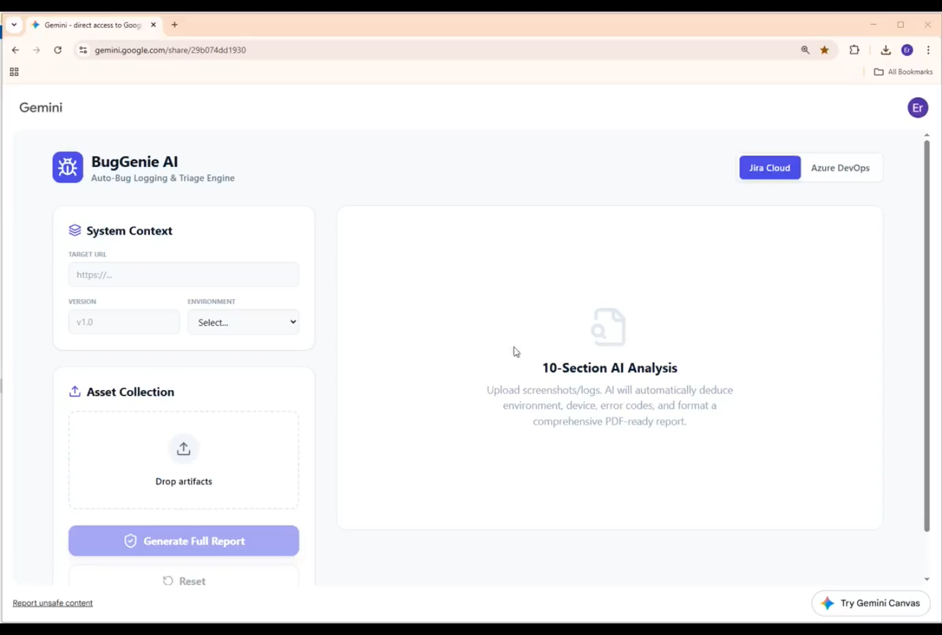
BugGenie AI
(A)
Google Gemini–Powered Bug Ticket Drafting Tool

Slide 23
Vibe Coding in Action: Testing-Aiding Tools
Real-world AI-assisted tools built for testing facilitation — explore the live applications via the links below
(B)
Agile Maturity Assessment App
Browser-Native Static JavaScript Application
A fully self-contained Agile maturity assessment app that runs by simply opening index.html — no build step, no package install, no dev server, and no deployment wrapper required.
100% browser-native — pure HTML, CSS & JS
Zero-dependency: no npm, no bundler, no server
Open index.html directly to run locally
Deployable to GitHub Pages in one step
⌥ GitHub Source Code Repository: https://github.com/hockchiyeer/google-ai-studio-generated-agile-maturity-assessment-app/tree/task/branch-for-github-page-deployment
▶ Live App: https://hockchiyeer.github.io/google-ai-studio-generated-agile-maturity-assessment-app/

Slide 24
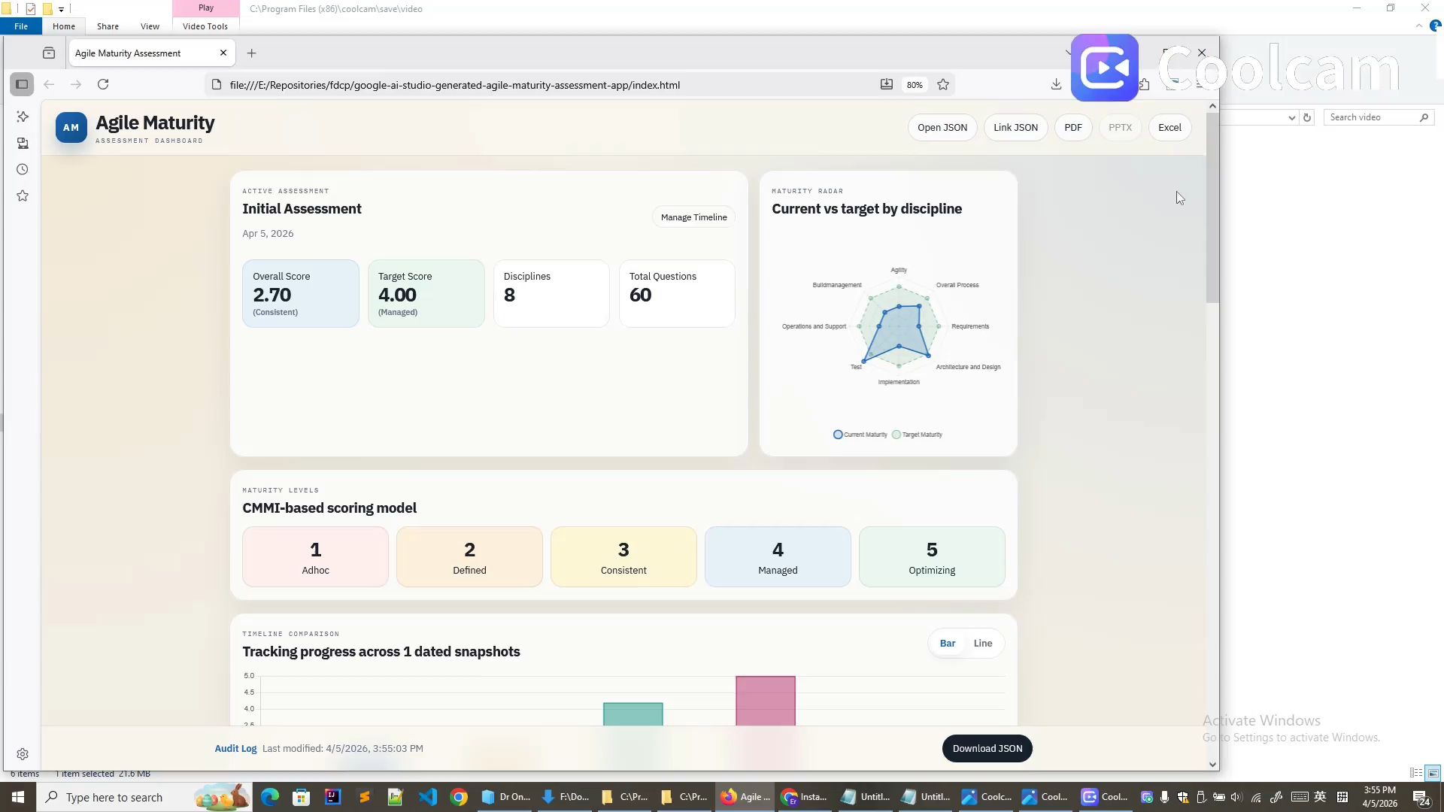
Agile Maturity Assessment App
(A)
Google Gemini–Powered Bug Ticket Drafting Tool

Slide 25

Key Takeaways
AI is a Prototype Powerhouse
Current AI tools are outstanding for rapid prototyping and POC development, but are not yet reliable partners for long-term refactoring and maintenance.
UI Automation Exposes AI's Limits
Probabilistic models fundamentally clash with the deterministic, zero-tolerance nature of reliable UI test automation. Expect humans to close the gap.
The Subtract Principle
When AI starts compounding complexity, the correct response is to simplify — reset to a clean state, switch models, and inject external insights.
Use LLMs as Accelerators, Not Authorities
Generate skeletons, retrieve syntax, debug with context, migrate frameworks — but always own the logic, the selectors, and the test strategy yourself.

