Slide 1
Embedded JavaScript
Kyle Gibbons
WDI: Denver

Slide 2
EJS Description
EJS is essentially a port of Masatoshi Seki's erb.rb in the Ruby Core. It operates in the same way that PHP, ERB, or any of the other embedded language interpreters work, except where all existing preprocessing engines execute on the server-side, EJS is intended to run within the web browser. This allows client-side code to process JavaScript-based web templates for insertion into the current page without consulting the server.
EJS uses <% %> or [% %] as its magic tags. Like most other frameworks of its type, <% %> tags cause all code within them to be executed, and the addition of an equals sign (<%= %>) causes the enclosed code to be evaluated and the toString representation of the result appended to the document.

Slide 3
What problem does this technology solve
EJS templates can be loaded within a page or a separate file.
Uses plain JavaScript
Fast development time
Simple Syntax
Speedy execution
Easy debugging
Active development
EJS has a large community of active users, and the library is under active development

Slide 4
Features of EJS
layout(view)
When called anywhere inside a template, requests that the output of the current template be passed to the given view as the body local.
partial(name,optionsOrCollection)
When called anywhere inside a template, adds the given view to that template using the current given optionsOrCollection.

Slide 5
Features of EJS
block(name,html)
When called anywhere inside a template, adds the given html to the named block. In the layout you can then do `<%-block('foo')%> to render all the html for that block.
script(src,type)
In the layout you can then do `<%-scripts%> to output the scripts from all the child templates.

Slide 6
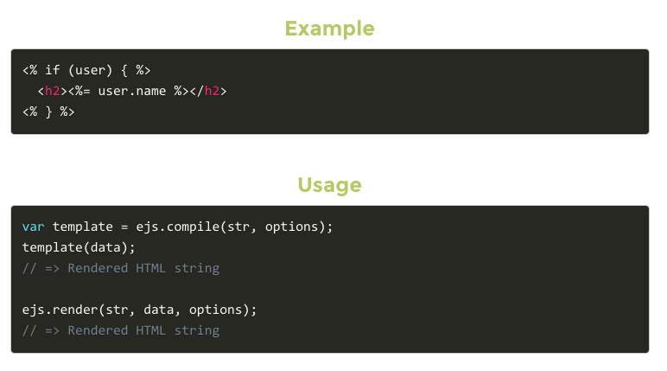
Commands to install EJS
npm install ejs
Var ejs = require(‘ejs’)

Slide 7
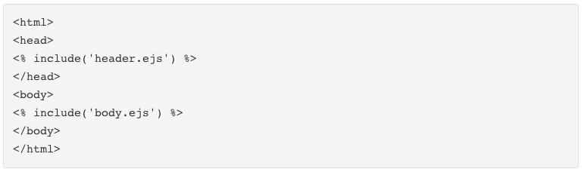
Creating Partial Views
Render different templates

Slide 8
How do you use it? Is there a "cheatsheet" you found or made that others can reference? https://github.com/RandomEtc/ejs-locals What did you build with this technology? (demo)

