Slide 1
Stakeholder Artifact
Trading Strategy Tester

Slide 2
SPY price plot with calculated SMA
Allows us to observe overall SPY trend
Full of information, hard to come up with a general strategy
Calculated SMA to show recent trend.
Graphed with the closing price of daily candles

Slide 3
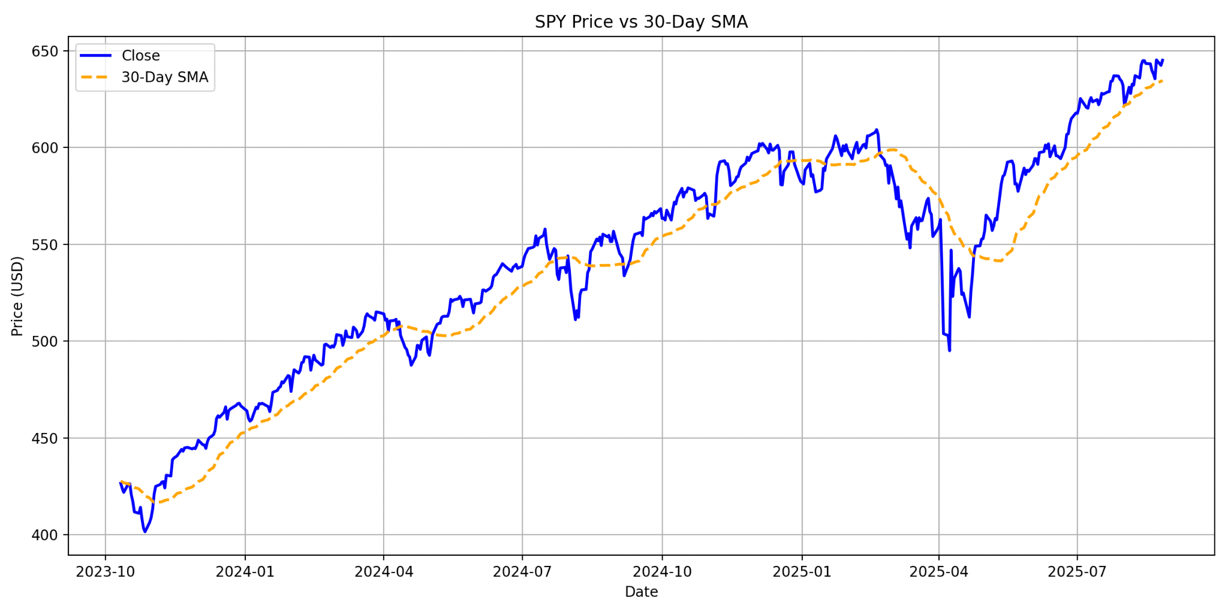

Slide 4
Strategy
Observations: - SPY generally goes up, with good reasoning (ETF), but has periodic dips, that are make good entries for trades.
Strategies:
Geometric Dip Buyer: buy exponentially if current prices are lower than all time highs. This was the most successful
30 SMA crossover: buy when price crosses above and sell when the price crosses below

Slide 5
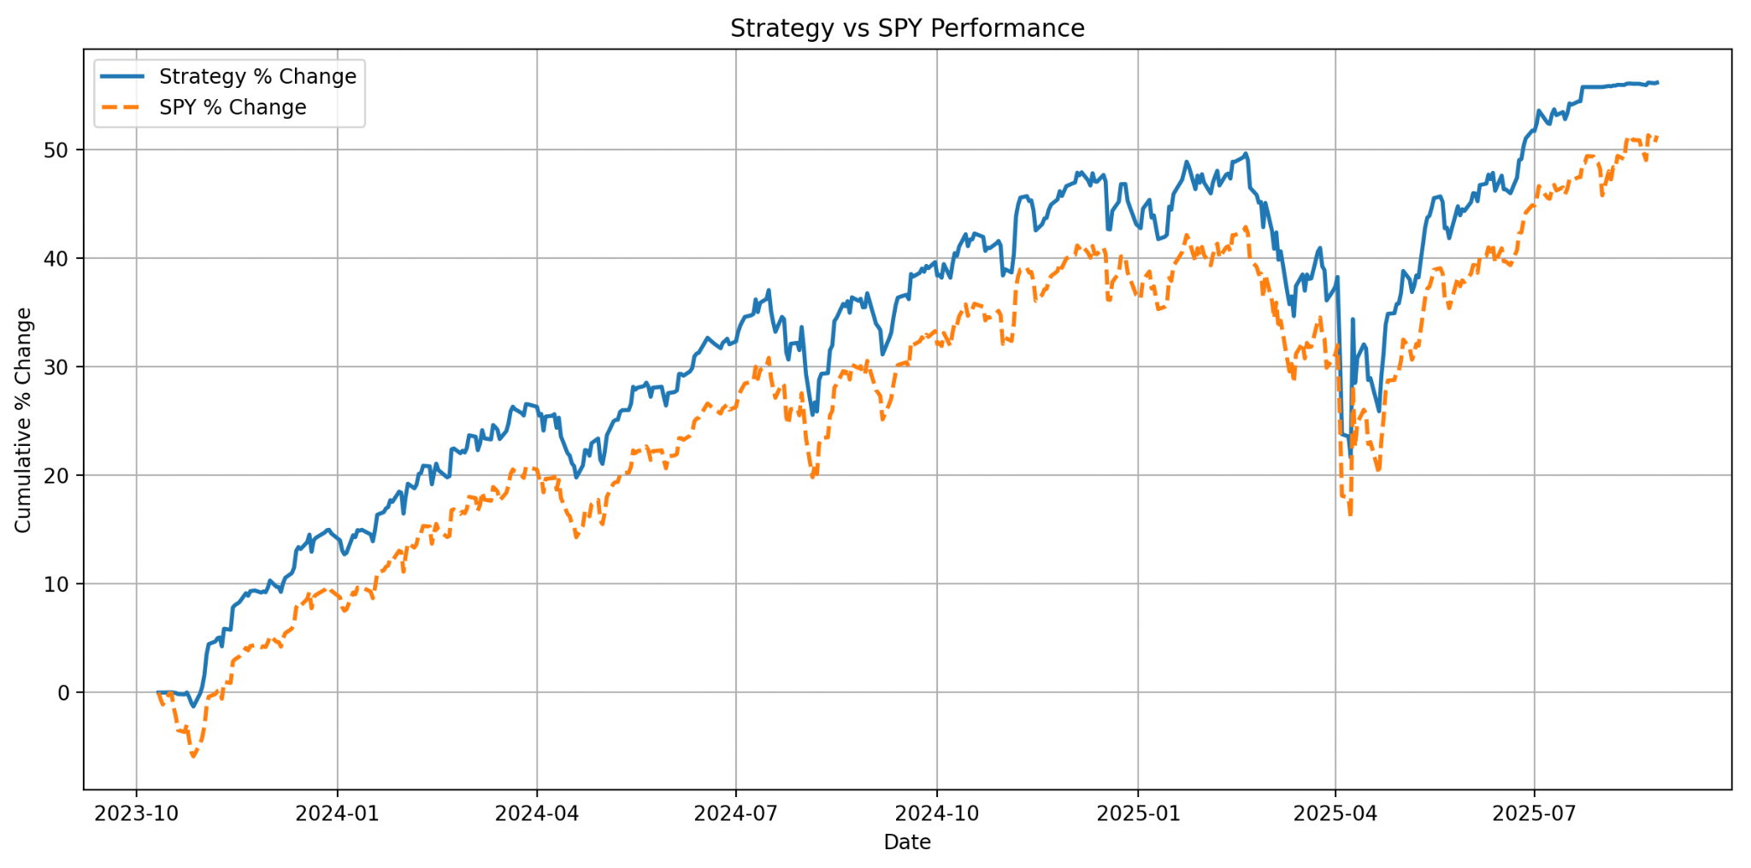
Geometric dip buyer returns

Slide 6
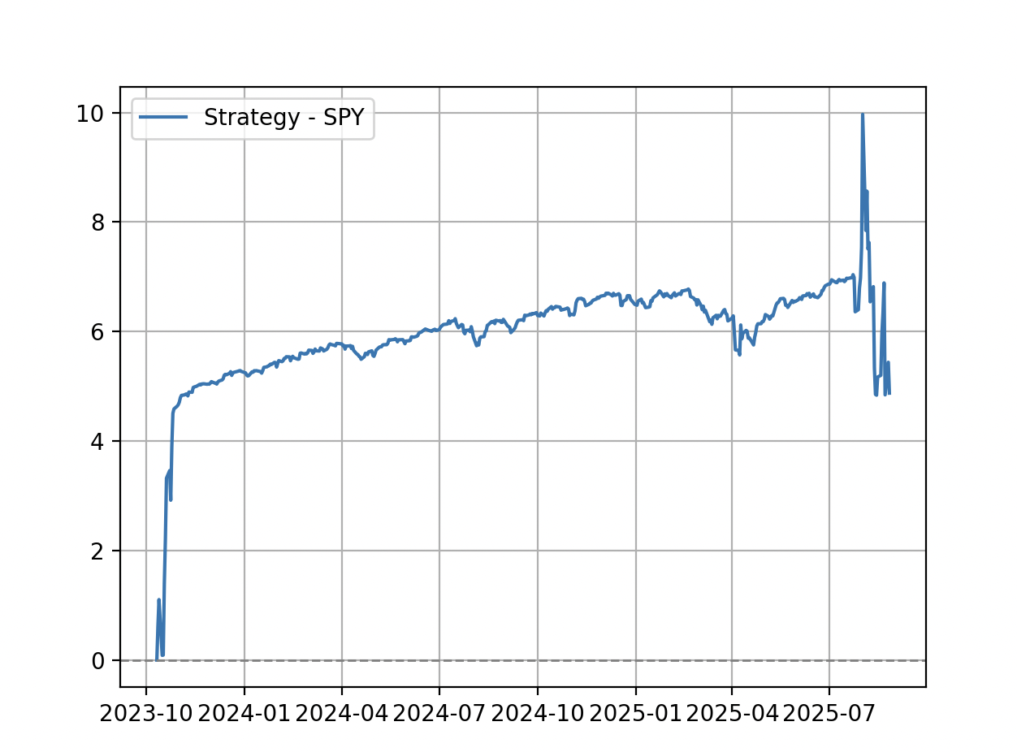

Slide 7
Observation of strategy - SPY
Most of the gains, came from the beginning, likely a specific condition at the start was key to the strategies success. This means the edge isn't fully established. Should this strategy have an actual edge, return rates should continuously deviate and tower over SPY returns, but after the initial boom, the difference remained stagnant.

Slide 8
Prediction
Linear Regression model is used to predict stock prices based on opening price and date. Using these parameters, we achieved
Test R² score: 0.9891
Test Mean Squared Error: 13.1184
in predicting the closing price of the SPY, with given input.

Slide 9
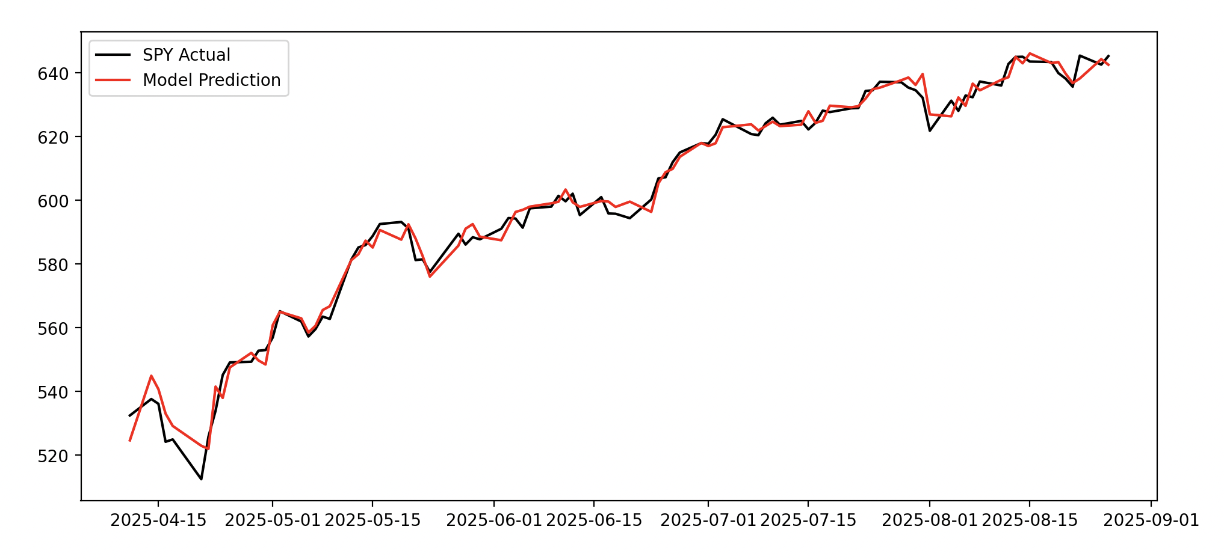

Slide 10
Assumptions data handling/ prediction
Outliers are flagged and not removed, the SPY outliers are extremely valid and play a big part in trading.
Data is already standardized with no NaNs as it is pulled from yfinance
Since opening price is one of the parameters, our success is very much based on the availability of the data.
This model, although is highly accurate in R^2 score, is not capable of accurately predicting months ahead.
There is also the underlying assumption that the SPY remains the same in nature, steadily increasing. Price accuracy should remain constant and our model’s accuracy should hold if our assumptions above are correct.

Slide 11
Final comments
The code for said graphs can be found by running main.py inside my project repo.
Should later changes affect this, load the committed latest as of 27th Aug 2026 6PM.

