Slide 1


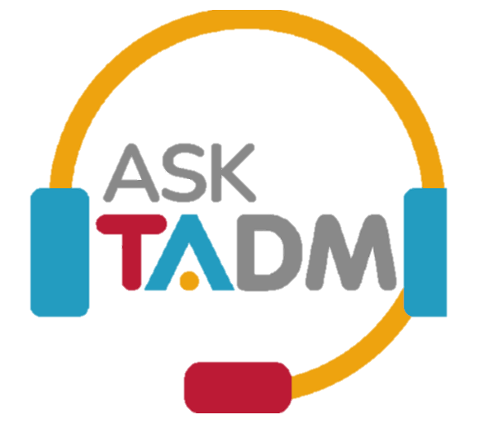


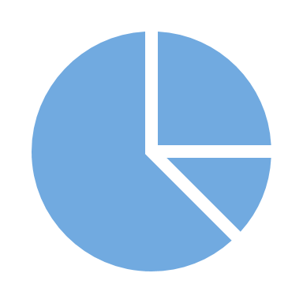






EmPOWER Transforms Dispute Resolution
e-Mediation
Ask TADM Chatbot
Dashboards
Convenient connections, seamless e-Agreements
Timely updates, all in one place
SingPass integration
Seamless lodgment
24/7 Anytime, Anywhere
e-Negotiation
Awards:
1. Minister for Manpower Award
2. Gartner Eye for Innovation Award
3. Pega Innovation Award.
Lodgment
Empowers self-resolution, 24/7, anytime, anywhere
Rules-based decision trees
Sentiment analysis capability
Lodge with ease
Self-help calculators

