Slide 1

Exploratory Data Analysis
G2M insight for Cab Investment firm
08.20.2023
by Abdullah Fatih Hocu

Slide 2

Agenda
Executive Summary
Problem Statement
Approach
EDA
EDA Summary
Recommendations

Slide 3
Executive Summary
In this project, we conducted a data analysis on taxi usage in different cities and demographic groups in the United States to determine the most appropriate taxi investment for XYZ. The findings provide critical recommendations for the firm to consider when making an investment.

Slide 4
Problem Statement
XYZ is planning to invest in taxis in the US. However, it does not have clear information about which taxi company is the most popular, which demographic group uses more taxis, or which taxi company is more prominent in which city. Having this information will guide the firm in making the right investment decision.

Slide 5
Approach
The dataset used in the project details taxi usage in different cities and demographic groups in the United States. First, the dataset was cleaned and preprocessed. Then, taxi usage was analyzed for different cities and demographic groups.

Slide 6
EDA
The analysis revealed that taxi use is high in certain cities and demographic groups. In addition, some taxi companies were found to be more popular in certain regions.

Slide 7
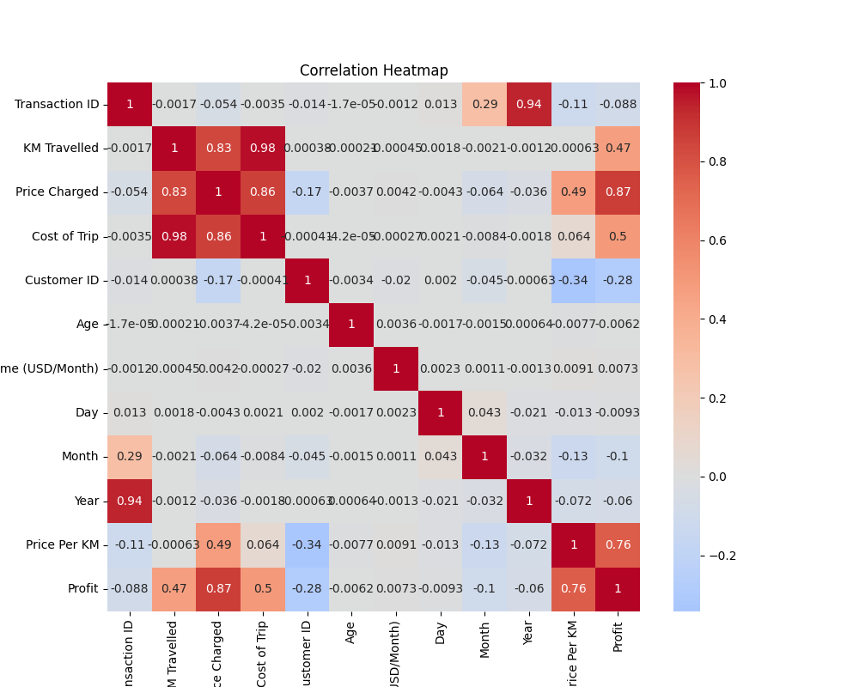

Slide 8
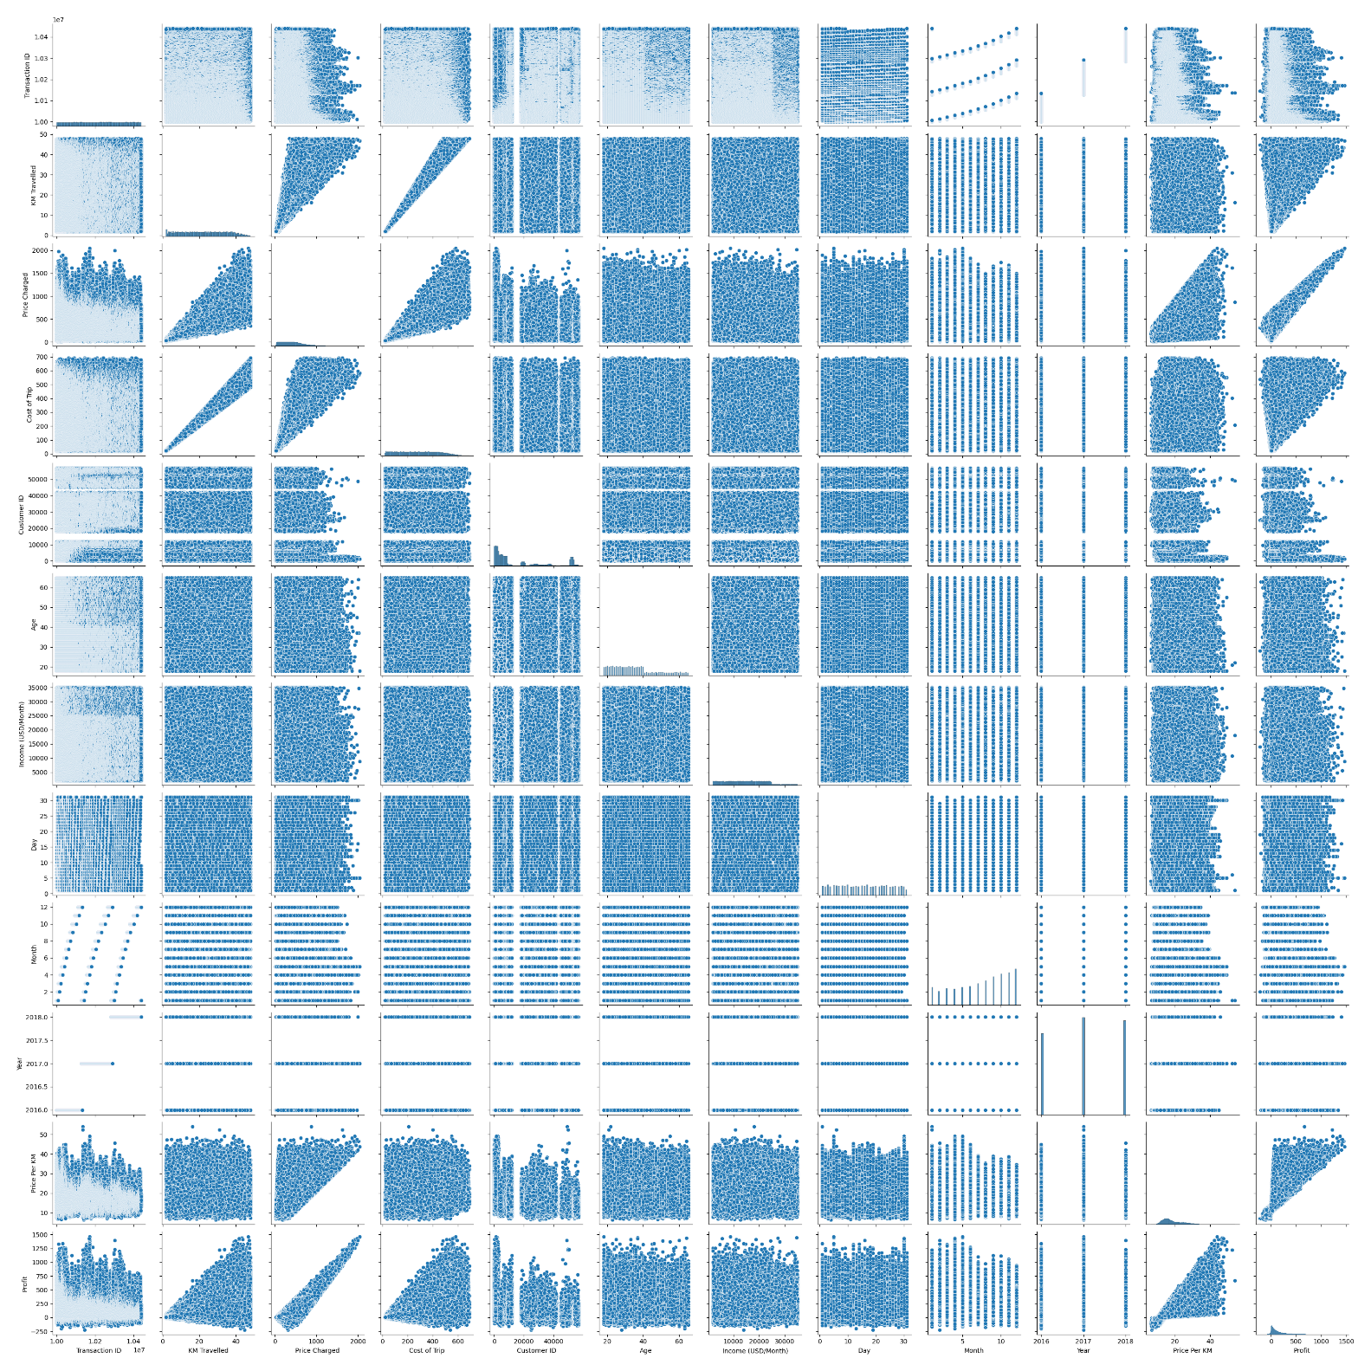

Slide 9
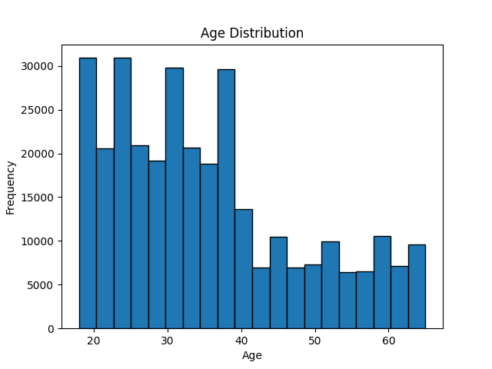

Slide 10
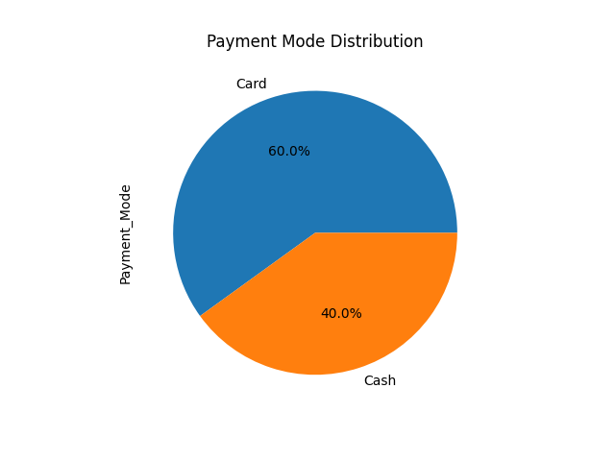

Slide 11
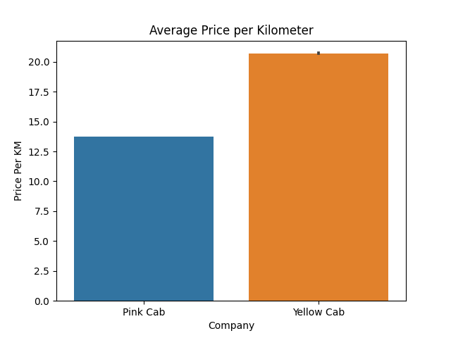

Slide 12
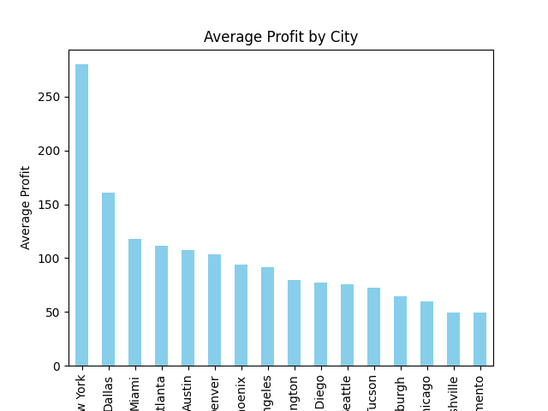

Slide 13
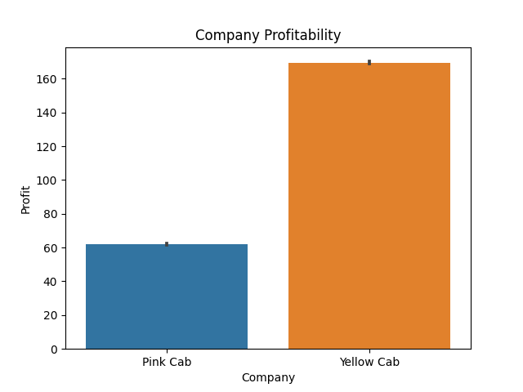

Slide 14
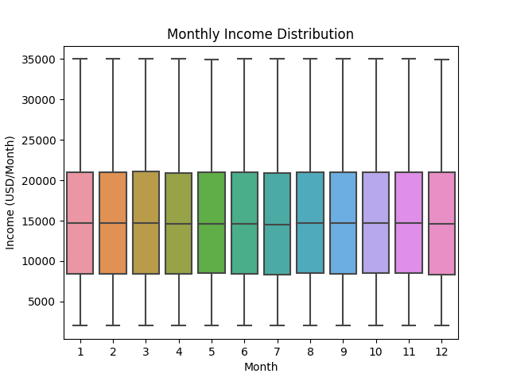

Slide 15
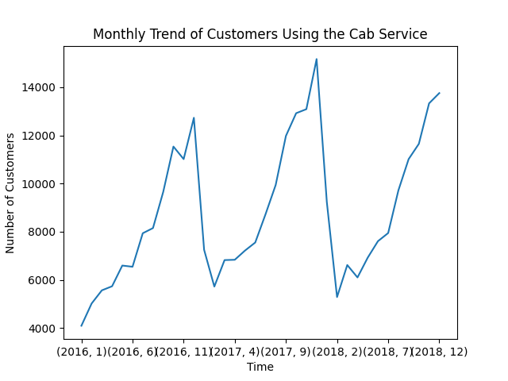

Slide 16
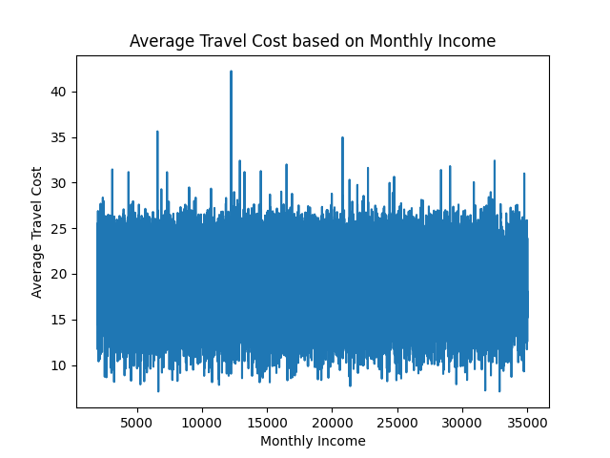

Slide 17
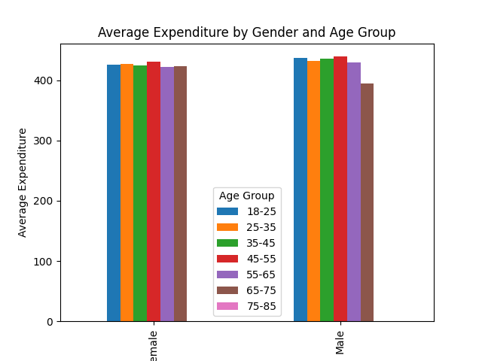

Slide 18
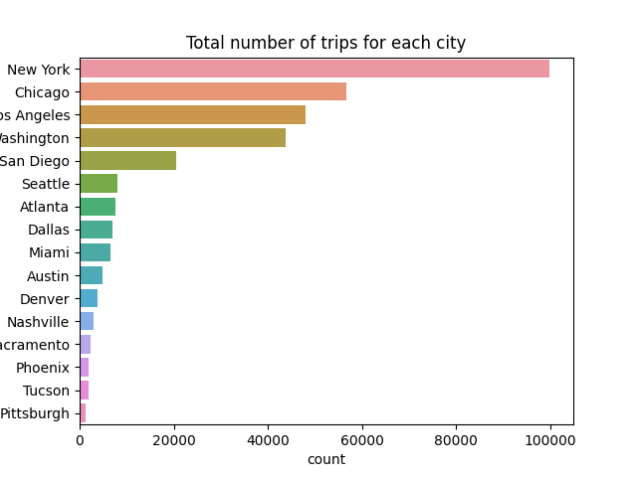

Slide 19
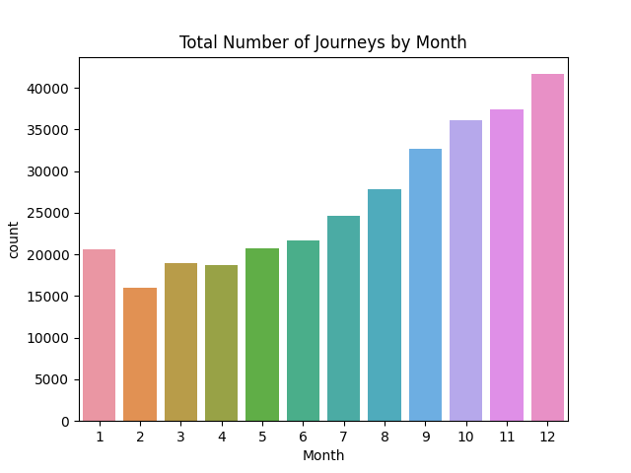

Slide 20
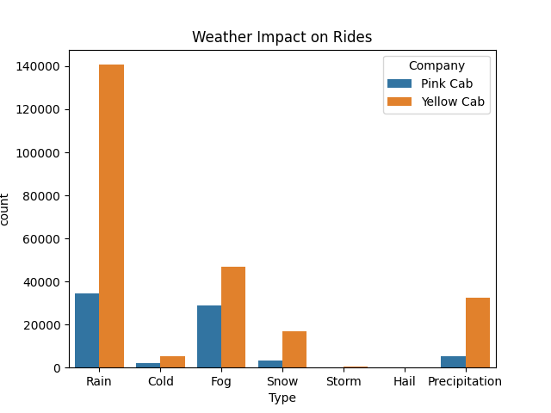

Slide 21
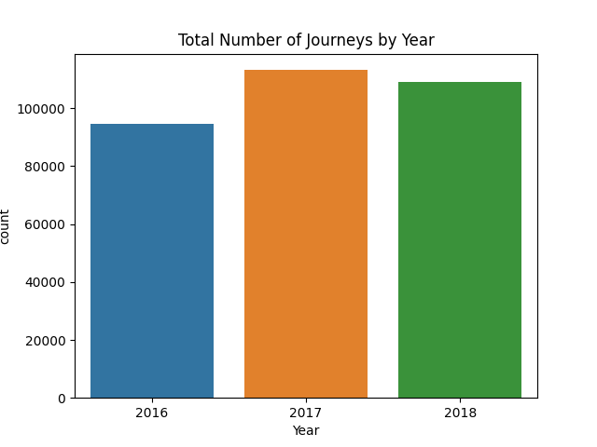

Slide 22
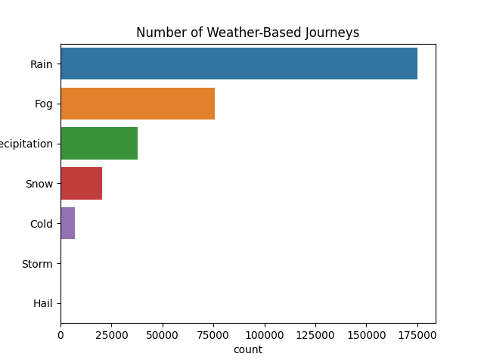

Slide 23
EDA Summary
The analysis revealed that taxi use is high in certain cities and demographic groups. In addition, some taxi companies were found to be more popular in certain regions.

Slide 24
Recommendations
XYZ is recommended to invest by considering the most popular taxi companies according to the regions and demographic groups it intends to invest in. In addition, a more effective investment strategy can be developed by targeting cities and demographic groups where taxi use is high.

Slide 25
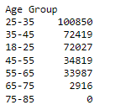
Which age group uses taxis the most?

Slide 26
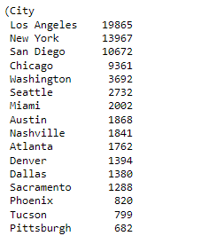
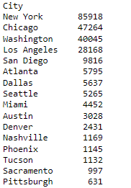
In which city is the Pink Cab company more popular than the Yellow Cab company?

Slide 27

Which payment mode is more popular among customers?

Slide 28

Which gender predominates in taxi usage?

Slide 29
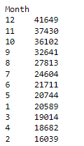
During which months do people use taxis the most?

Slide 30
Which age group uses taxis the most?

Slide 31
Which age group uses taxis the most?

Slide 32
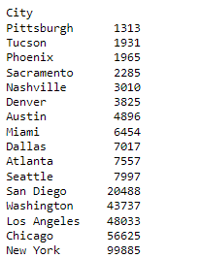
In which city is taxi usage the least?

Slide 33
Conclusion
By closely examining taxi usage patterns, demographic preferences, and company ratings, XYZ company can make informed decisions about their investments in the taxi industry. The data-driven insights provided above offer a comprehensive understanding of current market dynamics.

Slide 34
Thank You

