Slide 1
C-DE211: Data Analysis | Project 3
Smartphone Usage
& Addiction Analysis
Analyzing behavioral & demographic factors associated with smartphone dependency across 7,500 users
Egypt University of Informatics • Faculty of Computing & Information Sciences • May 2026

Slide 2
C-DE211: Data Analysis | Project 3
TEAM MEMBERS:
ID | NAME
24-101118 | Aamena Ahmed
24-101123 | Mariam Mohamed
24-101367 | Jomana Soliman
24-101399 | Hoda Hussein
Egypt University of Informatics • Faculty of Computing & Information Sciences • May 2026

Slide 3
Agenda
01
Introduction & Research Question
02
Dataset & Methodology
03
EDA & Visualizations
04
Hypothesis Testing Results
05
Conclusion & Limitations

Slide 4
01 Introduction
The Problem
Our Goal
Smartphones have quietly become one of the most dominant forces in modern daily life shaping how we sleep, study, and manage stress. While convenient, they raise serious questions about where healthy usage ends and addiction begins.
✦ Uncover behavioral patterns ✦ Test 4 meaningful hypotheses ✦ Draw data-driven conclusions ✦ Help students & mental health professionals

Slide 5
Research Question
"To what extent does daily smartphone screen time contribute to addiction, and how do behavioral and demographic factors such as sleep hours, stress level, and gender relate to smartphone dependency among users?"
📱 Screen Time
😴 Sleep Hours
😤 Stress Level
⚧ Gender

Slide 6
02 Dataset & Methodology
7,500
14
70.8%
819
Total Records
Features
Addicted Users
Missing Values Fixed
Feature | Type | Description
daily_screen_time_hours | Numerical | Average daily smartphone usage in hours
sleep_hours | Numerical | Average sleep hours per night
stress_level | Categorical | Perceived stress: Low, Medium, High
gender | Categorical | Male, Female, Other
addicted_label | Binary | Target: 0 = Not Addicted, 1 = Addicted

Slide 7
03 Key Visualizations
Distribution Plots
Countplots
Boxplots
Age, Screen Time & Sleep Hours show relatively uniform distributions
70.8% of users are addicted. Gender & stress are evenly distributed
Addicted users have higher screen time & fewer sleep hours
Heatmap
Pairplot
Stacked Bars
Screen time & weekend usage show strong positive correlation
No clear visual separation between addicted & non-addicted clusters
All genders show ~70% addiction rate. High stress shows slightly more
⚠️ Insert your actual plot screenshots into each section of the poster/report

Slide 8
04 Hypothesis Testing Results
H1
T-Test
Screen Time vs Addiction
t = 61.19 | p = 0.0
REJECT H₀ ✓
H2
Pearson r
Screen Time vs Sleep
r = 0.019 | p = 0.094
FAIL TO REJECT
H3
Chi-Square
Gender vs Addiction
χ² = 2.382 | p = 0.123
FAIL TO REJECT
H4
Chi-Square
Stress Level vs Addiction
χ² = 2.498 | p = 0.645
FAIL TO REJECT

Slide 9
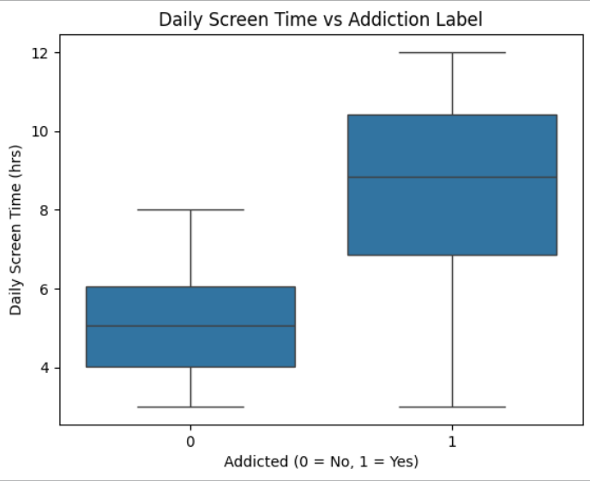
05 Analysis
The boxplot highlights daily screen time as a critical determinant of smartphone addiction:
Distinct Usage Patterns: Addicted users (1) exhibit significantly higher usage, with a median of 9 hours and peaks of 12 hours, whereas non-addicted users (0) maintain a much lower median of 5 hours.
Strong Predictability: The complete lack of overlap between the interquartile ranges of both groups suggests that screen time is a primary predictor for addiction.
Model Justification: These visual findings provide clear evidence for why machine learning models prioritize screen time as the most important feature

Slide 10
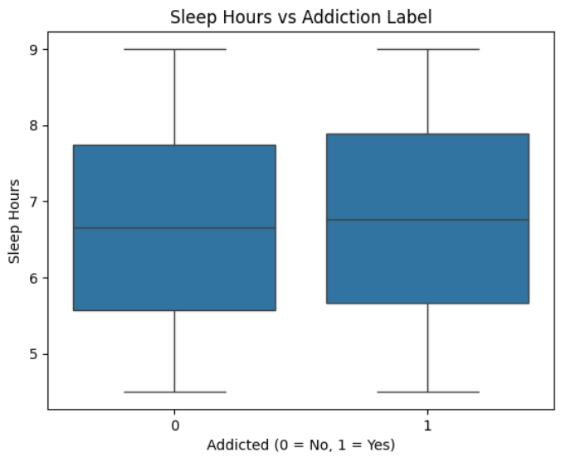
05 Analysis
The boxplot demonstrates that sleep duration does not differentiate addiction levels:
Identical Patterns: Both addicted (1) and non-addicted (0) groups share a nearly identical median of approximately 6.7 sleep hours.
High Overlap: The interquartile ranges and extreme values for both groups largely overlap, showing no substantial difference in sleep duration.
Statistical Confirmation: These visual findings support previous statistical tests and Pearson correlations that identified sleep hours as a non-significant indicator of smartphone addiction.

Slide 11
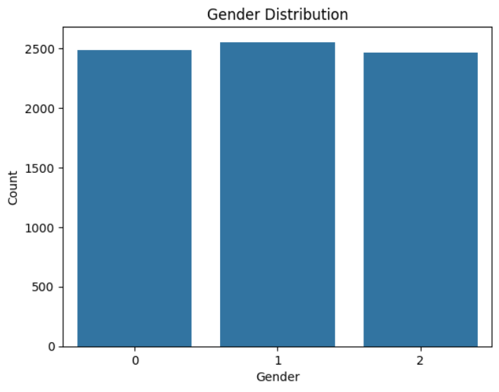
05 Analysis
The count plot highlights the demographic balance of the study:
Balanced Representation: The dataset features an almost equal distribution across all three gender categories: 0 (Other), 1 (Male), and 2 (Female).
Equal Volume: Each category contains approximately 2,500 individuals, totaling 7,500 participants.
Bias Mitigation: This near-equal distribution is a key strength, as it minimizes gender bias and ensures the addiction analysis is fair and applicable across different identities.

Slide 12
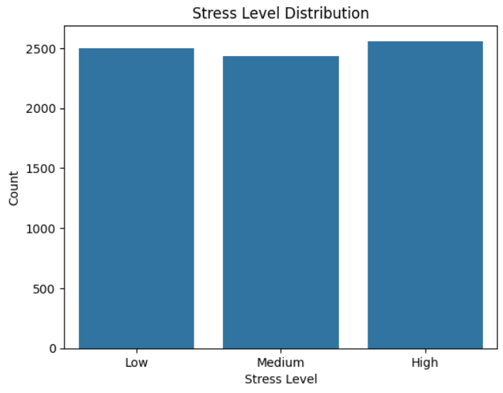
05 Analysis
The count plot demonstrates the distribution of stress levels within the study:
Equal Distribution: The 7,500 participants are evenly split among Low, Medium, and High stress categories.
Balanced Data: Each category contains approximately 2,500 individuals.
Unbiased Analysis: This perfect balance ensures a fair evaluation of how different psychological stress levels correlate with addiction behaviors, preventing any single group from skewing the results.

Slide 13
06 Conclusion
📱 Screen time is the ONLY significant factor linked to addiction (t=61.19, p<0.05)
😴 No significant linear relationship found between screen time and sleep hours
⚧ Gender shows no significant association with addiction status
😤 Stress level shows no significant association with addiction status

Slide 14
Thank You
Questions & Discussion
C-DE211: Data Analysis • Egypt University of Informatics • May 2026

