Slide 1

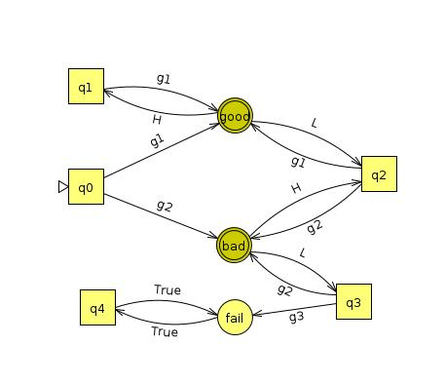
Component
Code
Buchi Game

Slide 2
State

