Slide 2
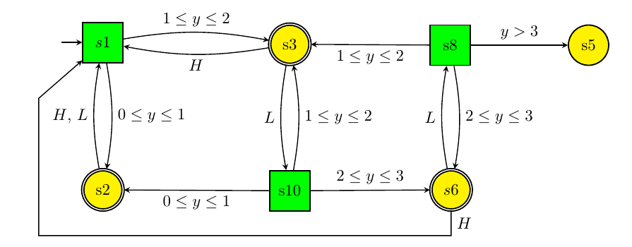
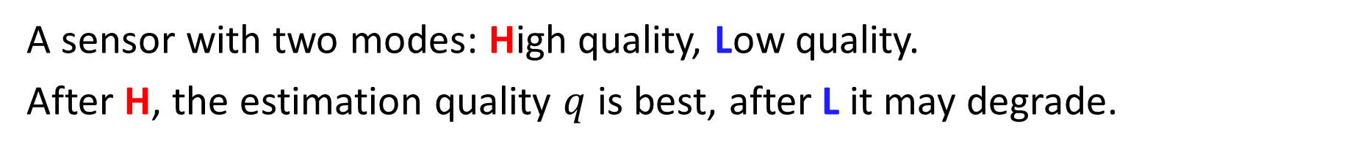
Example: A component that “plays” a game with its environment
A sensor with two modes: High quality, Low quality.
After H, the estimation quality $q$ is best, after L it may degrade.

Slide 3
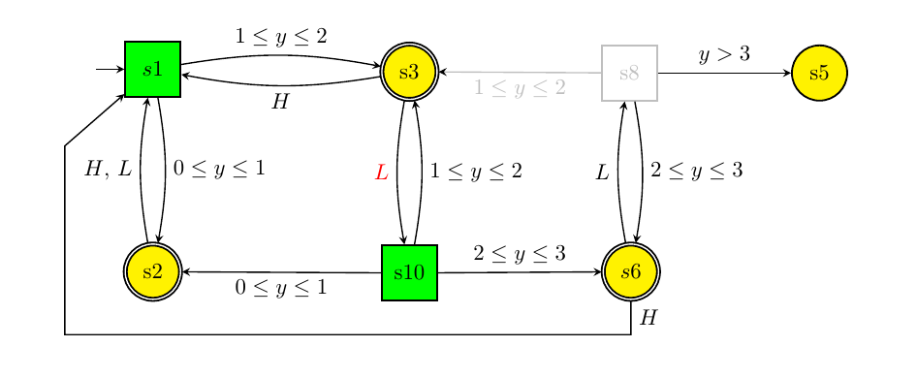
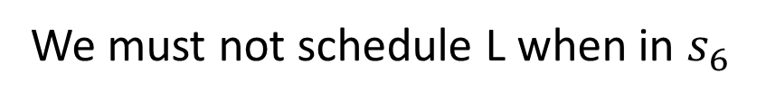
Example: A solution of the game
We must not schedule L when in $s_{6}$

Slide 4

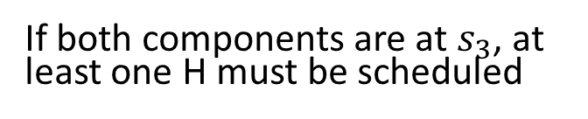
Example: simultaneous games (composition)
We cannot allow both games to be on $s_{10}$
If both components are at $s_{3}$, at least one H must be scheduled
Adding another similar component makes the system unchesdulable!

Slide 5
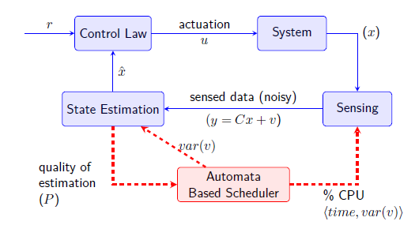
Example: A reactive scheduler
q
The scheduler is “in the loop”: it controls the tasks => %CPU, variance of $v$

Slide 6
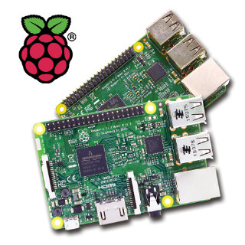

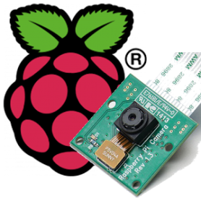
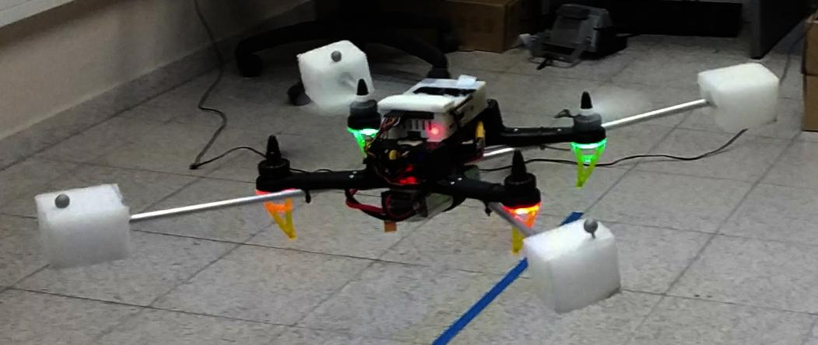


Raspberry-pi 3
Pi-camera
Spedix-S250

Slide 7


$$x[k]$$
a priory state
Measured state
Actuation and
process errors
Measurement error
$${\tilde{y}}_{k|k}$$

