Slide 1
ArielCast
Lectures Streaming App
Hodaya Sror
Instructor : Anat Paskin-Cherniavsky
Suha Edris

Slide 2
App Overview
A friendly, easy to use app where lecturers can upload their lectures and students can follow them, watch the lectures and get notified for new ones uploaded.

Slide 3
Current status
Login/Sign up to the app
Lecturers can upload courses and lectures easily
Clear and easy to use app
Student can follow multiple course
Watching many lectures any time you want

Slide 4
Goals
Application runs fast with no bugs
Easy to use
Student-lecturer interaction
One library for all the lectures
Download lecture and stream offline
Student can search for courses

Slide 5
Key App Requirements
Upload Content (video of lectures)
Uninterrupted streaming
Accessible at any time
Search for courses
Student-lecturer interaction

Slide 6
Unreachable Goals
Download lectures to device and have the option to watch it offline at anytime in case of no network
Advanced design/UI

Slide 7
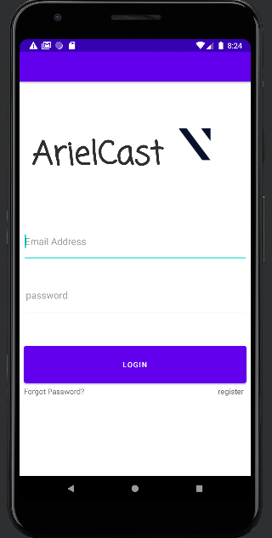
Log in Screen
Identifies the user by email address
Distinguishes between lecturer and student
In case you forget a password, the system will send an email to the user's email address
To register for the application, click on the register button

Slide 8
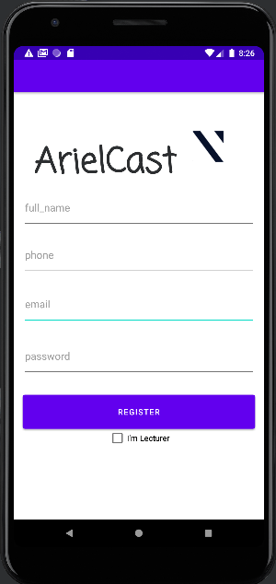
Register Screen
Allows the user to connect by entering a little personal details
The app distinguishes between a student and a lecturer when registering

Slide 9
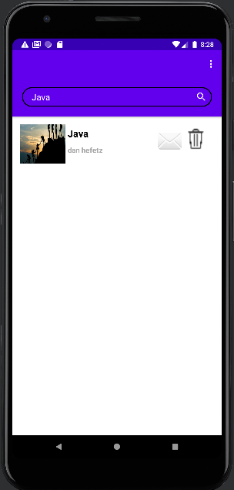
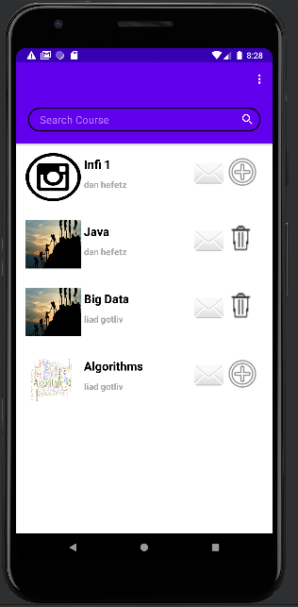
Student Screen
Displays all the available courses in the semester
Allows you to search the course database
The courses are presented in a simple graphical way, include course picture and title
Allows the student to contact the course lecturer by sending a personal message
Allows you to easily add and delete course tracking

Slide 10
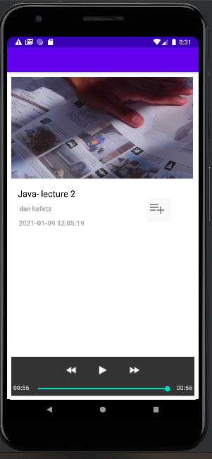
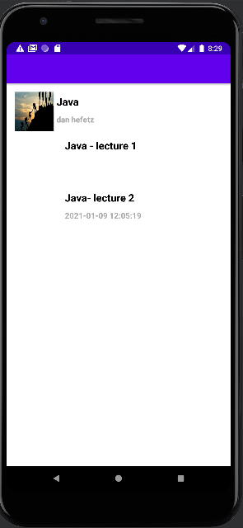
Student Course Screen
Displays all course lectures
Each lecture shows lectures time, lectures name and lecturers
Allows you to easily add a lecture to your watchlist

Slide 11
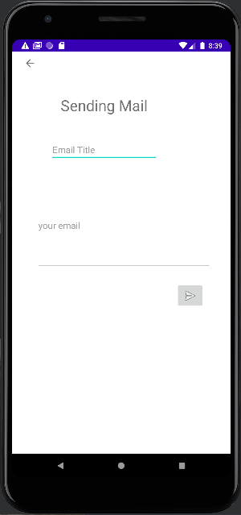
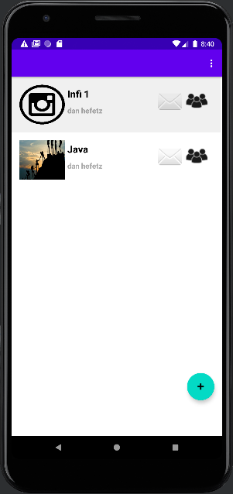
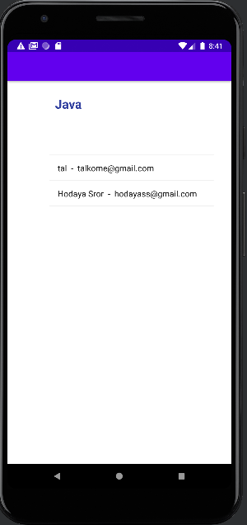
open the lecture class meeting
allow to easily contract with lectures lecturer
Notes:
מציג את הסטודנטים שעקבים אחרי אותו קורס .
כפתור המייל - שליחת מייל (אצל הסטודנט - שליחה למייל המרצה של אותו קורס)
(אצל המרצה - שליחת מייל לכל הסטודנטים שעוקבים אחרי הקורס הזה)

Slide 12
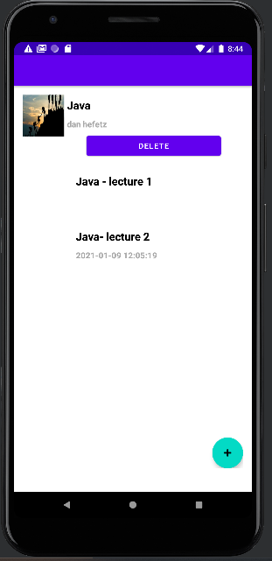
Lecturer Screen
Allows you to easily upload a lecture for all the following class
Each upload receives the date and name of the lecturer
Allows easily and simply edit a course

Slide 13
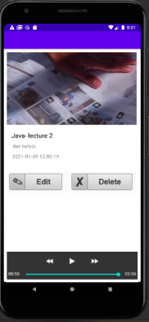
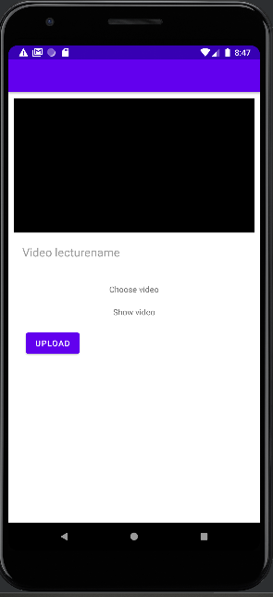
Upload Lecture Screen
only for lecturers!
Allows you to upload lectures in a simple way
Allows you to edit and delete lectures in a simple way
Displays information relevant to the lecture in a beautiful way

Slide 14
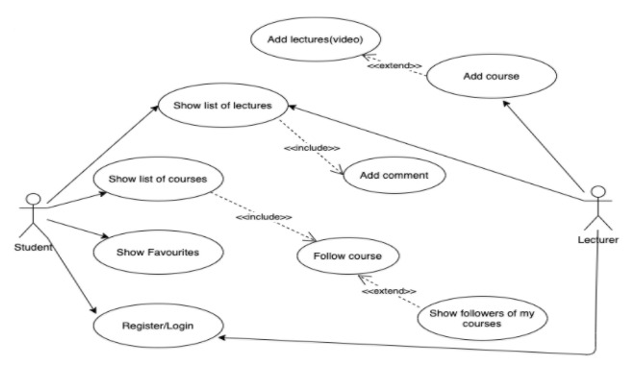
Use Case Diagram

Slide 15
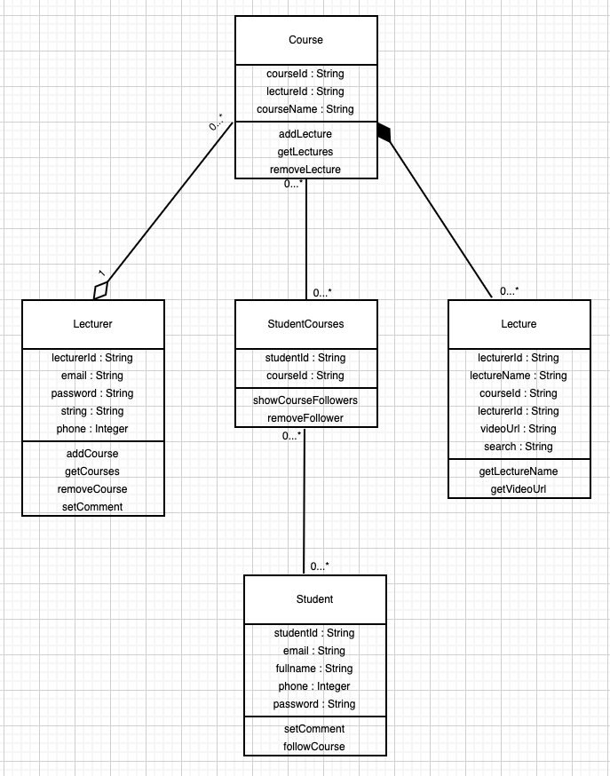
Class Diagram

Slide 16
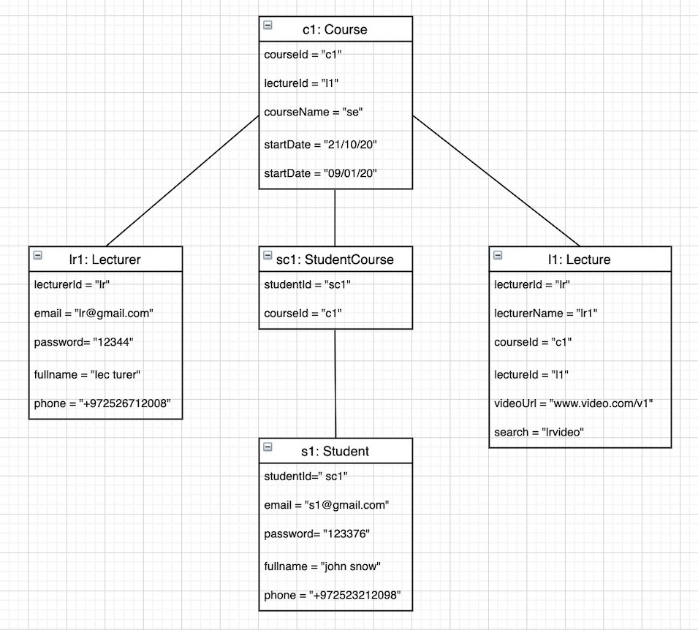
Object Diagram

Slide 17
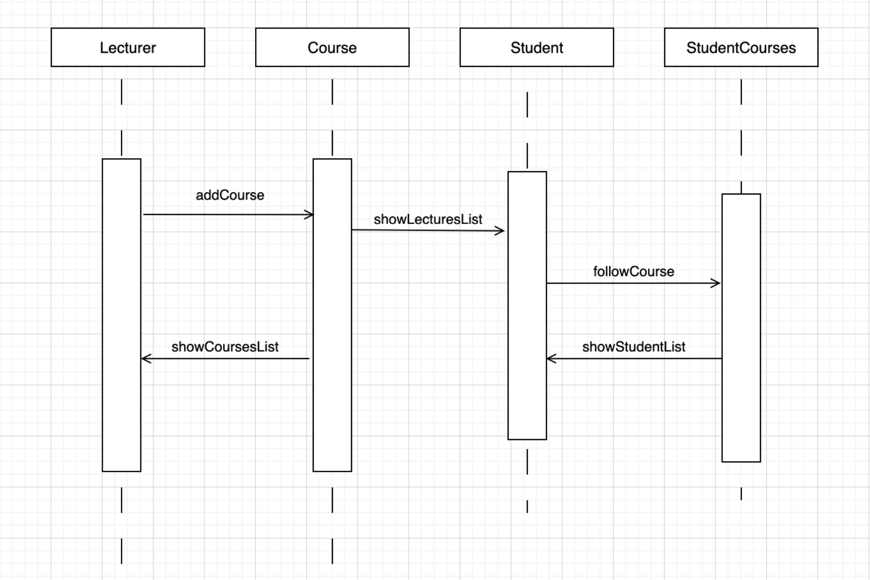
Sequence Diagram

Slide 18
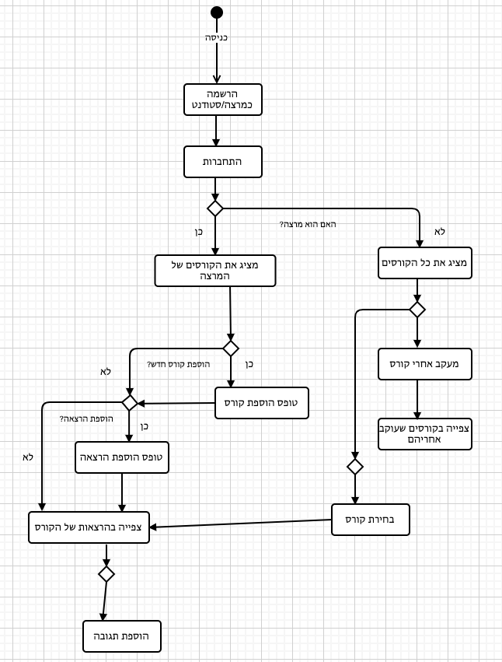
Activity Diagram

Slide 19
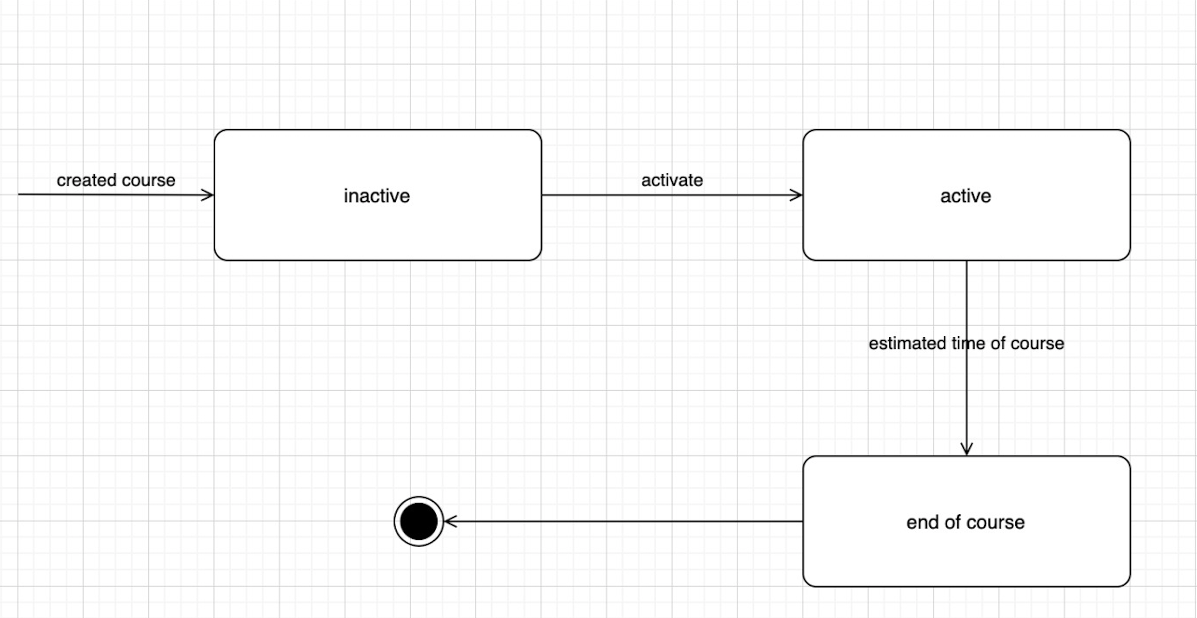
State Machine Diagram

Slide 20
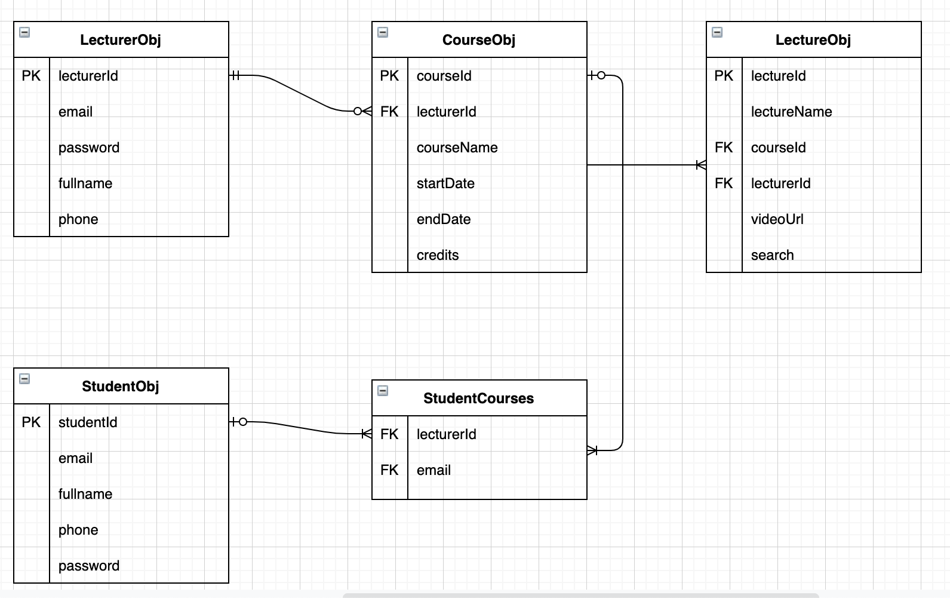
ERD

Slide 21
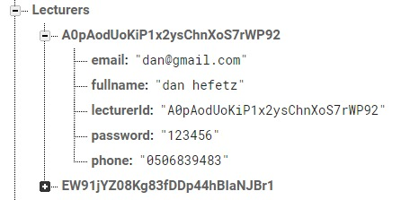
USER: LECTURER

Slide 22
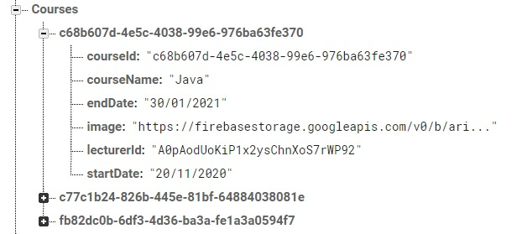
COURSES CREATED BY LECTURERS

Slide 23
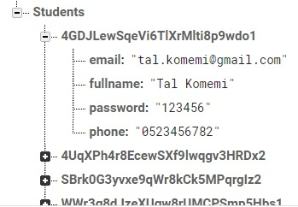
USER: STUDENT

Slide 24
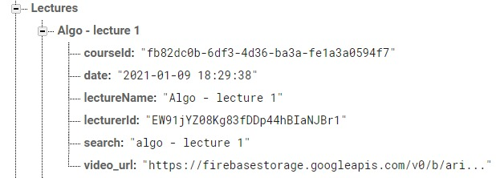
COURSES UPLOADED BY LECTURERS

Slide 25
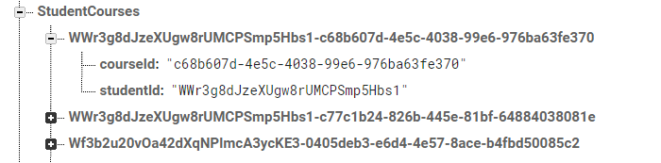
COURSES FOLLOWED BY STUDENT

Slide 26
https://github.com/hodayasr/FinalProject_ArielCast

