Slide 1
Wine Reviews
--- Text Analytics
Group 6 - Quanxu Pang, Yichen Pan, Ying Hu, Ziyue Zhong

Slide 2

Business Goal
Provide customers with appropriate wine selection strategies and generate business insights of the wine market

Slide 3
Data Description
The Wine Reviews dataset contains 130k wine reviews with variety, location, winery, price, and description.
Dataset Source: Kaggle.com
Data Source: Wine Enthusiast (multichannel marketer of a growing line of wine- and spirits-related products
Date updated: 11/24/2017
Columns: country, description, designation, points, price, province, region, taster, variety, and winery

Slide 4
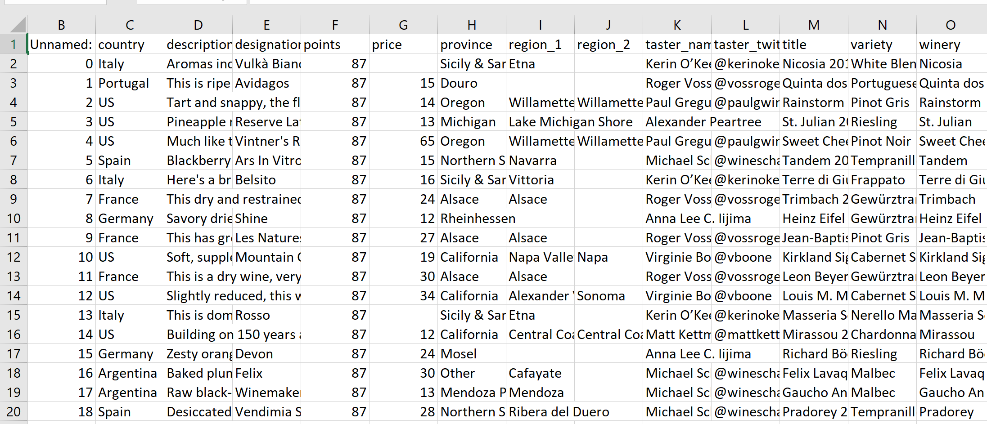
Data sample

Slide 5
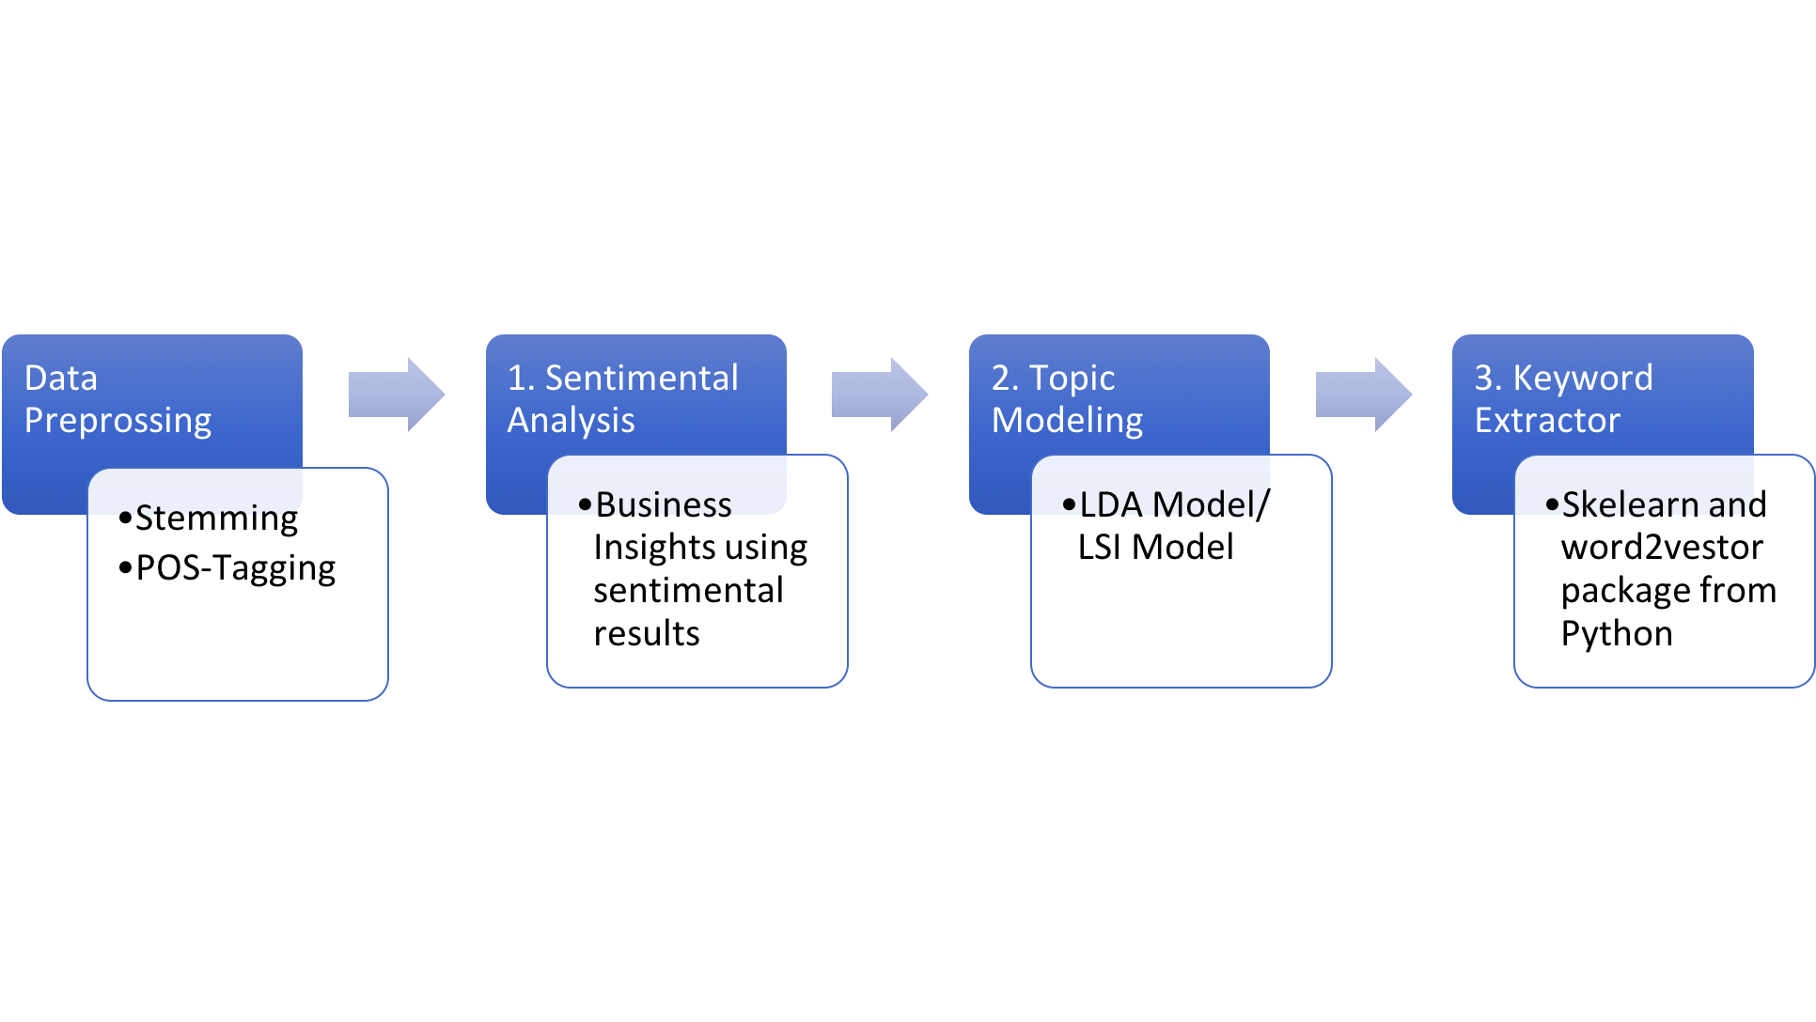
Process Review

Slide 6
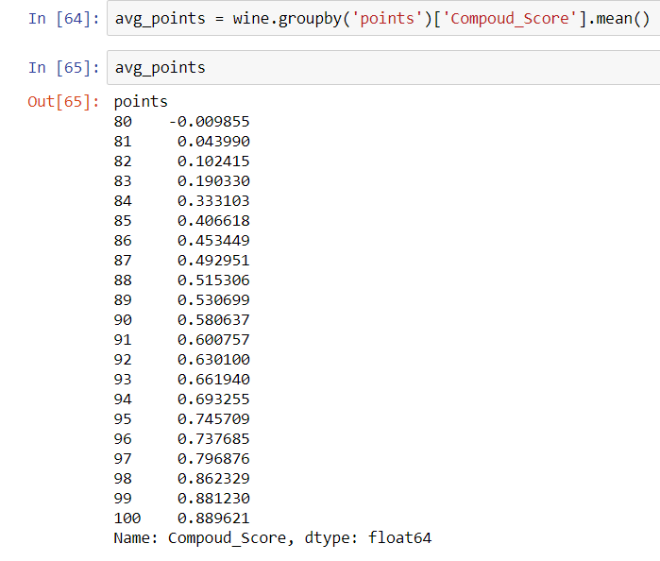
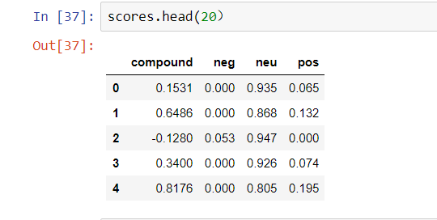
Sentiment Analytics

Slide 7
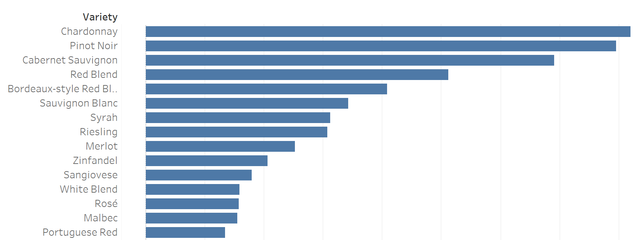
Sentiment Analytics
This chart shows the relationship between wine variety and its accumulative compound score, showing the top 15 variety
Chardonnay, Pinot Noir, and Cabernet Sauvignon are the top three in the rank
Ranking higher in this chart is more likely to be welcomed by most customers, and more likely to achieve better sale in market.

Slide 8
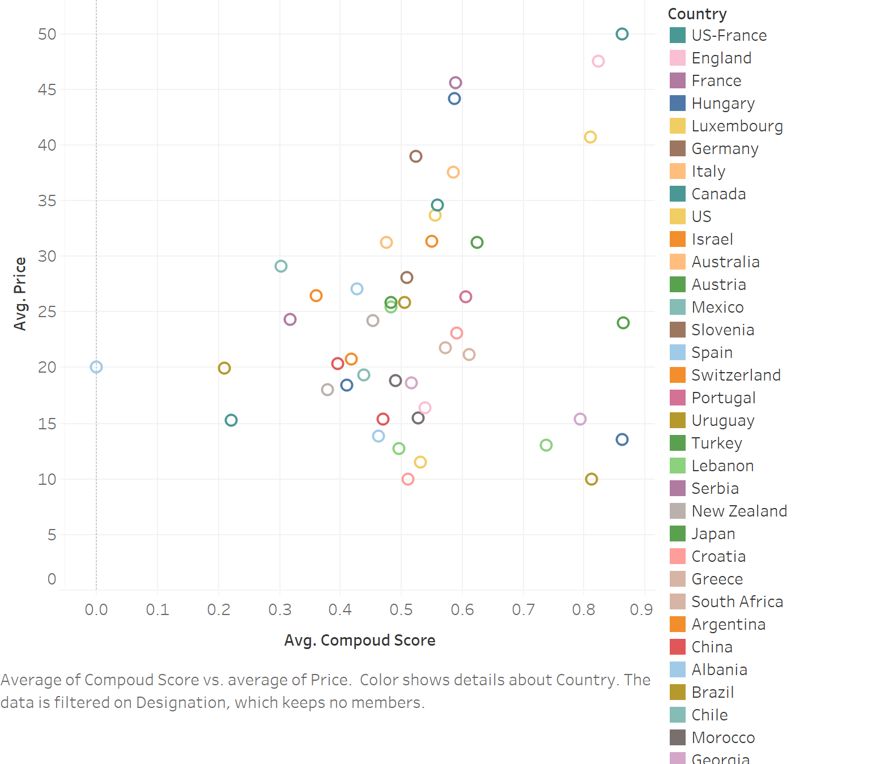
Sentiment Analytics
This chart shows the relationship between price and the compound score specified by colors according to different countries.
We can get the cost performance of the wine in each country
Wine from US-France, England and Luxembourg are of high price and high performance in score
Wine from Japan, Ukraine, Slovakia, South Korea and Lithuania are of high performance and low price.
They might be underpriced, there are more space for them to improve the marketing and pricing strategy.

Slide 9
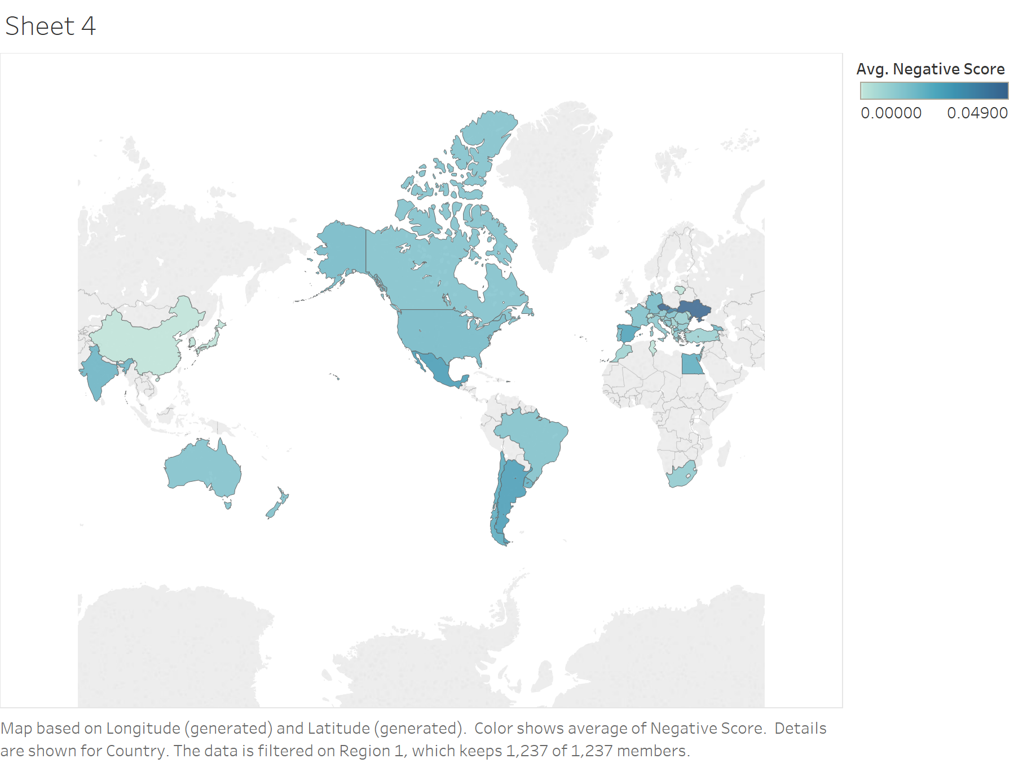
Sentiment Analytics
This chart shows the negative score worldwide
China is the region with lowest negative score which reached 0, Czech and Ukraine are the region with the highest negative score, and then follows Mexico and Argentina
Wine from North America and Australia are a moderate level in Negative score, which can be inferred their wine’s review and quality are of a stable level.
The wine from east Europe and South America requires more attentions when selecting.

Slide 10
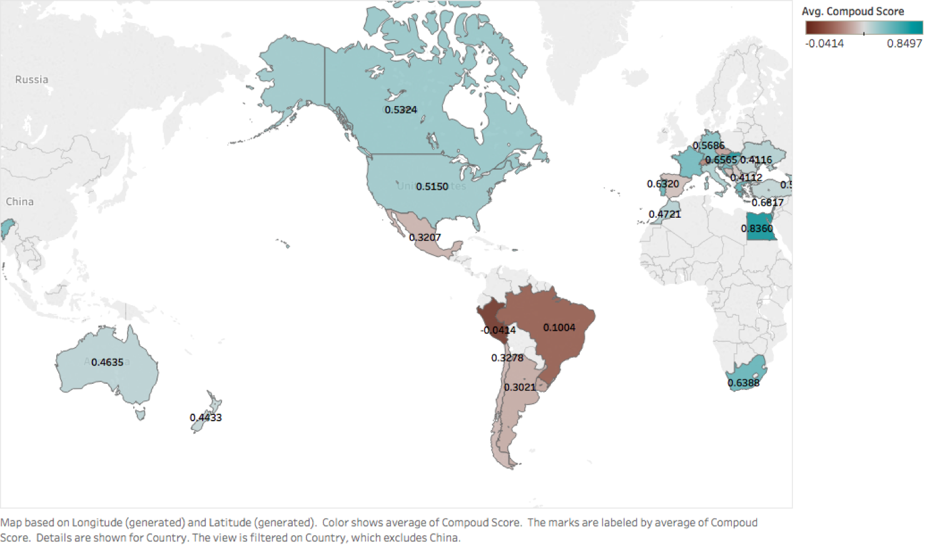
Sentiment Analytics
Average compound sentimental score of wine in different regions.
Egypt has the highest compound score. South Africa, U.S., Canada and part of European countries also have high-quality wines. But wine from Latin America have relatively low compound scores implying low quality.
geographic factor can have great impact on the quality of wine.

Slide 11
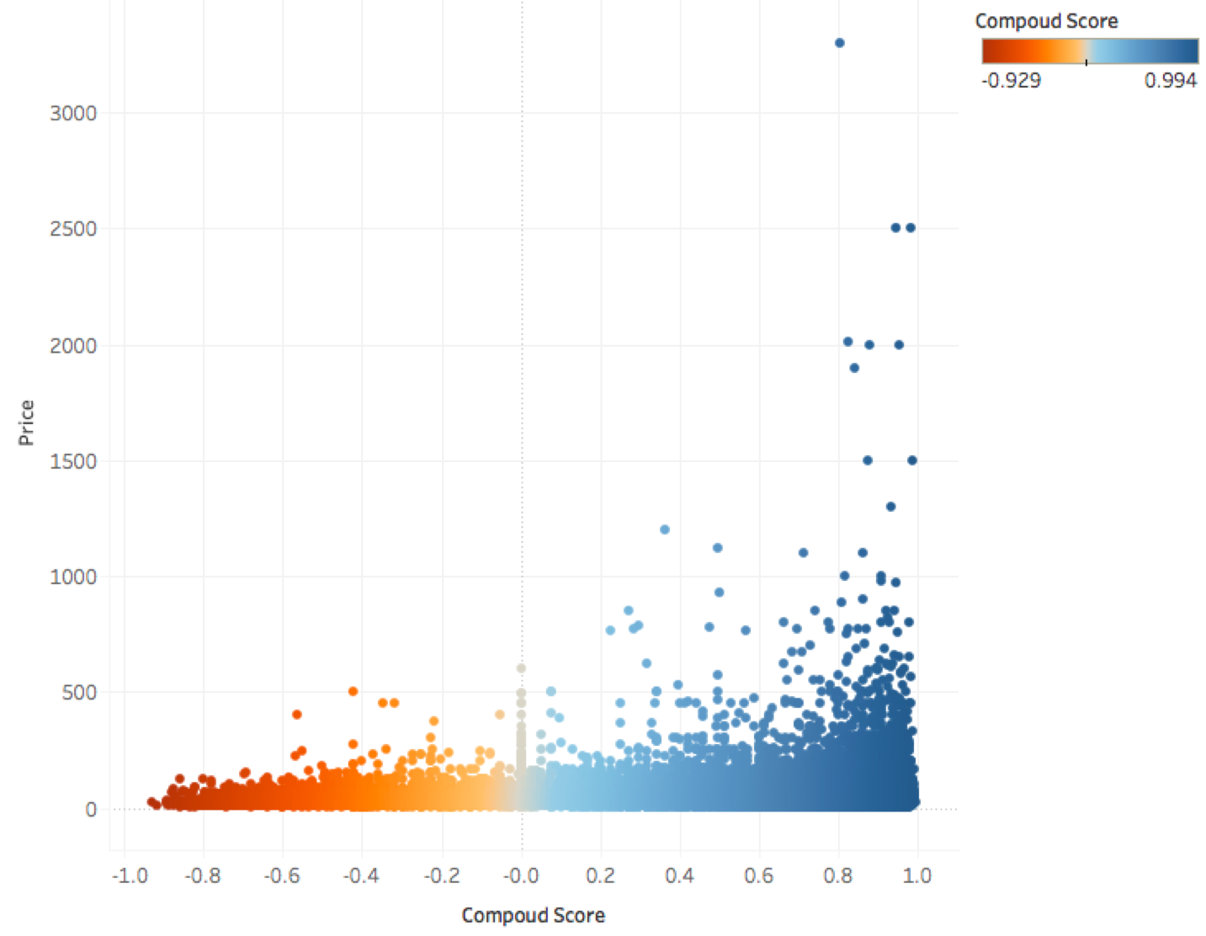
Sentiment Analytics
Wine which has a price within the range from 0 to 500 do not have significant association with its quality.
But for those wine whose price are higher than 500, they all have positive sentimental score.

Slide 12
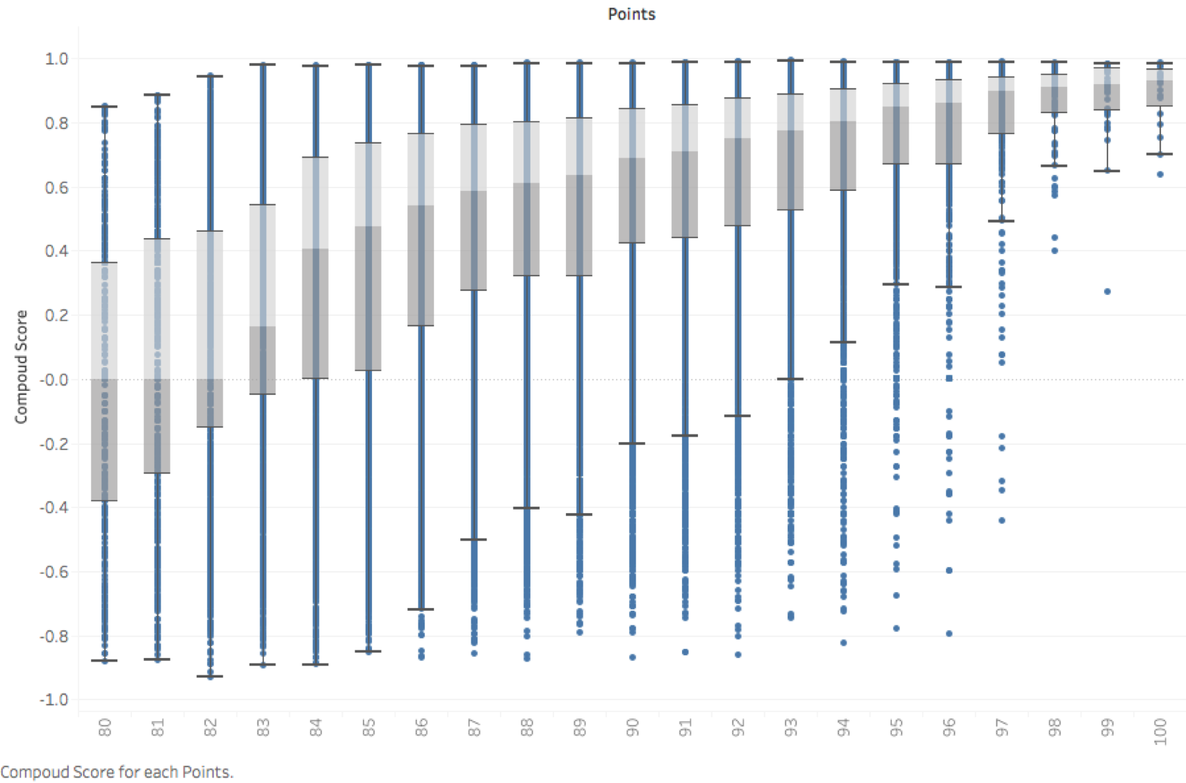
Sentiment Analytics
There is a strong positive correlation between compound score and points.
For wine with lower point, their scale is larger compared to wine with high score.
Business should pay attention to the wine that have low points but high sentimental score, because this may imply a low price with high quality.

Slide 13
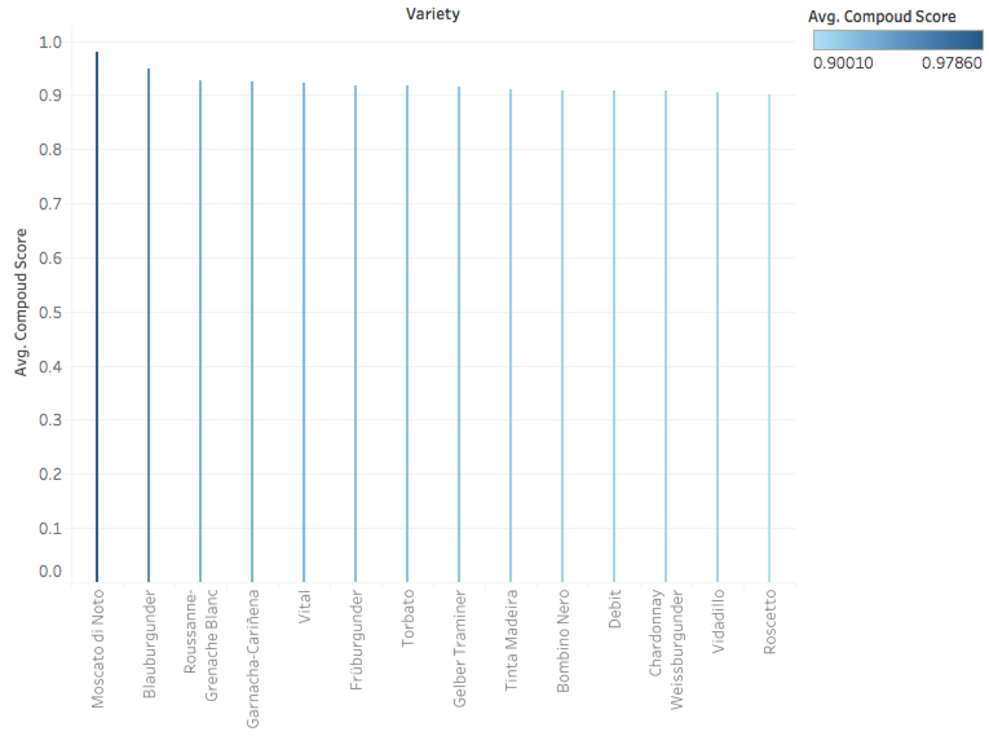
Sentiment Analytics
This figure shows all the wine name that have compound higher higher than 0.9.
This Ranking can help customers to quickly compare different type of wines.

Slide 14
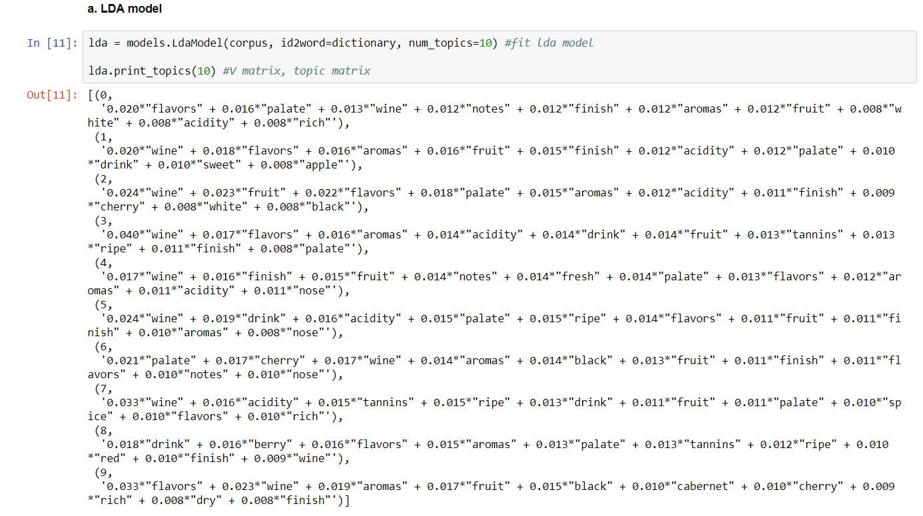
Topic modeling
Although, the content is all about wine, we still can use topic modeling to cluster descriptions.
Most of topics contain wine, flavors, aromas, and acidity
.
There are some difference based on wines’ category among all ten topics such as….

Slide 15
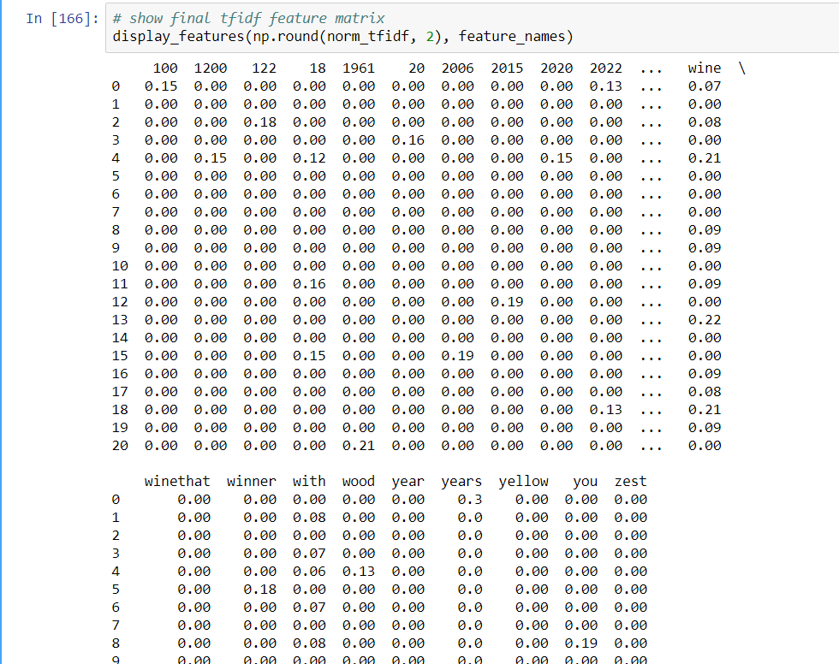
Keyword extractor
We use “feature_extraction” function from Sklearn package and word2vector from genism
Our target is to get three most meaningful words which stand for a description.
We calculate TFIDF value of each word. Then we select the top three meaningful words based on TFIDF value.
This is a demo by using 20 description of wine

Slide 16
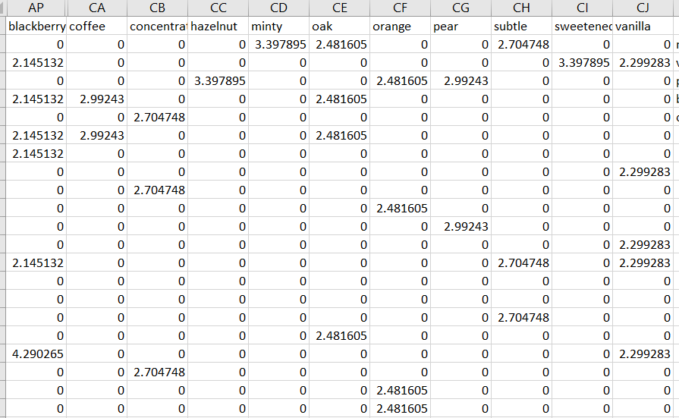
Keyword extractor
1. minty, subtle, aged
2. vanilla, sweetened, blackberry
3. pear, orange, hazelnut
4. blackberry, oak, coffee
5. concentration, aging, acidity
Limitation: we only use 20 descriptions. The corpus is not huge enough to generate reliable keywords.

Slide 17
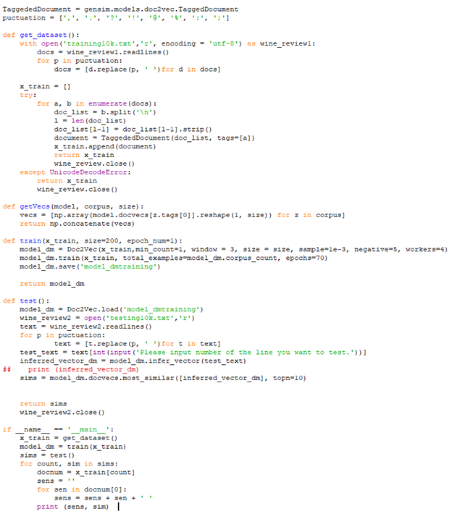
Text Similarity
This figure shows our codes for calculating Text Similarity basically using ‘gensim’ and ‘numpy’ modules.
Main thought is transferring documents to vectors in the convenience of calculating.
Accrossing to change the training text and testing text, we could select specific wines that customers are willing to know.

Slide 18
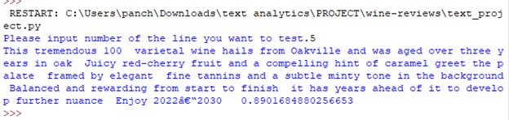
Text Similarity
If a customer is going to make investment on wine, we could test the descriptions similarity among all kinds of wine. There are two kinds of wine, one is at high price and the other low-price wine’s description shows high similarity with the high-price one.

Slide 19
Conclusion and Future Direction
Based on our findings, customers can accelerate their study on unknowing fields by developing core knowledge. Companies can offer customers more usable tools, reliable information and humanized user interface to improve user experience and improve company reputations.
For future direction, the most significant part would be gaining usable cleaning data. Generating investing opportunities would be more plausible if we drill down to wine prices. Trying other vector models and testing out their performance is also a big challenge.

Slide 20
Reference
Bansal, Shivam, et al. “Beginners Guide to Topic Modeling in Python.” Analytics Vidhya, 29 Aug. 2016, www.analyticsvidhya.com/blog/2016/08/beginners-guide-to-topic-modeling-in-python/.
“Sklearn.feature_extraction.Text.TfidfVectorizer¶.” Sklearn.feature_extraction.Text.TfidfVectorizer - Scikit-Learn 0.19.1 Documentation, scikit-learn.org/stable/modules/generated/sklearn.feature_extraction.text.TfidfVectorizer.html.

