Slide 1
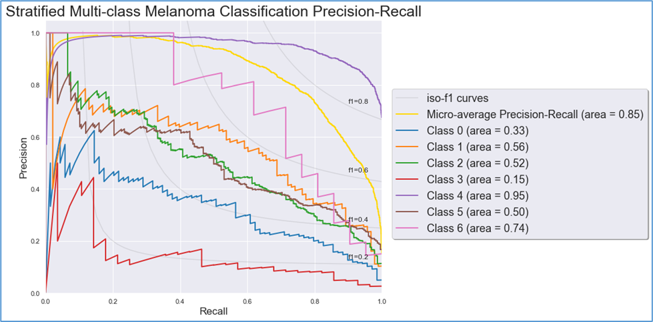
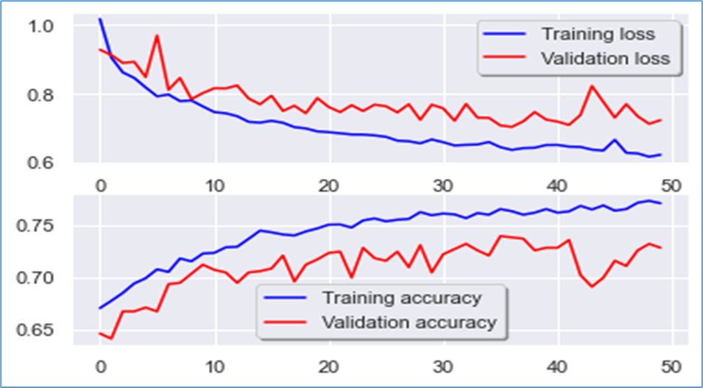
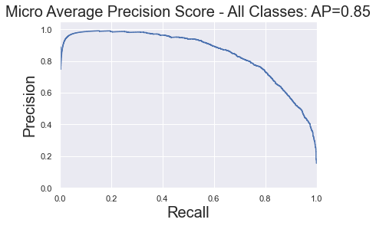
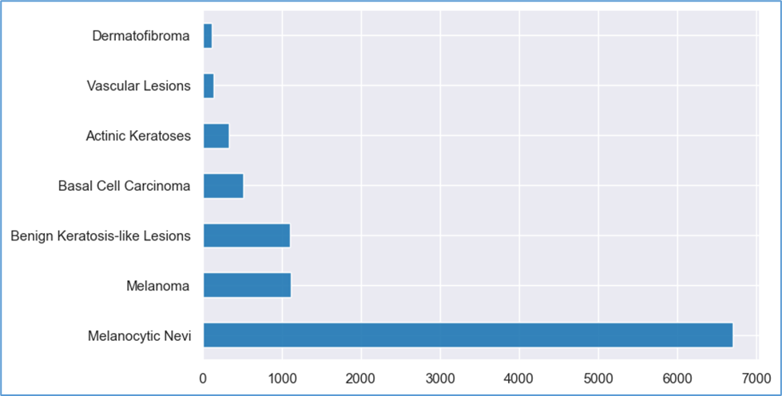
Multi-Class Skin Cancer Classification with Keras and Tensorflow using Convolutional Neural Networks
Robert Hodges, PharmD, MBA, RPh
Utica College – Master’s of Data Science Program
DSC 609 - Machine Learning
INTRODUCTION
METHODS (cont.)
RESULTS
RESULTS (cont.)
Skin cancer classification is an extremely vital medical topic as incidence of skin neoplasms have been increasing worldwide (Fabbrocini et al., 2010) The skin lesion cancer detection has been a challenging diagnostic when it comes to achieving high accuracy. Dermatologists perform this diagnostic challenge with an estimated 76-77% average accuracy while deep convolutional neural networks (CNN) have accuracy ranges of 81-84% (Harangi, 2018). A few examples of these CNNs include AlexNet, GoogLeNet, VGG, InceptionV3, and Resnet to name the more popular ones (Karim, 2019). Not only do deep CNNs have better accuracy than dermatologists, but CNNs also show a greater sensitivity compared to dermatologists, which are measured by the area under the curve (AUC) score of the precision-recall curve, with mean scores of 86% for CNNs and 79% for dermatologists, respectively (Haenssle et al., 2018). Most of these models are novel architectures and extremely complex. The author aims to compare a simple VGG model performance against dermatologist performance based on accuracy and AUC score (Sik-Ho Tsang, 2018).
Roughly 70% of the labels for the dataset are classified as melanocytic nevi. A model was attempted with a more balanced dataset. Mean age for data was 52 years of age. Male and female counts were roughly similar only differing by 1000 observations, or 10% of the 10,000-image dataset. The most common locations of skin lesions were on the back, lower and upper extremities, trunk, abdomen, and face.
Data pre-processing required resizing of images. Training without re-sizing images was not possible on a personal computer due to memory issues. Images were re-sized from 225x300 to 75x100. Null values were not deleted, but instead a mean imputation was used to prevent data loss. Training and test sets were made. Regularization was performed with a z-score transformation of the training and test sets. A validation test set was then made. Label encoding was performed on the dependent variable labels. OneHotEncoder was not used as it caused errors in training. Data augmentation was used to prevent overfitting. This included a random 10% zoom, 10% rotation, and 10% vertical upward shift. A learning rate reduction was also performed using the ReduceLROnPlateau algorithm where after 3 consecutive epochs of no validation accuracy increase, the learning rate was decreased by 50%. The final step of pre-processing the training, test, and validation images were converted into a three-dimensional tensor of 75x100x3. Five total models were performed using a Keras wrapper with a Tensorflow backend. Table 1 displays the architectures used in each CNN model. Table 1. CNN Architectures
Table 2. Test Accuracy for Models
The average precision-recall curve shows an AUC of 0.85. However, upon viewing figure 3, we can see that a high recall also happens with a precision score of around 0.2, which many false positives will be obtained. Figure 4 shows a stratified by class precision-recall curve.
Figure 4. Stratified Precision-Recall Curve for Model 2
Model 1 | Model 2 | Model 3 | Model 4 | Model 5
66.8 | 75.5 | 66.8 | 71.4 | 61.1
Model 2 performed with the best accuracy overall at 75.5% but still not as good as the mean dermatologist's accuracy of 76-77%. Models 1 and 3 had convergence issues and trained into dead neural networks stuck in a local minima. It is possible had a Leaky ReLU activation been used instead of ReLU, the weighting of some features wouldn’t have been set to zero and perhaps these models would have converged properly (Doshi, 2019). Figure 2 displays the training and validation loss and accuracy over epochs on the x-axis.
Figure 2. Training and Validation Loss and Accuracy for Model 2
OBJECTIVES
CONCLUSION
The null hypothesis shall be that a simple VGG model cannot perform better than a dermatologist based on accuracy and ROC’s AUC score. The alternative hypothesis states that a simple VGG model can perform better than a dermatologist with regards to precision-recall AUC score. A simple VGG layer shall be defined as a VGG architecture with less 16 or less layers, as this many layers are not considered deep learning, we will define them as being a simple VGG CNN. VGG architecture was selected for simplicity and ease of use. The structure of the VGG architecture means there are less hyperparameters to tune. Thus, our goal is to research if a simple CNN architecture can beat a clinician.
Class 4, melanocytic nevi, displayed the highest recall and precision, but was also 70% of the labels in the data. This was expected and all the other classes can be seen to perform much worse where they all converge around 0.2 precision which is where the recall scores are the highest.
It is important to point out that since this is a medical imaging classification problem, we don’t want false negatives. Therefore, the goal is to have a high recall. This was an imbalanced dataset and that the goal isn’t to compare model 2’s accuracy against 50% guesswork, as this isn’t a binary classification with balanced labels. Our most abundant label accounts for about 70% of the data, thus, if one were to guess melanocytic nevi on every prediction, one could achieve 70% accuracy. Therefore, the precision-recall curves must always be investigated as accuracy may look strong, but misclassifications can be detrimental depending on one’s goals. We could not reject the null hypothesis in this study as we did not outperform the dermatologists mean accuracy, 75 vs 76-77%, respectively. However, the mean AUC was better with model 2’s CNN, 85% vs 70% respectively. Simple models may have the same performance as a dermatologist, but future machine learning prototypes should be constructed with more advanced architectures such as ResNet or InceptionV3 using transfer learning, until a new better performing architecture can be designed.
METHODS
Accuracy ultimately increased and validation loss decreased, however, we can see the model diverged around epoch 42 and then started converging again. Precision-recall curves should also be investigated. Figure 3 illustrates the average precision-recall curve with AUC of 0.85.
Figure 3. Average Precision-Recall Curve of Model 2
Dependent variables are categorical classification outcomes from the MNIST: HAM10000 dataset and include melanocytic nevi, melanoma, benign keratosis-like lesions, basal cell carcinoma, actinic keratosis, vascular lesions, and dermatofibroma (Skin Cancer MNIST: HAM10000. (n.d.). Independent variables are the skin lesion imaged converted into a numerical array used in classification. Exploratory data analysis was completed. Figure 1 shows an imbalanced dataset.
REFERENCES
Doshi, C. (2019a, June 29). Comparison between Relu, Leaky Relu, and Relu-6. Medium. https://medium.com/@chinesh4/why-relu-tips-for-using-relu-comparison-between-relu-leaky-relu-and-relu-6-969359e48310
Doshi, C. (2019b, June 29). Comparison between Relu, Leaky Relu, and Relu-6. Medium. https://medium.com/@chinesh4/why-relu-tips-for-using-relu-comparison-between-relu-leaky-relu-and-relu-6-969359e48310
Fabbrocini, G., Triassi, M., Mauriello, M. C., Torre, G., Annunziata, M. C., De Vita, V., Pastore, F., D’Arco, V., & Monfrecola, G. (2010). Epidemiology of Skin Cancer: Role of Some Environmental Factors. Cancers, 2(4), 1980–1989. https://doi.org/10.3390/cancers2041980
Haenssle, H. A., Fink, C., Schneiderbauer, R., Toberer, F., Buhl, T., Blum, A., Kalloo, A., Hassen, A. B. H., Thomas, L., Enk, A., Uhlmann, L., Alt, C., Arenbergerova, M., Bakos, R., Baltzer, A., Bertlich, I., Blum, A., Bokor-Billmann, T., Bowling, J., … Zalaudek, I. (2018). Man against machine: diagnostic performance of a deep learning convolutional neural network for dermoscopic melanoma recognition in comparison to 58 dermatologists. Annals of Oncology, 29(8), 1836–1842. https://doi.org/10.1093/annonc/mdy166
Harangi, B. (2018). Skin lesion classification with ensembles of deep convolutional neural networks. Journal of Biomedical Informatics, 86, 25–32. https://doi.org/10.1016/j.jbi.2018.08.006
Karim, R. (2019, October 17). Illustrated: 10 CNN Architectures. Medium. https://towardsdatascience.com/illustrated-10-cnn-architectures-95d78ace614d
Sik-Ho Tsang. (2018a, August 22). Review: VGGNet — 1st Runner-Up (Image Classification), Winner (Localization) in ILSVRC 2014. Medium; Coinmonks. https://medium.com/coinmonks/paper-review-of-vggnet-1st-runner-up-of-ilsvlc-2014-image-classification-d02355543a11
Sik-Ho Tsang. (2018b, August 22). Review: VGGNet — 1st Runner-Up (Image Classification), Winner (Localization) in ILSVRC 2014. Medium; Coinmonks. https://medium.com/coinmonks/paper-review-of-vggnet-1st-runner-up-of-ilsvlc-2014-image-classification-d02355543a11
Skin Cancer MNIST: HAM10000. (n.d.). Kaggle.Com. https://www.kaggle.com/kmader/skin-cancer-mnist-ham10000
All models used the Adam optimizer, rectified linear unit activation (ReLU), 50 epochs (except model 4 run at 75 epochs), 0.0001 learning rate, 3x3 kernel size, 2x2 pooling size, and a batch size of 10. A softmax activation function was used in the last dense layer because of multiple classification outcomes. Table 2 in the next section displays accuracies for each mode.
Figure 1. Imbalanced dataset

