Slide 1
Inserting Data to MySQL through PHP
Dr. Hamad Odhabi

Slide 2

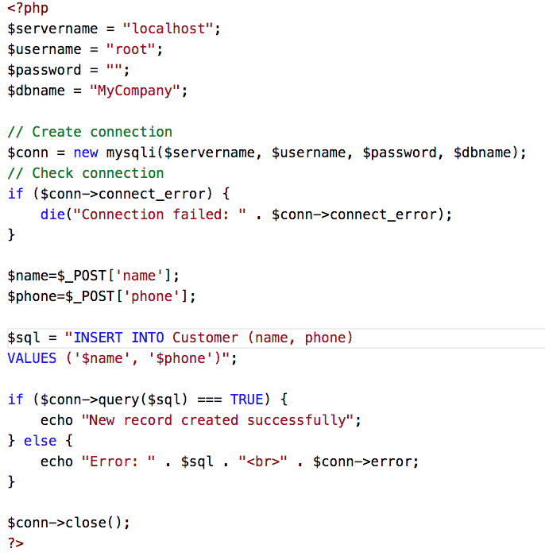
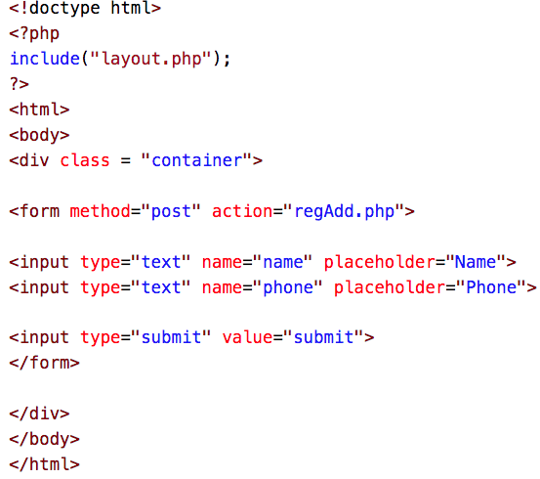
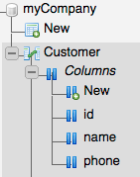
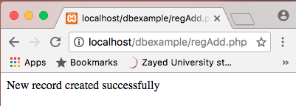
regAdd.php
Insert data to the database
reg.php
This page has a simple form that
allows user to enter data

Slide 3
reg.php

Slide 4
reg.php

Slide 5
The id is A.I
reg.php

Slide 6
reg.php

Slide 7
reg.php

Slide 8
The id is A.I
reg.php

Slide 9
reg.php

Slide 10
Insert data to the database
regAdd.php

Slide 11
Insert data to the database
regAdd.php

Slide 12
Insert data to the database
regAdd.php

Slide 13
Insert data to the database
regAdd.php

Slide 14
Insert data to the database
regAdd.php

Slide 15
Insert data to the database
regAdd.php

Slide 16
Insert data to the database
regAdd.php

Slide 17
In PHP variables must start by $
regAdd.php

Slide 18
regAdd.php

Slide 19
regAdd.php

Slide 20
regAdd.php

Slide 21
regAdd.php

Slide 22
regAdd.php

Slide 23
regAdd.php
Insert data to the database
reg.php
This page has a simple form that
allows user to enter data

