Slide 1
JavaScript by Example
Dr. Hamad Odhabi

Slide 2
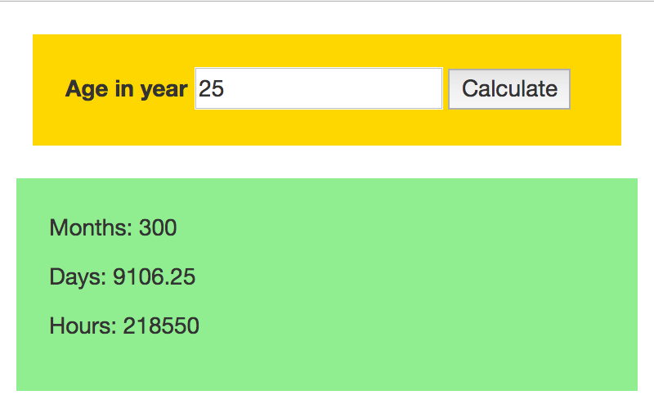
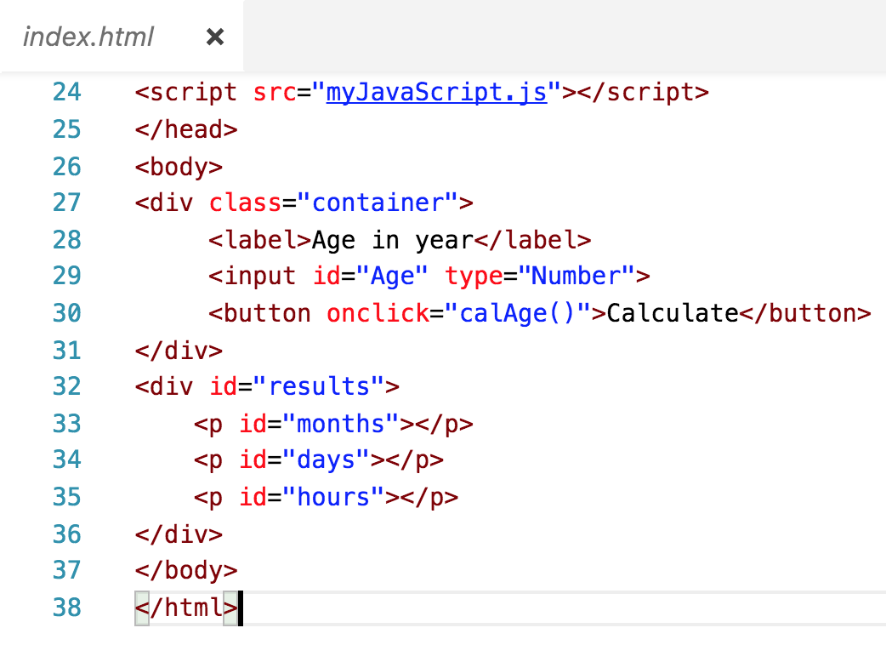
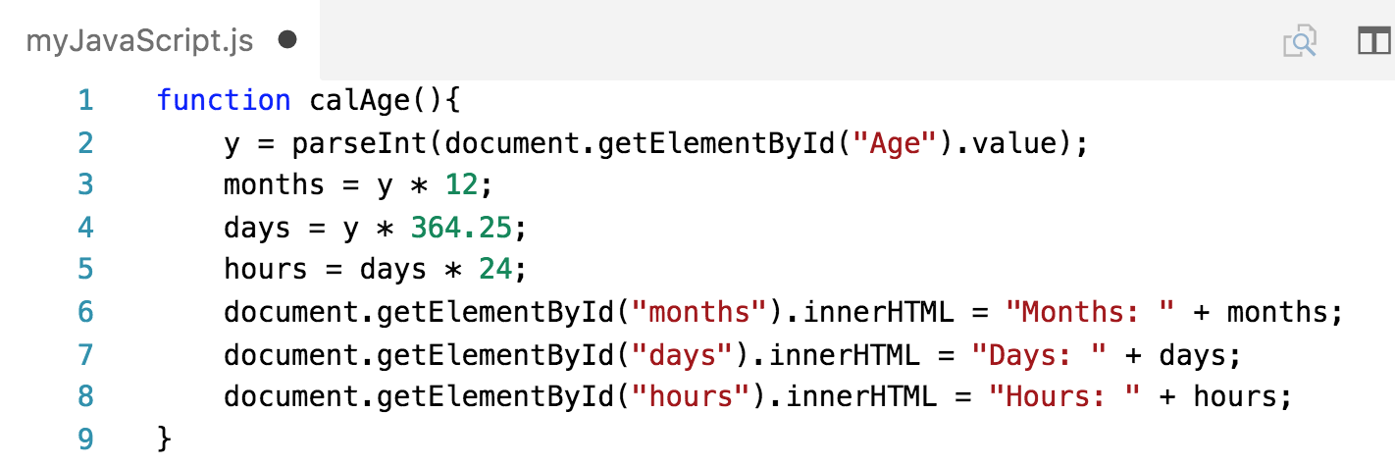

Slide 7
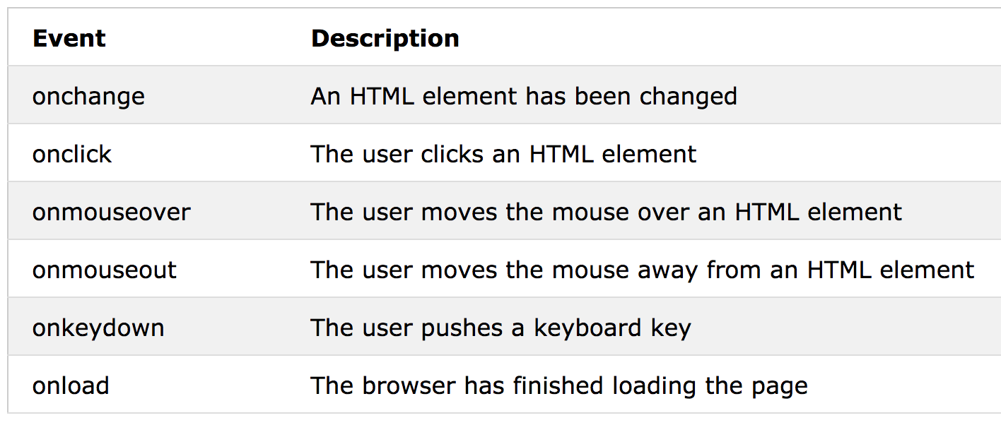

Slide 8
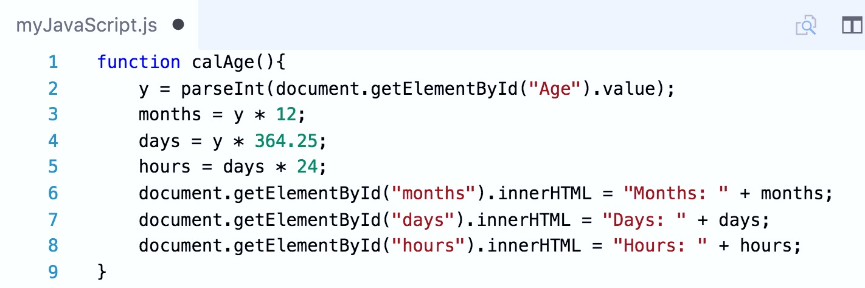

Slide 20
JavaScript
JavaScript is a client side technology aims to create greater interactivity in Web applications.
It used to perform high level validation and client side calculations/processes.

Slide 21
JavaScript
JavaScript Can Change HTML Content
JavaScript Can Change HTML Attributes
JavaScript Can Change HTML Styles (CSS)
JavaScript Can Hide HTML Elements
JavaScript Can Show HTML Elements

Slide 22
JavaScript
The most commonly used JavaScript method is
getElementById().

Slide 23
Thank you

