Slide 1
Performance Monitoring Tools TKProf, ASH and AWR

Slide 2
Agenda and Scope
TKProf extraction and interpretation.
Demo.
Introduction to Active Session History (ASH) and demonstration of using ASH.
AWR important aspects for performance and walkthrough.
Real Time SQL Monitor.
Scope is limited to performance monitoring tools and methodologies. Finer details of tuning will be discussed in upcoming sessions.

Slide 3
In order to know what to fix, we need to be able to see what’s broken!
- Dan Roam

Slide 4
Understanding the issue…
Initial
Data
collec-tion
What
Identify
(app is slow)
How Much
Quantify
(takes 1m)
TKProf, ASH, AWR, Real time monitoring, Apps Logs/Tables,
OS/IO stats etc
When
Timeline
(in peak hours)
Where
Component
(MT or DB or N/W)
Analyze
How
Flow chart
Additional
Data
collec-tion
SQL/Object Stats,
Execution Plans, Logic(code) etc
Why
Root Cause
(Stats not updated)

Slide 5
TKPROF

Slide 6
Transient Kernel Profiler (TKProf)
Tkprof is very useful report for diagnosing performance issues.
It essentially formats a trace file into a more readable format for performance analysis. The DB performance analyst can then identify the problematic SQL by analyzing the explain plan, user level statements and recursive SQL calls, wait events, row source generation etc.

Slide 7
Trace Files
When the SQL Trace facility is enabled for a session, Oracle generates a trace file containing statistics for traced SQL statements for that session. When the SQL Trace facility is enabled for an instance, Oracle creates a separate trace file for each process. Before enabling the SQL Trace facility:
Trace files are written to the USER_DUMP_DEST destination.

Slide 8
TKProf sample
The following attachment contains a sample TKProf

Slide 9
Initialization Parameters for Trace File Management
ALTER SESSION SET MAX_DUMP_FILE_SIZE = UNLIMITED;
ALTER SESSION SET TIMED_STATISTICS=TRUE;
TIMED_STATISTICS
This enables and disables the collection of timed statistics, such as CPU and elapsed times
MAX_DUMP_FILE_SIZE
The maximum size of these files (in operating system blocks) is limited by this initialization parameter.

Slide 10
Generating a trace and tkprof
-- Setting tracefile Identifier inside code. Note: You may set any appropriate name
ALTER SESSION SET TRACEFILE_IDENTIFIER = 'Jobname_Perfmon_01';
-- Turn on the trace alter session set events '10046 trace name context forever, level 12';
Run your code now. (procedure,plsql block or query)
alter session set statistics_level = <<To the Value which was there before execution>> ;
Generate TKProf
tkprof <trace file name> <output file name> sys=no aggregate=yes sort=(fchela,exeela,prsela)

Slide 11
Tracing other’s session
exec dbms_system.set_ev(sid,serial#,10046,12,'')
exec dbms_system.set_ev(sid,serial#,10046,0,'')
Use the following query to get the trace file name
select rtrim(c.value,'/')||'/'||d.instance_name||'_ora_'||ltrim(to_char(a.spid))||'.trc' from v$process a,v$session b,v$parameter c,v$instance d where a.addr=b.paddr and b.sid= :a1 and b.serial#=:a2 and c.name='user_dump_dest'

Slide 12
Tracing specific sqls
alter session set events 'sql_trace level 12';
Here cxr83zg2yu4g9 and 517qkwc2bqnap are the SQL IDs
alter session set events 'sql_trace[sql:cxr83zg2yu4g9|517qkwc2bqnap] level 12';
alter session set events 'sql_trace[sql:cxr83zg2yu4g9|517qkwc2bqnap] off';

Slide 13
10046 Trace levels
0= No statistics generated10046
2=Standard trace output including parsing, executes and fetches etc.
4=Level 2 + Bind Variables
8=Level 2 + Waits
12=Level 2 + Bind Variables + Waits

Slide 14
Tracing General Guidelines
Enable the trace from the beginning of the job run or session.
Tracing should be enabled for maximum duration, preferably till the end of the job or program.
Enable the trace for given SQL, only when you are sure about the problematic SQL.
Record the exact timing of the job/session launched and stopped.
Record the Info about the program (like module, machine, schema name etc. to identify the session )
For API call through wrapper : Enable the trace before running wrapper , run wrapper , disable the trace

Slide 15
ASH

Slide 16
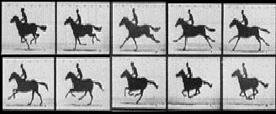
ASH Sampling is like taking Pictures

Slide 17




ASH Samples Session State
Every second
10:00:00
10:00:01
10:00:02
10:00:03
10:00:04
10:00:05
?
?
?
?
?
TIME
Sessions change a lot quicker but can get the main picture via sampling by sampling faster

Slide 18
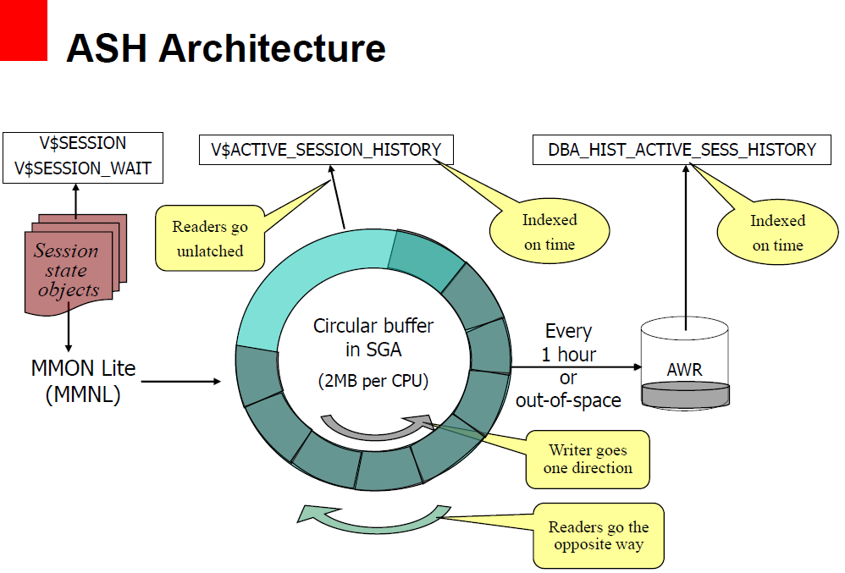

Slide 19
Family of ASH Tables
Real time
v$session
(before 10g v$session_wait)
Last 10 waits
v$session_wait_history
v$active_session_history
DBA_HIST_ACTIVE_SESS_HISTORY
wrh$active_session_history

Slide 20
v$active_session_history
When
SAMPLE_ID NUMBER
SAMPLE_TIME TIMESTAMP(3)
Session
SESSION_ID NUMBER
SESSION_SERIAL# NUMBER
USER_ID NUMBER
SERVICE_HASH NUMBER
SESSION_TYPE VARCHAR2(10)
PROGRAM VARCHAR2(64)
MODULE VARCHAR2(48)
ACTION VARCHAR2(32)
CLIENT_ID VARCHAR2(64)
State
SESSION_STATE VARCHAR2(7)
WAIT_TIME NUMBER
EVENT VARCHAR2(64)
EVENT_ID NUMBER
EVENT# NUMBER
SEQ# NUMBER
P1 NUMBER
P2 NUMBER
P3 NUMBER
WAIT_TIME NUMBER
TIME_WAITED NUMBER
CURRENT_OBJ# NUMBER
CURRENT_FILE# NUMBER
CURRENT_BLOCK# NUMBER0
Wait
SQL
SQL_ID VARCHAR2(13)
SQL_CHILD_NUMBER NUMBER
SQL_PLAN_HASH_VALUE NUMBER
SQL_OPCODE NUMBER
QC_SESSION_ID NUMBER
QC_INSTANCE_ID NUMBER
Duration
TIME_WAITED NUMBER

Slide 21
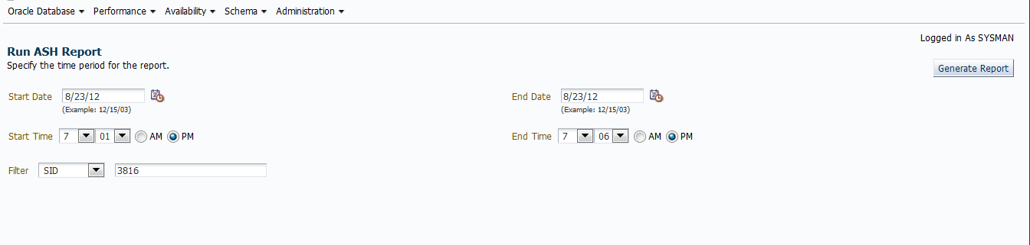
Running ASH Report
Or you can run @$ORACLE_HOME/rdbms/admin/ashrpt.sql ( ashrpti for RAC)

Slide 22
HTML reports are just for fancy client presentations.
Querying V$Active_Session_History is more flexible, powerful and quick.

Slide 23
Top Waiting Session
in last 5 minutes
Select
session_id,
count(*)
from
v$active_session_history
where
session_state=‘WAITING’ and
SAMPLE_TIME > SYSDATE - (5/(24*60))
group by
session_id
order by
count(*) desc;

Slide 24
Top CPU Session
Top CPU consuming Session in last 5 minutes
Select
session_id,
count(*)/(5*60) as load
,100*(count(*)/(5*60)) as “%active”
from
v$active_session_history
where
session_state= ‘ON CPU’ and
SAMPLE_TIME > sysdate - (5/(24*60))
group by
session_id
order by
count(*) desc;
Who is the rogue session ?
Last 5 minutes

Slide 25
Top SQL from ASH
select
ash.SQL_ID ,
sum(decode(ash.session_state,'ON CPU',1,0)) "CPU",
sum(decode(ash.session_state,'WAITING',1,0)) -
sum(decode(ash.session_state,'WAITING', decode(en.wait_class, 'User I/O',1,0),0)) "WAIT" ,
sum(decode(ash.session_state,'WAITING', decode(en.wait_class, 'User I/O',1,0),0)) "IO" ,
sum(decode(ash.session_state,'ON CPU',1,1)) "TOTAL"
from v$active_session_history ash,
v$event_name en
where SQL_ID is not NULL and en.event#=ash.event#
group by sql_id
order by sum(decode(session_state,'ON CPU',1,1)) desc
No time window specified

Slide 26
Top Session
select
ash.session_id,
ash.session_serial#,
ash.user_id,
ash.program,
sum(decode(ash.session_state,'ON CPU',1,0)) "CPU",
sum(decode(ash.session_state,'WAITING',1,0)) -
sum(decode(ash.session_state,'WAITING',
decode(en.wait_class,'User I/O',1, 0 ), 0)) "WAITING" ,
sum(decode(ash.session_state,'WAITING',
decode(en.wait_class,'User I/O',1, 0 ), 0)) "IO" ,
sum(decode(session_state,'ON CPU',1,1)) "TOTAL"
from v$active_session_history ash,
v$event_name en
where en.event# = ash.event#
group by session_id,user_id,session_serial#,program
order by sum(decode(session_state,'ON CPU',1,1))
select
ash.session_id,
ash.session_serial#,
ash.user_id,
ash.program,
sum(decode(ash.session_state,'ON CPU',1,0)) "CPU",
sum(decode(ash.session_state,'WAITING',1,0)) -
sum(decode(ash.session_state,'WAITING',
decode(en.wait_class,'User I/O',1, 0 ), 0)) "WAITING" ,
sum(decode(ash.session_state,'WAITING',
decode(en.wait_class,'User I/O',1, 0 ), 0)) "IO" ,
sum(decode(session_state,'ON CPU',1,1)) "TOTAL"
from v$active_session_history ash,
v$event_name en
where en.event# = ash.event#
group by session_id,user_id,session_serial#,program
order by sum(decode(session_state,'ON CPU',1,1))
No time window specified

Slide 27
Top Session w/ Username
select
decode(nvl(to_char(s.sid),-1),-1,'DISCONNECTED','CONNECTED')
"STATUS",
topsession.session_id "SESSION_ID",
u.name "NAME",
topsession.program "PROGRAM",
max(topsession.CPU) "CPU",
max(topsession.WAITING) "WAITING",
max(topsession.IO) "IO",
max(topsession.TOTAL) "TOTAL"
from {previous query} ) topsession ,
v$session s,
user$ u
where
u.user# =topsession.user_id and
/* outer join to v$session because the session might be disconnected */
topsession.session_id = s.sid (+) and
topsession.session_serial# = s.serial# (+)
group by topsession.session_id, topsession.session_serial#, topsession.user_id,
topsession.program, s.username,s.sid,s.paddr,u.name
order by max(topsession.TOTAL) desc
ASH
Connected
User name
No time window specified

Slide 28
Top Session Finding a Rogue User
STATUS SESSION_ID NAME PROGRAM CPU WAITING IO
--------------- ---------- ---------- ------------------------- ----- ---------- ----
CONNECTED 247 CPU_Monger ChMgr304.exe 11704 0 0
CONNECTED 277 SYS oracle@labsfrh903 (LGWR) 14 19 0
CONNECTED 278 SYS oracle@labsfrh903 (DBW0) 29 0 0
CONNECTED 276 SYS oracle@labsfrh903 (CKPT) 18 9 0
CONNECTED 280 SYS oracle@labsfrh903 (PMON) 20 0 0
DISCONNECTED 255 SYSTEM Executor.exe 11 4 5
DISCONNECTED 257 SYSTEM Executor.exe 13 0 3
DISCONNECTED 255 SYSTEM Executor.exe 14 0 2
DISCONNECTED 257 SYSTEM Executor.exe 13 0 3

Slide 29
ASH QUERIES

Slide 30
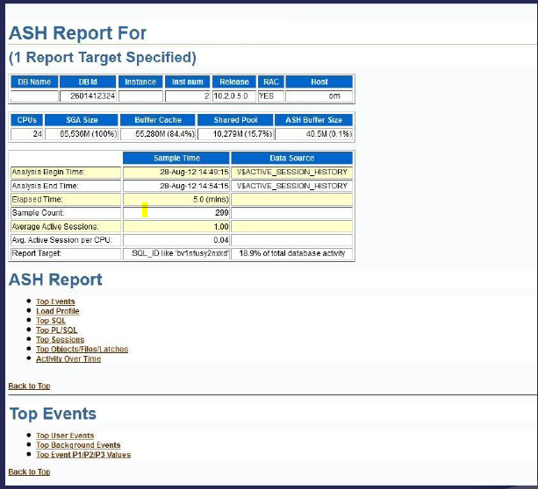

Slide 31
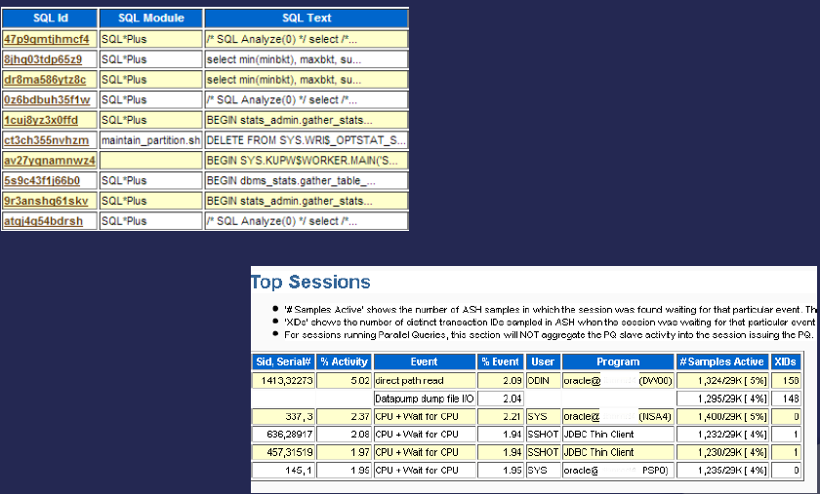

Slide 32
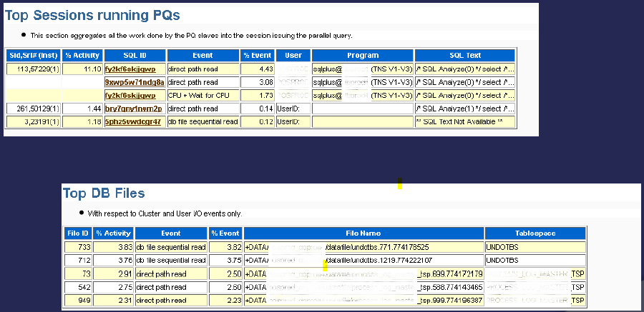

Slide 33
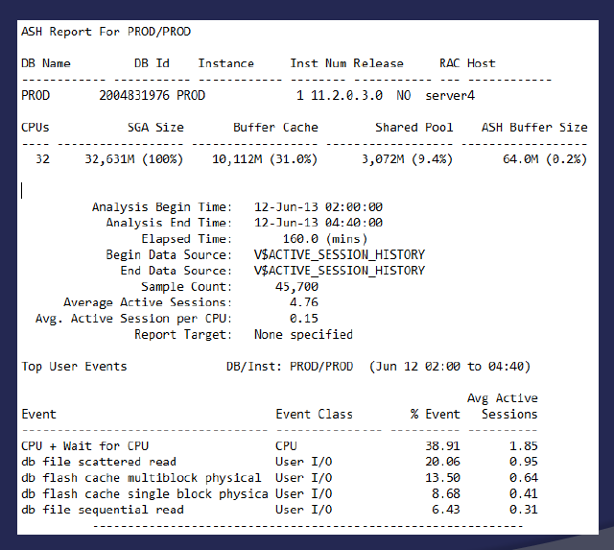

Slide 34
AWR

Slide 35
AWR is one of many RDBMS performance data sources
Sometimes it isn’t the best source (aggregation)
SQL Extended trace (event 10046)
RAW trace
tkprof
TRCAnlzr [ID 224270.1]
Method-R state of art tools
others
Sometimes it is the best/efficient source!
Sometimes it is the only one available!

Slide 36
When should you consider AWR?
General resource tuning (high CPU, IO utilization)
Find TOP resource consuming SQLs
You are asked to reduce server load X times.
You would like to analyze load patterns/trends.
You need to travel back in time and see how things progressed.
AWR SQL Execution Plans historical information analysis.
You don’t have any other source of performance information.

Slide 37
AWR Snapshots
By default snapshots of the relevant data are taken every hour and retained for 7 days.
EXEC DBMS_WORKLOAD_REPOSITORY.modify_snapshot_settings
( retention => 43200, -- Minutes (= 30 Days), interval => 30);
--Minutes. Current value retained if NULL.
Extra snapshots can be taken and existing snapshots can be removed, as shown below.
EXEC DBMS_WORKLOAD_REPOSITORY.create_snapshot;
EXEC DBMS_WORKLOAD_REPOSITORY.drop_snapshot_range ( low_snap_id => 22, high_snap_id => 32);

Slide 38
Generating AWR : Method1
@$ORACLE_HOME/rdbms/admin/awrrpt.sql
@$ORACLE_HOME/rdbms/admin/awrrpti.sql
The scripts prompt you to enter the report format (html or text), the start snapshot id, the end snapshot id and the report filename. The resulting report can be opend in a browser or text editor accordingly.

Slide 39
Generating AWR : 2
SELECT
output
FROM
TABLE
(dbms_workload_repository.awr_report_text
(937843061,1,25649,25650 )
);
SELECT
output
FROM
TABLE
(dbms_workload_repository.awr_report_html
(937843061,1,25649,25650 )
);
SELECT MAX (snap_id), MIN (snap_id)
FROM SYS.wrm$_snapshot

Slide 40
AWR : Header
 | Snap Id | Snap Time | Sessions | Cursors/Session
Begin Snap: | 7556 | 19-Oct-12 21:00:05 | 247 | 41.9
End Snap: | 7558 | 19-Oct-12 23:00:14 | 249 | 41.6
Elapsed: |  | 120.14 (mins)
DB Time: |  | 239.38 (mins)

Slide 41
AWR : Load Profile
 | Per Second | Per Transaction | Per Exec | Per Call
DB Time(s): | 2.0 | 0.0 | 0.01 | 0.01
DB CPU(s): | 1.3 | 0.0 | 0.01 | 0.00
Redo size: | 31,071.8 | 423.5
Logical reads: | 1,022,277.2 | 13,933.4
Block changes: | 174.3 | 2.4
Physical reads: | 493.9 | 6.7
Physical writes: | 10.2 | 0.1
User calls: | 301.1 | 4.1
Parses: | 22.6 | 0.3
Hard parses: | 0.7 | 0.0
W/A MB processed: | 12.8 | 0.2
Logons: | 0.2 | 0.0
Executes: | 160.6 | 2.2
Rollbacks: | 66.9 | 0.9
Transactions: | 73.4

Slide 42
AWR : Top 5 Foreground Events
Event | Waits | Time(s) | Avg wait (ms) | % DB time | Wait Class
db file sequential read | 2,817,676 | 810 | 0 | 62.0 | User I/O
DB CPU |  | 130 |  | 9.9
free buffer waits | 5,505 | 70 | 13 | 5.3 | Configurat
log file sync | 142 | 46 | 324 | 3.5 | Commit
log buffer space | 371 | 36 | 97 | 2.7 | Configurat

Slide 43
Time Model Statistics
Statistic Name | Time (s) | % of DB Time
sql execute elapsed time | 12,416.14 | 86.45
DB CPU | 9,223.70 | 64.22
parse time elapsed | 935.61 | 6.51
hard parse elapsed time | 884.73 | 6.16
failed parse elapsed time | 821.39 | 5.72
PL/SQL execution elapsed time | 153.51 | 1.07
hard parse (sharing criteria) elapsed time | 25.96 | 0.18
connection management call elapsed time | 14.00 | 0.10
hard parse (bind mismatch) elapsed time | 4.74 | 0.03
PL/SQL compilation elapsed time | 1.20 | 0.01
repeated bind elapsed time | 0.22 | 0.00
sequence load elapsed time | 0.11 | 0.00
DB time | 14,362.96
background elapsed time | 731.00
background cpu time | 72.00

Slide 44
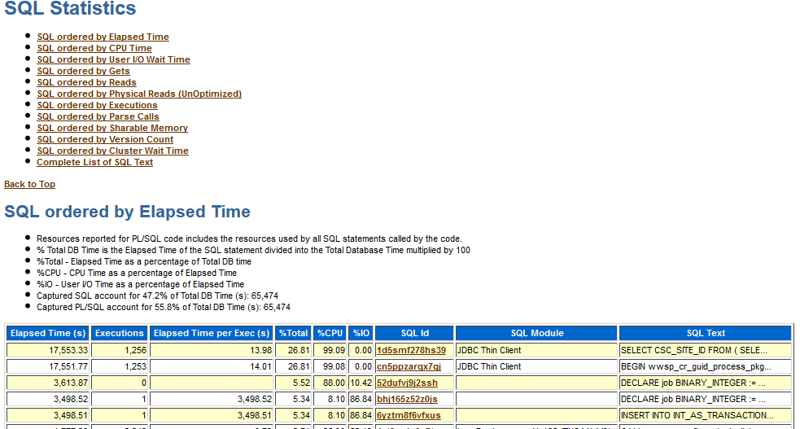

Slide 45
AWR Sample

Slide 46
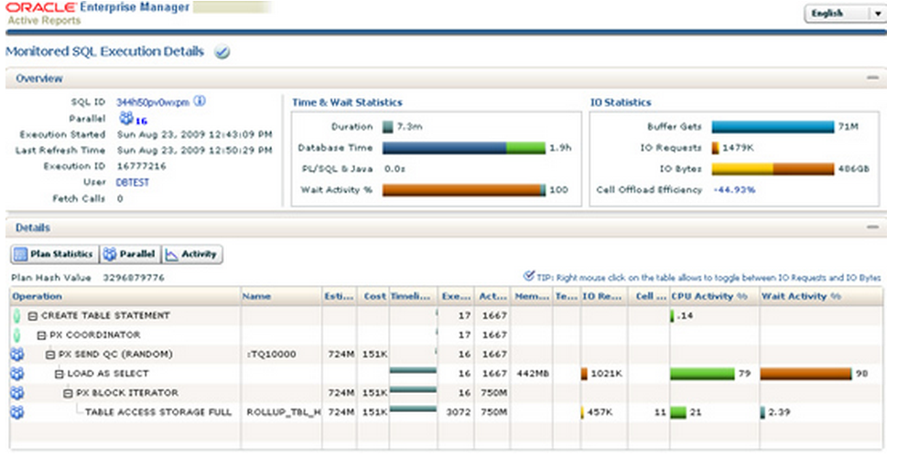
Real Time SQL Monitor

Slide 47
Real Time SQL Monitor - Query
select m.sql_id ,m.sql_plan_hash_value ,p.id,
rpad(' ',p.depth*2, ' ')||p.operation ||' ' || p.options operation,
p.object_name object,
p.cardinality card,
p.cost cost,
substr(m.status,1,4) status,
m.output_rows
from gv$sql_plan p, gv$sql_plan_monitor m , gv$sql_monitor s
where p.sql_id=m.sql_id
and p.child_address=m.sql_child_address
and p.plan_hash_value=m.sql_plan_hash_value
and p.id=m.plan_line_id
-- and m.sql_id='4qk105sn61usy'
AND s.sid = 4011
AND s.inst_id = 1
AND substr(m.status,1,4) = 'EXEC'
AND s.inst_id = m.inst_id
AND s.inst_id = p.inst_id
and s.key = m.key
order by id

Slide 48
Thank you

