Slide 1
Lung & Colon Cancer
Histopathology Classification
Using Handcrafted Features and Gradient Boosting
Odyek Henry
2025/HD07/26018U | Makerere University, Kampala | MSB7216 — Deep Learning for Health Data
Notes:
Welcome. This presentation covers the classical machine learning track of the MSB7216 final project. Total time: 12–14 minutes.

Slide 2
Background
Why Histopathology Classification?
25K
Lung and colorectal cancers rank among the top causes of cancer mortality globally (Bray et al., 2018).
Diagnosis depends on microscopic H&E tissue examination — time-consuming and expert-dependent.
Automated classification can reduce workload and improve diagnostic consistency.
Deep learning achieves >99% accuracy but is opaque and GPU-dependent.
Classical ML with handcrafted features offers interpretable, CPU-friendly alternatives — under-explored on modern benchmarks.
H&E images (LC25000)
5
tissue classes
99.87%
ResNet-50 benchmark
Notes:
Emphasise the gap: deep learning is accurate but opaque and GPU-hungry. The question is whether classical ML can close that gap while remaining interpretable. (~60 sec)

Slide 3
Related Work
Borkowski et al. (2019)
Introduced LC25000; CNN exceeds 99% on 5-class tissue classification.
Haralick et al. (1973)
GLCM texture features for spatial cell arrangement.
Ojala et al. (2002)
Local Binary Patterns — efficient rotation-invariant texture descriptor.
Dalal & Triggs (2005)
HOG descriptors capture local edge and gradient structure.
Macenko et al. (2009)
SVD-based stain normalisation maps slides to a fixed H&E reference.
Breiman (2001)
Random forests reduce variance via decorrelated tree ensembles.
Chen & Guestrin (2016)
XGBoost — regularised gradient boosting, competitive on feature data.
Lundberg & Lee (2017)
SHAP provides consistent, model-agnostic feature attribution.
This study (2025)
421 handcrafted features + XGBoost = 99.87% on LC25000, full SHAP analysis, CPU only.
Notes:
Highlighted row is this study. No prior work combined this feature set with SHAP and a fair split-level DL comparison on LC25000. (~60 sec)

Slide 4
Research Gap
Deep learning is accurate but opaque
CNNs exceed 99% on LC25000 yet predictions cannot be traced to named biological features without extra post-hoc tools.
GPU dependency limits clinical reach
ResNet-50 requires hours of GPU training — hardware unavailable in many low-resource clinical facilities.
Classical ML under-explored at this scale
No published study applies a multi-family handcrafted feature set with SHAP analysis on LC25000 compared fairly against deep learning on identical splits.
Notes:
Three gaps. Emphasise the third: fair comparison on identical splits has not been done. (~45 sec)

Slide 5
Problem Statement
Automated histopathology classification with convolutional neural networks achieves near-perfect accuracy but produces decisions that cannot be directly explained in biological terms, and requires GPU infrastructure that is often unavailable in low-resource healthcare settings. This study asks whether a machine learning pipeline based on handcrafted colour, texture, and structural features can match deep learning accuracy on the LC25000 dataset while providing built-in feature-level explanations and running entirely on standard CPU hardware.
Notes:
Read this paragraph aloud. Single paragraph, no boxes, dark background. (~30 sec)

Slide 6
Research Objectives
Main Objective
To design and evaluate a classical machine learning pipeline for five-class histopathology classification using handcrafted image features, and to compare its performance and interpretability against a deep learning baseline on the same data splits.
Specific Objectives
Extract a 421-dimensional feature set (colour, GLCM, LBP, HOG) after Macenko stain normalisation.
Train and evaluate four classifiers: logistic regression, k-NN, random forest, and XGBoost.
Identify which feature families carry the most predictive importance using SHAP, permutation importance, and native feature importance.
Compare the best classical model against ResNet-50 on accuracy, AUC-ROC, training cost, and explainability.
Notes:
State main objective first then walk through the four specific objectives. (~45 sec)

Slide 7
Dataset — LC25000
Borkowski et al. (2019) | arXiv:1912.12142 | 25,000 H&E histopathology images
25,000
Class | Type | Count
colon_aca | Colon adenocarcinoma | 5,000
colon_n | Benign colon tissue | 5,000
lung_aca | Lung adenocarcinoma | 5,000
lung_n | Benign lung tissue | 5,000
lung_scc | Lung squamous cell carcinoma | 5,000
total images
768×768
raw resolution (px)
224×224
resized for extraction
Split (seed = 42, same as DL pipeline)
Train 70% · Validation 15% · Test 15%
Balanced
5,000 per class
Notes:
Emphasise perfect class balance. Same split as DL pipeline makes the comparison valid. (~60 sec)

Slide 8
Methodology — Feature Extraction Pipeline
Raw Image
768×768
▶
Macenko
Normalisation
▶
Resize
224×224
▶
421 Feature
Vector
▶
Scale + PCA-50
▶
Classifier
Colour
GLCM
LBP
HOG
75 dims
12 dims
10 dims
324 dims
RGB/HSV/LAB moments
+ HSV histograms.
Captures H&E stain differences.
Haralick properties
d={1,3}, 4 angles.
Spatial cell regularity.
Uniform LBP P=8,R=1
histogram.
Micro-texture patterns.
9 orientations,
56×56px cells.
Edge and gradient structure.
SHAP: 82%
SHAP: 10%
SHAP: 7%
SHAP: 1%
Notes:
Pipeline: raw image → Macenko normalisation → resize → 4 feature families. Colour dominates at 82% SHAP importance. (~90 sec)

Slide 9
Classifiers and Experimental Setup
Logistic
Regression
k-Nearest
Neighbours
Random
Forest
SVM (RBF)
XGBoost
Multinomial, max_iter=2000.
Linear baseline.
k ∈ {3,5,7,9},
3-fold CV.
n_est {200,400},
max_depth {20,30,None}.
C {1,10}, γ {scale,0.01}.
Tuned on 6K subset.
600 trees, depth 6, lr=0.1.
Early stopping (patience=30).
Features: Scaled 421
Features: PCA-50
Features: Scaled 421
Features: PCA-50
Features: Scaled 421
Metrics: Accuracy · AUC-ROC (macro) · F1 (macro) · Sensitivity · Specificity | Test set: 3,750 images | Platform: Google Colab CPU
Notes:
Five models from simplest to most complex. XGBoost highlighted. No-leakage discipline: scaler and PCA fitted on training data only. (~60 sec)

Slide 10
Results — Model Leaderboard
Model | Accuracy | AUC-ROC | F1 (macro) | Sensitivity | Specificity | Gap
XGBoost | 0.9987 | 1.0000 | 0.9987 | 0.9987 | 0.9997 | 0.0013
Random Forest | 0.9941 | 0.9999 | 0.9941 | 0.9941 | 0.9985 | 0.0059
SVM (RBF) | 0.9776 | 0.9958 | 0.9776 | 0.9776 | 0.9944 | 0.0212
Logistic Reg. | 0.9709 | 0.9984 | 0.9709 | 0.9709 | 0.9927 | 0.0094
k-NN | 0.9030 | 0.9820 | 0.9027 | 0.9030 | 0.9757 | —
ResNet-50 (DL) | 0.9987 | 0.9999 | 0.9987 | 0.9987 | — | 0.0021
★ XGBoost matches ResNet-50 exactly at 99.87% — training on CPU in minutes vs GPU hours
Gap = training accuracy − test accuracy. All models: dominant error between lung_aca and lung_scc.
Notes:
Point out XGBoost and ResNet-50 rows — identical accuracy. Gap column shows generalisation quality. (~60 sec)

Slide 11
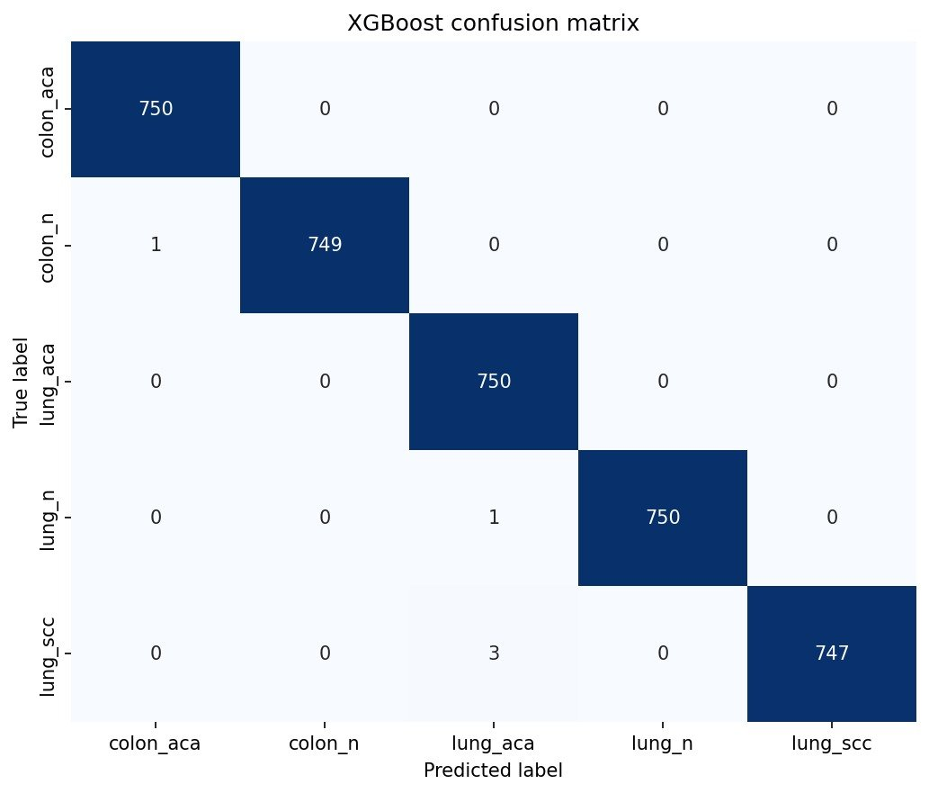
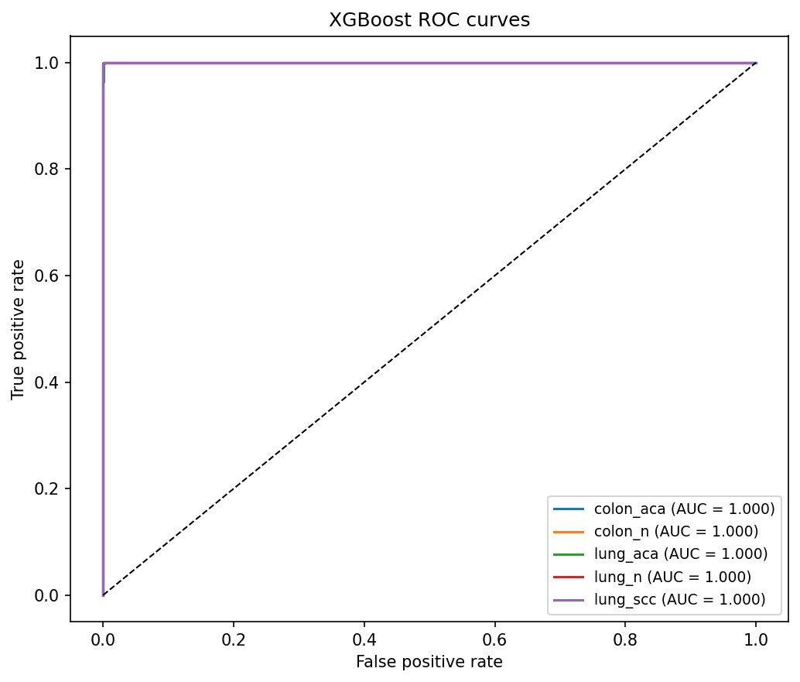
Results — XGBoost Confusion Matrix & ROC Curves
Confusion matrix: 3,750 test images. Errors concentrated in lung_aca ↔ lung_scc.
All five classes: AUC = 1.000. Curves overlap perfectly above the diagonal.
Notes:
Confusion matrix is nearly diagonal. ~5 misclassifications total. All ROC curves sit in the top-left corner. The AUC values in the legend all read 1.000. (~45 sec)

Slide 12
Explainability — Feature Importance and SHAP
Key findings
Colour features dominate at 82% — H&E staining differences are the primary discriminator.
Top feature: skewness of the red channel (color_RGB_c0_skew), capturing haematoxylin density asymmetry.
GLCM homogeneity is key for separating lung_aca from lung_scc — different cellular packing densities.
HOG edge features contribute <2% — global edge statistics add little beyond colour and texture.
Native importance and permutation importance give the same family ranking — consistent finding.
SHAP connects decisions to biology: colour → staining, GLCM → cell arrangement, LBP → micro-texture.
Notes:
The bar chart uses actual SHAP values. Walk through the key finding: colour explains 82%, connecting directly to what pathologists see. (~60 sec)

Slide 13
ML vs Deep Learning — Head-to-Head Comparison
Property | XGBoost | ResNet-50
Test Accuracy | 99.87% | 99.87%
AUC-ROC | 1.0000 | 0.9999
Training time | < 1 min CPU | Hours GPU
Hardware | CPU only | GPU recommended
Explainability | SHAP + importance | Grad-CAM (post-hoc)
Interpretability | High | Low (without tools)
Equal accuracy, lower cost, higher transparency. The ML pipeline is the better choice when explainability and resource constraints matter.
Notes:
Both models reach 99.87%. The difference is cost and transparency. The table column colours match the chart legend. (~60 sec)

Slide 14
Error Analysis
Where do the models fail?
Dominant error: lung_aca predicted as lung_scc and vice versa — consistent across all five models.
XGBoost misclassifies ~5 of 3,750 test images in total; almost all are the lung_aca ↔ lung_scc pair.
No systematic confusion between colon and lung classes, or between benign and malignant classes across organs.
The same pattern appears in the companion ResNet-50 pipeline — this is a data-level challenge, not a model weakness.
Root cause: genuine morphological overlap between glandular (aca) and squamous (scc) lung tissue at patch scale.
Implication: reducing this error would require higher-resolution nuclear morphology features or multi-scale descriptors that distinguish glandular from squamous cell structure.
Notes:
Key point: every model makes the same mistake. This tells us the confusion is in the biology at the patch level, not in the method. (~45 sec)

Slide 15
Lessons Learned
Split before fitting
Colour dominates histopathology
Cache expensive steps
Fitting the scaler or PCA before the train/test split inflates results. This was enforced strictly throughout the project.
H&E staining encodes biology directly. 82% of SHAP importance came from colour features — connecting the model to what pathologists see.
Feature extraction took ~90 minutes. Caching arrays to Drive meant all five model notebooks loaded in seconds.
Test dependencies early
Classical ML still competes
staintools and spams both fail on Colab Python 3.12. A custom NumPy/OpenCV Macenko was needed.
XGBoost with handcrafted features matched ResNet-50 at 99.87%. On clean, balanced data, the feature engineering gap is small.
Notes:
Pick 2–3 to speak to. Most important: split-before-fitting (methodology rigour) and colour dominance (scientific insight). (~60 sec)

Slide 16
Conclusion
What was achieved
A 421-feature classical ML pipeline classifies five tissue classes at 99.87% test accuracy — matching ResNet-50.
XGBoost with early stopping achieves this on CPU with a train-test gap of only 0.0013.
SHAP analysis shows colour features drive 82% of predictions, connecting the model to known H&E biology.
The main advantage over deep learning is explainability: decisions trace to named descriptors without post-hoc tools.
Future directions
Validate on multi-site datasets to assess robustness to scanner and staining variation.
Replace HOG with morphological/nuclear shape features for better biological grounding.
Explore hybrid pipelines combining handcrafted interpretability with deep representation learning.
Notes:
Summarise three numbers: 99.87% accuracy, 82% colour importance, 0.0013 gap. End with future directions. (~45 sec)

Slide 17
Thank You
Questions and Discussion
GitHub: github.com/hodyek/lung-colon-cancer-histopathology-ml
Dataset: Borkowski et al. (2019) — LC25000 — arXiv:1912.12142
Odyek Henry | 2025/HD07/26018U | Makerere University | MSB7216
Notes:
Leave time for questions. Be ready to discuss: (1) why XGBoost not RF — smaller gap; (2) improving lung_aca/scc — nuclear morphology features; (3) clinical deployment — needs prospective validation.

