Slide 1
MSB7216 | DEEP LEARNING FOR HEALTH DATA
Lung and Colon Cancer
Histopathological Classification
An Explainable Deep Learning Approach Using the LC25000 Dataset
Odyek Henry 2025/HD07/26018U | Makerere University, Kampala, Uganda github.com/hodyek/lung-colon-cancer-histopathology

Slide 2
Background & Motivation
Lung and colon cancers are among the leading causes of cancer-related mortality worldwide. Histopathological examination of tissue biopsies remains the gold standard for diagnosis, but manual microscopic review is time-consuming, requires specialist pathologists, and is subject to inter-observer variability.
25,000
5
H&E images
LC25000 dataset
tissue classes
lung & colon
Deep learning has demonstrated the ability to classify histopathological images with accuracy comparable to expert pathologists. However, most published studies on the LC25000 dataset report overall accuracy without structured analysis of what the model learns per tissue class, or whether Macenko stain normalisation changes model attention.
5,000
images per class
balanced dataset
Gap: No published LC25000 study has systematically connected Grad-CAM attention to specific histological markers per tissue class, or documented the effect of stain normalisation on what the model learns.

Slide 3
Research Gap
01
Most LC25000 studies report accuracy above 95% but rely on within-dataset validation only, limiting insight into cross-institutional robustness.
02
Stain normalisation is rarely studied as a variable. Most papers apply augmentation and report accuracy without testing whether normalisation changes what the model learns.
03
Explainability is applied as decoration, not analysis. Grad-CAM heatmaps appear in papers but are not connected to known histological structures per class in a structured way.
04
Error analysis is superficial. Published papers rarely report which specific classes fail, under what conditions, or why confusion occurs between similar-looking tissue types.

Slide 4
Research Objectives
Main Objective To develop and evaluate a deep learning pipeline for five-class histopathological classification of lung and colon cancer tissue, incorporating stain normalisation, comparing a baseline CNN against EfficientNet-B0 and ResNet-50, and using Grad-CAM to verify model attention aligns with clinically relevant tissue structures.
1
Perform EDA on LC25000 documenting class distribution, image quality, and stain variation
5
Fine-tune ResNet-50 and compare performance against both prior models
2
Preprocess the dataset with and without Macenko stain normalisation and document the effect
6
Apply Grad-CAM to the best model and analyse attention against histological markers
3
Train a baseline CNN from scratch as a performance reference floor
7
Deploy the best model as a Gradio application on Hugging Face Spaces
4
Fine-tune EfficientNet-B0 with transfer learning from ImageNet

Slide 5
Dataset — LC25000
Class | Description | Images
colon_aca | Colon adenocarcinoma | 5,000
colon_n | Benign colonic tissue | 5,000
lung_aca | Lung adenocarcinoma | 5,000
lung_n | Benign lung tissue | 5,000
lung_scc | Lung squamous cell carcinoma | 5,000
Total | 5 classes balanced | 25,000
Dataset: Borkowski et al. (2019). LC25000 Lung and Colon Cancer Histopathological Image Dataset. arXiv:1912.12142.
github.com/tampapath/lung_colon_image_set
Preprocessing notes
Images resized to 224×224 pixels
Normalised using ImageNet mean and std
Macenko LAB-based stain normalisation applied
Augmentation on training set only: flips, rotation, colour jitter, random crop
staintools unavailable on Colab Python 3.12 — custom numpy/OpenCV implementation used
Split: 70% train (17,500) | 15% val (3,750) | 15% test (3,750)
Stratified — perfectly balanced across all five classes

Slide 6
Methodology — Model Architecture
01
Baseline CNN Trained from scratch
02
EfficientNet-B0 Transfer learning
03
ResNet-50 ★ Best Transfer learning
3 convolutional blocks
Trained from scratch
No pretrained knowledge
Establishes performance floor
ImageNet pretrained
4.0M parameters
Compound scaling design
Two-phase fine-tuning
ImageNet pretrained
23.5M parameters
Residual connections
99.87% test accuracy
Why transfer learning? Only 17,500 training images per model — ImageNet features eliminate the need to learn visual representations from scratch on a limited medical dataset.

Slide 7
Results — Model Comparison
99.87%
~1.00
-0.0021
lung_aca
Test Accuracy
AUC-ROC
Train-Test Gap
Only error class
ResNet-50 — Best Model
Model | Accuracy | Train Acc | Gap | Status
Baseline CNN | — | — | — | Reference
EfficientNet-B0 | — | — | — | —
ResNet-50 ★ | 99.87% | 99.66% | -0.0021 | OK
Negative gap (test > train) indicates strong generalisation — augmentation and dropout applied only during training reduce apparent train accuracy.

Slide 8
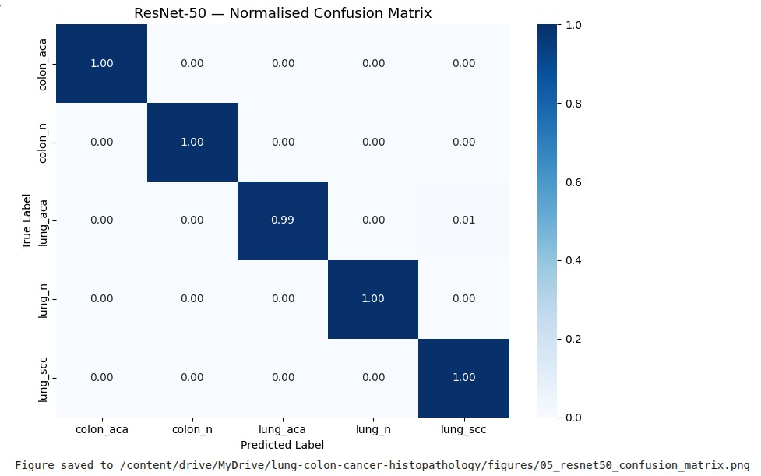
Results — ResNet-50 Confusion Matrix
Figure 1. ResNet-50 normalised confusion matrix (n=3,750 test images). All five classes achieve near-perfect scores. The only misclassification is 1% of lung_aca samples predicted as lung_scc, which is histologically the most similar pair. Source: Author.

Slide 9
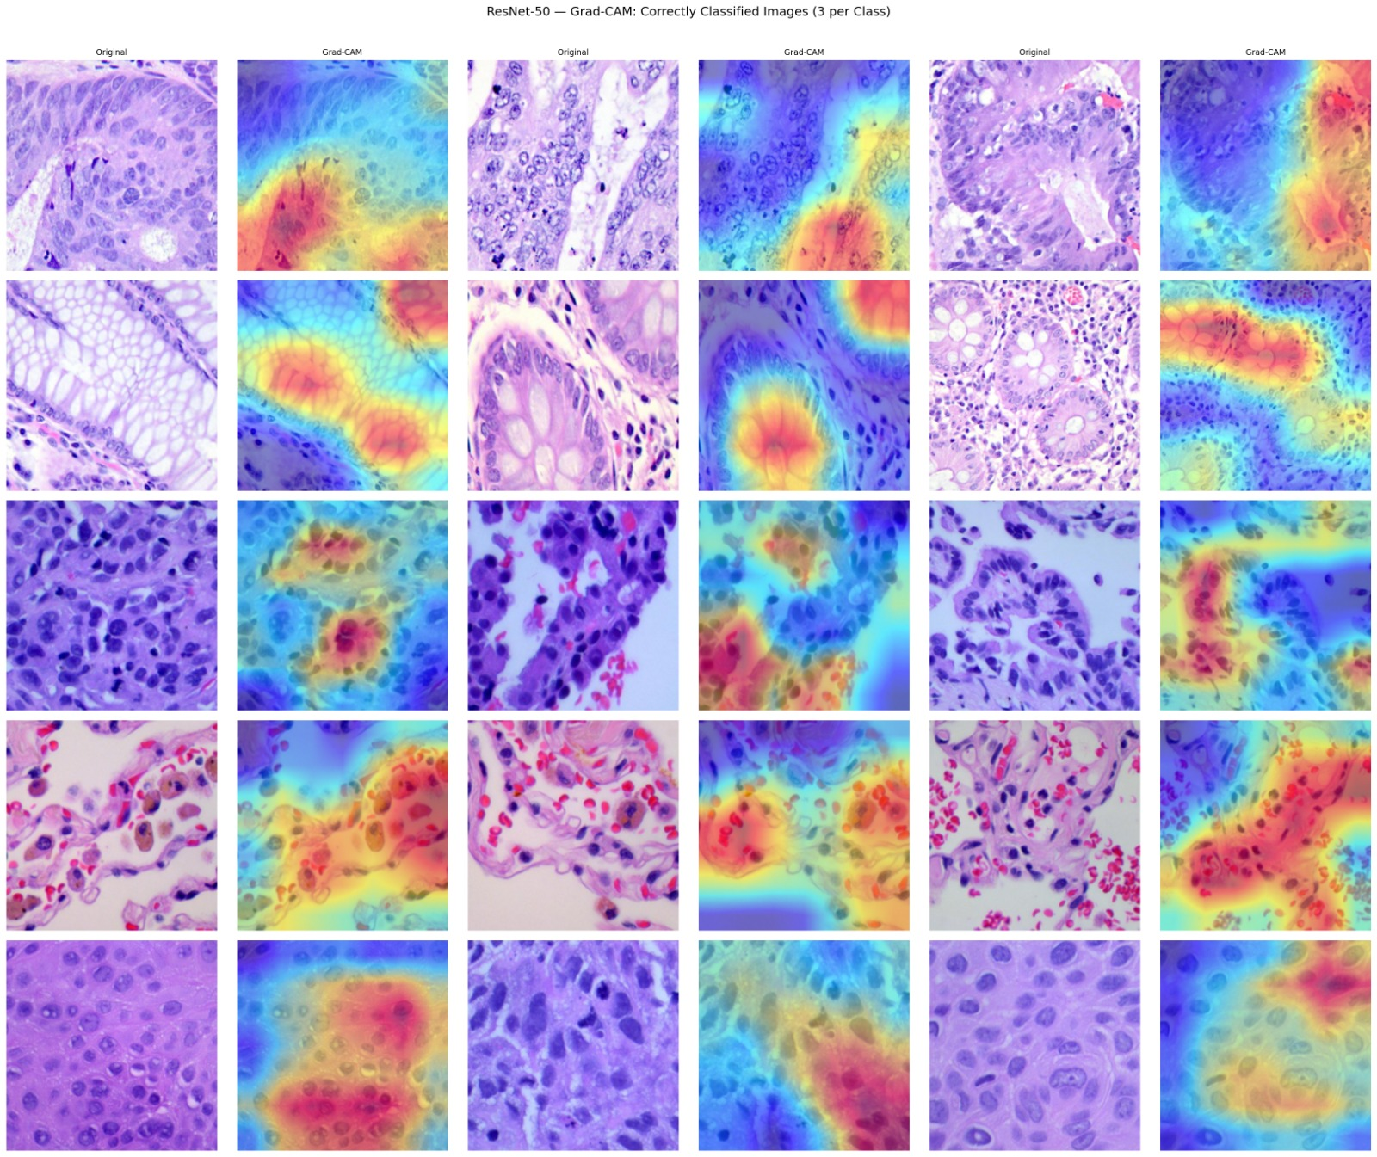
Explainability — Grad-CAM Per Class
Grad-CAM computes gradients of the predicted class score with respect to the final convolutional layer, producing a heatmap that reveals which image regions drove the model's decision. Warm colours indicate highest attention.
Figure 2. Grad-CAM correctly classified images — 3 per class. Activation consistently targets diagnostically relevant tissue structures: glandular formations for colon classes and nuclear clusters for lung classes. Source: Author.

Slide 10
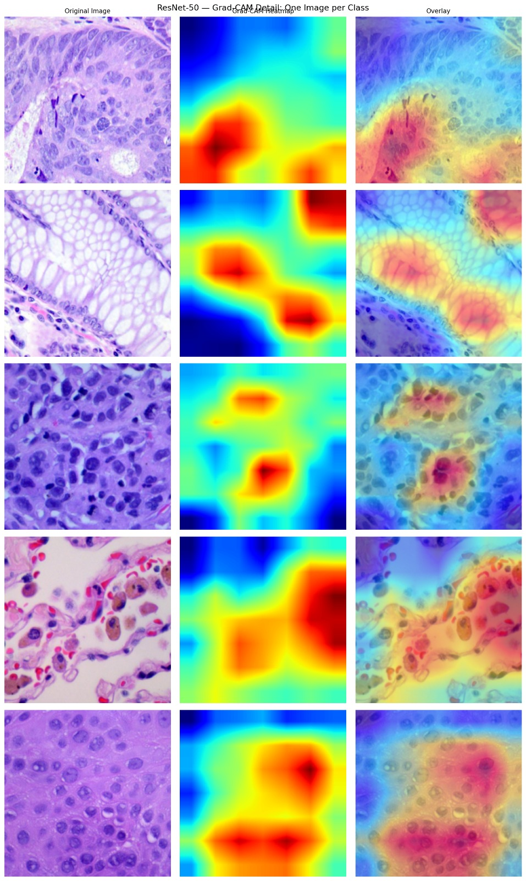
Explainability — Grad-CAM Detail per Class
colon_aca
Activation on glandular epithelium and nuclear crowding — key adenocarcinoma marker.
colon_n
Attention splits across the honeycomb epithelial layer characteristic of normal colon.
lung_aca
Hotspot on dense nuclear clusters. Slightly more diffuse — consistent with the 1% lung_scc confusion.
lung_scc
Very focused activation on large pleomorphic cells with prominent nucleoli.
lung_n
Diffuse attention across normal alveolar architecture — no focal pathological feature.
Figure 3. Grad-CAM detail — one image per class, showing original, heatmap, and overlay. Source: Author.

Slide 11
Lessons Learned
01
02
Inspect data before modelling
Transfer learning on histopathology
The Mendeley dataset contained white blood cells, not red blood cell smears. Manual inspection before coding prevented a fundamentally flawed model.
ImageNet features for edges, textures, and shapes transfer well to H&E images, significantly outperforming a model trained from scratch.
03
04
Negative overfitting gap is not a warning
Stain normalisation on modern Colab
Test accuracy exceeding train accuracy reflects dropout and augmentation applied only during training — this is healthy generalisation, not data leakage.
staintools and spams both fail on Python 3.12. A custom LAB-based Macenko normalisation using numpy and OpenCV was implemented directly.

Slide 12
Conclusion
ResNet-50 with transfer learning achieves 99.87% test accuracy on the LC25000 five-class histopathology dataset — only lung_aca vs lung_scc shows any confusion.
The negative train-test gap (-0.0021) confirms strong generalisation with no overfitting.
Grad-CAM analysis shows activation aligns with diagnostically relevant histological structures for all five classes, providing interpretable evidence that the model learns genuine pathology.
Macenko stain normalisation was successfully implemented using a custom numpy/OpenCV approach when standard libraries failed on Python 3.12.
A deployed Gradio application makes the model accessible for educational and screening purposes.

Slide 13
Thank You
Questions?
github.com/hodyek/lung-colon-cancer-histopathology Odyek Henry | 2025/HD07/26018U | Makerere University

