Slide 1

Machine Learning
Dr. Matthias Hölzl
Notes:
Welcome back to the Machine Learning course for programmers.
In previous sections we have seen approaches to machine learning that might be called “traditional” ML, such as linear and logistic regression, decision trees or random forests.
But if you are following academic conferences – or even the news on TV – you’ll surely be aware that a lot of the recent advances in the area are due to so-called deep learning techniques, or deep learning models.
In this section of the course, we want to understand what deep learning is, what its advantages and disadvantages over the methods we already know are, in which scenarios you might want to employ deep learning and when you’re probably better off sticking with traditional methods.
And obviously we want to get a lot of practical experience with frameworks specialized for deep learning tasks.

Slide 2
Overview
Traditional and Deep Learning

Slide 3
Contents
Programming vs. modeling
Machine-learning workflows: Traditional ML and Deep Learning
Choosing the right ML model
Notes:
In this lecture we’ll continue, by looking at three topics:
We’ll revisit the differences and similarities between programming and modelling,
We’ll look at machine-learning workflows and how they differ between deep learning approaches and traditional approaches. (Spoiler alert: they are mostly the same, but there are some topics that we glossed over so far that become more important with deep learning.)
And finally, we’ll discuss in which scenarios you might want to use a deep learning model and when a traditional model might be more appropriate.
We clearly won’t be able to answer that last question in a definite way – a lot of the experience you gain as an ML engineer will actually be concerned with this kind of topic – but I want to give you at least a rule of thumb that you can use as a starting point.

Slide 4
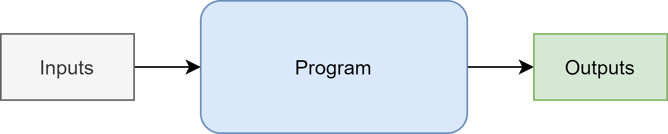
Program vs. Model

Slide 5
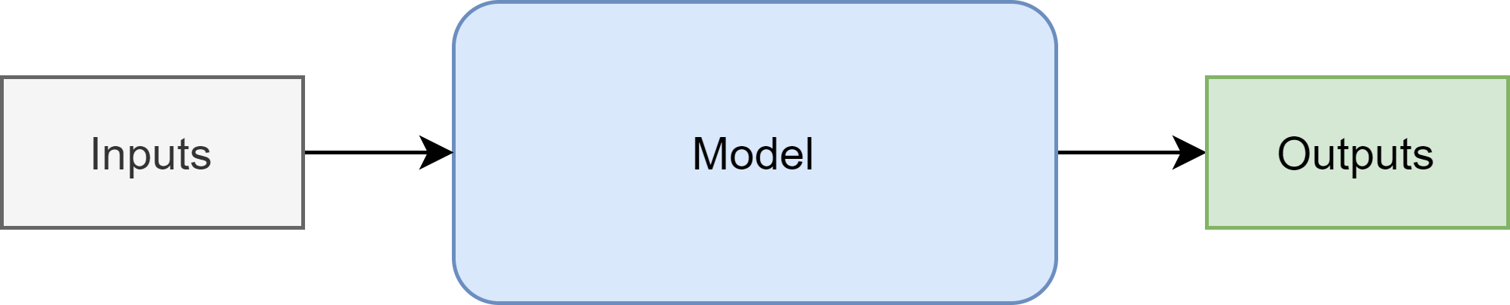
Program vs. Model

Slide 6
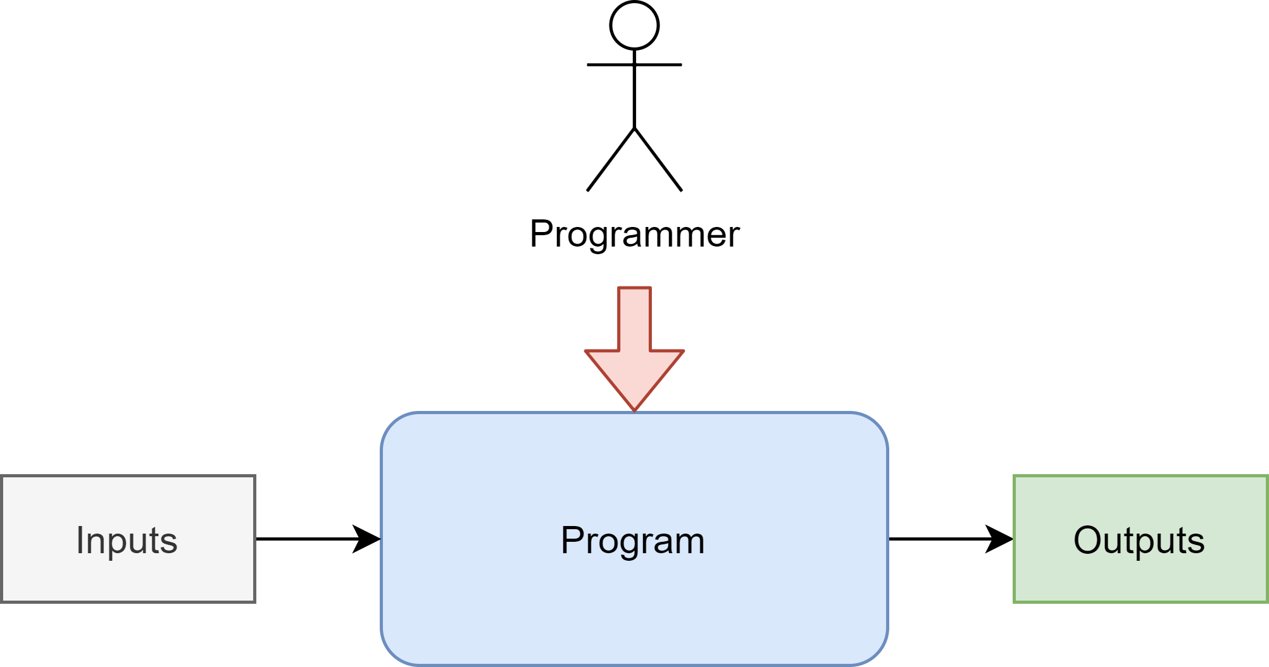
Program vs. Model

Slide 7
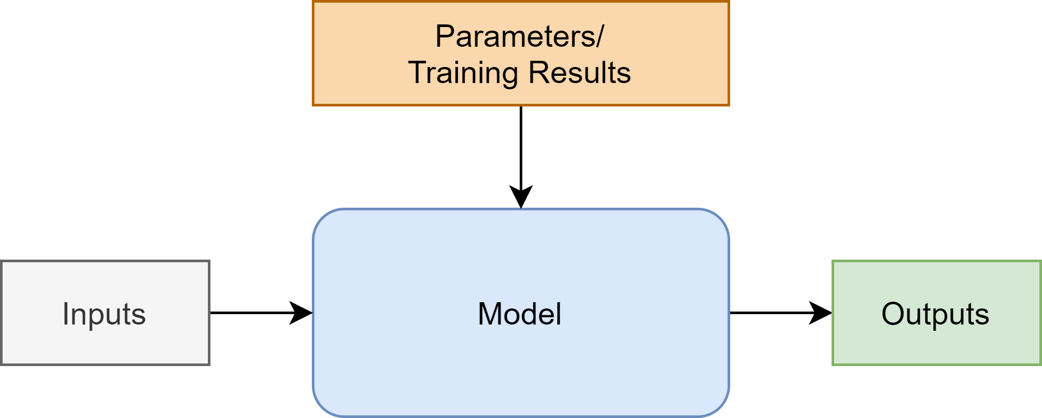
Program vs. Model

Slide 8
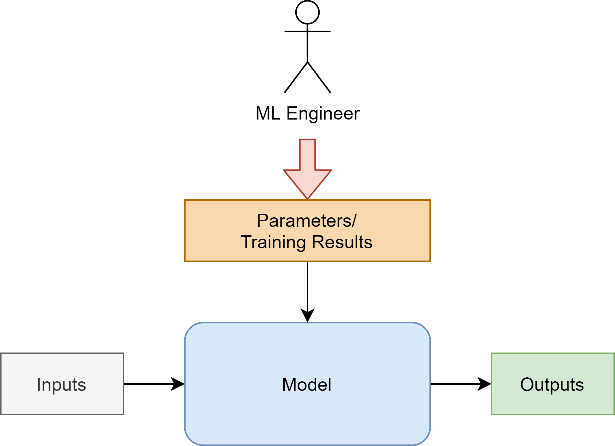
Program vs. Model

Slide 9
ML Workflow
x_train, x_test = split_data()
y_train, y_test = split_expected()
model = RandomForestRegressor( n_estimators=100, max_depth=3, criterion=“mse” )
model.fit(x_train, y_train)
predictions = model.predict(x_test)
Traditional Models
(Random Forest)

Slide 10
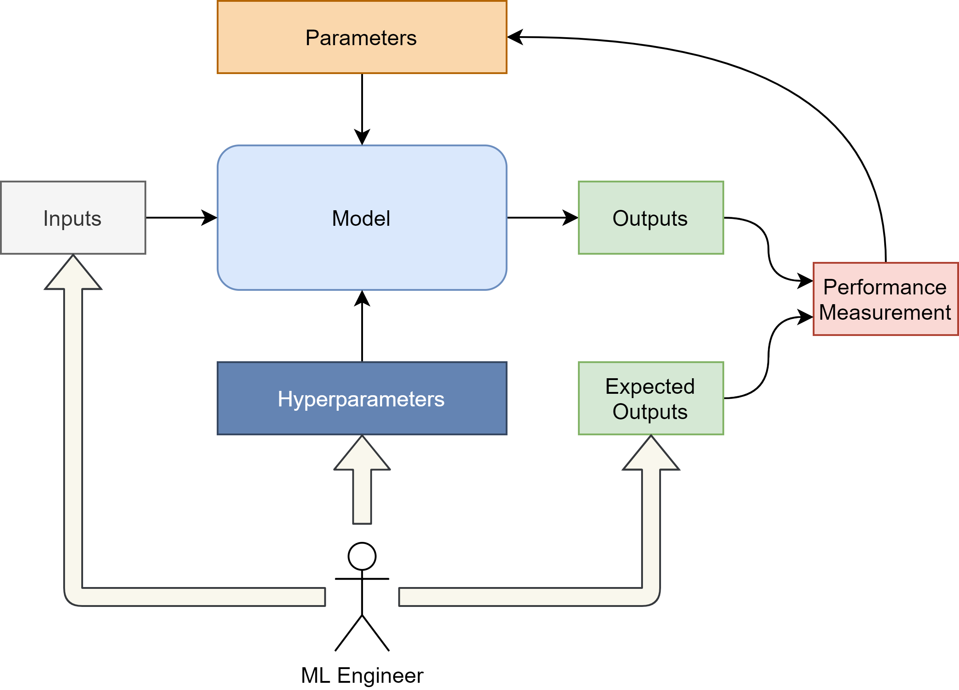
ML Workflow
Traditional Models

Slide 11

ML Workflow
Deep Learning

Slide 12
Building a Program
Notes:
That’s simple, you simply build the program
(in whichever language, libraries etc.)

Slide 13
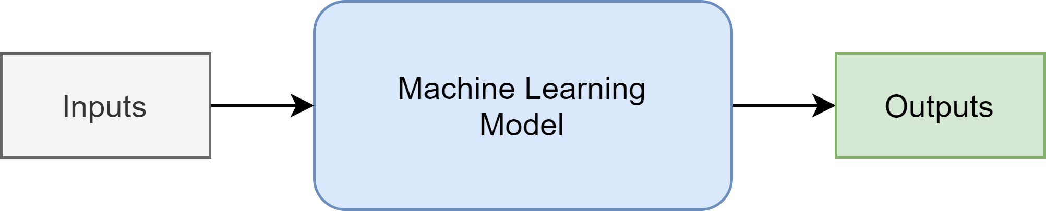
Choosing an ML model
Notes:
But for models the question is

Slide 14
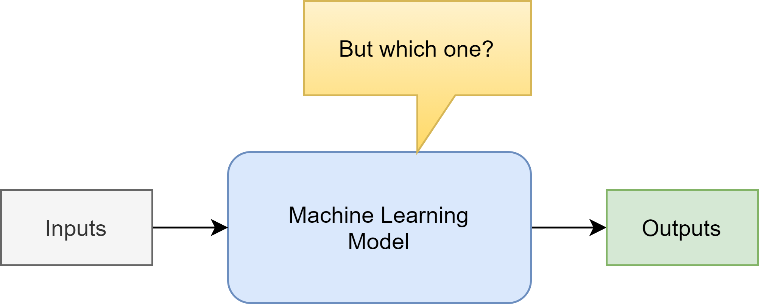
Choosing an ML model

Slide 15
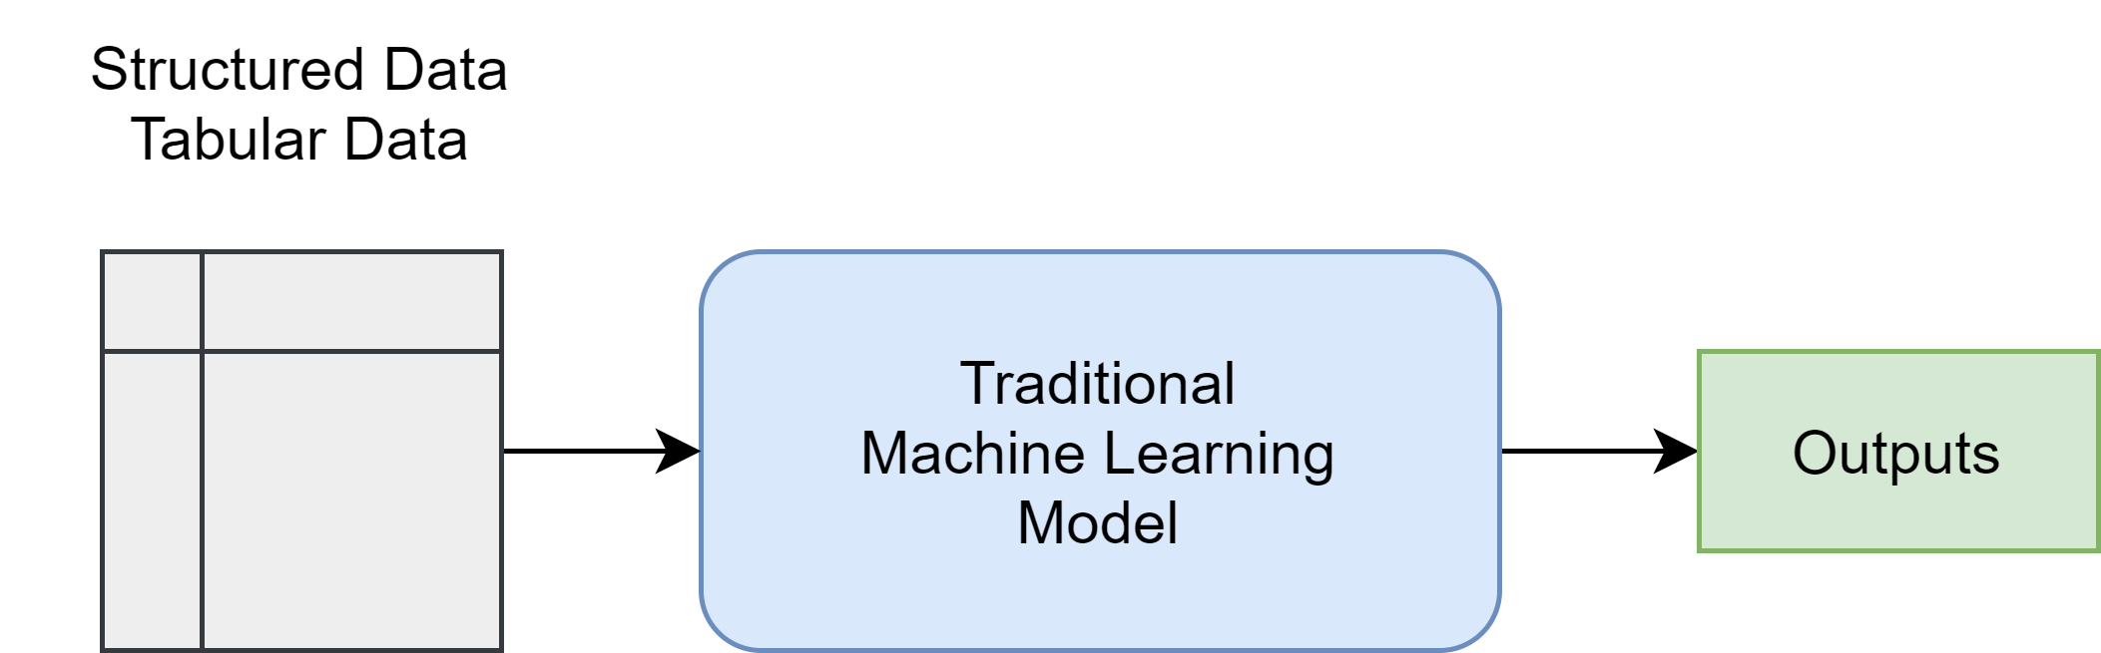
Choosing an ML model

Slide 16
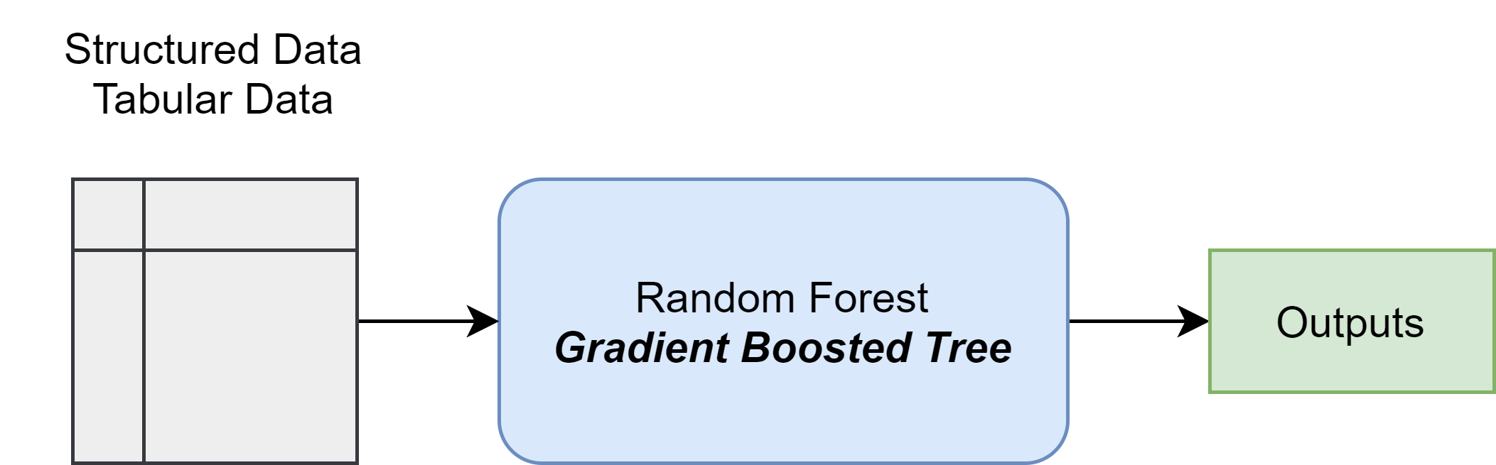
Choosing an ML model

Slide 17
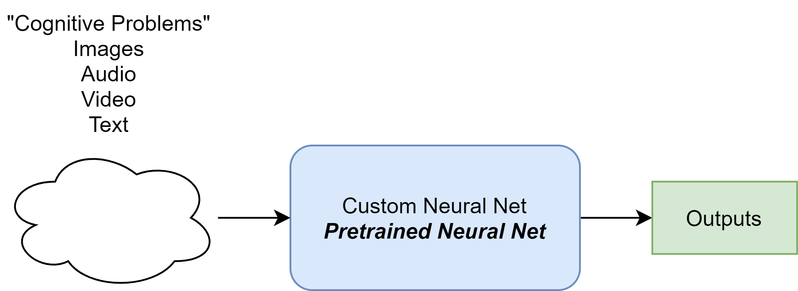
Choosing an ML model

Slide 18
Let’s dig deeper…

