Slide 1

Basics of Machine Learning
Dr. Matthias Hölzl
Notes:
Welcome back to the Machine Learning course for programmers.
In previous sections we have seen approaches to machine learning that might be called “traditional” ML, such as linear and logistic regression, decision trees or random forests.
But if you are following academic conferences – or even the news on TV – you’ll surely be aware that a lot of the recent advances in the area are due to so-called deep learning techniques, or deep learning models.
In this section of the course, we want to understand what deep learning is, what its advantages and disadvantages over the methods we already know are, in which scenarios you might want to employ deep learning and when you’re probably better off sticking with traditional methods.
And obviously we want to get a lot of practical experience with frameworks specialized for deep learning tasks.

Slide 2
Overview
How does machine Learning work?

Slide 3
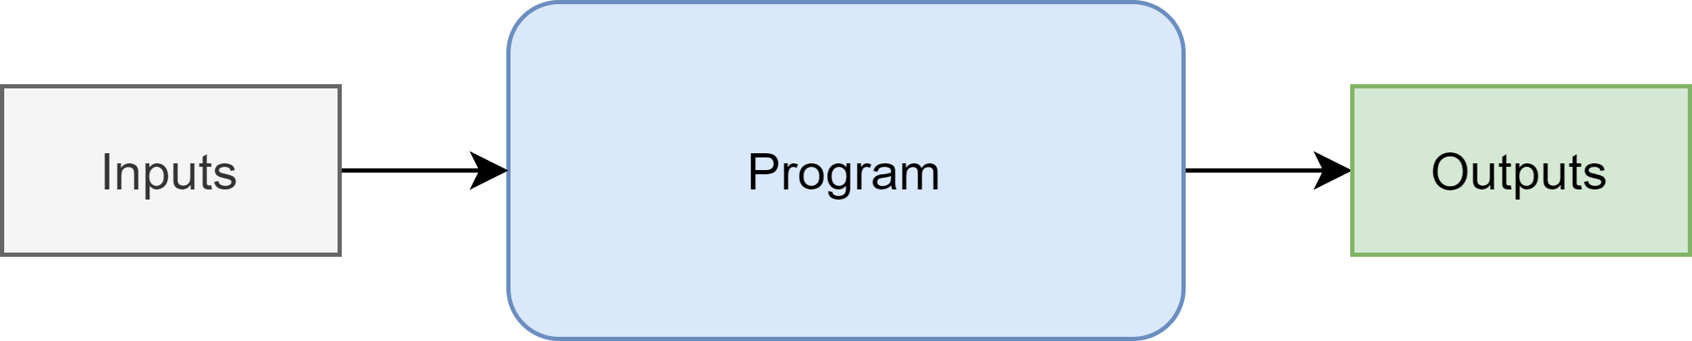
Program vs. Model

Slide 4
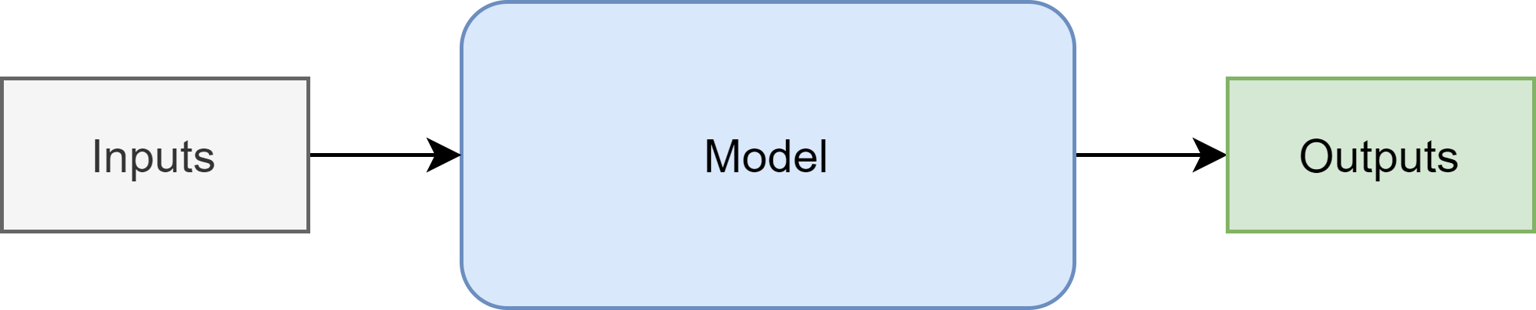
Program vs. Model

Slide 5
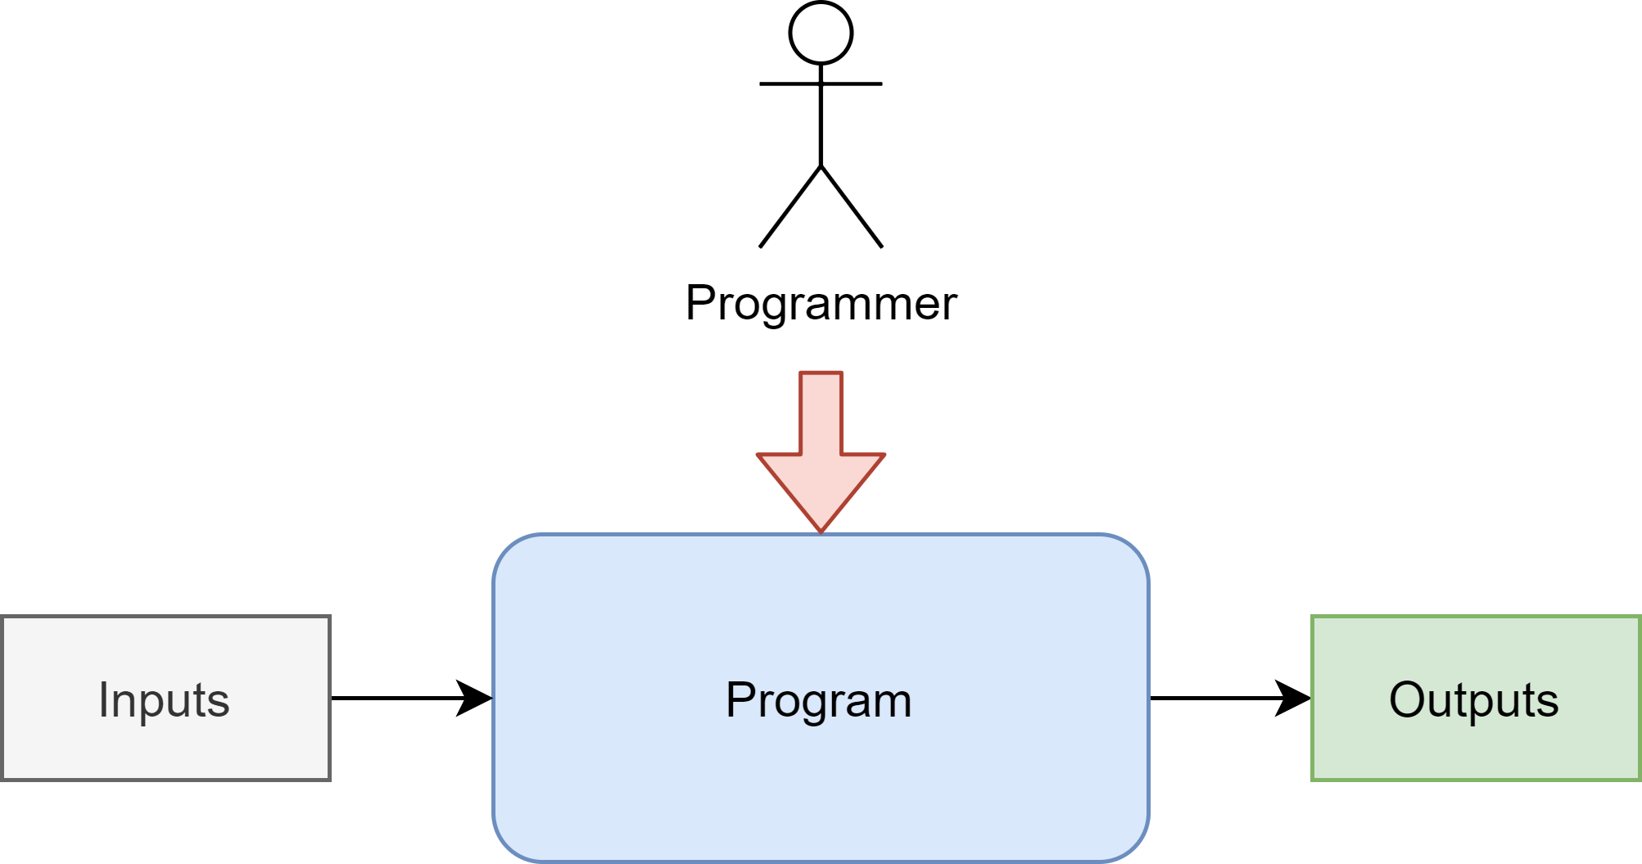
Program vs. Model

Slide 6
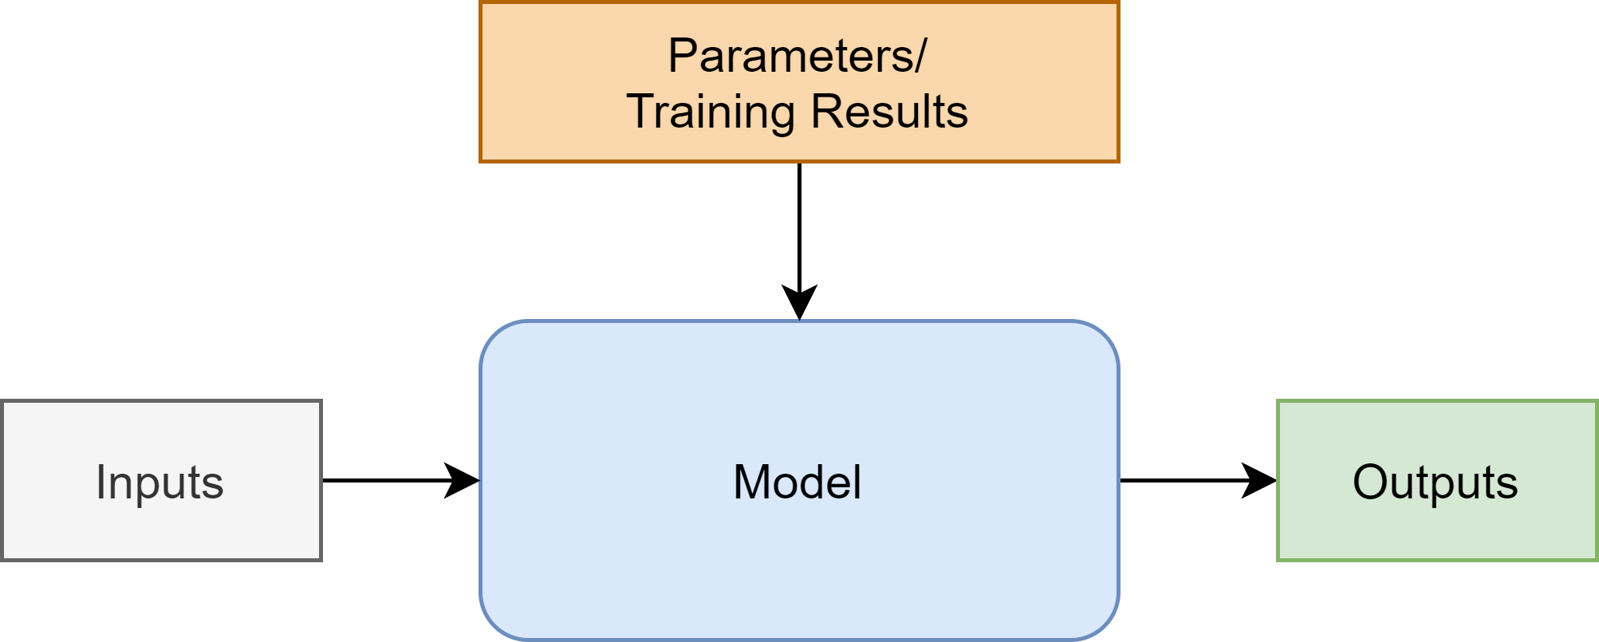
Program vs. Model

Slide 7
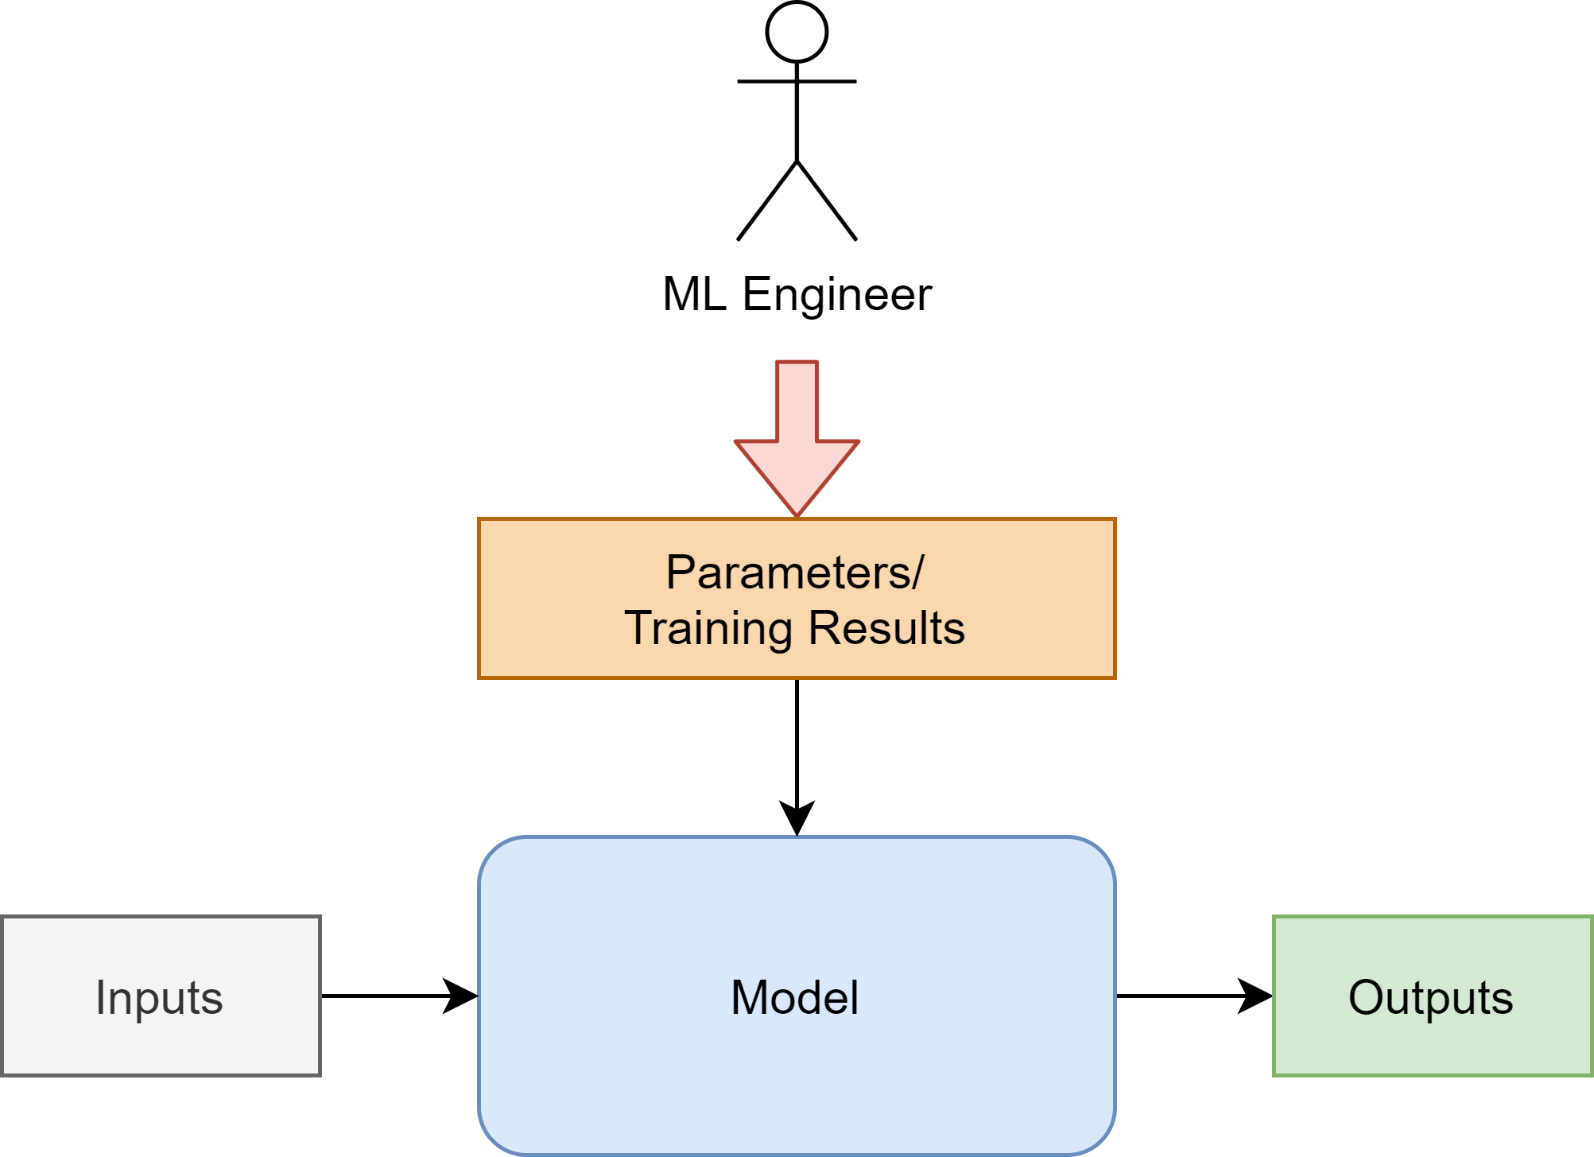
Program vs. Model

Slide 8
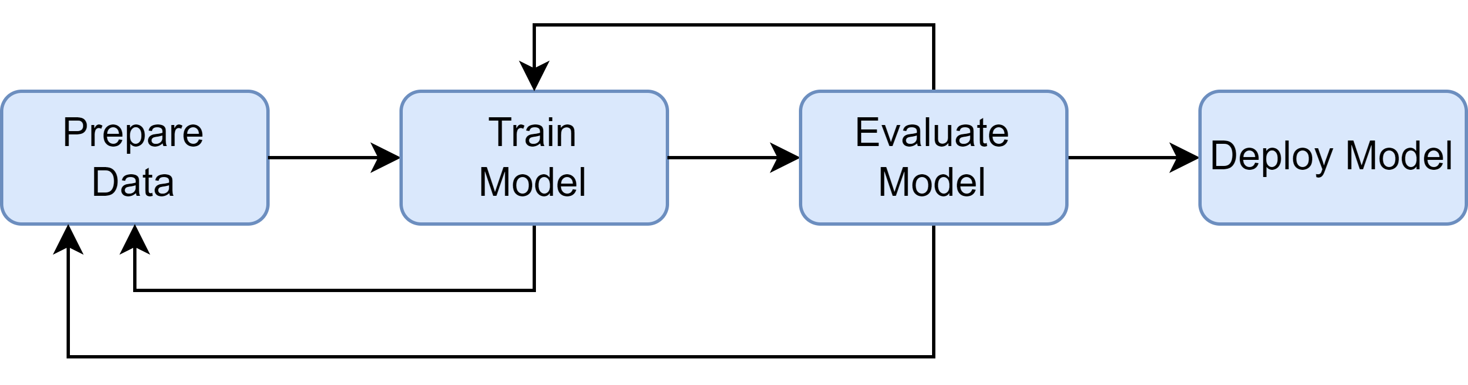
Machine Learning Workflow

Slide 9
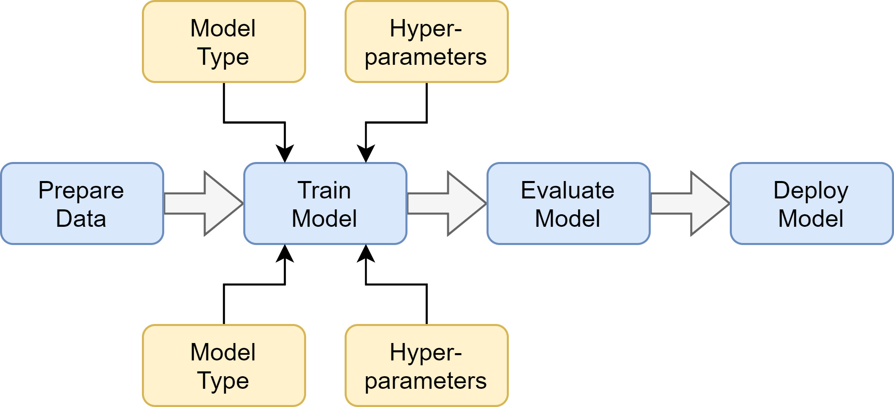
Machine Learning Workflow

Slide 10
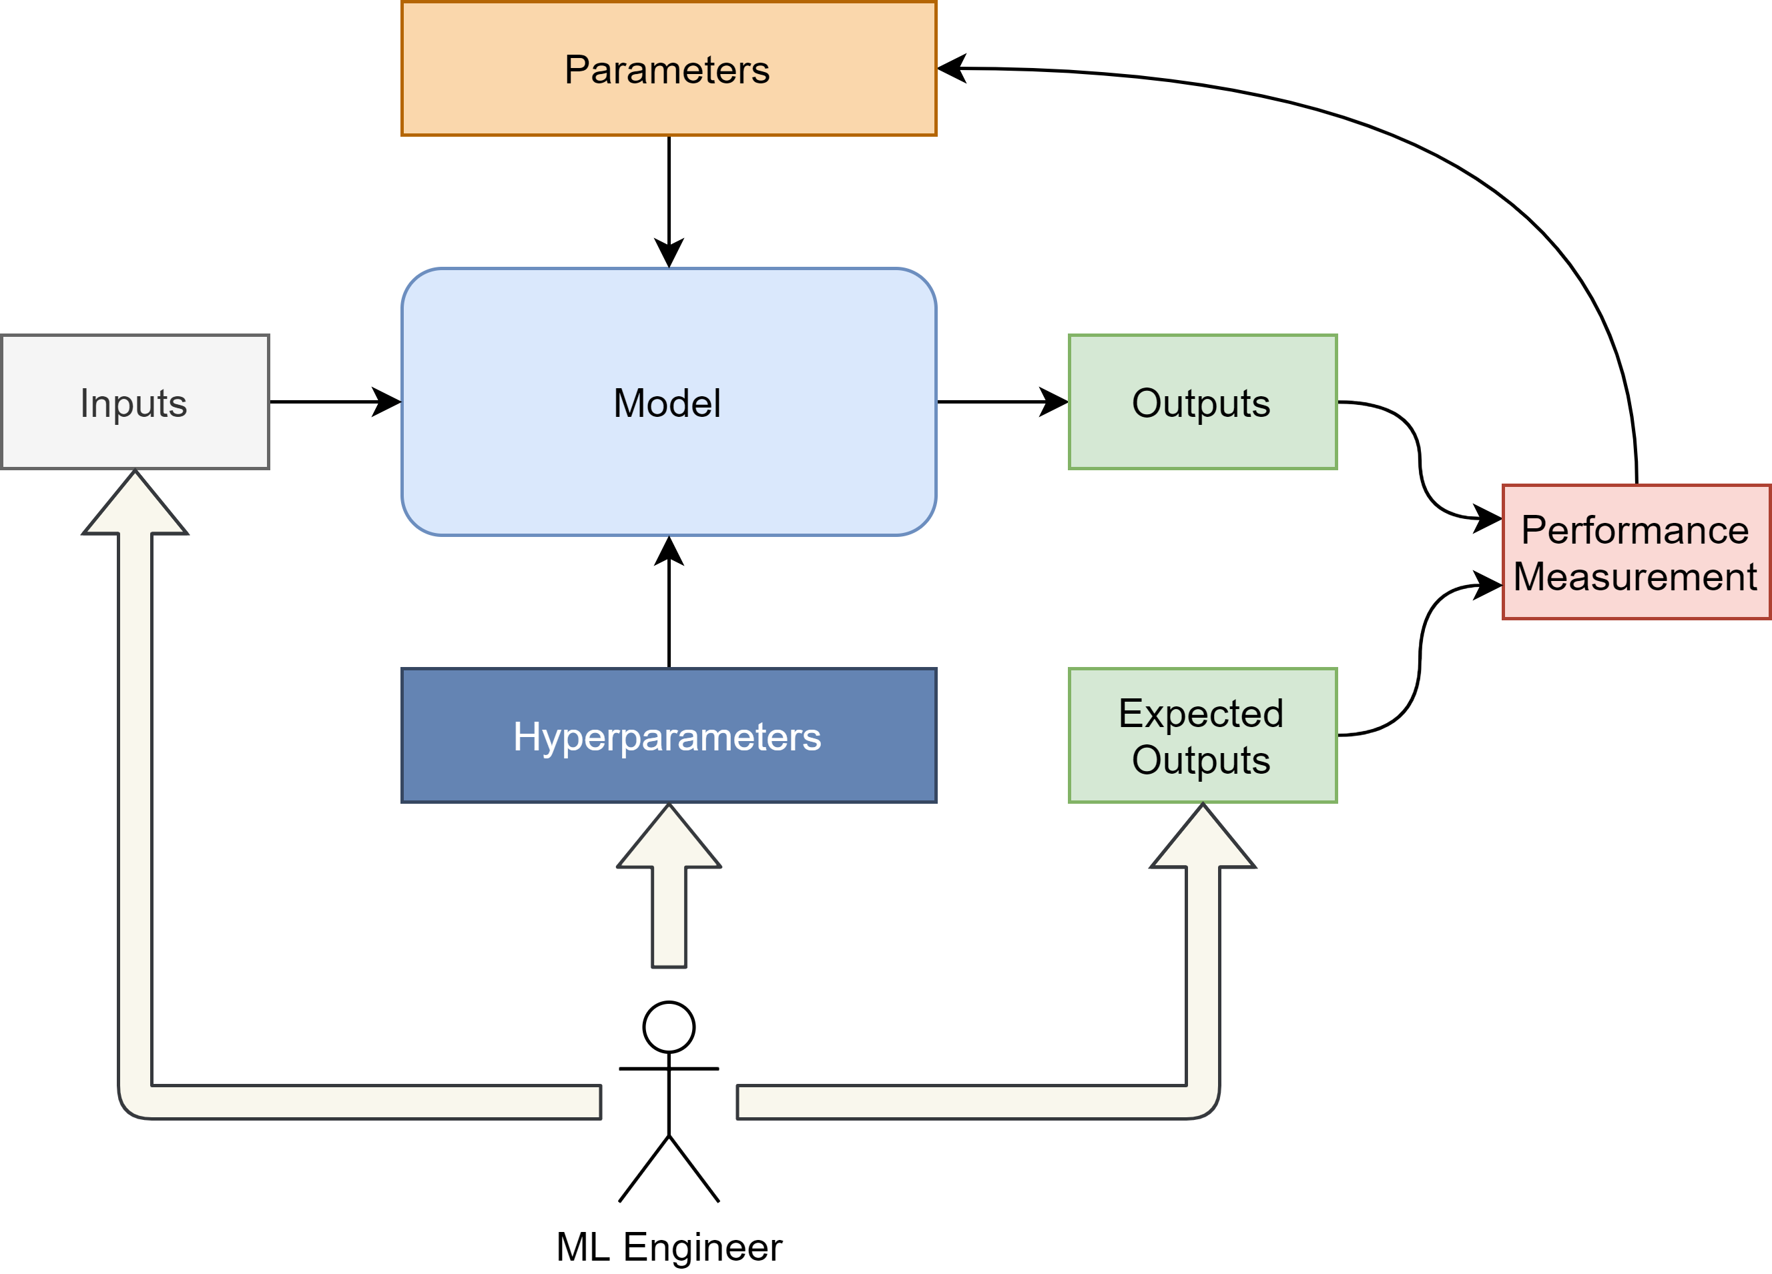
ML Workflow
Traditional Models

Slide 11
ML Workflow
x_train, x_test = split_data()
y_train, y_test = split_expected()
model = RandomForestRegressor( n_estimators=100, max_depth=3, criterion=“mse” )
model.fit(x_train, y_train)
predictions = model.predict(x_test)
Traditional Models
(Random Forest)

Slide 12

ML Workflow
Deep Learning

Slide 13
Building a Program
Notes:
That’s simple, you simply build the program
(in whichever language, libraries etc.)

Slide 14
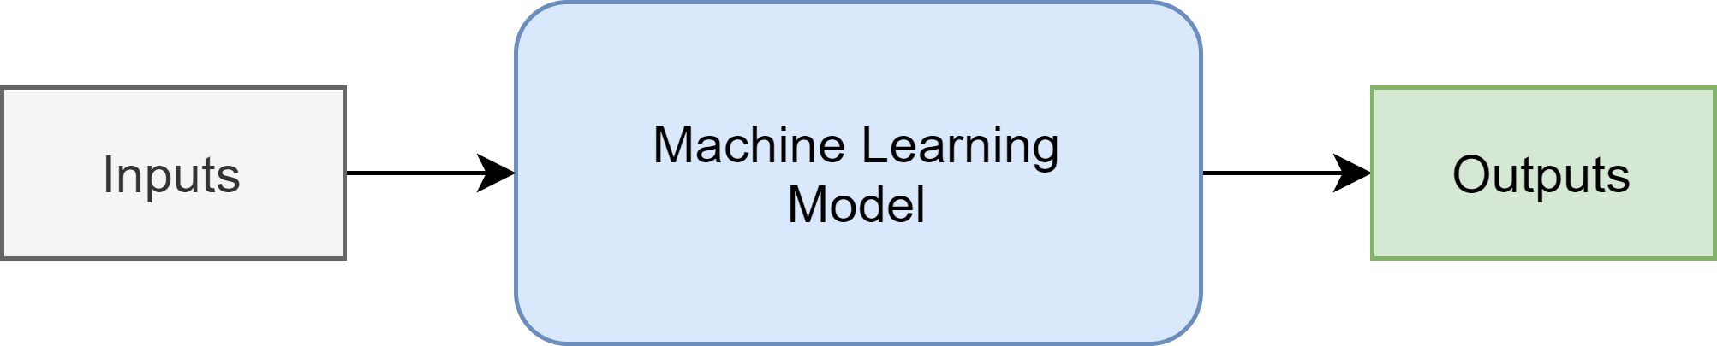
Choosing an ML model
Notes:
But for models the question is

Slide 15
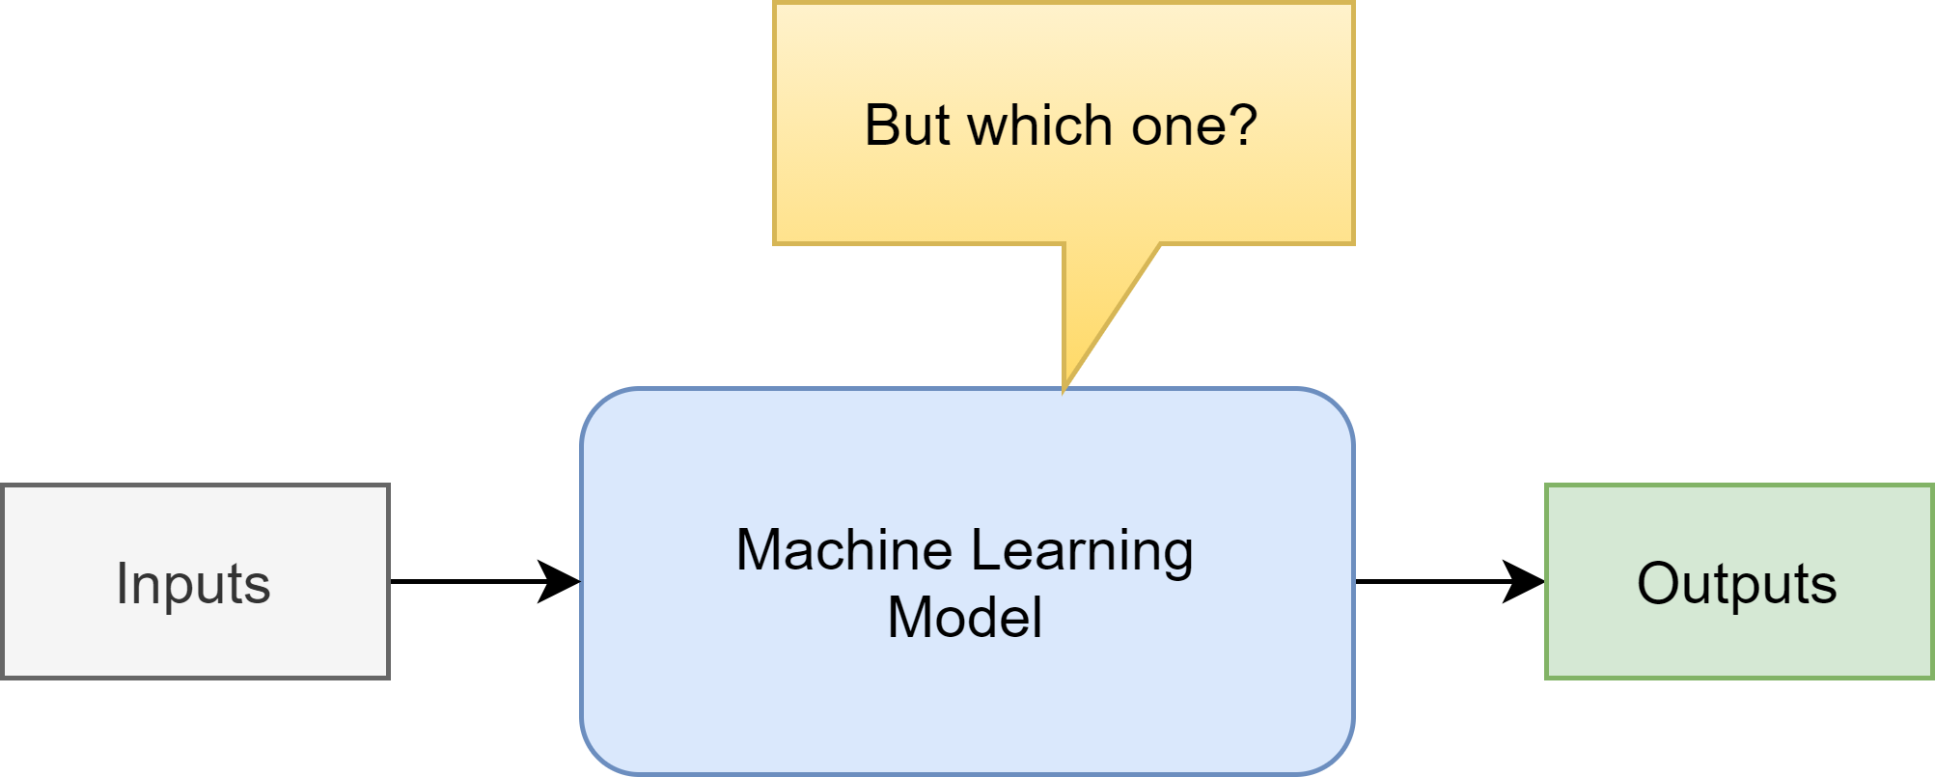
Choosing an ML model

Slide 16
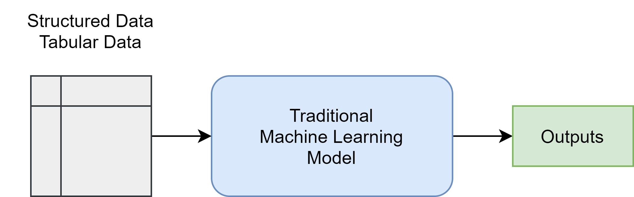
Choosing an ML model

Slide 17
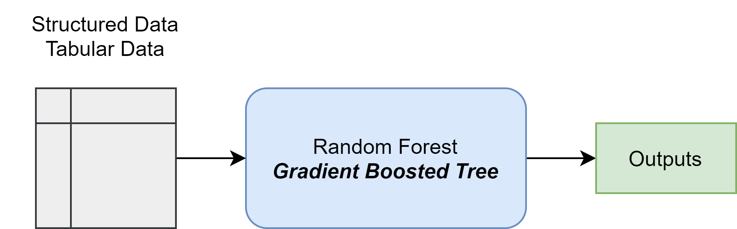
Choosing an ML model

Slide 18
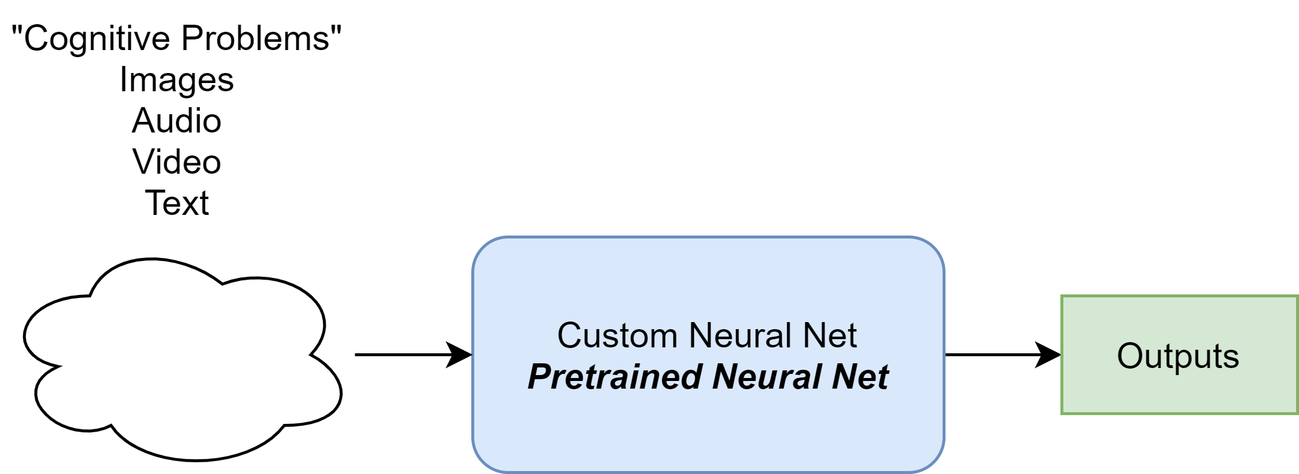
Choosing an ML model

Slide 19
Let’s dig deeper…

