Slide 1
PowerLoom Overview, Features and Examples
Hans Chalupsky
Project Leader, USC/ISI Loom KR&R Group

Slide 2
Overview
Logic-based KR&R
  What is it, advantages, disadvantages
PowerLoom
  Quick overview
  Basic features
  Tutorial
  Advanced features relevant for scientific reasoning
  Debugging failed inferences
Conclusion

Slide 3
Logic-Based Knowledge Representation
& Reasoning

Slide 4
Logic-Based KR&R
Knowledge Representation & Reasoning
  Studies a wide variety of paradigms & algorithms for
    Modeling salient aspects of a world of interest
    Reasoning with such models
There are many different modeling paradigms
  Logic-based, frame-based, graph-based, probabilistic, etc.
PowerLoom is a logic-based KR&R system
How do logic-based models represent the world?

Slide 5
Logical Models 101
“Real” World
Logical Model
Terms represent entities:
Joe, car002
Joe Blow
denotes
Predicates represent relations:
owns
Sentences represent what is true in the world (facts):
(Person Joe)
(= (age Joe) 17)
(Car car002)
(owns Joe car002)
(model car002 Ford)
(not (rich Joe))
owns
Joe’s Ford
Rules define terms and represent domain regularities:
(<=> (and (> (age ?x) 12) (< (age ?x) 20)
(Teenager ?x))
(=> (and (Teenager ?x) (car ?y) (owns ?x ?y))
(happy ?x))
Facts + rules + inference derive concluded facts:
(Teenager Joe)
(happy Joe)

Slide 6
How Does Logic Model the World?
Terms correspond to entities in the (some) world
Predicates model properties and relations between entities
Domain rules define and constrain relations, for example,
“If Joe is a teenager who owns a car then Joe is happy”
Logical inference rules define the propagation of truth between logical sentences, for example:
from X and X => Y it must be true that Y
The more rules and sentences we add, the higher constrained their “interpretation” (what they could mean) becomes
However, every consistent theory always has infinitely many (formal) interpretations

Slide 7
Advantages of Logic-based Models
Tradition
  Well-understood syntax and semantics
  Very large amount of relevant research (> 2000 yrs.)
  Many available logic-based tools
    Provers, constraint reasoners, learners, planners, KR&R systems, etc.
Representational power
  Negation
  Disjunction
  Equality (object identity)
  Logical connectives
  Quantification
  Rules, constraints
  Abstraction
  Definitions
  Extendable vocabulary, ontologies
  “If you can’t say it in logic, you probably don’t want to say it”

Slide 8
Advantages of Logic-based Models
General purpose, well-understood inference mechanisms
  Deduction
  Abduction
  Induction
  Constraint satisfaction
  Automated reasoners

Slide 9
Advantages of Logic-based Models
Formalizes reasoning and gives justification
  Proofs provide justifications for derived facts
  If one accepts the premises one must/should accept the conclusions
Explanation and understandability
  Proofs are a good starting point to provide explanations
  Logical models are “easy” to understand and interpret (e.g., rules learned by an ILP method)
  Logical models are easier to debug than other approaches
Translatability
  Different logical representations are (often) easily translatable into each other (e.g., this diffuses the attribute-vs.-collection distinction)

Slide 10
Disadvantages?
Disadvantages
  Difficult to handle uncertainty and probabilistic reasoning
    But, various efforts to combine logical and probabilistic models (e.g., PRM’s)
  Complexity of reasoning algorithms
  Sometimes too expressive, too many different ways of saying the same thing
  Hard to handle grey areas, but the world is grey
    Have to make hard decisions (true, false)
    Hard to say “many”, “few”, “nearly”, etc. (frustrates NLP people)

Slide 11
PowerLoom

Slide 12
PowerLoom KR&R System
Successor to the successful Loom KR&R system with
  More expressive representation language
  Less arcane syntax
  Better scalability
  Better portability & extensibility (available in Lisp, C++, Java)
Based on first-order predicate logic
Not a description logic but has description logic features
  E.g., classifier, type and cardinality reasoning, subsumption
Focus on expressivity + scalability
Pragmatic stance
  Usability is more important than theoretical “neatness”
  Expressivity is more important than inferential completeness

Slide 13
Expressivity vs. Inferential Completeness
Qualitative comparison of KR-system philosophies
  Description logics: restricted expressivity, sound, complete, tractable
  PowerLoom: representationally promiscuous, sound, 80/20 complete & tractable (handle most expected inferences in reasonable time)
What we need to express
Expressible in
Description Logic
Expressible in
PowerLoom
Inferable in
PowerLoom
Inferable in
Description Logic

Slide 14
Inference Capabilities
Query engine to retrieve asserted and inferable statements
Prolog-style backward inference enhanced by
  Recursive subgoal detection
  Proper handling of negation
  Hypothetical reasoning
  Resource-bounded depth-first or iterative deepening search
  Proof tree (justification) recording
Forward inference and simple constraint propagation
Equality and inequality reasoning
Subsumption reasoning + relation & instance classification
Partial match for reasoning with incomplete information
“WhyNot” abductive inference for query diagnosis
Extensible reasoning specialists architecture

Slide 15
Knowledge Base Management
Incremental monotonic and non-monotonic updates
  Interleave definitions, assertions, retractions with retrieval and inference
  Truth maintenance via inference caches
Context mechanism
  Separate name and assertion spaces with inheritance
  Provides powerful structuring mechanism for KBs
  Facilitates scenarios and hypothetical reasoning
Simple load and save KB mechanism via files
  Experimental RDBMS persistence in the works

Slide 16
Built-in Ontologies
PL-KERNEL-KB
  Minimal upper level that defines the core representational vocabulary
    Relation, concept, function, set, holds, proposition, range-cardinality,…
  Emphasis on minimality
    Represent what’s absolutely necessary to make PowerLoom work
    The less it contains, the less opportunities for modeling conflicts there are when preexisting ontologies get imported
    Not yet minimal enough, various things still need to be extracted into their own loadable ontology
Other available ontologies
  Small time ontology: supports time points, durations, temporal arithmetic
  Units ontology: units support loadable on demand
  Various translations of upper models (e.g., Cyc, SENSUS), application ontolgies (e.g., EELD, Seismology, …)

Slide 17
Tools and APIs
Ontosaurus KB browser
  Web-based, dynamic generation of HTML pages viewable in standard browser
PowerLoom GUI
  Java-based browse/edit/query environment
  Client/server based, deployable via Java WebStart in standard browser
Interactive command-line interface
Programmatic PowerLoom Interface (PLI)
  Lisp, C++ and Java bindings
Lisp-based Loom API
  Facilitates import of legacy Loom KBs
OntoMorph translation system
  Facilitates import of KBs in other languages (e.g. Flogic)
Initial Semantic Web support
  Import translator for RDF/RDFS

Slide 18
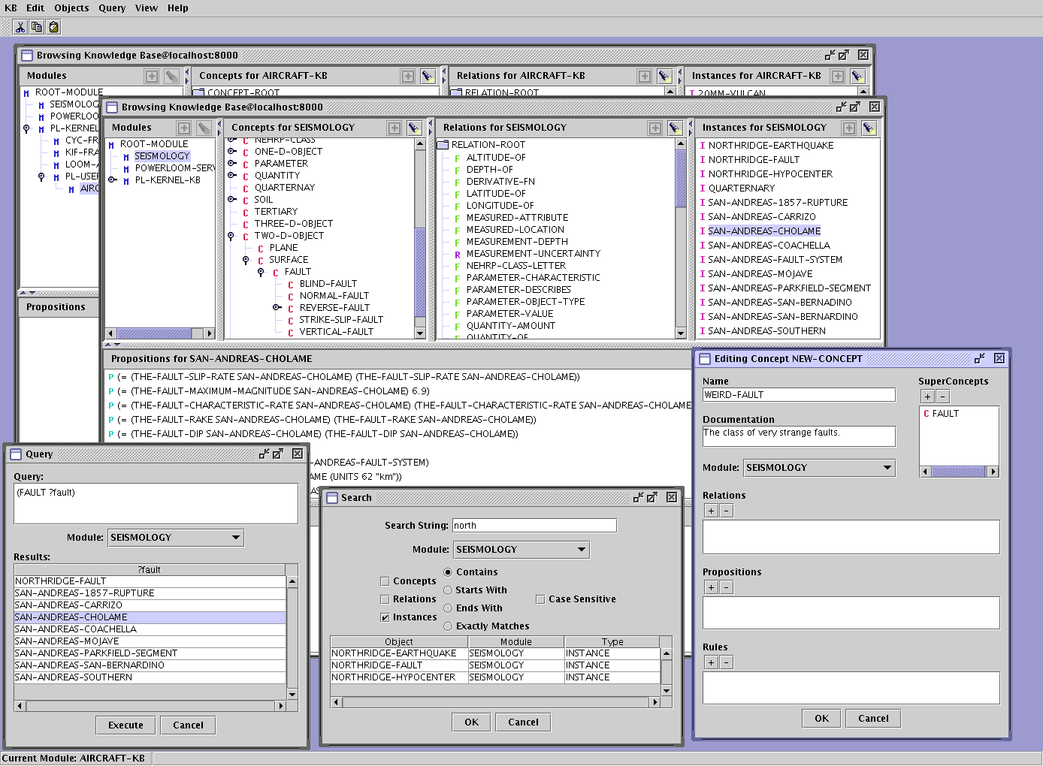
PowerLoom GUI

Slide 19
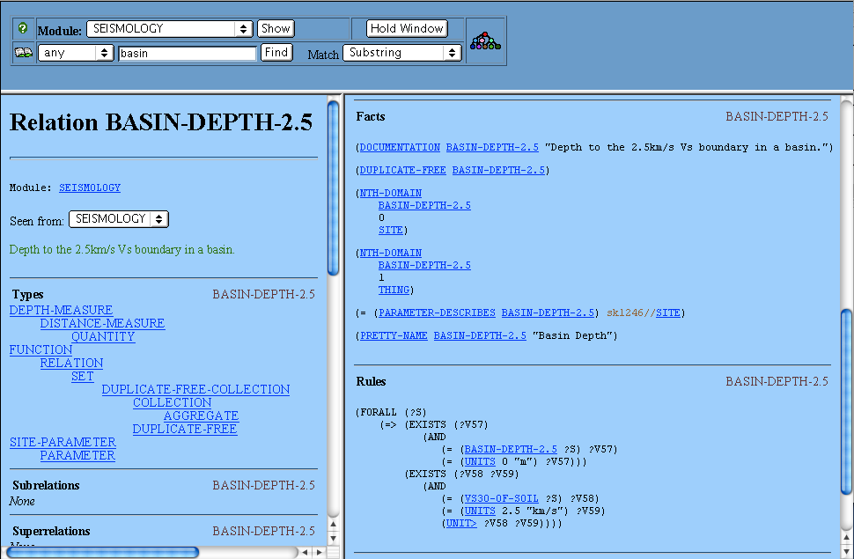
Ontosaurus Browser
Textual Definition
Formal logical encoding of one constraint implied by the textual definition
Structured Description
(Basin-depth = 0m) ⇔ (Vs30 > 2.5km/s)

Slide 20
Status and Distribution
Written in STELLA
  Available in Lisp, C++ and Java
Current release: PowerLoom 3.0.2.beta
  Basic KR&R system only
  Distributed as Lisp, C++ and Java source
  ~500 downloads world-wide
  ~400 subscribers to the mailing lists
Licensing Terms
  Open Source, user choice of 3 standard licences
    GPL
    LGPL
    Mozilla

Slide 21
PowerLoom Features
Full-function, robust and stable KR&R system
  Representation, reasoning, query language, storage, extensive API
  Available in Java (useful for integration with Protégé)
Expressivity
  KR failures often due to “we could not express X”
Meta-representation & reasoning
  Concepts, relations, contexts, rules, queries, etc. are all first-class citizens which can be represented and reasoned about
Explanation support
  Built-in recording and rendering of proof trees
  Explanation of failed inferences (“WhyNot”)
Sophisticated context & module system
  Encapsulation and organization of knowledge
  Efficient inference
  Representation of assumptions: e.g., “all reactions modeled here assume 20°C ambient temperature”
Sophisticated support for units & measures

Slide 22
PowerLoom Features /2
Extensible architecture
  Easy to add new specialized reasoning procedures
Scalability
  Caveat: PowerLoom inference is worst-case exponential complexity
  But: many design features to deal with performance
    Common inferences (e.g. subsumption) supported by specialists
    Expensive inference (e.g., classifier) available on demand
    Various search control directives, e.g., forward/backward-only rules, resource bounded inference
    Different inference levels
    Modules to focus reasoning
    Database interface to offload data-intensive operations onto RDBMS
  Successfully handled very large KBs
    Reasoned with full Cyc KB (~1,000,000 facts, 35,000 rules)
    Large EELD ontologies and datasets (not loadable into XSB deductive database) O(1000) ontology & rules, O(10,000) instances, O(100,000) assertions (see example later)

Slide 23
PowerLoom Language Concepts

Slide 24
PowerLoom Representation Language
PowerLoom language is based on KIF
  The Knowledge Interchange Format (Genesereth 91)
  Developed as part of DARPA’s knowledge sharing effort
  Proposed ANSI standard, now one of the accepted syntaxes of the Common-Logic effort
  Syntax and declarative semantics for First-Order Predicate Logic
  Lisp-based, uniform prefix syntax, similar to CycL
Example:
Facts: (person fred)
(citizen-of fred germany)
(national-language-of germany german)
Rules: (forall (?p ?c ?l)
(=> (and (person ?p)
(citizen-of ?p ?c)
(national-language-of ?c ?l))
(speaks-language ?p ?l)))

Slide 25
PowerLoom Representation Language /2
Many extensions to standard FOL:
  Type, set & cardinality relations, e.g., subset-of, instance-of, range-cardinality, etc.
  Second-order definitions via holds
  Selective closed-world assumption (OWA is default)
  Classical negation and negation-by-failure
  Defaults (still need work)
Frame-style definition language as syntactic sugar
  defconcept, defrelation, deffunction, definstance, defrule
  Allows concise definitions but expands internally into standard (more verbose) logic assertions

Slide 26
PowerLoom Knowledge Bases
Terminology Definitions
  Concepts (classes), functions, and relations define the vocabulary of a domain, e.g., person, citizen-of, age, etc.
Assertions
  Describe what is true in a domain
  Facts, e.g, (person Fred)
  Rules, e.g., (forall ?x (=> (rich ?x) (happy ?x)))
Contexts & Modules
  Knowledge is organized into modules
  Facts & rules are not asserted globally but relative to modules, can have different truth values in different modules
  Hierarchical module structure, assertions from higher modules are inherited to lower modules

Slide 27
Terms, Relations & Propositions
A KB captures a useful representation of a physical or virtual world
Entities in the world are modeled in the KB by terms
  “Georgia”, “Ben Franklin”, 3, ”abc” , concept “Person”
Terms are categorized and related via relations
  “has age”, “greater than”, “is married to”, “plus”, “Person”
  Concepts such as “Person” are considered unary relations
Propositions are sentences with an associated truth value
  “Ben Franklin is a person”, “Bill is married to Hillary”, “two plus three equals six” (which is false)
PowerLoom uses KIF terms and sentences to represent propositions
  (person Ben-Franklin) (married-to Bill Hillary)
  (= (+ 2 3) 6)

Slide 28
Logical Connectives & Rules
Predicate logic uses logical connectives to construct complex sentences from simpler ones:
  and, or, not, <=, =>, <=>, quantifiers exists and forall
Examples:
  “Richard is not a crook”:
  (not (crook Richard))
  “Every person has a mother”:
  (forall ?p
  (=> (person ?p)
  (exists ?m
  (has-mother ?p ?m))))

Slide 29
Definitions
Terminology (relations, concepts) need to be defined before they are used via defconcept, deffunction & defrelation
Examples:
(defconcept person)
(defrelation married-to ((?p1 person) (?p2 person))
(deffunction + ((?n1 number) (?n2 number))
:-> (?sum number))
Advantage & Disadvantage
  Allows certain amount of error checking (e.g., misspelled relations, argument type violations)
  A bit more tedious and can sometime generate ordering problems

Slide 30
Definition Ordering
Forward references are only allowed within definitions
  Evaluation of rules within definitions is deferred until query time
Example:
(defconcept parent (?p)
:<=> (and (person ?p)
(exists ?c (parent-of ?p ?c))))
(defrelation parent-of ((?p parent) (?c person)))
Equivalent definition but illegal forward reference:
(defconcept parent)
(assert
(forall (?p)
(<=> (parent ?p)
(and (person ?p) (exists ?c (parent-of ?p ?c))))))
(defrelation parent-of ((?p parent) (?c person)))

Slide 31
Redefinitions
Definition constructs primarily serve two roles
  Convenience; more compact syntax for often used idioms
  Linking sets of related axioms to a name to facilitate redefinition
Redefinition is useful during interactive ontology and KB development
Example Definition:
(defrelation parent-of ((?p person) (?c person))
:<=> (relative-of ?p ?c))
Example Redefinition:
(defrelation parent-of ((?p parent) (?c person)))
Result:
  Redefines parent-of with a different domain
  Erases the rule (<=> (parent-of ?p ?c) (relative-of ?p ?c))

Slide 32
Truth Values
Each PowerLoom proposition (sentence) is associated with a truth value (relative to a context or module)
Five possible truth values:
  true, false, default-true, default-false, unknown
Standard assertion assigns truth value true
(assert (person Bill))
Negation asserts truth value false
(assert (not (crook Richard)))
Presume command asserts default truth values
(presume (=> (bird ?x) (flies ?x)))
Propositions that are assigned true and false generate a clash (or contradiction)
  Useful to detect certain constraint violations or errors
  Used by proof-by-contradiction specialist
  Contradictory propositions do not bring down the system and are treated as unknown

Slide 33
Changing Truth Values
The truth value of assertions can be changed
  Implicitly, by strengthening the truth value, e.g.,
  from default-true to true
  By explicit retraction of the old truth value and new assertion, e.g.,
  (assert (not (crook Richard)))
  (retract (not (crook Richard)))
  (assert (crook Richard))
Truth values of inferred propositions cannot be retracted
(defconcept employee (?e) :=> (person ?e))
(assert (employee Mary))
(ask (person Mary)) ⇒ true
(retract (person Mary))
(ask (person Mary)) ⇒ true

Slide 34
Contexts & Modules
Contexts & Modules
  Knowledge is organized into contexts
    Modules define name-spaces + assertion spaces
    Worlds define assertion spaces only
  Facts & rules are not asserted globally but relative to modules, can have different truth values in different modules
  Hierarchical module structure, assertions from higher modules are inherited to lower modules
    Non-monotonic inheritance is possible (e.g., override some inherited assertions for scenario reasoning)
  Contexts are first-class objects that can be asserted to and queried about in the KB
    Allows attachment of meta-information, e.g., source, assumptions, etc.
  Very efficient, light-weight implementation derived from OPLAN
    Support built in at a very low level (STELLA)

Slide 35
An Annotated Example

Slide 36
Using Modules
We define a separate BUSINESS module for our example
  Inherits built-in PowerLoom definitions from PL-KERNEL/PL-USER
  Sets up a separate name and assertion space to avoid unwanted interference with/from other loaded knowledge bases
  Allows easy experimentation (clearing/changing/editing/saving)
  All PowerLoom commands are interpreted relative to current module
(defmodule "BUSINESS"
:documentation "Module for the Business demo example."
:includes ("PL-USER"))
(in-module "BUSINESS")
(clear-module "BUSINESS")
List of inherited modules
Set current module
Clear out local content

Slide 37
Concepts
Concepts define classes of entities
  Defined via the defconcept command
  Can have zero or more parent concepts (they all inherit THING)
  Used to introduce typed instances
(defconcept company)
(defconcept corporation (?c company))
(assert (company ACME-cleaners))
(assert (corporation megasoft))
(retrieve all ?x (company ?x))
There are 2 solutions:
#1: ?X=ACME-CLEANERS
#2: ?X=MEGASOFT
(retrieve all ?x (corporation ?x))
There is 1 solution:
#1: ?X=MEGASOFT
Simple “parentless” concept
Parent concept
Concept variable (optional)
Create some instances
Retrieve all companies
Found via simple subsumption inference

Slide 38
Relations
Relations define sets of relationships between entities
  Defined via the defrelation command (& deffunction see later)
  Can have one or more arguments (unary to n-ary)
  Can be fixed or variable arity
  Can be single or multi-valued
  Usually specify types for each argument
  Used to specify relationships between entities
Argument/role variable
Simple binary relation
Argument type = domain
Argument type = range
(defrelation company-name ((?c company) (?name STRING)))
(assert (company-name ACME-cleaners "ACME Cleaners, LTD"))
(assert (company-name megasoft "MegaSoft, Inc."))

Slide 39
Relations /2
Retrieve all relations asserted in the BUSINESS module:
Number of solutions sought
Retrieval variables specified implicitly
(retrieve all (company-name ?x ?y))
There are 2 solutions:
#1: ?X=MEGASOFT, ?Y="MegaSoft, Inc."
#2: ?X=ACME-CLEANERS, ?Y="ACME Cleaners, LTD"
(retrieve all (?y ?x) (company-name ?x ?y))
There are 2 solutions:
#1: ?Y="MegaSoft, Inc.", ?X=MEGASOFT
#2: ?Y="ACME Cleaners, LTD", ?X=ACME-CLEANERS
Explicit retrieval variables allow value reordering

Slide 40
Relation Hierarchies
Hierarchies for concepts as well as relations are supported
  PowerLoom represents a subconcept/subrelation relationship by asserting an “implication” relation (or an “implies” link)
  Link is equivalent to a logic rule but allows more efficient inference
  Various syntactic shortcuts are available to support often-used implication relations
(defrelation fictitious-business-name ((?c company) (?name STRING))
:=> (company-name ?c ?name))
Equivalent definitions
(forall (?c ?name)
(=> (fictitious-business-name ?c ?name)
(company-name ?c ?name))
Internal representation
(2nd order)
(subset-of fictitious-business-name company-name)

Slide 41
Relation Hierarchies /2
Retrieve all names of MegaSoft, fictitious or not
  Illustrates that company-name is a multi-valued relation
(assert (fictitious-business-name megasoft “MegaSoft”))
(retrieve all ?x (company-name megasoft ?x))
There are 2 solutions:
#1: ?X="MegaSoft, Inc."
#2: ?X="MegaSoft"
Directly asserted
Inferred via the subrelation rule/link

Slide 42
Functions
Functions are term-producing, single-valued relations
  Defined via the deffunction command
  Very similar to relations defined via defrelation but:
  Term producing: a function applied to its first n-1 input arguments specifies a unique, intensional term, e.g., “Fred’s age”
  Single-valued: each set of input arguments has at most one output argument (the last argument), e.g., “Fred’s age is 42”
  By default, functions are assumed to be partial, i.e., could be undefined for some legal input values (e.g., 1/0)
Input argument
Output argument
(deffunction number-of-employees ((?c company)) :-> (?n INTEGER))
(assert (= (number-of-employees ACME-cleaners) 8))
(assert (= (number-of-employees megasoft) 10000))
Function term
Function value

Slide 43
Functions /2
Functions syntax often results in shorter expressions than using similar relation syntax:
(retrieve all (and (company ?x)
(< (number-of-employees ?x) 50)))
There is 1 solution:
#1: ?X=ACME-CLEANERS
Compare to:
(retrieve all (and (company ?x)
(exists ?n
(and (number-of-employees ?x ?n)
(< ?n 50)))))
There is 1 solution:
#1: ?X=ACME-CLEANERS
Multiple function terms:
(retrieve all (> (number-of-employees ?x) (number-of-employees ?y)))
There is 1 solution:
#1: ?X=MEGASOFT, ?Y=ACME-CLEANERS

Slide 44
Defined Concepts
Concepts (and functions/relations) can be defined completely in terms of rules
  Useful to name often-used queries or subexpressions and build up powerful vocabulary
(defconcept small-company (?c company)
:<=> (and (company ?c)
(< (number-of-employees ?c) 50)))
New keyword
Expands into these rules
(forall ?c (=> (and (company ?c)
(< (number-of-employees ?c) 50))
(small-company ?c)))
(forall ?c (=> (small-company ?c)
(and (company ?c)
(< (number-of-employees ?c) 50))))

Slide 45
Defined Concepts /2
Retrieve small companies even if we don’t know exactly how many employees they have
(assert (and (company zz-productions)
(< (number-of-employees zz-productions) 20)))
(retrieve all (small-company ?x))
There are 2 solutions:
#1: ?X=ZZ-PRODUCTIONS
#2: ?X=ACME-CLEANERS
All we know is that ZZ Productions has less than 20 employees
Rule-based inference + transitivity of ‘<‘

Slide 46
Negation & Open/Closed-World Semantics
PowerLoom uses classical negation and an open-world assumption (OWA) by default
  KB is not assumed to be a complete model of the world: if something can’t be derived the answer is UNKNOWN, not FALSE
  Can distinguish between failure and falsity!
  Inference engine uses asymmetric effort to derive the truth or falsity of a query
    Focuses effort on deriving truth, picks up falsity only via quick, shallow disproofs
    Full effort for falsity available by asking for the negated query
    Possible extension: 3-valued ask (similar to Loom)
(defconcept s-corporation ((?c corporation)))
(ask (s-corporation zz-productions)) ⇒ UNKNOWN
(ask (not (s-corporation zz-productions))) ⇒ UNKNOWN
(assert (not (s-corporation zz-productions)))
(ask (s-corporation zz-productions)) ⇒ FALSE
(ask (not (s-corporation zz-productions))) ⇒ TRUE
Due to open-world assumption
Quick disproof from assertion

Slide 47
Negation & Open/Closed-World Semantics /2
Falsity can also come from sources other than explicit assertion
  Single-valued functions and relations
  Inequalities
  Disjoint types
  Negated rule heads, etc.
(ask (= (number-of-employees ACME-cleaners) 8)) ⇒ TRUE
(ask (= (number-of-employees ACME-cleaners) 10)) ⇒ FALSE
(ask (not (= (number-of-employees ACME-cleaners) 10)))⇒ TRUE
(ask (= (number-of-employees zz-productions) 100)) ⇒ FALSE
(ask (= (number-of-employees zz-productions) 10)) ⇒ UNKNOWN
Quick disproof since functions are single-valued
Quick disproof via inequality constraints
Truly unknown since there is not enough information

Slide 48
Negation & Open/Closed-World Semantics /3
Selective closed-world semantics and negation-by-failure are also available (as used by Prolog, deductive databases, F-Logic, etc.)
  Useful in cases where we do have complete knowledge
  If something can’t be derived, it is assumed to be false
  Closed-world semantics specified by marking relations as closed
  Negation-by-failure via fail instead of not
(defrelation works-for (?p (?c company)))
(assert (works-for shirly ACME-cleaners))
(assert (works-for jerome zz-productions))
(ask (not (works-for jerome megasoft))) ⇒ UNKNOWN
(assert (closed works-for))
(ask (not (works-for jerome megasoft))) ⇒ TRUE
(retract (closed works-for))
(ask (not (works-for jerome megasoft))) ⇒ UNKNOWN
(ask (fail (works-for jerome megasoft))) ⇒ TRUE
Due to open world
Mark relation as closed
Via selective closed-world semantics
Via explicit negation-by-failure

Slide 49
Retraction
Retraction allows the erasure or change of a previously asserted truth-value of a proposition
  Useful for error correction or iterative “change of mind” during development
  Useful to change certain aspects of a scenario without having to reload the whole knowledge base
  Allows efficient, fine-grained change
    Some cached information is lost and needs to be regenerated
    Loss can be minimized by careful structuring of module hierarchy (put more stable knowledge higher up in the hierarchy)
  Allows the exploration of hypothetical conjectures
    What would change if F were true or false?
    Module system allows us to consider both possibilities at the same time

Slide 50
Retraction /2
Some geographic terminology and information
(defconcept geographic-location)
(defconcept country ((?l geographic-location)))
(defconcept state ((?l geographic-location)))
(defconcept city ((?l geographic-location)))
(defrelation contains ((?l1 geographic-location)
(?l2 geographic-location)))
(assert (and
(country united-states)
(geographic-location eastern-us)
(contains united-states eastern-us)
(state georgia) (contains eastern-us georgia)
(city atlanta) (contains georgia atlanta)
(geographic-location southern-us)
(contains united-states southern-us)
(state texas) (contains eastern-us texas)
(city dallas) (contains texas dallas)
(city austin) (contains texas austin)))

Slide 51
Retraction /3
Retraction to fix an incorrect assertion
(ask (contains eastern-us texas)) ⇒ TRUE
(retract (contains eastern-us texas))
(assert (contains southern-us texas))
(ask (contains eastern-us texas)) ⇒ UNKNOWN

Slide 52
Value Clipping
Functions allow implicit retraction via value clipping
  Assertion of a function value automatically retracts a preexisting value
  Justified, since functions are single-valued
(deffunction headquarters ((?c company)) :-> (?city city))
(assert (= (headquarters zz-productions) atlanta))
(retrieve all (= ?x (headquarters zz-productions)))
There is 1 solution:
#1: ?X=ATLANTA
(assert (= (headquarters zz-productions) dallas))
(retrieve all (= ?x (headquarters zz-productions)))
There is 1 solution:
#1: ?X=DALLAS
Assertion automatically clips previous value
DALLAS value replaced ATLANTA

Slide 53
Value Clipping /2
Clipping also works for single-valued relations
(defrelation headquartered-in ((?c company) (?city city))
:axioms (single-valued headquartered-in))
(assert (headquartered-in megasoft atlanta))
(retrieve all (headquartered-in megasoft ?x))
There is 1 solution:
#1: ?X=ATLANTA
(assert (headquartered-in megasoft dallas))
(retrieve all (headquartered-in megasoft ?x))
There is 1 solution:
#1: ?X=DALLAS

Slide 54
Contradictions
Propositions that are both TRUE and FALSE are contradictory
  Contradictions can result from explicit assertions, during forward-chaining, or as the result of a refutation proof
  Contradictory propositions are treated as UNKNOWN to allow the system to continue to function
(assert (not (state texas)))
Derived both TRUE and FALSE for the proposition `|P#|(STATE TEXAS)'.
Clash occurred in module `|MDL|/PL-KERNEL-KB/BUSINESS'.
(ask (state texas)) ⇒ UNKNOWN
(ask (not (state texas))) ⇒ UNKNOWN

Slide 55
Rule-Based Inference
Logic rules can be used to model complex relationships
  Rules can be unnamed or named via defrule
  Most definition commands expand into one or more rules
  Inference engines apply rules to derive conclusions
(retrieve all (contains southern-us ?x))
There is 1 solution:
#1: ?X=TEXAS
(defrule transitive-contains
(forall (?l1 ?l2 ?l3)
(=> (and (contains ?l1 ?l2)
(contains ?l2 ?l3))
(contains ?l1 ?l3))))
(retrieve all (contains southern-us ?x))
There are 3 solutions:
#1: ?X=TEXAS
#2: ?X=AUSTIN
#3: ?X=DALLAS
Finds only directly asserted values
Defines contains to be transitive
(defrule transitive-contains
(=> (and (contains ?l1 ?l2)
(contains ?l2 ?l3))
(contains ?l1 ?l3)))
Same rule via implicit quantification

Slide 56
Named Rules & Axiom Schemata
Logic rules can be defined and named via defrule
  Rules are propositions which are in the domain of discourse
    Allows meta-annotations and reasoning
  Naming rules (or any proposition) provides extra level of convenience
Axiom schemata allow simple definition of commonly used rule patterns
Retract rule by name
(retract transitive-contains)
(retrieve all (contains southern-us ?x))
There is 1 solution:
#1: ?X=TEXAS
(assert (transitive contains))
(retrieve all (contains southern-us ?x))
There are 3 solutions:
#1: ?X=TEXAS
#2: ?X=AUSTIN
#3: ?X=DALLAS
Reassert transitivity via meta-relation + axiom schema
(defrelation transitive ((?r RELATION))
:=>> (and (binary-relation ?r)
(not (function ?r)))
:=>> (=> (and (?r ?x ?y)
(?r ?y ?z))
(?r ?x ?z)))
Transitivity relation and axiom schema from PL-KERNEL KB

Slide 57
Justifications and Explanation
Explanation of true/false queries
  Backward inference can store proof trees that can be rendered into explanations
  Simple built-in explanation mechanism
    Various rendering possibilities, ASCII, HTML, XML
    Eliminates explanation of duplicate and low-level goals
    Explanation strings for different audiences (technical, lay)
(ask (contains southern-us dallas)) ⇒ TRUE
(why)
1 (CONTAINS SOUTHERN-US DALLAS)
follows by Modus Ponens
with substitution {?l1/SOUTHERN-US, ?l3/DALLAS, ?l2/TEXAS}
since 1.1 ! (FORALL (?l1 ?l3)
(<= (CONTAINS ?l1 ?l3)
(EXISTS (?l2)
(AND (CONTAINS ?l1 ?l2)
(CONTAINS ?l2 ?l3)))))
and 1.2 ! (CONTAINS SOUTHERN-US TEXAS)
and 1.3 ! (CONTAINS TEXAS DALLAS)

Slide 58
Explanation /2
Explanation of retrieved results
  Separate explanation for each derived solution
  why explains most recently retrieved solution
(retrieve 3 (contains southern-us ?x))
There are 3 solutions so far:
#1: ?X=DALLAS
#2: ?X=TEXAS
#3: ?X=AUSTIN
(why)
1 (CONTAINS SOUTHERN-US AUSTIN)
follows by Modus Ponens
with substitution {?l1/SOUTHERN-US, ?l3/AUSTIN, ?l2/TEXAS}
since 1.1 ! (FORALL (?l1 ?l3)
(<= (CONTAINS ?l1 ?l3)
(EXISTS (?l2)
(AND (CONTAINS ?l1 ?l2)
(CONTAINS ?l2 ?l3)))))
and 1.2 ! (CONTAINS SOUTHERN-US TEXAS)
and 1.3 ! (CONTAINS TEXAS AUSTIN)

Slide 59
Contexts & Modules
Hypothetical or scenario reasoning can be achieved by
  creating a new context which inherits existing set of facts and
  allows the exploration of "assumptions".
In this example, we show how certain inherited assertions can be retracted and changed
(defmodule "ALTERNATE-BUSINESS"
:includes "BUSINESS")
(in-module "ALTERNATE-BUSINESS")
(assert (and (company web-phantoms)
(company-name web-phantoms "Web Phantoms, Inc.")))
(retract (company-name megasoft "MegaSoft, Inc."))
(assert (company-name megasoft "MegaZorch, Inc."))

Slide 60
Contexts & Modules /2
The ALTERNATE-BUSINESS module
  inherits all of the information of its parent module
  is subject to the specific changes made in the local module.
(in-module "BUSINESS")
(retrieve all (company-name ?x ?y))
There are 3 solutions:
#1: ?X=MEGASOFT, ?Y="MegaSoft, Inc."
#2: ?X=ACME-CLEANERS, ?Y="ACME Cleaners, LTD"
#3: ?X=MEGASOFT, ?Y="MegaSoft"
(in-module "ALTERNATE-BUSINESS")
(retrieve all (company-name ?x ?y))
There are 4 solutions:
#1: ?X=MEGASOFT, ?Y="MegaZorch, Inc."
#2: ?X=WEB-PHANTOMS, ?Y="Web Phantoms, Inc."
#3: ?X=ACME-CLEANERS, ?Y="ACME Cleaners, LTD"
#4: ?X=MEGASOFT, ?Y="MegaSoft"
Changed local assertion
New local assertion
From “fictitious business name” assertion

Slide 61
Cross-Contextual Reasoning
Normally queries operate in the current module.
  The IST (IS-TRUE) relation (J. McCarthy) allows us to query about the state of knowledge in other modules.
  This also allows cross-module inference by binding variables across forms
  Example: “find all companies whose names differ in the two modules”
(in-module "BUSINESS")
(retrieve all (ist alternate-business (company-name ?x ?y)))
There are 4 solutions:
#1: ?X=MEGASOFT, ?Y="MegaZorch, Inc."
#2: ?X=MEGASOFT, ?Y="MegaSoft, Inc."
#3: ?X=ACME-CLEANERS, ?Y="ACME Cleaners, LTD"
#4: ?X=MEGASOFT, ?Y="MegaSoft"
(retrieve all (and (ist business (company-name ?x ?y))
(fail (ist alternate-business (company-name ?x ?y)))))
There is 1 solution:
#1: ?X=MEGASOFT, ?Y="MegaSoft, Inc."

Slide 62
RDBMS to PowerLoom Mapping
Defining a PowerLoom database instance edb1:
(DEFDB edb1
:dsn "EELD_EDB17JUN03_COMPLIANT_PUBLIC_PL“
:user "scott" :host "blackcat.isi.edu")
Defining a PowerLoom relation EDB-Person
that maps onto the EDB table Person:
(DEFTABLE EDB-Person edb1 "PERSON“
(?ENTITYID ?REPORTID ?SOURCEID
?LASTNAME ?FIRSTNAME ?MIDDLENAME ?NICKNAME ?GENDER
?COUNTRYCITIZENSHIP ?AGE ?BIRTHLOCATION ?RESIDENCE))
Defining a PowerLoom lifting axiom that maps the ontology concept Person onto EDB-Person:
(ASSERT
(=> (QUERY
(EXISTS (?rep ?s ?l ?f ?m ?n ?g ?c ?a ?b ?res)
(EDB-Person ?p ?rep ?s ?l ?f ?m ?n ?g ?c ?a ?b ?res))
:MATCH-MODE :EELD :HOW-MANY :ALL)
(Person ?p)))

Slide 63
Advanced Topics

Slide 64
Concept Definitions
Define new concept term event
(defconcept event
:documentation "The class of events.")
Documentation string
Define movement-event as subconcept of event
(defconcept movement-event (?ev event)
:documentation "The class of movement events."
:=> (= (* (time ?ev) (speed ?ev))
(distance ?ev)))
Constraint rule in KIF syntax

Slide 65
Definitions are Syntactic Sugar
Constructs such as defconcept facilitate concise expression of commonly needed definition tasks
Example: Previous definitions expand into the following more verbose set of assertions:
Meta assertion about the concept movement-event
(defconcept event)
(defconcept movement-event)
(assert (documentation movement-event
"The class of movement events.“))
(assert (forall ?ev
(=> (movement-event ?ev)
(event ?ev))))
(assert (forall ?ev
(=> (movement-event ?ev)
(= (* (time ?ev) (speed ?ev))
(distance ?ev)))
Represents the subconcept
relationship
Represents the constraint

Slide 66
Relation Definitions
Define binary relation sub-event with domain and range event:
(defrelation sub-event ((?sub event) (?super event))
:documentation “Links a sub-event to its super-event.”)
Relations can have arbitrary as well as variable arity.
Functions are single-valued, term-generating relations:
(deffunction time ((?ev movement-event) ?time)
:documentation “The duration of a movement event.”)
(deffunction speed ((?ev movement-event) ?speed)
:documentation “The speed of a movement event.”)
(deffunction distance ((?ev movement-event) ?distance)
:documentation “The distance covered by a movement.”)

Slide 67
Instance Definitions
Define event instance ev1 with various properties:
(definstance ev1
:movement-event true :speed 10 :time 20)
The above concise, frame-style definition expands into
the following individual assertions:
(assert (movement-event ev1))
(assert (= (speed ev1) 10))
(assert (= (time ev1) 20)))
Function term “time of event ev1”

Slide 68
Attaching Information to Rules
Rules are also in the domain of discourse and can be named for easy attachment of other information
  For example, documentation strings or explanation templates:
(defrule speed-rule
(forall ?ev
(=> (movement-event ?ev)
(= (* (time ?ev) (speed ?ev))
(distance ?ev))))
:documentation “Distance = time * speed of a movement.”)
(assert
(explanation-template speed-rule
“The distance ?(distance ?ev) of the movement event ?ev equals
its duration ?(time ?ev) times its speed ?(speed ?ev).”))

Slide 69
Arithmetic Constraint Reasoning
Arithmetic reasoning is important for scientific, engineering and everyday reasoning
PoweLoom’s built-in arithmetic specialists can compute a result from any two bound arguments
  Allows us to model this formula via a single “speed” rule
  (instead of three – was an issue with Cyc in Phase-1)
  Example: (+ 5 ?x 2) => ?x = -3
(definstance ev1 :movement-event true :speed 10 :time 20)
(definstance ev2 :movement-event true :speed 10 :distance 50)
(retrieve all (distance ev1 ?x))
There is 1 solution:
#1: ?X=200
(retrieve all (time ev2 ?x))
There is 1 solution:
#1: ?X=5

Slide 70
General Queries
Many other systems have problems with general queries that ask about classes of things:
  “Is it true that the ionization of diluted solutions is higher than those of concentrated solutions?”
  This is often worked around by introducing a specific solution individual and asking the question about the instance
In PowerLoom we can ask the universal question directly:
(defconcept solution :documentation "The class of chemical solutions.")
(deffunction concentration-level ((?s solution) ?level)
:documentation “Concentration ?level of some particular solution ?s.")
(deffunction ionization ((?s solution) ?level)
:documentation “Ionization ?level of some particular solution ?s.")
(defrelation greater-than (?x ?y)
:documentation "Qualitative `>' relation.")

Slide 71
General Queries /2
Two (mock) rules describing relationships between concentration levels of solutions and their ionization level
  Note that these rules operate at the instance level: given a specific solution instance and its concentration, we can infer the solution’s ionization level
(defrule ionization-rule1
(=> (and (solution ?x)
(concentration-level ?x diluted))
(= (ionization ?x) high))
:documentation “Diluted solutions have high ionization.")
(defrule ionization-rule2
(=> (and (solution ?x)
(concentration-level ?x concentrated))
(= (ionization ?x) low))
:documentation “Concentrated solutions have low ionization.")
(assert (greater-than high low))
Qualitative ordering

Slide 72
General Queries /3
Can phrase the general query directly as a universally quantified statement
  PowerLoom’s Universal Introduction reasoner is used to prove it
  Automatically introduces hypothetical solution individuals with the necessary properties in a hypothetical world
(ask (forall (?x ?y)
(=> (and (solution ?x)
(solution ?y)
(concentration-level ?x diluted)
(concentration-level ?y concentrated))
(greater-than (ionization ?x) (ionization ?y)))))
⇒ TRUE
Contrast this with the “hand-reification” approach:
(assert (and (solution sol1) (concentration-level sol1 diluted)))
(assert (and (solution sol2) (concentration-level sol2 concentrated)))
(ask (greater-than (ionization sol1) (ionization sol2)))
⇒ TRUE

Slide 73
Representing Queries
Question answering applications
  Reasoning about the queries itself is often important (e.g., answering a multiple-choice question by identifying the incorrect answers)
PowerLoom can represent queries as terms to facilitate such query-level reasoning
  Example: Wh-query can be represented via a KAPPA term and then evaluated via the query engine to generate the answers
(deffunction wh-query (?q) :-> (?kappa SET))
(assert (wh-query q1
(kappa ?x
(and (solution ?x) (concentration-level ?x diluted)))))
(assert (and (solution s1) (concentration-level s1 diluted)))
(assert (and (solution s2) (concentration-level s2 concentrated)))
(assert (and (solution s3) (concentration-level s3 diluted)))
(retrieve all ?x (member-of ?x (wh-query q1)))
There are 2 solutions:
#1: ?X=S3
#2: ?X=S1

Slide 74
Units and Dimensions
Scientific reasoning uses various units and dimensions
PowerLoom has full support for units
  Large number of predefined units
    SI and other measurement systems
    Fundamental quantities:
    mass, distance, time, angle, solid angle, amount of substance, electric current, luminous intensity, data
  Arithmetic operations on units
  Arbitrary combinations of units introduced by formulae
    —not limited to predefined combinations
  Extensible via STELLA code
Integration with Ontology
  Datatype introduced via the units function
  All logical operations and inferences work with units

Slide 75
Reasoning with Units
Assertions and Comparisons
The units function introduces the data types
  Assertions
  Comparisons
Magnitude of expression
Units (as string)
(assert (= (age Fred) (units 35 "yr")))
(assert (= (age Pebbles) (units 18 "month")))
(assert (= (answer problem) (units 42 "m2kg/s3")))
(ask (< (units 10 "mm") (units 10 "ft")))
TRUE
(ask (< (units 10 "ft") (units 11 "m")))
TRUE
(ask (< (units 11 "m") (units 10 "ft")))
FALSE
(ask (< (units 11 "kg") (units 10 "ft")))
UNKNOWN
Arbitrary unit combinations
Comparisons normally give true or false answers
Incompatible units, so no meaningful answer

Slide 76
Reasoning with Units
Conversions
Conversions
  All units are stored internally in canonical form (SI mks)
  Conversions are performed on input or output
(retrieve (= (units ?x "mile") (units 100 "km")))
There is 1 solution so far:
#1: ?X=62.13711922373341
(retrieve (= (units ?x ?y) (units 100 "km")))
There is 1 solution so far:
#1: ?X=100000.0, ?Y="m"
(retrieve all (= (age Fred) (units ?x "yr")))
There is 1 solution:
#1: ?X=35.0
(retrieve (= (units 1000 ?y) (units 1 "km")))
No solutions.
Miles to kilometers
Both magnitude and unit (in canonical units)
More useful example
Too open-ended

Slide 77
Reasoning with Units
Arithmetic
Arithmetic
  Units combine appropriately
  Arbitrary units combinations
Creates 20 km/h unit, a common unit
(retrieve (= (units ?x ?y) (u-div (units 20 "km") (units 1 "h"))))
There is 1 solution so far:
#1: ?X=5.555555555555555, ?Y="m/s"
(retrieve (= (units ?x "km/h") (u-div (units 20 "km") (units 1 "h"))))
There is 1 solution so far:
#1: ?X=20.0
(retrieve (= (units ?x "km") (u* (units 20 "km/h") (units 1.5 "hr"))))
There is 1 solution so far:
#1: ?X=30.0
? (retrieve (= (units ?x ?y) (u-div (units 1 "h") (units 20 "km"))))
There is 1 solution so far:
#1: ?X=0.18, ?Y="s/m"
Canonical internal representation.
Synonyms
Converted back to km/h
Synonyms
Creates 20h/km, a quite uncommon unit

Slide 78
Time Points and Durations
Time is an important aspect of the world
PowerLoom has support for exact time points and durations
  Time point specification uses flexible strings and timepoint-of function
    ISO-8601 extended format for dates
    Many other (US-centric) date formats supported:
    "5-Jan-2000", "1/5/2000", "January 10, 1997", "now", "today", "yesterday"
    Time zones are specified numerically as offset from UTC
    (i.e., what you add to UTC to get local time)
    Common time zone strings are also supported: UTC, Z, PST, EDT
  Duration uses simple strings of days and milliseconds and duration-of function
    "plus 5 days; 85000 ms", "minus 3 days; 0 ms"
    Integrated and interchangeable with units function
  Arithmetic operations on time points and durations
  Comparisons of time points or durations
Integration with Ontology
  Datatypes introduced via the timepoint-of and duration-of functions
  All logical operations and inferences work with time points and durations
  Durations interoperate with the units function

Slide 79
Reasoning with Time
Assertions and Comparisons
The timepoint-of function introduces time points and the duration-of function introduces durations
  Assertions
  Comparisons
Type of time expression
Specification (as string)
(assert (= (birthday Fred) (timepoint-of "2001-Jan-8 7:00Z")))
(assert (= (duration Project85) (duration-of "180 days")))
(assert (= (duration Concert75) (duration-of "0 days; 7200000 ms")))
(ask (< (timepoint-of "2005-Jul-3")
(timepoint-of "2005-Jul-4")))
TRUE
(ask (< (timepoint-of "2005-07-03T12:30Z")
(timepoint-of "2005-07-03T18:30+8:00")))
FALSE
(ask (< (timepoint-of "2006-10-May") (duration-of "2 days")))
UNKNOWN
Comparisons normally give true or false answers
Timezones are respected
Incompatible time types, so no meaningful answer

Slide 80
Reasoning with Time Durations
Conversions
Conversions
  Durations and time units can be converted between each other.
  Time points can be destructured using the timepoint-of* function
Simple conversion
(retrieve (= (duration-of ?x) (units 10 "day")))
There is 1 solution so far:
#1: ?X="plus 10 days; 0 ms"
(retrieve (= (duration-of ?x) (units 2 "h")))
There is 1 solution so far:
#1: ?X="plus 0 days; 7200000 ms"
(retrieve all (= (duration Concert75) (units ?x "h")))
There is 1 solution:
#1: ?X=2.0
(retrieve all (= (duration Concert75) (units ?x ?y)))
There is 1 solution:
#1: ?X=7200.0, ?Y="s"
(retrieve (= (timepoint-of* ?y ?m ?d ?hh ?mm ?ss "PST")
(timepoint-of "Feb/5/2002 00:25:30 EST")))
There is 1 solution so far:
#1: ?Y=2002, ?M=2, ?D=4, ?HH=21, ?MM=25, ?SS=30.0
More useful example
Convert to units
Magnitude and unit (canonical units)
Destructuring with time zone conversion

Slide 81
Reasoning with Time
Arithmetic
Arithmetic
  Addition and Subtraction of points and durations
  Time types combine appropriately
(retrieve all (time- (timepoint-of "2006-10-20")
(timepoint-of "2006-10-15")
(duration-of ?interval)))
There is 1 solution:
#1: ?INTERVAL="plus 5 days; 0 ms"
(retrieve all (time+ (timepoint-of "2006-12-25")
(duration-of "12 days")
(timepoint-of ?date)))
There is 1 solution:
#1: ?DATE="2007-JAN-06 7:00:00.000 UTC"
(retrieve all (time+ (duration-of "12 days")
(units ?n "h")
(duration-of "14 days")))
There is 1 solution:
#1: ?N=48.0
Amount of time between two time points
Adding a duration to a time points to get a new time point
Works together with units
Output variable can be in any position

Slide 82
Forward Inference (FIX)
simple propositional reasoning, e.g.,
(or p q), ~p |= q
simple equality reasoning
forward skolemization, e.g.,
(forall (?x Person)
(exists (?y Person) (mother-of ?x ?y)))

Slide 83
WhyNot Query Debugging

Slide 84
Debugging Queries in Large KBs
Logic-based knowledge representation & reasoning system
    Use language of some logic L to represent knowledge (e.g., KIF)
    Use implementation of proof procedure for L as reasoning engine
Some (partially) developed knowledge base:
Facts: (person fred)
(citizen-of fred germany)
(national-language-of germany german)
Rules: (forall (?p ?c ?l)
(=> (and (person ?p)
(citizen-of ?p ?c)
(national-language-of ?c ?l))
(speaks-language ?p ?l)))
Queries: (speaks-language fred german)?
(speaks-language fred french)?
TRUE
UNKNOWN

Slide 85
The Problem
Failed query: (speaks-language fred french)?
UNKNOWN
Diagnosis is simple: the query failed because:
  Not asserted as a fact
  Not enough facts to infer it via the known rule
  Open world assumption!
Ask similar query in Cyc (1,000,000 facts, 35,000 rules)
  “Does Doug Lenat speak German?”
  Answer: UNKNOWN
Diagnosis is very difficult: the query failed because
  Not asserted as a fact
  All attempts to infer the answer failed
    Search tree explored by Cyc is very large, timeout at 30 CPU seconds
  Hard to debug for knowledge engineers, impossible for non-experts

Slide 86
Solution: Explaining Query Failures via
Plausible Partial Proofs
Standard explanation technique for logic-based reasoners:
  Find and record a proof for the query
  Present the proof to the user in an understandable way
  Problem: No proof ⇒ no explanation
Solution: Need to create a proof even though none could be found
Generate plausible partial proofs for a query
  Partial proofs can be explained
  Proof "holes" identify potential knowledge or inference gaps
  Multiple plausible partial proofs to explain different failure modes
  Top-ranked partial proofs focus on most plausible failures
Challenges:
  What is a plausible partial proof?
  Scaling, find plausible proofs without looking at too many options
  ⇒ there are infinitely many possible proofs!

Slide 87
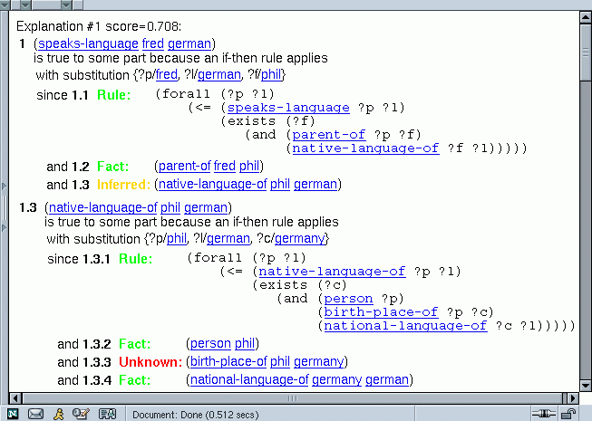
Example Explanation of Query Failure

Slide 88
PowerLoom’s “WhyNot” Query Diagnosis Tool
PowerLoom KR&R system
  First-order-logic-based KR&R system
  Representation language is KIF (variant of FOL)
  Natural deduction reasoner combining forward, backward reasoning plus variety of reasoning specialists
  Type & cardinality reasoning, relation subsumption, classifier
  Selective closed-world reasoning
  Modules and light-weight worlds for hypothetical reasoning
“WhyNot” built into inference engine of PowerLoom
  Partial inference mode to generate plausible partial proofs
  Score propagation instead of truth-values
  Various plausibility heuristics
PowerLoom explanation component used to explain partial proofs
Only diagnosis of missing facts at the moment

Slide 89
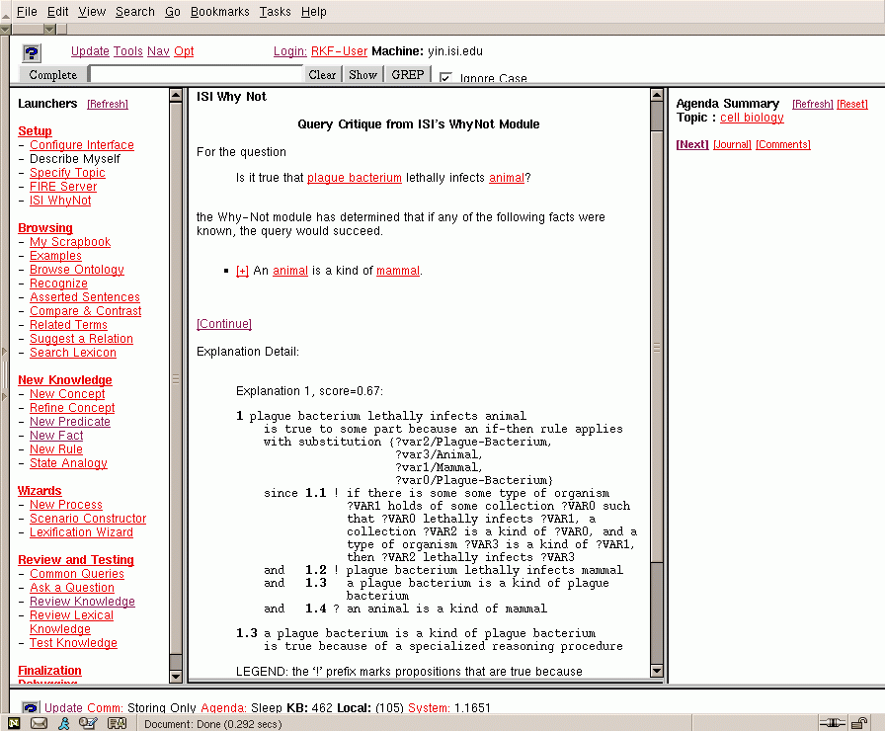
“WhyNot” Plug-in to Debug Queries in
Large Cyc Knowledge Bases
Cyc-based KRAKEN KA Tool
  input and output in natural language
  very large amount of background knowledge (over 1,000,000 facts, O(10,000) rules)
  query diagnosis is very difficult
PowerLoom “WhyNot”
  external knowledge source
  integrated via blackboard
  dynamically fetches and
  translates Cyc knowledge
  performs partial inference
  against very large KB
  pinpoints potential
  knowledge gaps
  ships explanations to
  KRAKEN UIA display
PowerLoom WhyNot
WhyNot
Classifier
Structural
Refinement
Consistency
Tests
PowerLoom
Inference Engine
VirB³
Blackboard
PowerLoom KB Indexing
PL/Cyc
KB-Store/ Cache
PowerLoom
KB-Store
OntoMorph Translator
Cyc/KRAKEN
PL/Cyc Knowledge Pager API
Cyc API
Cyc Integrated Knowledge Base
UIA

Slide 90
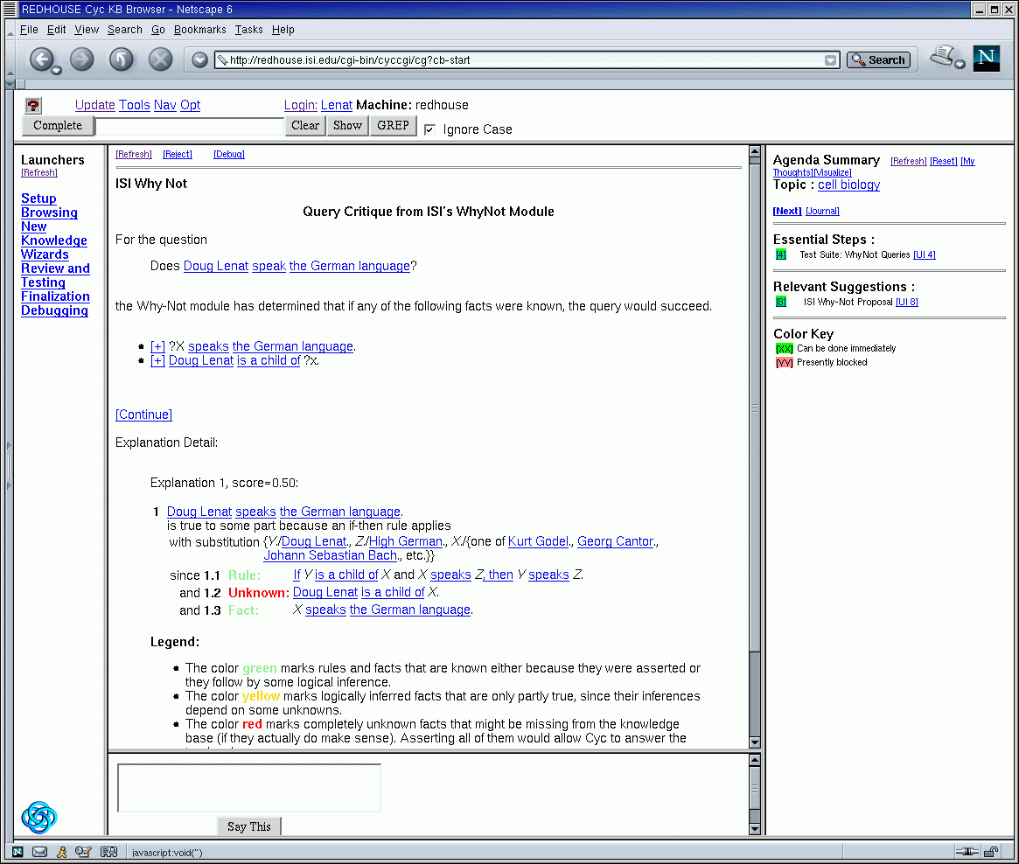
WhyNot Result in KRAKEN UIA

Slide 91
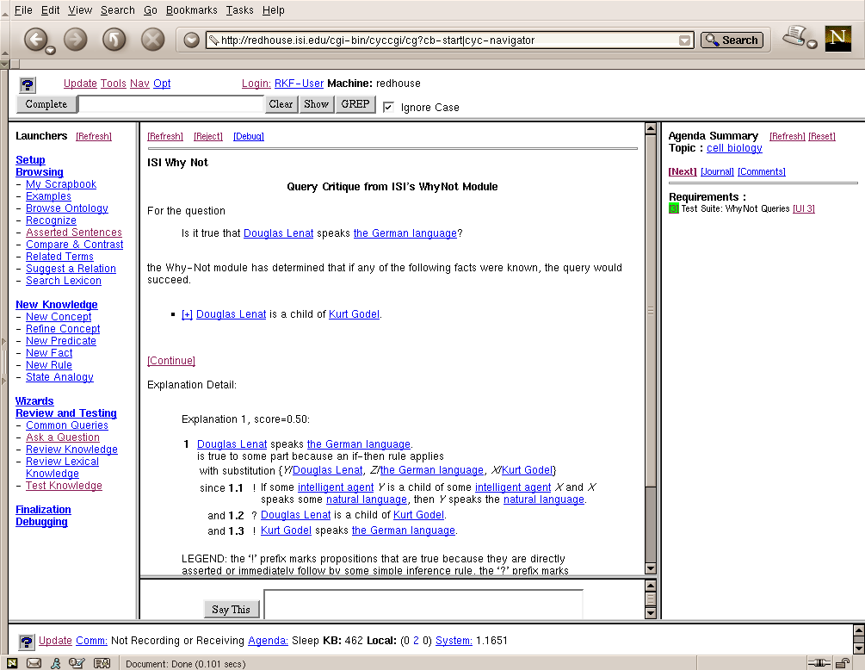
Does Doug Lenat Speak German?
Many similar explanations
Need to generalize

Slide 92
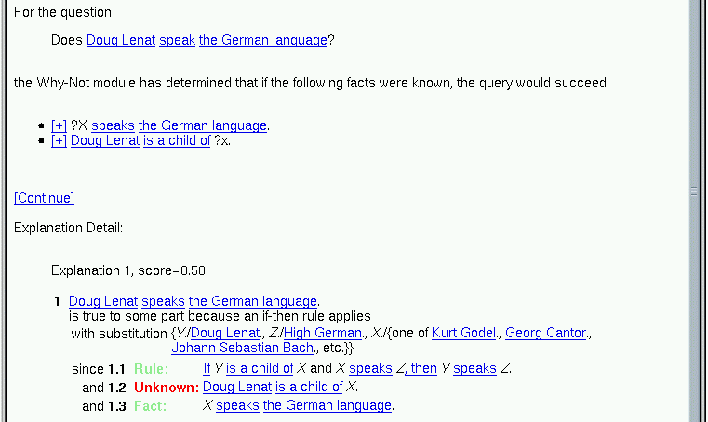
Improved Explanation by Generalizing Similar Proofs

Slide 93
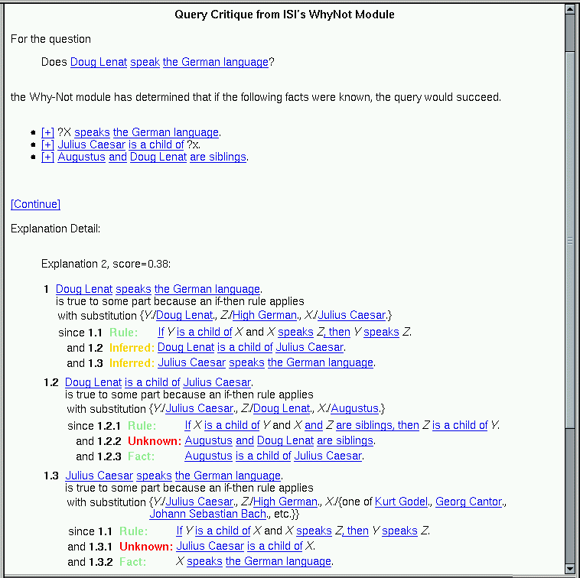
Alternative Lower-Score Explanation
Explanation 2 (score 0.38):
?

Slide 94
Alternative Lower-Score Explanation Detail
Example Explanation 2 Detail (score 0.38)

Slide 95

Partial Inference Application #2:
Pattern Matching for Link Discovery (EELD)
KOJAK
Link Discovery Problem
  Given: large amounts of evidence
    people, organizations, places, events, relationships, accounts, transactions, etc.
  Discover: high-level activities of interest
    Contract murders, gang wars, industry takeovers, terrorist activities, etc.
KOJAK approach:
  Represent evidence as large-scale PowerLoom evidence KBs
  Represent domain knowledge via logic rules
  Represent patterns via logic rules and queries
  Use partial inference to detect patterns of interest
Challenges:
  Scale, incompleteness, noise, corruption

Slide 96
Example: Using “WhyNot” Partial Inference in EELD Evaluation Domain
Example domain (small/medium size):
  150 concepts, 200 relations, 6000 individuals
  10,000 asserted facts
  125 rules
Example query:
Strict proof is fairly large:
  121 facts (or leaves)
  80 rule applications
  Chaining depth up to 9
  Impossible to debug manually if it fails
Great domain for WhyNot partial match to show its utility:
  Example: explain query failure caused by 1 missing assertion
(contract-murder UID517 UID3)?

Slide 97
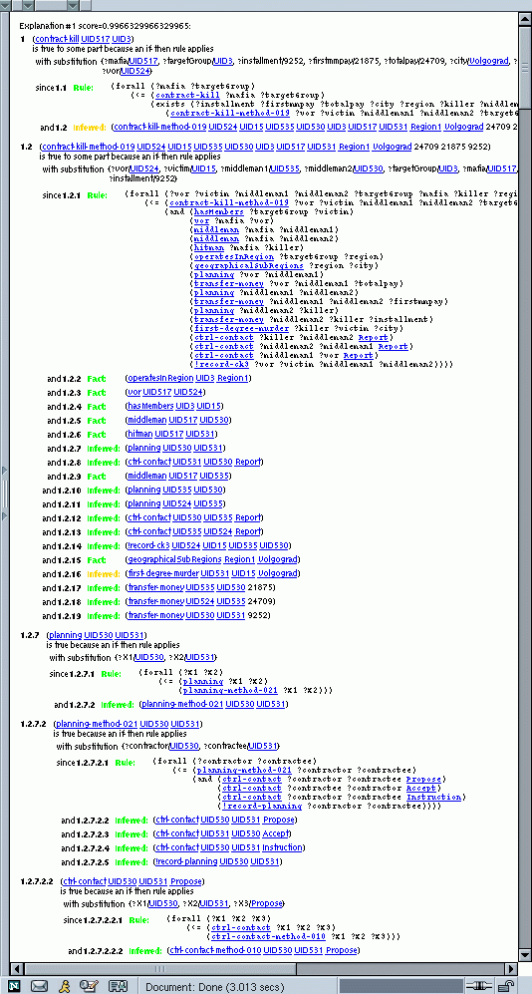
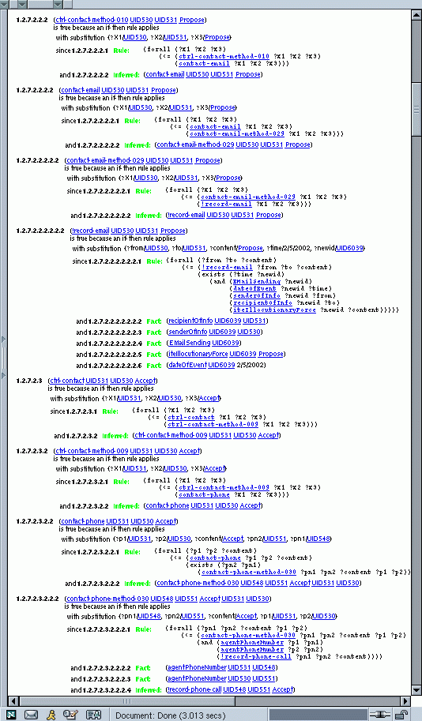

Slide 98
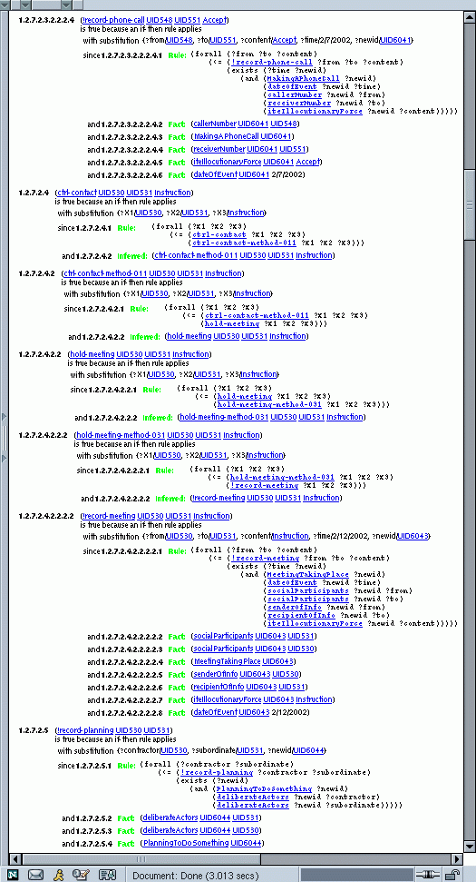
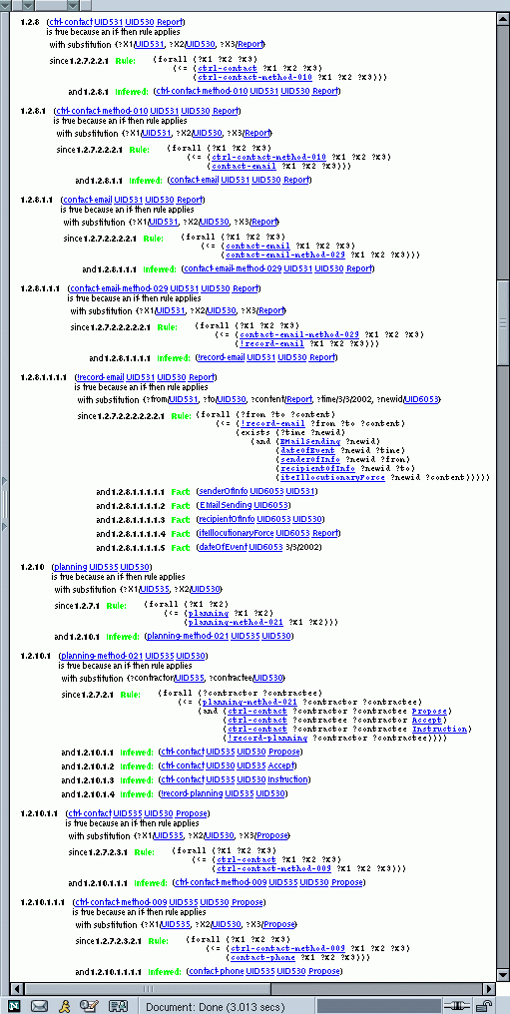

Slide 99
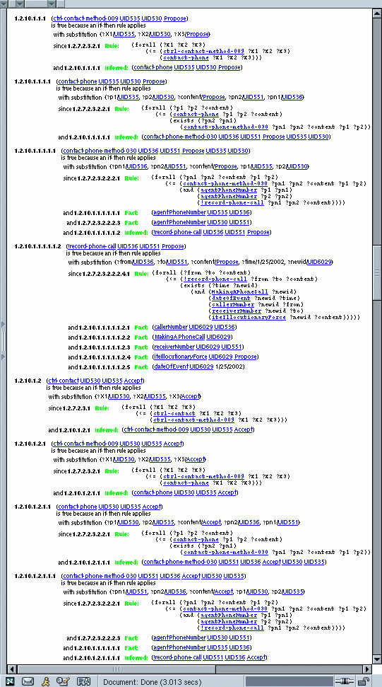
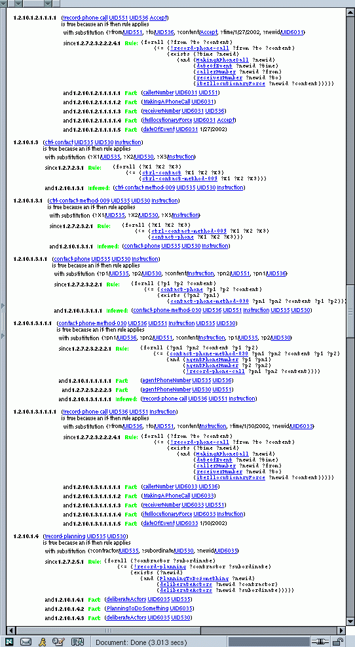

Slide 100
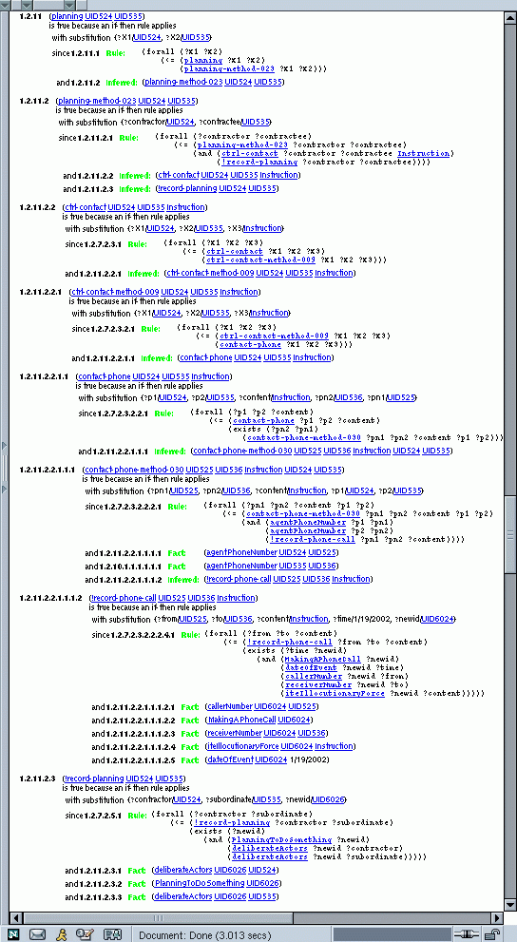
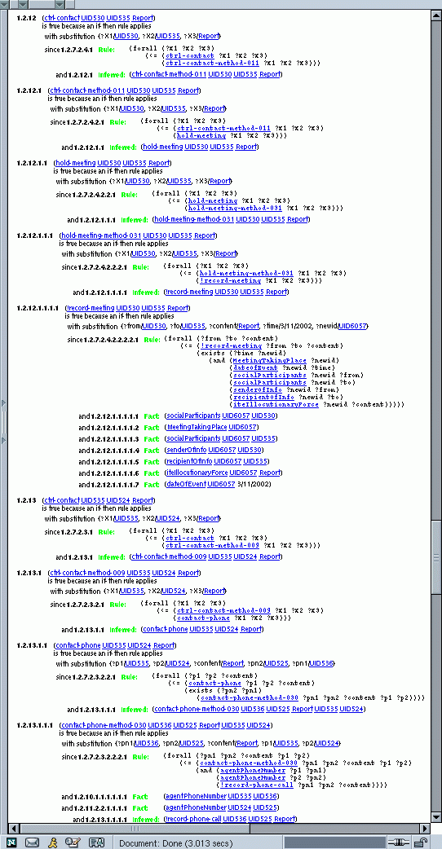

Slide 101
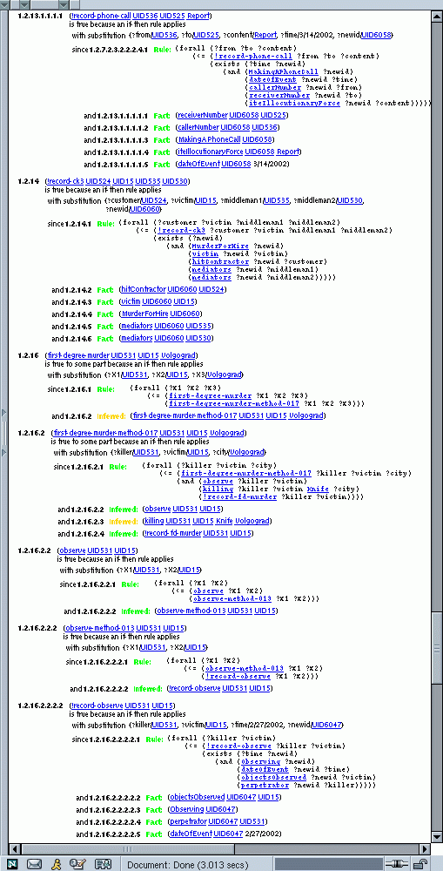
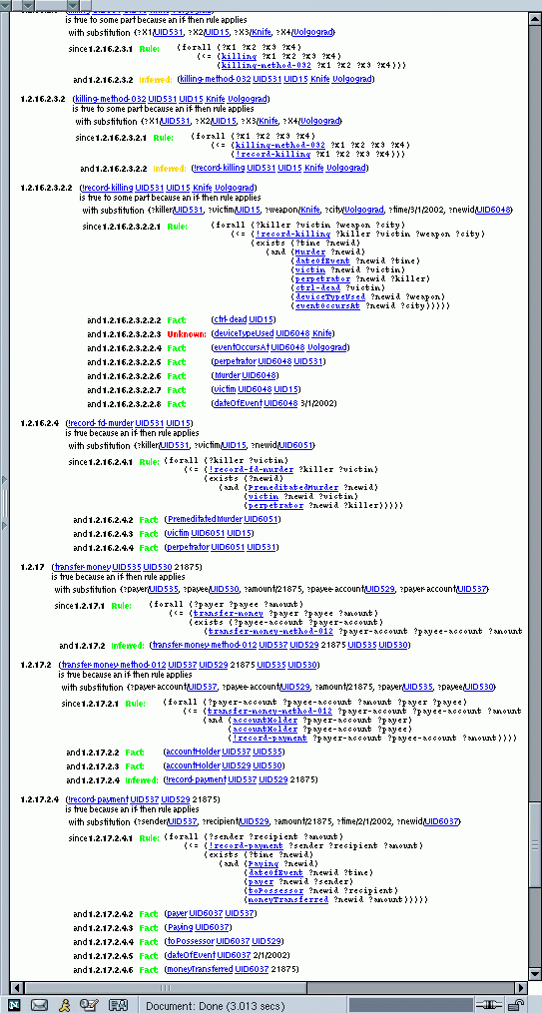
Failure

Slide 102
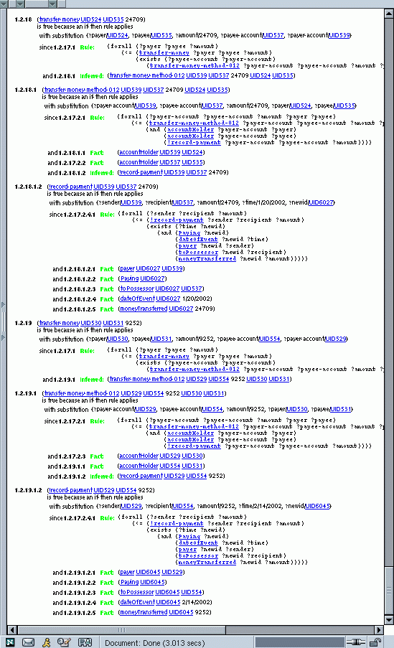
Strict proof: ~1 second
Partial proof: ~2 minutes
  Large space of potential partial proofs explored

Slide 103
Conclusion
PowerLoom is well-suited for the representation & reasoning tasks:
  Full-function, robust and stable KR&R system
    Expressive representation, reasoning, query language, storage, extensive API
    Available in Java (useful for integration with Protégé)
  Meta-representation & reasoning
  Concepts, relations, contexts, rules, queries, etc. are all first-class citizens which can be represented and reasoned about
  Explanation support for successful and failed reasoning
  Sophisticated context & module system
    Encapsulation, efficient inference, representation of assumptions
  Sophisticated support for units & measures
  Support for simple timepoint reasoning.

