Slide 1
PhD update 20/02/2019
Johan & Ilse

Slide 2
Timeline

Slide 3
WP1: two studies on implicit learning of distributions
Participants

Slide 4
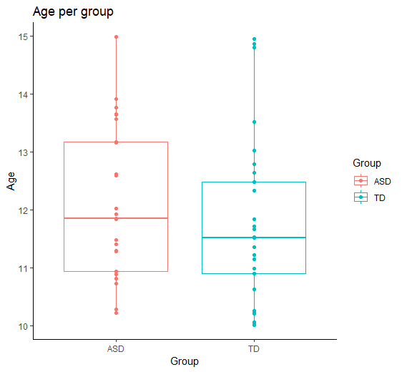
Participants tested
30 TD children
21 in group (Krullevaar’t)
9 children individually
25 children with ASD via ECA
Group | N | Mean age | Min | Max age | SD age | N girls
ASD | 25 | 12.11299 | 10.22 | 14.9863 | 1.312873 | 8
TD | 29 | 11.75713 | 10.01 | 14.9500 | 1.419907 | 15
→ 1 participant removed, because did not understand the tasks and did not complete the tasks.

Slide 5
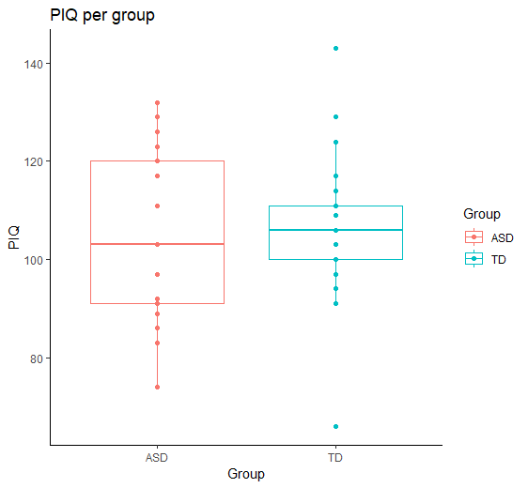
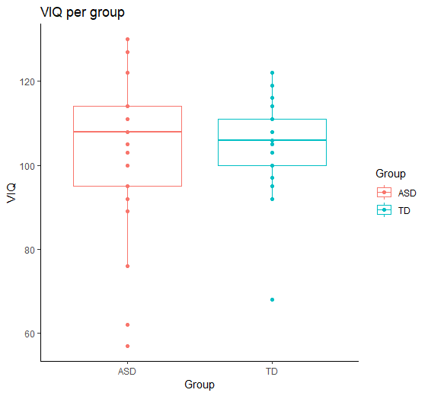
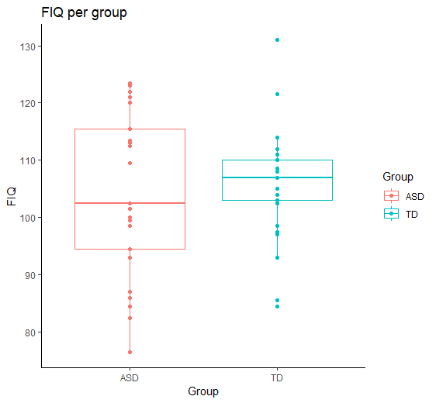
Participants tested: IQ
ASD group: questionnaire data of 4 children missing TD group: questionnaire data of 5 children missing
VIQ of 57? But FIQ of 87
FIQ of 76.5, removed from data, because parents reported intellectual disability.

Slide 6
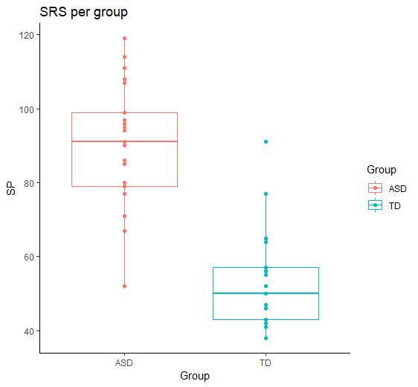
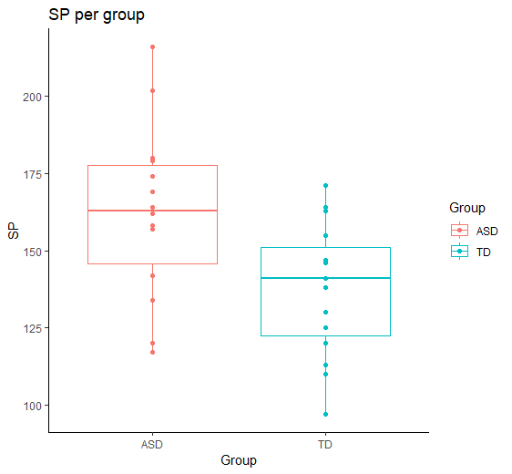
Participants tested: SRS & SP
ASD group: questionnaire data of 4 children missing TD group: questionnaire data of 5 children missing
2 TD participants with SRS of 77 and SRS of 91 removed. (>76 = ernstige tekortkomingen)
Only SP’s of children > 10 y included.
7 children of ASD group < 11, 9 TD children < 11y

Slide 7
Participants tested: comorbidities
TD children (comorbidities as reported by parents)
1 participant with CDD (complex developmental disorder) → removed
1 participant with ADHD → removed (but also participants with ADHD in ASD group?) → include again, so + 1 in ‘general population’ group.
1 participant: parents report ‘characteristics of ADHD’, but T-scores on CBCL attention problems and ADHD scales are very low.
ASD children (comorbidities as reported by parents)
1 participant with mental disability → removed
4 participants with ADHD → Not removed? Don’t remove.

Slide 8

Participants included
25 TD children → 26 children
16 children in group (Krullevaar’t)
9 children individually
2 removed because of dev. Disorder 1 removed because of CDD
2 removed because of high SRS
25 children with ASD via ECA
Group | N | Mean age | Min | Max age | SD age | N girls
ASD | 24 (of 25) | 12.04853 | 10.22 | 14.9863 | 1.300072 | 8
TD | 25 (of 29) | 11.82827 | 10.01 | 14.9500 | 1.512985 | 12

Slide 9
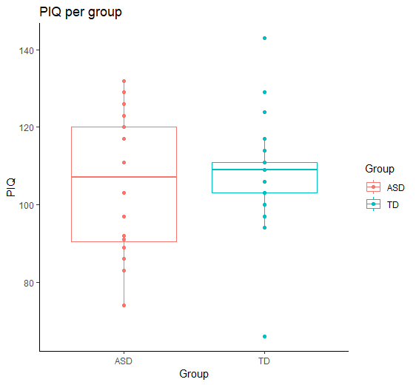
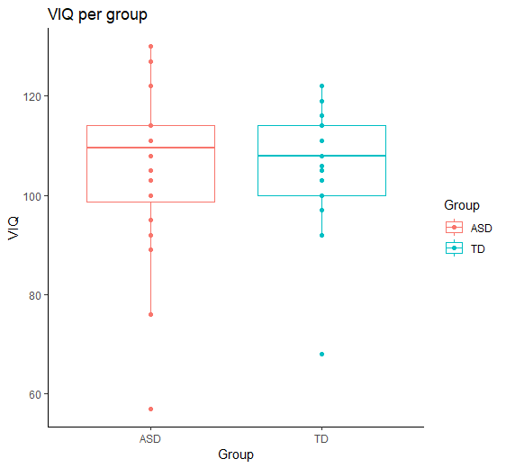
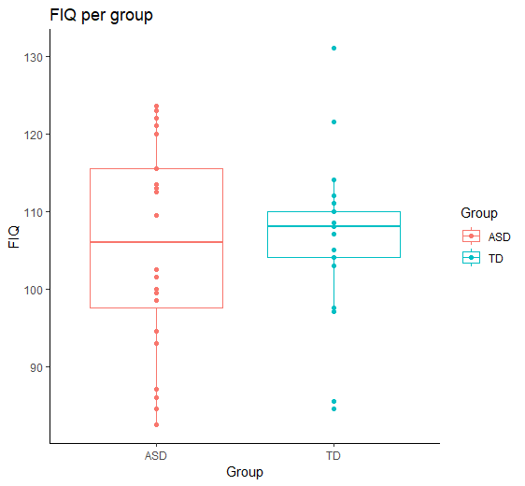
Participants tested: IQ (no sign. group differences, p>0.60)
Participant of ASD group with FIQ of 76.5, removed from data, because parents reported intellectual disability.
VIQ of 57? But FIQ of 87

Slide 10
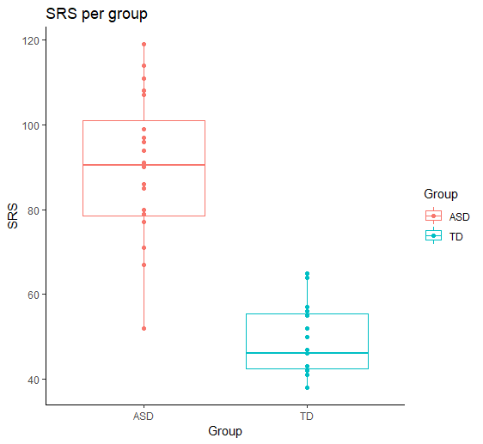

Participants tested: SRS & SP
ASD group: questionnaire data of 4 children (all 11 y or older) missing TD group: questionnaire data of 5 children (all 11 y or older) missing
p < 0.0001
p = 0.002618
Only SP’s of children 11 y or older included. (7 out of 25 TD and 7 out of 24 ASD children of <11y)

Slide 11
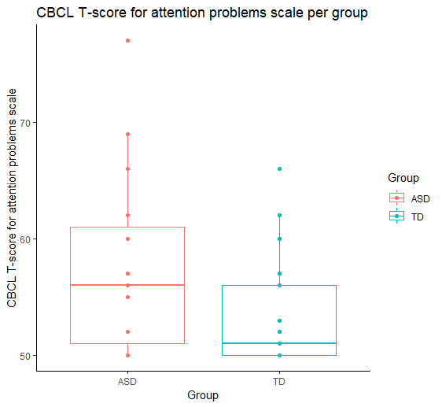
Participants tested: SRS & SP
ASD group: questionnaire data of 4 children missing TD group: questionnaire data of 5 children missing
p-value = 0.09731

Slide 12
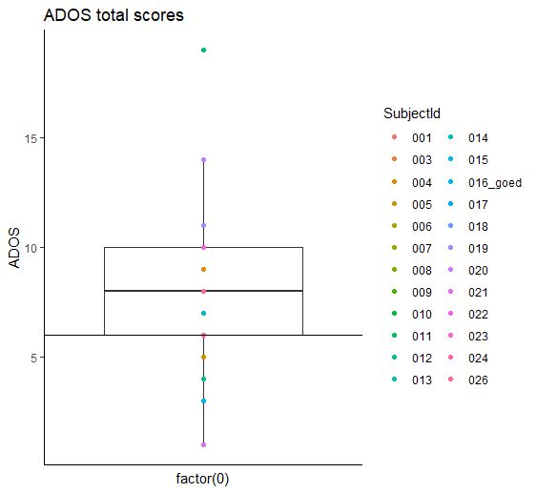
Participants tested: ADOS
→ 5 participants in ASD group with ADOS score < 6.
Participant | ADOS score | SRS total score
021 | 1 | ?
015 | 3 | 108
012 | 4 | 90
001 | 5 | 91
005 | 5 | 96
Ilse: in line with 80% > cut-off
Notes:
021: Diagnose op ECA
022: wel opvallend ASS volgens Lise, maar scoorde vooral hoog op dingen die niet meetellen voor algoritme. Lise herbekijkt ADOS.

Slide 13
Feedback: ICF participants
Mededeling van de resultaten en privacy
Wij benadrukken dat de verkregen gegevens gedurende het gehele onderzoekstraject gecodeerd verwerkt en vertrouwelijk behandeld worden. Indien u dit wenst, ontvangt u een schriftelijk verslag van de resultaten van het gehele onderzoek. Indien uit één van de testen een resultaat zou komen waarvoor het advies van een arts of klinisch psycholoog nuttig lijkt, kan u dit ook meegedeeld worden. Op het toestemmingsformulier kunt u aangeven of u een verslag van de conclusies van het onderzoek wilt ontvangen. Verder zullen alle gegevens die in het van deze studie verzameld worden, zoals alle medische gegevens, uiterst vertrouwelijk behandeld worden. Hierbij worden het medisch geheim, de internationale richtlijnen (ICH-GCP) en de Belgische wetgeving nageleefd (onder meer de wettelijke vereisten zoals bepaald in de Belgische Wet van 8 december 1992 inzake bescherming van de persoonlijke levenssfeer en de Belgische Wet van 22 augustus 2002 inzake rechten van de patiënt).
Wil ik graag op de hoogte gehouden worden van de algemene resultaten van het onderzoek.
per e-mail: ……………………………………………………………...
per post op volgend adres: …………………………………………..

Slide 14
Feedback: in research protocol of approved EC documents
At the end of the entire study, we will inform the participants and their parents about the overall findings of the research (at a group level). At their request, recorded on the informed consent form (ICF), they will also receive the individual test results on the standardized test instruments (WISC III-NL and questionnaires). This is in line with the standard protocol provided by the Leuven Autism Research (LAuRes) group.
Adjust in protocol of next study!!

Slide 15
Feedback?
Overall study results
Individual test results
TD participants:
→Only “actionable” results:
- Two children with high SRS score. → telefonisch contacteren & bespreken.
→ 322: SRS = 91, CBCL: in clinical range for ADHD scale. Parents report ‘maybe dyslexia (logo)’
→ 316: SRS = 77, CBCL: different scales in clinical range.. See report. Parents report ‘maybe a developmental problem’
Participants with ASD:
SRS, SP and intelligence data following the LAuRes prescriptions
Also CBCL?
ADOS? Alle ADOS’en opnieuw scoren en bij twijfelgevallen zelf ook bekijken. Dan bekijken hoe terug te koppelen.
TO DO: check all CBCL data, now only checked based on T-score for attention problems, and checked when high SRS score in TD children.

Slide 16
Study 1
Participants

Slide 17
Participants
Group | N | Mean age | Min | Max age | SD age | N girls
ASD | 24 | 12.04853 | 10.22 | 14.9863 | 1.300072 | 8
TD | 24 | 11.89070 | 10.01 | 14.9500 | 1.519935 | 11
5 participants in ASD group with ADOS score < 6.
4 of them have an SRS score > 76
30 TD children tested
2 removed because of dev. Disorder → 1 removed because of CDD
2 removed because of high SRS
1 participant did not understand the tasks and did not finish
Data of 1 participant not well saved.
25 children with ASD tested
1 removed from analysis because of a intellectual disability reported by parents.
Group-wise matched for age, IQ and gender ratio
Higher SP total scores in ASD group (p = 0.002618)
Higher SRS total scores in ASD group (p < 0.0001)
Same level of attention problems based on CBCL scale (p = 0.1114)

Slide 18
Study 2
Participants

Slide 19
Participants
Group | N | Mean age | Min | Max age | SD age | N girls
ASD | 24 | 12.04853 | 10.22 | 14.9863 | 1.300072 | 8
TD | 24 | 11.89070 | 10.01 | 14.9500 | 1.519935 | 11
5 participants in ASD group with ADOS score < 6.
4 of them have an SRS score > 76
30 TD children tested
2 removed because of dev. Disorder → 1 removed because of CDD
2 removed because of high SRS
1 participant did not understand the tasks and did not finish
1 participant was not wearing glasses and said this when completed half of the task.
25 children with ASD tested
1 removed from analysis because of a intellectual disability reported by parents.

Slide 20
Participants
In study by Karvelis et al. (2018), they exclude the participants who have a RMS error > 30° on the easiest trials. (= 7 ASD participants, 6 TD participants).
But in Chalk & Seitz (2010) all participants with a mean absolute error > 30° excluded. (= 1 ASD participant & 2 TD participants). Do analyses with and without these participants.
id | trial_sigma | group | rms_error | abs_error
3 | 10 | ASD | 33.51442 | 26.1035
7 | 10 | ASD | 32.67020 | 26.8060
8 | 10 | ASD | 39.80974 | 27.9630
13 | 10 | ASD | 32.20667 | 25.4470
15 | 10 | ASD | 32.49005 | 26.8155
16 | 10 | ASD | 30.30551 | 22.9730
17 | 10 | ASD | 44.92435 | 33.2255
302 | 10 | TD | 30.12820 | 24.3120
306 | 10 | TD | 31.15631 | 25.2335
309 | 10 | TD | 39.32883 | 28.1855
310 | 10 | TD | 31.58469 | 25.7605
312 | 10 | TD | 31.44090 | 22.8975
313 | 10 | TD | 37.86812 | 30.4440
314 | 10 | TD | 40.14649 | 30.3465
317 | 10 | TD | 36.82663 | 28.2665
327 | 10 | TD | 32.03156 | 26.8900
Zoals bij pilots, geen deelnemers verwijderen obv errors. Moeilijk om volwassenen te vergelijken met kinderen.
id | trial_sigma | group | rms_error | abs_error
17 | 10 | ASD | 44.92435 | 33.2255
313 | 10 | TD | 37.86812 | 30.4440
314 | 10 | TD | 40.14649 | 30.3465

Slide 21
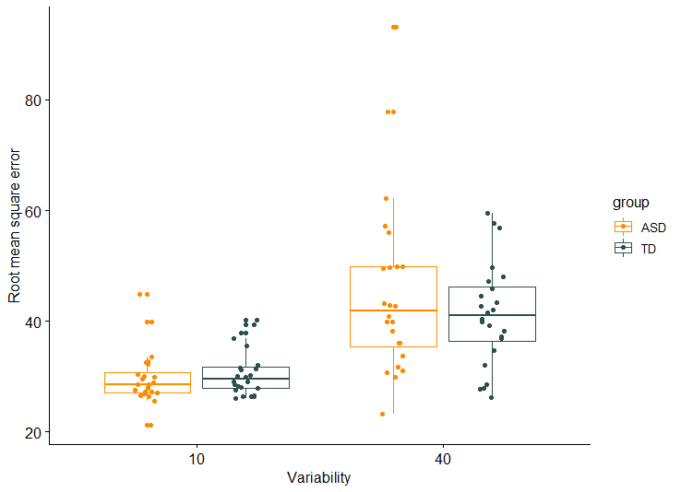
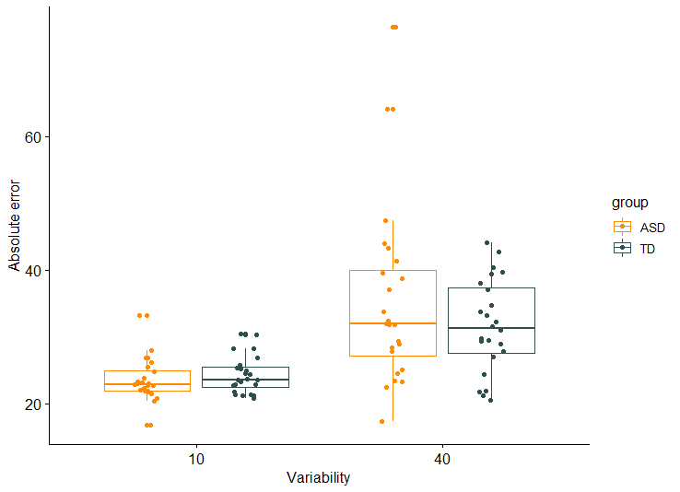
Participants

Slide 22
Study 1
Predictions & Results

Slide 23
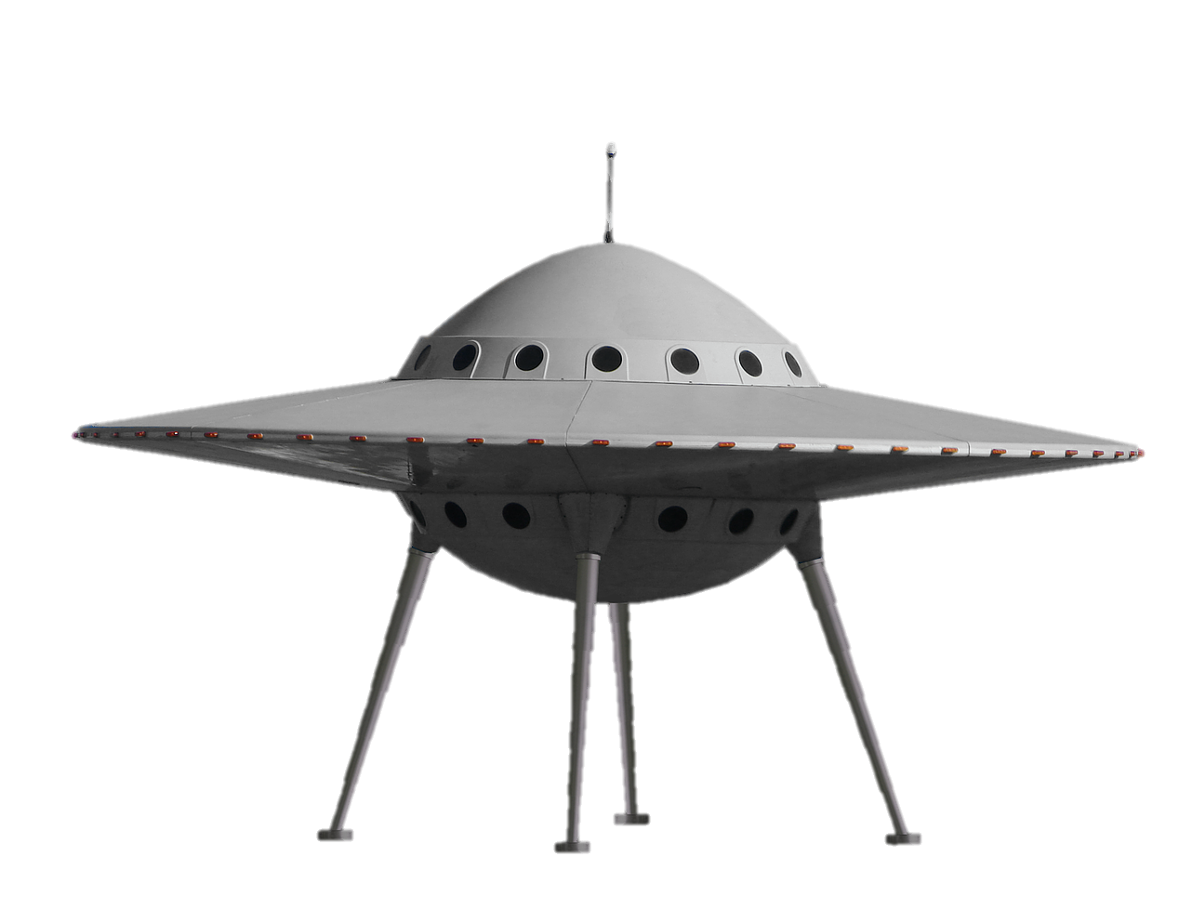
Predictions
WCC & EPF
ASD > TD on visual search task
Hypo-prior hypothesis & High precision of likelihood hypothesis
RTs over trials within prime streaks: Repetition effect in ASD < in TD
RTs over CTPD:
→ Less precise representation of the learned distribution
→ RTs in ASD children less influenced by CTPD (~less surprise)
HIPPEA
RTs over trials within prime streaks: Repetition effect in ASD = > TD
RTs over CTPD: → More precise representation of the learned distribution
→ Higher RTs in ASD children compared to TD children in test trials with small CTPD (~more surprise)

Slide 24
3. Preliminary results

Slide 25
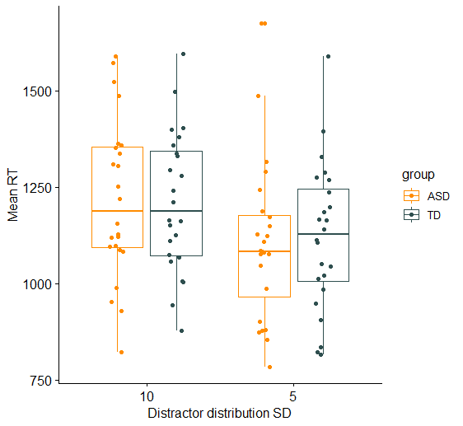
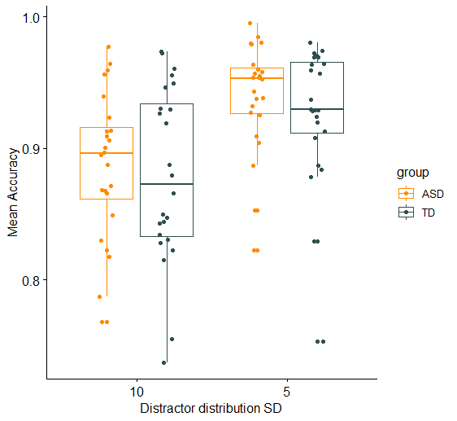
Overall accuracy and RTs
Significant main effect of DSD on both RTs and accuracy
Bayes factors: evidence for model with DSD as predictor and accounting for repeated measures. Enough evidence to refute model with group as predictor.
Notes:
Mixed effects logistic regression
ANOVA – Bayes factor

Slide 26
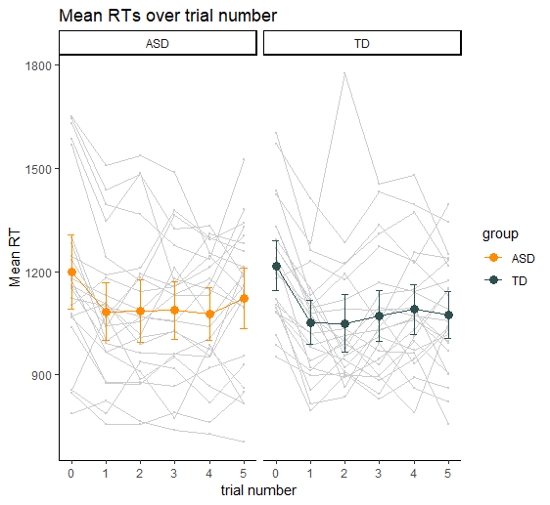
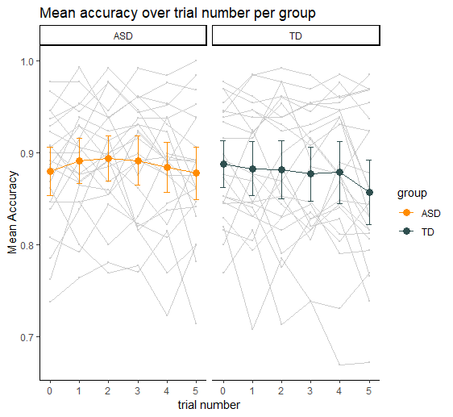
Repetition effect?

Slide 27
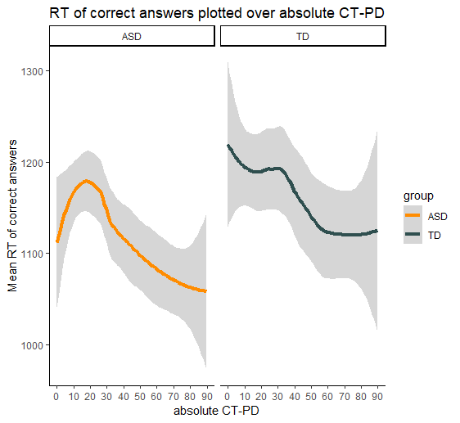
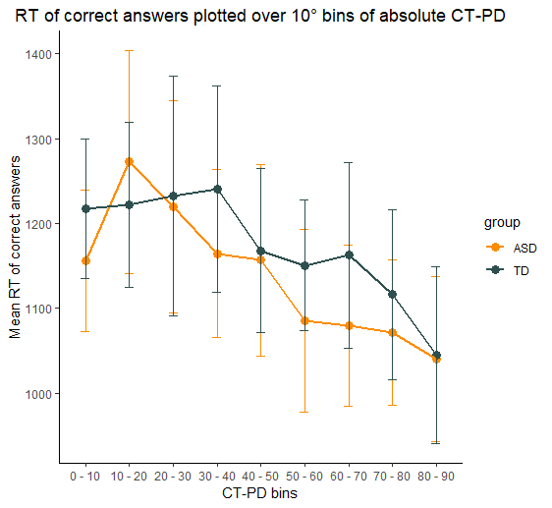
RT over CT-PD

Slide 28
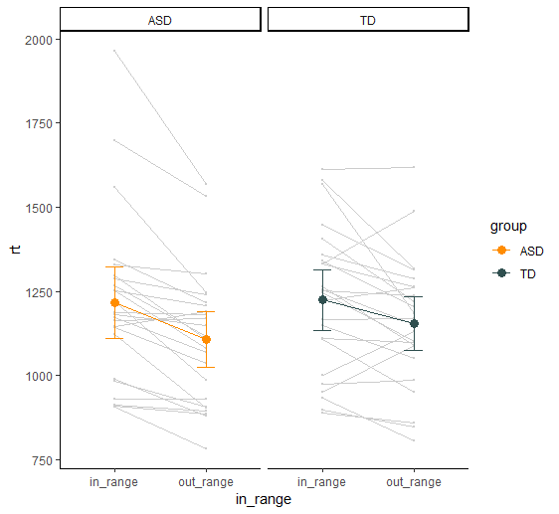
RT in range vs out range
Main effect of in_range as predictor
No effect of group or interaction between group and in_range
TO DO: Verschilscores ook eens bekijken in relatie tot SRS, IU, SP.

Slide 29
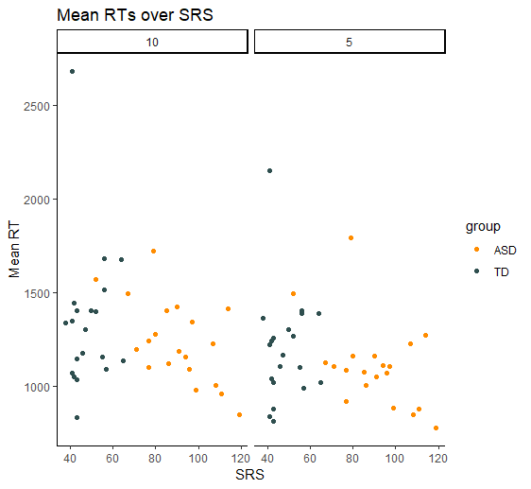
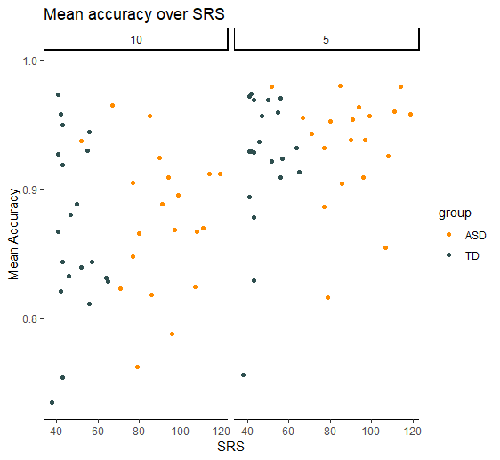
Performance and autistic traits
p-value = 0.01436
n.s
Notes:
Significant correlation RT and SRS in whole group and in ASD group. Not in TD group.

Slide 30
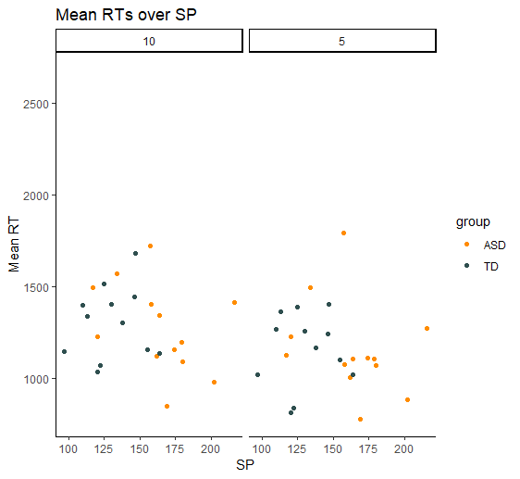
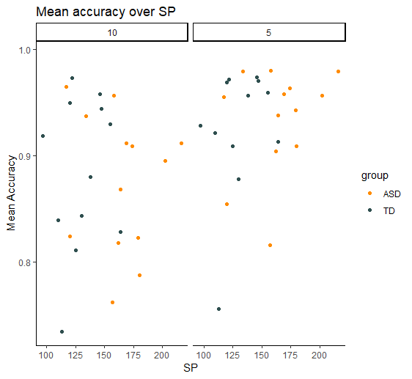
Performance and Sensory Profile
n.s
n.s
Notes:
Significant correlation RT and SRS in whole group and in ASD group. Not in TD group.

Slide 31
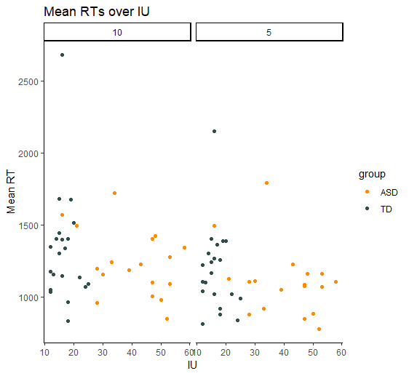
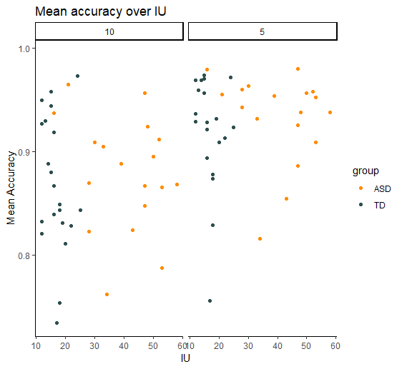
Performance and IU
p-value = 0.03842
n.s
Notes:
Significant correlation RT and SP in whole group and in ASD group. Not in TD group.

Slide 32
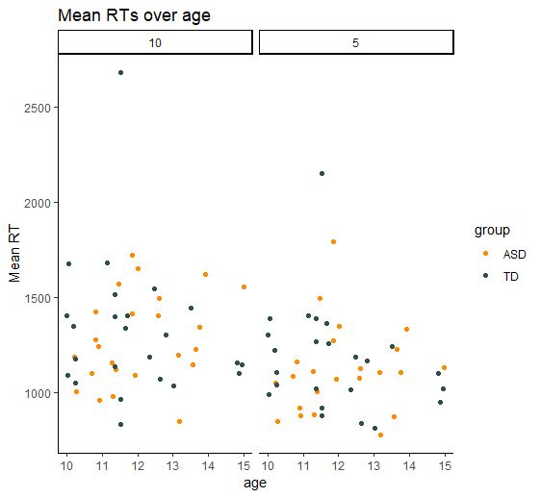
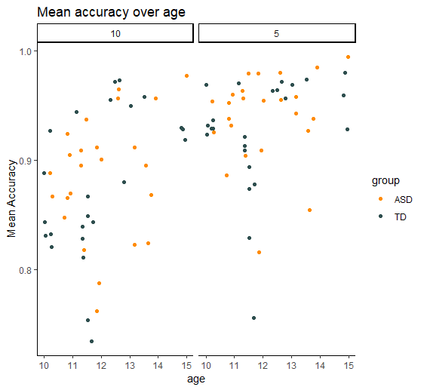
Performance and age
n.s.
p-value = 0.005429
Notes:
Significant correlation RT and SP in whole group and in ASD group. Not in TD group.

Slide 33
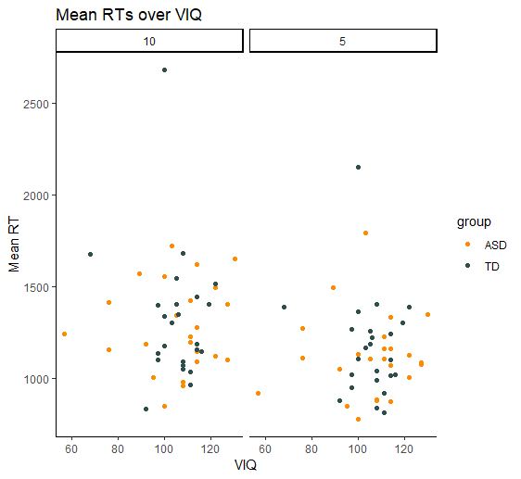
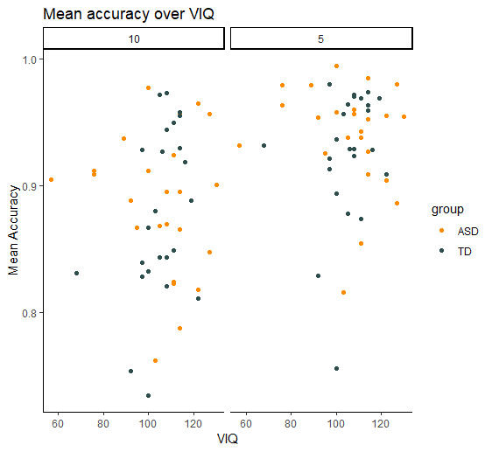
Performance and VIQ
n.s.
n.s.
Notes:
Significant correlation RT and SP in whole group and in ASD group. Not in TD group.

Slide 34
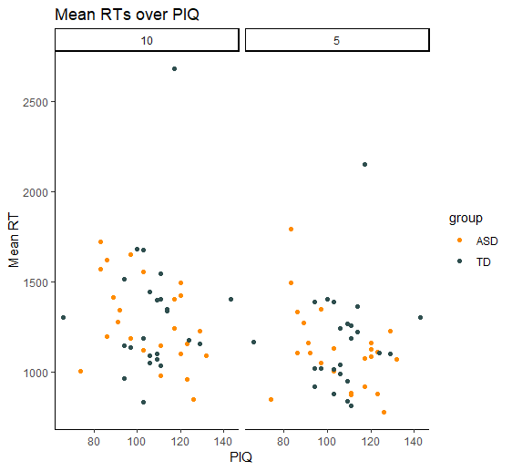
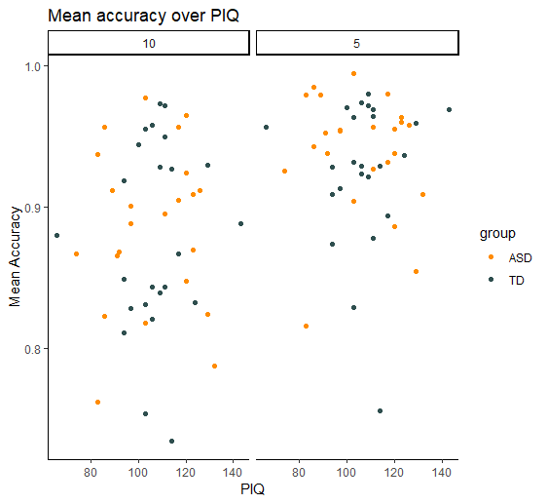
Performance and PIQ
n.s.
n.s.
Notes:
Significant correlation RT and SP in whole group and in ASD group. Not in TD group.

Slide 35
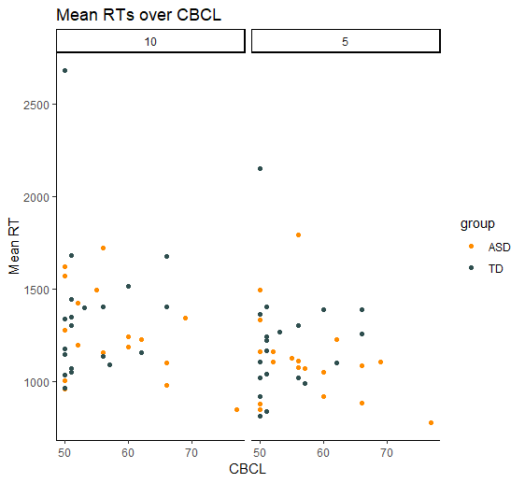
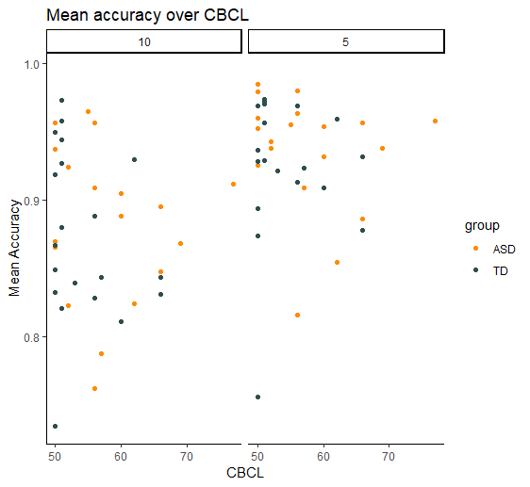
Performance and PIQ
n.s.
n.s.
Notes:
Significant correlation RT and SP in whole group and in ASD group. Not in TD group.

Slide 36
3. Discussion

Slide 37
Implicit learning of distributions?
No difference in overall performance between children with and without ASD
Higher score on SRS ~ lower RTs
Higher IU ~ lower RTs
Both TD and ASD children seem to learn the distractor distributions

Slide 38
WP2: Perceptual uncertainty and stress and anxiety in children with ASD
Ethical Approval

Slide 39
Questions?
Principal investigator? (~ CELSA?) Jean gaat navragen. Verdere info afwachten. En nakijken extra bijlage’s ICF’s!!
Questionnaires
SRS
Sensory Profile – GSQ → e-mailed David Simmons, no response.
IU (Rodgers et al., 2012) → translated, self-report + parent report
Anxiety Scale for children (ASC-ASD; Rodgers et al., 2015) → approval of authors, self-report + parent report.
Repetitive Behaviors Questionnaire-2 (RBQ-2; Leekam et al., 2007) → contacted Sue Leekam, translating it is okay.
CBCL (for externalizing and internalizing problem behaviors → long! Include it? SDQ eventueel? Genoeg info voor deze studie? Conner’s voor aandacht?
Questionnaires via RedCap? Eens navragen bij Lotte (SBO) over licentie en eravingen. Bij CDP gebruiken ze dit ook?
Notes:
Lisa,
Yes I remember the very interesting conversation we had in Leuven and am delighted to hear that you are interested to use the RBQ-2.
The RBQ-2 is for use with parents and you will see from the paper by Caroline Joyce (below) that she used it together with a self-report version for adolescents (the RBQ2-A was designed for adults but she used it with adolescents. Let us know if you are interested in both versions.
Regarding the translation we need to talk again and I am copying in my Cardiff University colleagues Sarah Barrett and Catherine Jones who are working together with me on these questionnaires. Our Newcastle colleagues arranged a translation to Dutch perhaps more than 10 years ago but right now we are also in the process of bringing together our RBQ-2 and 2A documents into our Wales Autism Research Centre website. Also the overlap between RBQ and RBQ-2 can be confusing as the RBQ-2 was a new measure included DISCO items in it. It includes 13 items found in both the RBQ and the Diagnostic Interview for Social and Communication Disorders (DISCO; Wing, Leekam, Libby, Gould, & Larcombe, 2002), plus five DISCO-only items and two RBQ-only items. However the RBQ-2 scaling and questionnaire form is based on the RBQ questionnaire.
Because Leuven is also doing so much work with the DISCO it would be ideal to collect these data in Dutch (and perhaps scope to compare with the questionnaire items at a later point beyond this project). Can you let us know when you need to start your data collection with the Dutch translation and I will talk to Cardiff and Newcastle colleagues to check out the previous translation and get arrangements set up.
Best wishes
Sue Leekam
Joyce, C.et al. 2017. Anxiety, intolerance of uncertainty and restricted and repetitive behaviour: insights directly from young people with ASD. Journal of Autism and Developmental Disorders 47(12), pp. 3789-3802. (10.1007/s10803-017-3027-2)

Slide 40
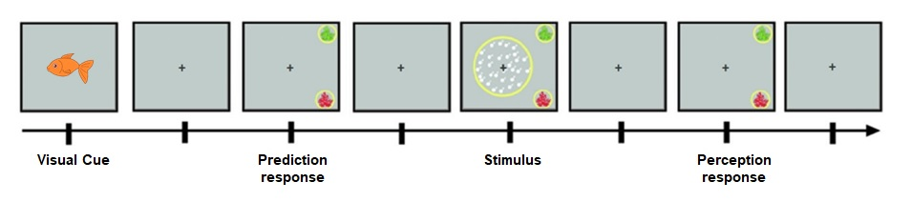
Associative learning task
+
Auditory cue
→ Social vs. non-social cue

