Slide 1
DACUM-Workshop
Organisation XXX
Facilitator XX
Date XX

Slide 2
Description of the occupation
Please provide a brief description of the occupation to be analysed

Slide 3
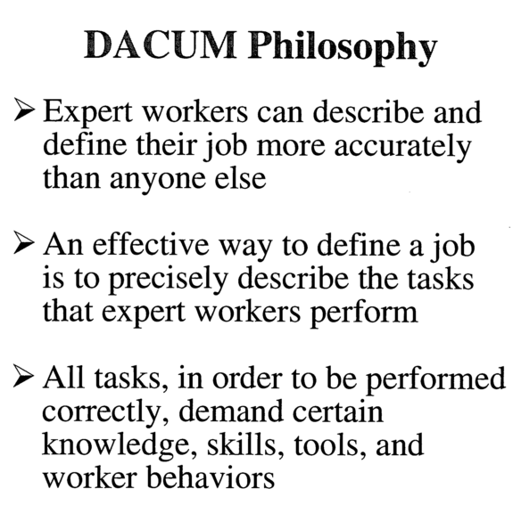
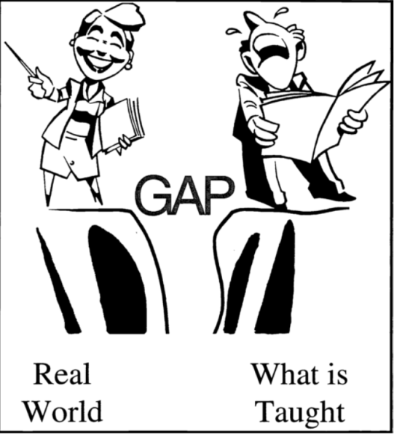
Norton 1997

Slide 4
Norton 1997
Notes:
The profile chart that results from the DACUM analysis is a detailed and graphic portrayal of the skills or competencies involved in the occupation being studied. The DACUM analysis can be used as a basis for (1) curriculum development, (2) student learning, (3) training needs assessments, (4) worker performance evaluations, and (5) competency test development.

Slide 5
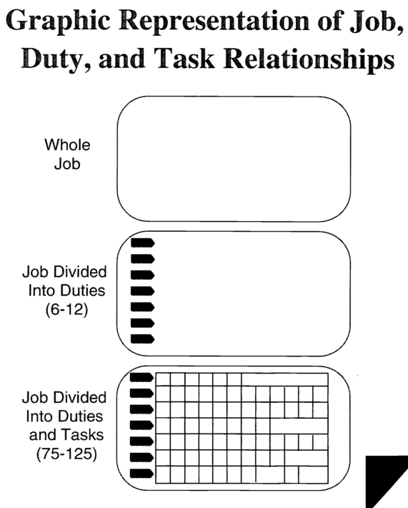
Norton 1997

Slide 6
Norton 1997

Slide 7
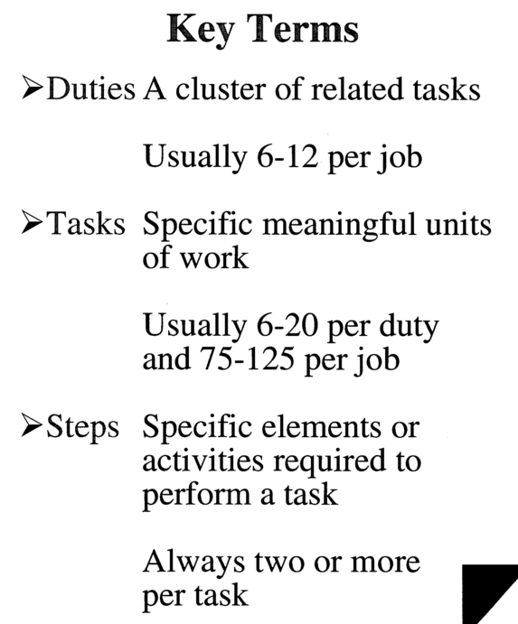
Norton 1997

Slide 8
Norton 1997

Slide 9
Additional Information

Slide 10
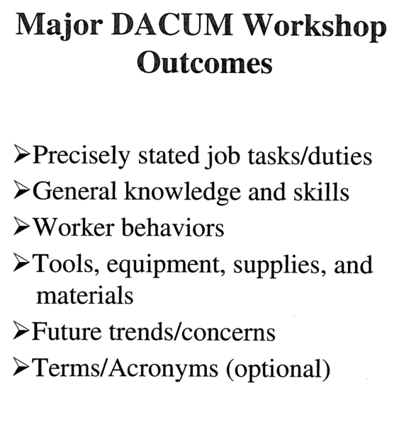
Norton 1997

Slide 11
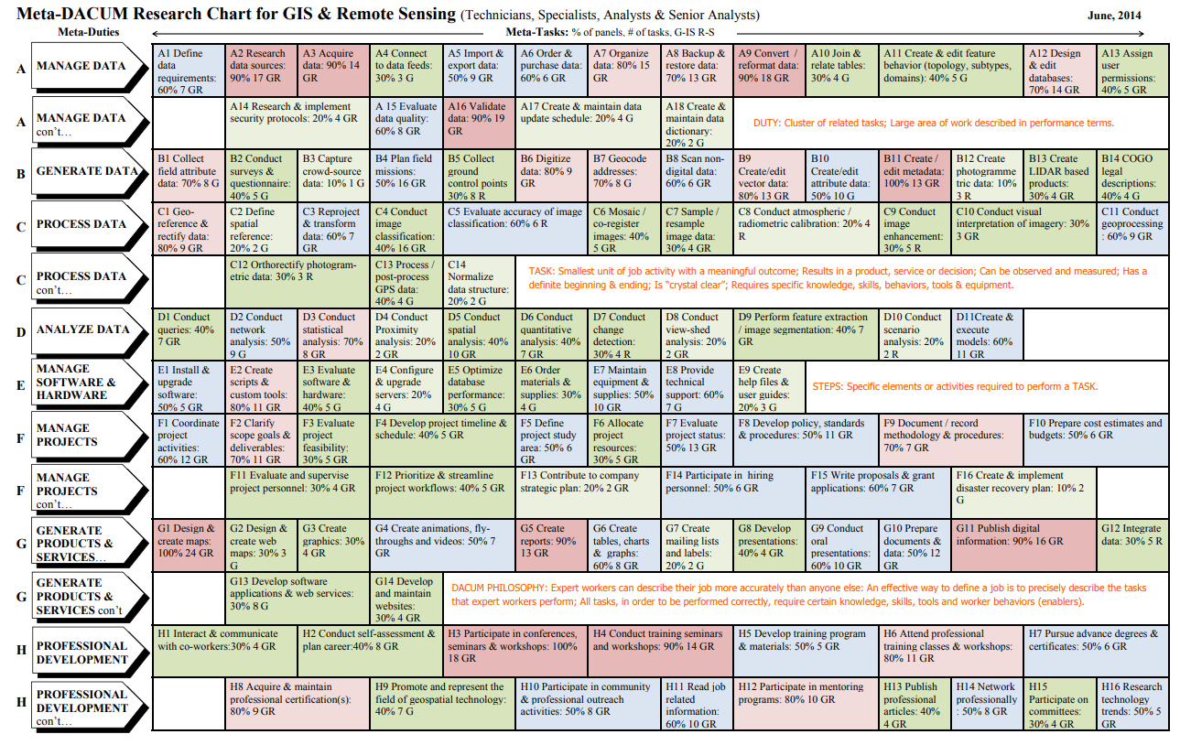
Notes:
http://www.geotechcenter.org/uploads/2/4/8/8/24886299/metadacum_gis_rs_june_2014.pdf

Slide 12
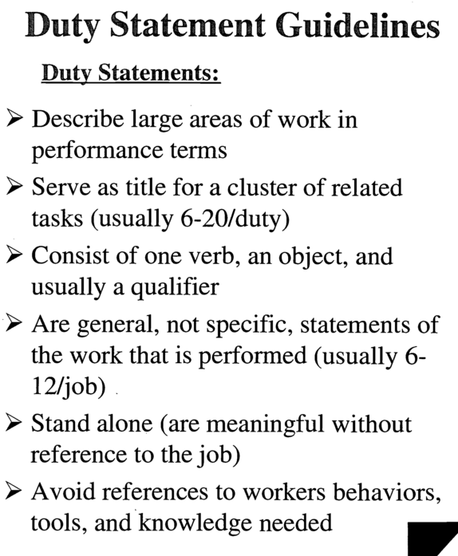
Norton 1997

Slide 13
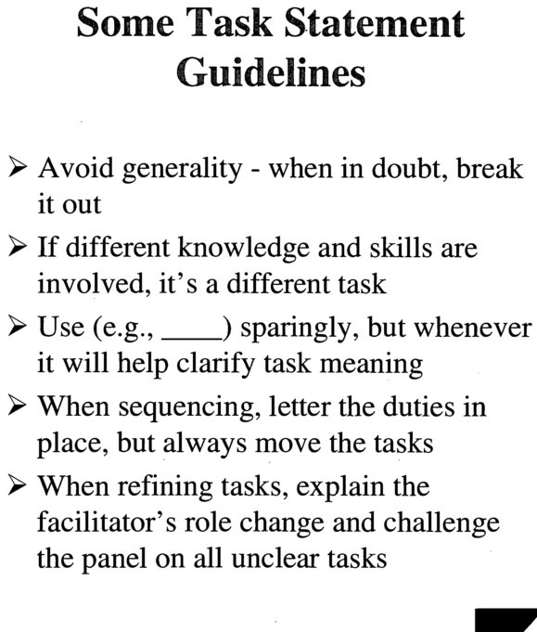
Norton 1997

Slide 14
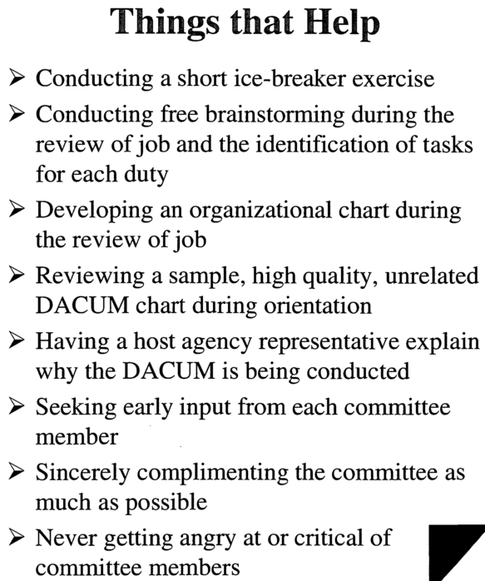
Norton 1997

Slide 15
References
Norton, R. E. (1997). DACUM Handbook (2 ed.): Center on Education and Training for Employment, College of Education, The Ohio State University, Columbus, Ohio.
http://www.geotechcenter.org/uploads/2/4/8/8/24886299/metadacum_gis_rs_june_2014.pdf

