Slide 1
Quokka Care
A new look for endangered animal awareness

Slide 2
Why Quokka Care?
Quokkas are cute, but few people actually know about them
Highly threatened animal
Raised awareness aids in conservation efforts

Slide 3
Creative direction
Bright yet complementary colours
Contribute to user’s association of the Quokka to their native habitat

Slide 4
Homepage information
What Quokkas look like
What a Quokka is
Habitat map

Slide 5
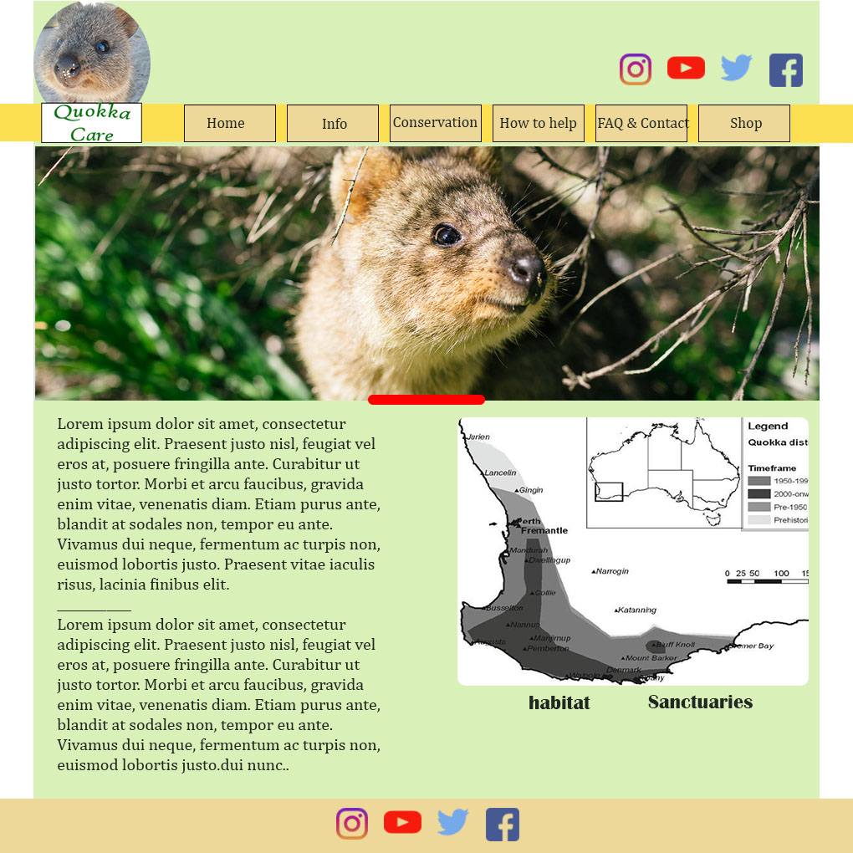

Slide 6
Responsiveness
Currently primarily optimized best for laptop and tablet viewing
Working through bugs with mobile and larger desktop screen viewing

