Slide 1

Global Governance and AI
Existing global AI policy documents
Abb. 1 Global Governance AI
Lukas Hofstetter, , & Mag. Petra Koller BEd.
2024S 180168-1 Global Governance and AI
Prof. Mark Coeckelbergh
Universität Wien 2024

Slide 2
CONTENTS
Overview
EU AI Act
GPAI
Conclusion
Perspectives
Discussion

Slide 3

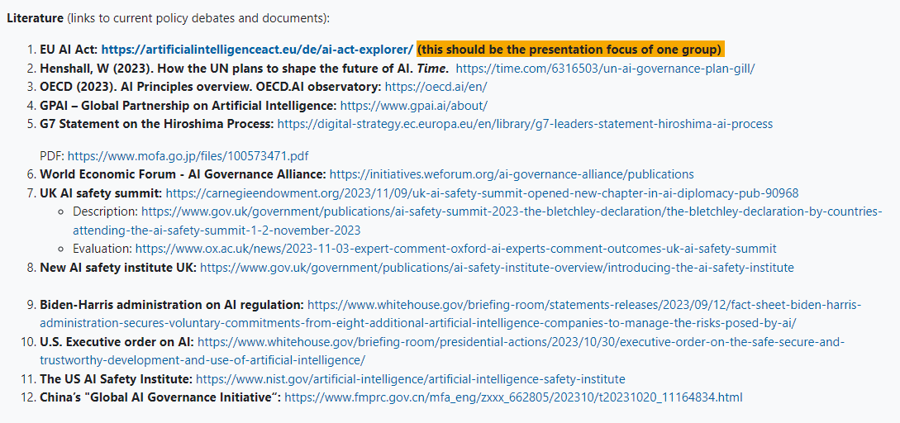

Slide 4

Quelle: EU AI Act Compliance Checker: https://artificialintelligenceact.eu/assessment/eu-ai-act-compliance-checker/
Quelle: GPAI – Global Partnership on Artificial Intelligence: https://www.gpai.ai

Slide 5
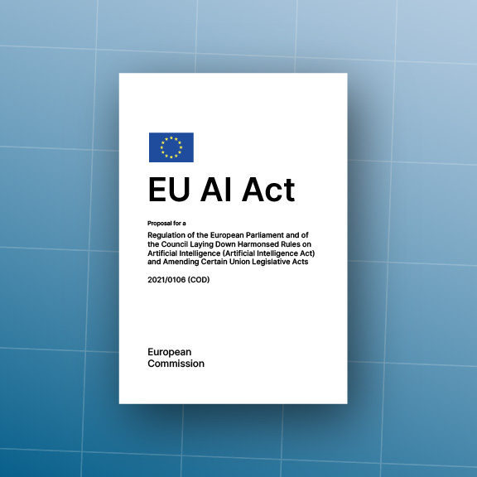
Motivation
Human-centric
Regulatory and Legal Framework
Ethical Development
Quelle: GPAI – Global Partnership on Artificial Intelligence: https://www.gpai.ai
Quelle: GPAI – Global Partnership on Artificial Intelligence: https://www.gpai.ai

Slide 6
Implementation
Minimal
Risk
Limited
Risk
High
Risk
Unacceptable
Risk
1
2
3
4
Quelle: GPAI – Global Partnership on Artificial Intelligence: https://www.gpai.ai
Quelle: GPAI – Global Partnership on Artificial Intelligence: https://www.gpai.ai

Slide 7
Four Levels of Risk
Minimal
Risk
No EU Intervention required
Simple applications like games or spam filters
1
Limited
Risk
High
Risk
Unacceptable
Risk
Quelle: GPAI – Global Partnership on Artificial Intelligence: https://www.gpai.ai
Quelle: GPAI – Global Partnership on Artificial Intelligence: https://www.gpai.ai
2
3
4

Slide 8
Four Levels of Risk
Limited
Risk
Deep Fake
Transparency
Chat Bots
2
Minimal
Risk
High
Risk
Unacceptable
Risk
Quelle: GPAI – Global Partnership on Artificial Intelligence: https://www.gpai.ai
Quelle: GPAI – Global Partnership on Artificial Intelligence: https://www.gpai.ai
1
2
3
4

Slide 9
Four Levels of Risk
Rigorous Risk Assessment
Education
High
Risk
Use High-quality Datasets
Transport
Maintain Activity Logs
Safety
Law Enforcement
Provide Comprehensive Doc.
Health
3
Clear User Information
Minimal
Risk
Limited
Risk
Unacceptable
Risk
Quelle: GPAI – Global Partnership on Artificial Intelligence: https://www.gpai.ai
Quelle: GPAI – Global Partnership on Artificial Intelligence: https://www.gpai.ai
1
2
4

Slide 10
Four Levels of Risk
Unacceptable
Risk
Social Scoring Systems
4
Minimal
Risk
Limited
Risk
High
Risk
Quelle: GPAI – Global Partnership on Artificial Intelligence: https://www.gpai.ai
Quelle: GPAI – Global Partnership on Artificial Intelligence: https://www.gpai.ai
1
2
3

Slide 11

Military
Defense
Exemptions
National Security use
Science
Research
Quelle: GPAI – Global Partnership on Artificial Intelligence: https://www.gpai.ai

Slide 12
Exemptions
Quelle: GPAI – Global Partnership on Artificial Intelligence: https://www.gpai.ai

Slide 13
Discussioin
☝️
Same Topic
✋
New Topic
Quelle: GPAI – Global Partnership on Artificial Intelligence: https://www.gpai.ai
Quelle: GPAI – Global Partnership on Artificial Intelligence: https://www.gpai.ai

Slide 15

Multi-stakeholder-initiative
bridge the gap between theory and practice
international organisations
science
civil
society
industry
governments
academia
Quelle: GPAI – Global Partnership on Artificial Intelligence: https://www.gpai.ai

Slide 16
GPAI Council
Structure
Steering Committee
Secretariat / hosted by the OECD
Two Centres of Expertise (Montreal & Paris)
Quelle: GPAI – Global Partnership on Artificial Intelligence: https://www.gpai.ai

Slide 17


MEMBERSHIP
letter of intent setting out reasons for seeking membership
two-thirds majority vote by GPAI Council
open to all countries, including emerging and developing countries
confirmation that the applicant endorses the shared values reflected in the OECD Recommendation on AI
Quelle: GPAI – Global Partnership on Artificial Intelligence: https://www.gpai.ai

Slide 18


VALUES
to foster responsible development of AI grounded in these principles of human rights, inclusion, diversity, innovation and economic growth
shared commitment to the values expressed in the OECD Recommendation on Artificial Intelligence
Quelle: GPAI – Global Partnership on Artificial Intelligence: https://www.gpai.ai

Slide 19

Principles for responsible stewardship of trustworthy AI
Inclusive growth, sustainable development and well-being
Human-centred values and fairness
Transparency and explainability
Robustness, security and safety
Accountability
Quelle: GPAI – Global Partnership on Artificial Intelligence: https://www.gpai.ai

Slide 20

National policies and international cooperation for trustworthy AI
Investing in AI research and development
Fostering a digital ecosystem for AI
Shaping an enabling policy environment for AI
International cooperation for trustworthy AI
Building human capacity and preparing for labour market transformation
Quelle: GPAI – Global Partnership on Artificial Intelligence: https://www.gpai.ai

Slide 21

sharing multidisciplinary research
AIMS
identifying key issues among AI
facilitating international collaboration
promoting trust in and the adoption of trustworthy AI
Scientific, technical and socio-economic informations!

Slide 22




Responsible AI
WORKING GROUPS
Data governance
The future of work
Innovation & commercialisation
Quelle: GPAI – Global Partnership on Artificial Intelligence: https://www.gpai.ai

Slide 24
Perspectives
digitalization
human rights
global controling instruments
ethical guidelines
(international) security
impact on democracy
human risks

Slide 25
Abb.1 Global Governance AI
https://medium.com/@officialprateekraj/global-governance-gap-patching-the-ip-framework-for-ai-in-2024-8edef3fd5748

