Slide 1
Adding Custom Instructions to the MicroWatt Processor These slides and the accompanying instructions can be found at https://github.com/hofstee-hp/MicroWatt_on_Arty_A7-100T/tree/main/Custom_Ops_Example
H. Peter Hofstee

Slide 2
Agenda
Power ISA Reminder
Application Area: Spiking Neural Networks (just an example)
New Instruction Definitions
Microwatt Reminder
Implementation of New Instructions
Enabling and Testing the New Instructions

Slide 3
Simple Spiking Neural Network
Each neuron is at a certain internal charge represented by a byte (unsigned byte integer)
The neuron produces an output if the internal voltage crosses a threshold
The neuron voltage decreases every cycle by a fixed (leakage) amount and by an additional amount if it fires
When a neuron fires it can either increase or decrease the charge of the neurons it is connected to (by a fixed amount)
ea
es
Inputs-ext
0001 0000 0x10
0100 0000 0x40
0000 1000 0x08
0000 0010 0x0a
0000 0000 0x00
0000 1001 0x09
0000 0000 0x00
0000 0000 0x00
0000 0000 0x00
0000 0000 0x00
0010 0000 0x20
0000 0000 0x00
0000 0000 0x00
0000 0000 0x00
0001 0000 0x10
0000 0100 0x04
…
Inputs-int
0000 0000 0x00
0000 0000 0x00
0000 1000 0x08
0010 0000 0x20
0001 0100 0x14
0100 0000 0x40
0000 0010 0x02
0000 0100 0x04
0000 0000 0x00
0000 0000 0x00
0000 0000 0x00
0000 0000 0x00
0000 0000 0x00
0000 1000 0x08
0000 0000 0x00
0000 0000 0x00
…
ia
is
Neurons
Outputs-int
Outputs-ext

Slide 4
Simple Spiking Neural Network
ea 0x1040080a00090000
ia 0x0000082014400204
es 0x0000200000001004
is 0x0000000000080000
Each neuron is at a certain internal charge represented by a byte (unsigned byte integer)
The neuron produces an output if the internal voltage crosses a threshold
The neuron voltage decreases every cycle by a fixed (leakage) amount and by an additional amount if it fires
When a neuron fires it can either increase or decrease the charge of the neurons it is connected to (by a fixed amount)
ea
es
Inputs-ext
0001 0000 0x10
0100 0000 0x40
0000 1000 0x08
0000 0010 0x0a
0000 0000 0x00
0000 1001 0x09
0000 0000 0x00
0000 0000 0x00
0000 0000 0x00
0000 0000 0x00
0010 0000 0x20
0000 0000 0x00
0000 0000 0x00
0000 0000 0x00
0001 0000 0x10
0000 0100 0x04
…
Inputs-int
0000 0000 0x00
0000 0000 0x00
0000 1000 0x08
0010 0000 0x20
0001 0100 0x14
0100 0000 0x40
0000 0010 0x02
0000 0100 0x04
0000 0000 0x00
0000 0000 0x00
0000 0000 0x00
0000 0000 0x00
0000 0000 0x00
0000 1000 0x08
0000 0000 0x00
0000 0000 0x00
…
ia
is
Neurons
Outputs-int
Outputs-ext

Slide 5
Simple Spiking Neural Network
Inputs-ext
0
1
1
1
0
1
1
0
…
0
0
0
0
0
0
0
0
Inputs-int
Threshold is 2 for each neuron
-1 whenever it fires
-1 every time step
…
Neurons
0 0 0 0 0 0 0 0
0 0 0 0 0 0 0 0
0 0 0 0 0 0 0 0
Outputs-int
Outputs-ext

Slide 6
Simple Spiking Neural Network
Inputs-ext
0
1
1
1
0
1
1
0
ei 0x00FFFFFF00FFFF00
ea 0x1040080a00090000
ia 0x0000082014400204
es 0x0000200000001004
is 0x0000000000080000
…
0
0
0
0
0
0
0
0
Inputs-int
ii 0x0000000000000000
Threshold is 2 for each neuron to fire
-1 every time step
…
0 1 0 0 3 0 1 1
2 0 1 1 1 0 1 1
0 0 0 0 0 0 0 0
Neurons
0 0 0 0 0 0 0 0
Outputs-int
Outputs-ext

Slide 7
Simple Spiking Neural Network
Inputs-ext
0
1
1
1
0
1
1
0
…
0
0
0
0
1
0
0
0
Inputs-int
Threshold is 2 for each neuron
-1 every time step
…
0 0 0 0 0 0 0 0
0 0 0 0 2 0 0 0
Neurons
0 0 0 0 1 0 0 0
1 0 0 0 0 0 0 0
Outputs-int
Outputs-ext

Slide 8
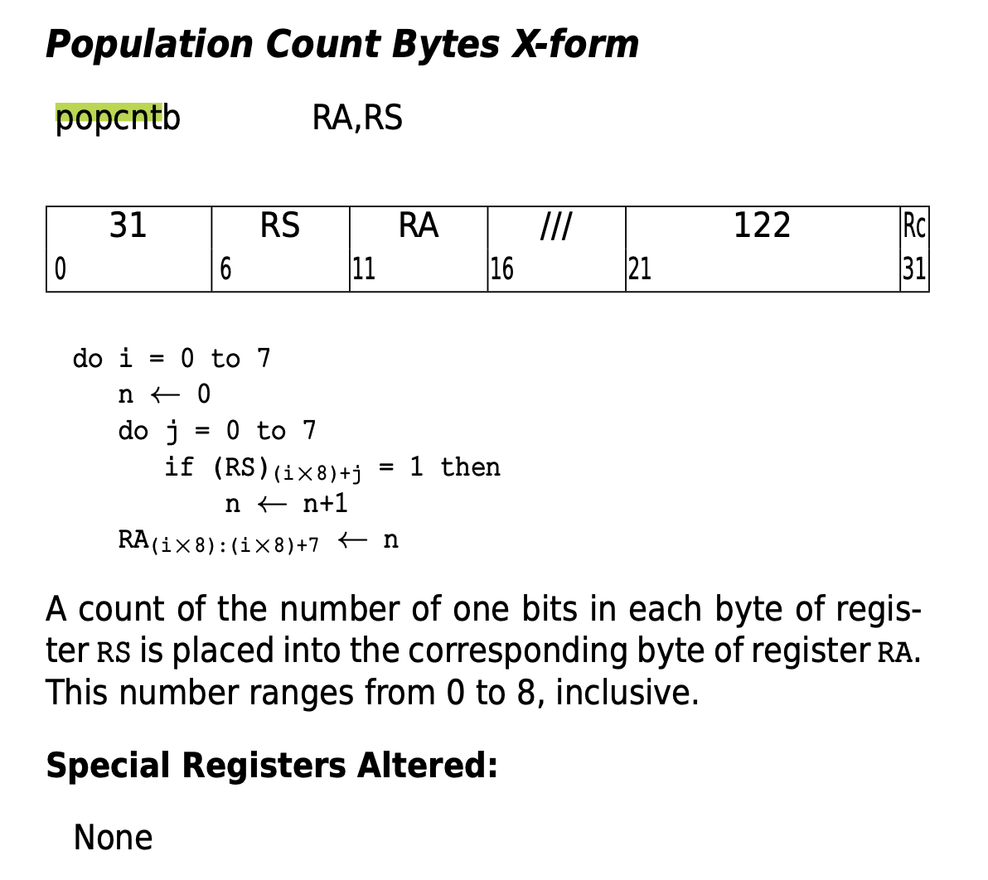

Slide 9
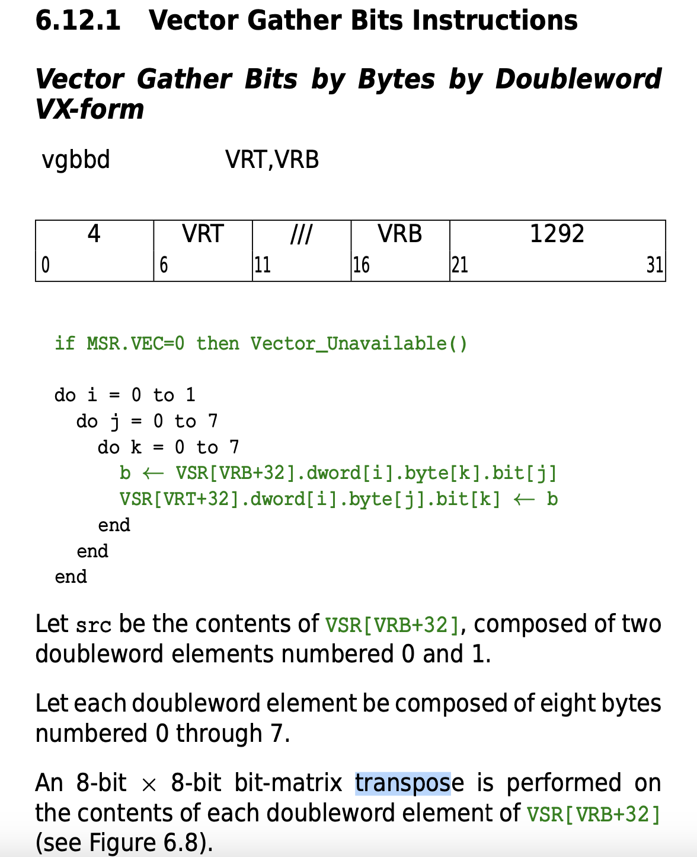
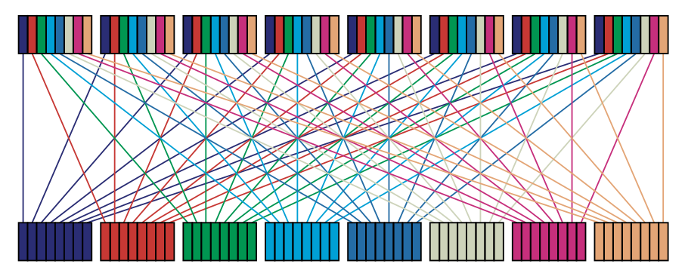

Slide 10
New custom instructions definition
addbusat RT, RA, RB, RC – add bytes unsigned saturating
Opcode 22, secondary opcode 48
For each i_th byte of RT
RT <- min (255, RA + RB)
subbusat RT, RA, RB , RC – subtract bytes unsigned saturating
Opcode 22, secondary opcode 49
For each i_th byte of RT
RT <- max (0, RB – RA)
maskbu RT, RA, RB, RC – create a mask from unsigned bytes
Opcode 22, secondary opcode 50
For each i_th byte of RT
RT <- ( if RA = “00000000”-> “00000000” else “11111111” )
gbbd RT, RA , RB, RC – gather bits by bytes doubleword
Opcode 22, secondary opcode 51
RT <- Transpose(RA)
Transpose of the bit matrix considering the doubleword as 8x8bits

