Slide 1
Adding Custom Instructions to the MicroWatt Processor These slides and the accompanying instructions can be found at https://github.com/hofstee-hp/MicroWatt_on_Arty_A7-100T/tree/main/Custom_Ops_Example
H. Peter Hofstee

Slide 2
Today’s talk
Objective: customize MicroWatt with your own opcodes
Double-edged sword …
More performance … but …
… responsible for your own tooling
powerpc architecture is defined with custom extensions in mind
See previous talk ( & https://openpowerfoundation.org/specifications/isa/ )
Opcode 22
We give a specific example just to make the process of adding and using new instructions concrete
What instructions you will want to add will depend on your own use case
For more broadly useful instructions you are encouraged to work with the OpenPower foundation to propose inclusion in future versions of the ISA

Slide 3
Agenda
Motivating example: Spiking Neural Networks
Implementation of New Instructions
Enabling and Testing the New Instructions

Slide 4
Simple Spiking Neural Network
Each neuron is at a certain internal charge represented by a byte (unsigned byte integer)
The neuron produces an output if the internal voltage crosses a threshold
The neuron voltage decreases every cycle by a fixed (leakage) amount and by an additional amount if it fires
When a neuron fires it can either increase or decrease the charge of the neurons it is connected to (by a fixed amount)
ea
es
Inputs-ext
0001 0000 0x10
0100 0000 0x40
0000 1000 0x08
0000 0010 0x0a
0000 0000 0x00
0000 1001 0x09
0000 0000 0x00
0000 0000 0x00
0000 0000 0x00
0000 0000 0x00
0010 0000 0x20
0000 0000 0x00
0000 0000 0x00
0000 0000 0x00
0001 0000 0x10
0000 0100 0x04
…
Inputs-int
0000 0000 0x00
0000 0000 0x00
0000 1000 0x08
0010 0000 0x20
0001 0100 0x14
0100 0000 0x40
0000 0010 0x02
0000 0100 0x04
0000 0000 0x00
0000 0000 0x00
0000 0000 0x00
0000 0000 0x00
0000 0000 0x00
0000 1000 0x08
0000 0000 0x00
0000 0000 0x00
…
ia
is
Neurons
Outputs-int
Outputs-ext

Slide 5
Simple Spiking Neural Network
Each neuron is at a certain internal charge represented by a byte (unsigned byte integer)
The neuron produces an output if the internal voltage crosses a threshold
The neuron voltage decreases every cycle by a fixed (leakage) amount and by an additional amount if it fires
When a neuron fires it can either increase or decrease the charge of the neurons it is connected to (by a fixed amount)
ea
es
Inputs-ext
0001 0000 0x10
0100 0000 0x40
0000 1000 0x08
0000 0010 0x0a
0000 0000 0x00
0000 1001 0x09
0000 0000 0x00
0000 0000 0x00
0000 0000 0x00
0000 0000 0x00
0010 0000 0x20
0000 0000 0x00
0000 0000 0x00
0000 0000 0x00
0001 0000 0x10
0000 0100 0x04
…
Inputs-int
0000 0000 0x00
0000 0000 0x00
0000 1000 0x08
0010 0000 0x20
0001 0100 0x14
0100 0000 0x40
0000 0010 0x02
0000 0100 0x04
0000 0000 0x00
0000 0000 0x00
0000 0000 0x00
0000 0000 0x00
0000 0000 0x00
0000 1000 0x08
0000 0000 0x00
0000 0000 0x00
…
ia
is
Neurons
Outputs-int
Outputs-ext

Slide 6
Simple Spiking Neural Network
ea 0x1040080a00090000
ia 0x0000082014400204
es 0x0000200000001004
is 0x0000000000080000
Each neuron is at a certain internal charge represented by a byte (unsigned byte integer)
The neuron produces an output if the internal voltage crosses a threshold
The neuron voltage decreases every cycle by a fixed (leakage) amount and by an additional amount if it fires
When a neuron fires it can either increase or decrease the charge of the neurons it is connected to (by a fixed amount)
ea
es
Inputs-ext
0001 0000 0x10
0100 0000 0x40
0000 1000 0x08
0000 0010 0x0a
0000 0000 0x00
0000 1001 0x09
0000 0000 0x00
0000 0000 0x00
0000 0000 0x00
0000 0000 0x00
0010 0000 0x20
0000 0000 0x00
0000 0000 0x00
0000 0000 0x00
0001 0000 0x10
0000 0100 0x04
…
Inputs-int
0000 0000 0x00
0000 0000 0x00
0000 1000 0x08
0010 0000 0x20
0001 0100 0x14
0100 0000 0x40
0000 0010 0x02
0000 0100 0x04
0000 0000 0x00
0000 0000 0x00
0000 0000 0x00
0000 0000 0x00
0000 0000 0x00
0000 1000 0x08
0000 0000 0x00
0000 0000 0x00
…
ia
is
Neurons
Outputs-int
Outputs-ext

Slide 7
Simple Spiking Neural Network
Inputs-ext
0
1
1
1
0
1
1
0
ei 0x00FFFFFF00FFFF00
ea 0x1040080a00090000
ia 0x0000082014400204
es 0x0000200000001004
is 0x0000000000080000
…
0
0
0
0
0
0
0
0
Inputs-int
ii 0x0000000000000000
Threshold is 2 for each neuron to fire
-1 every time step ( neuron leakage )
…
0 1 0 0 3 0 1 1
2 0 1 1 1 0 1 1
0 0 0 0 0 0 0 0
Neurons ( ns )
0 0 0 0 0 0 0 0
Outputs-int
Outputs-ext

Slide 8
Simple Spiking Neural Network
Inputs-ext
0
1
1
1
0
1
1
0
…
0
0
0
0
1
0
0
0
Inputs-int
Threshold is 2 for each neuron
-1 every time step
…
0 0 0 0 0 0 0 0
0 0 0 0 2 0 0 0
Neurons
0 0 0 0 1 0 0 0
1 0 0 0 0 0 0 0
Outputs-int
Outputs-ext

Slide 9
Operations
map nonzero input bytes ( neurons ) to “11111111”
broadcast
and
bitwise mirror
count bits in each byte
byte add and subtract ( saturating )
Update neuron state

Slide 10
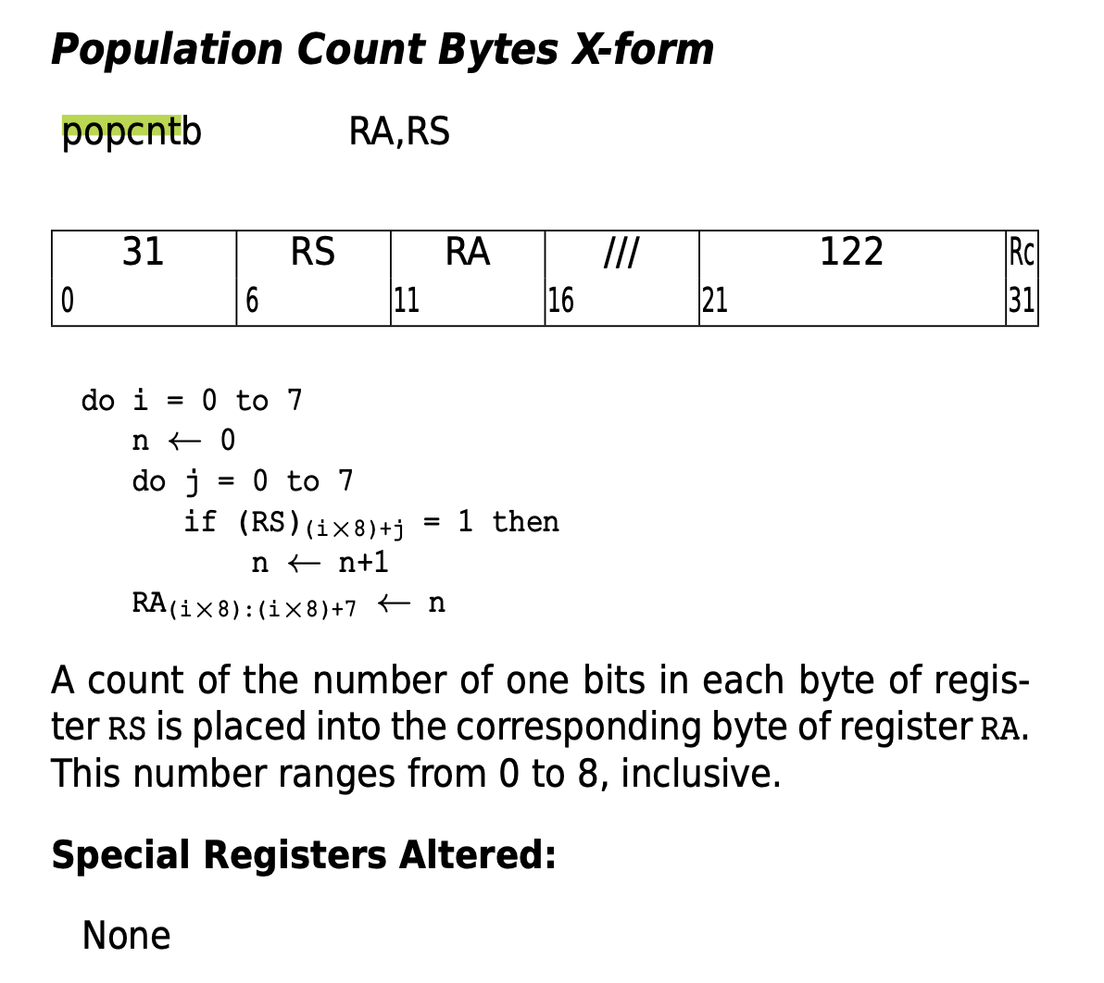

Slide 11
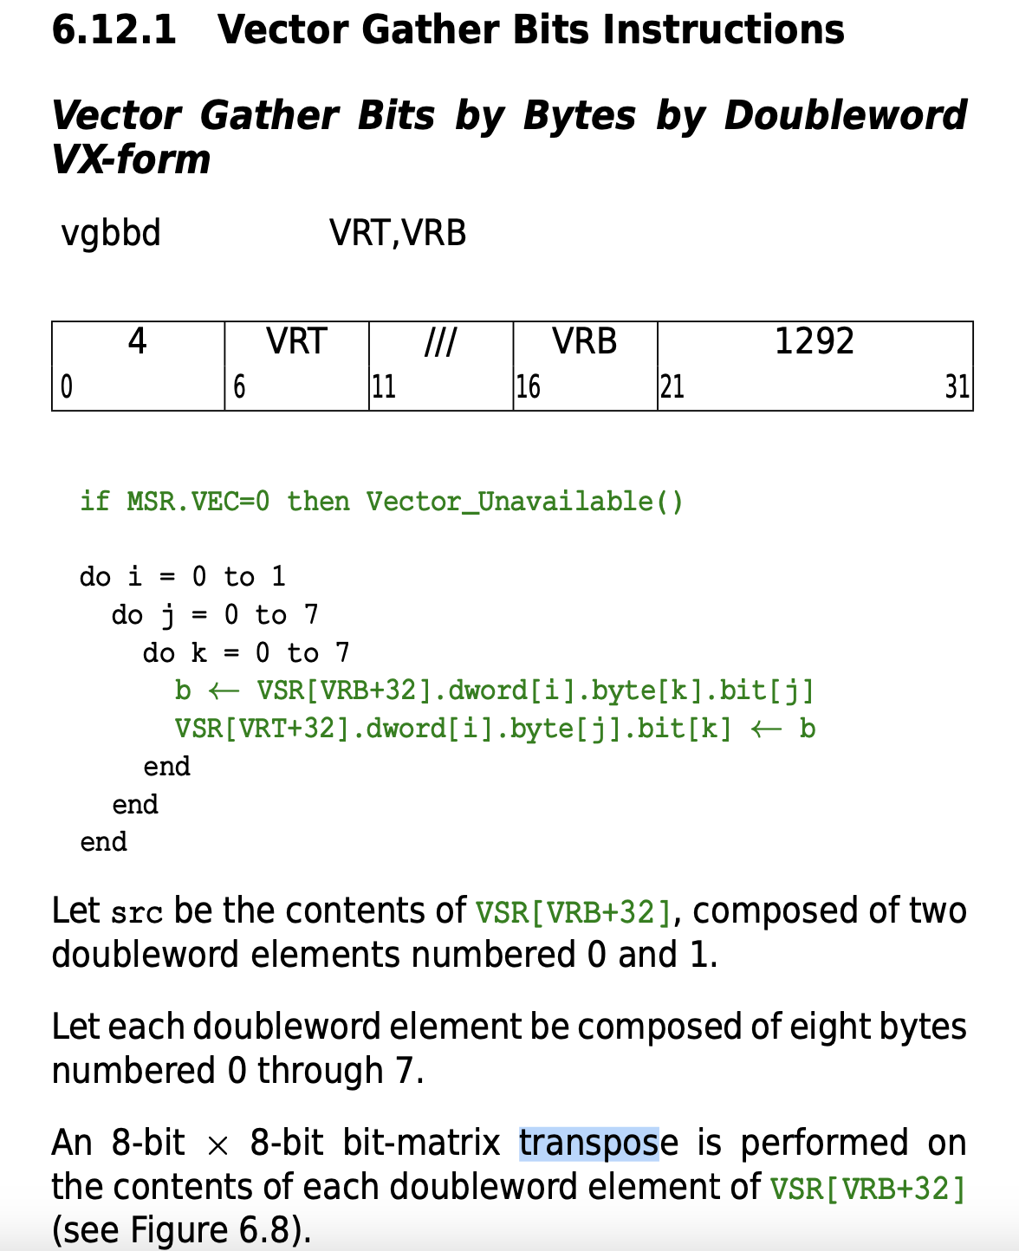
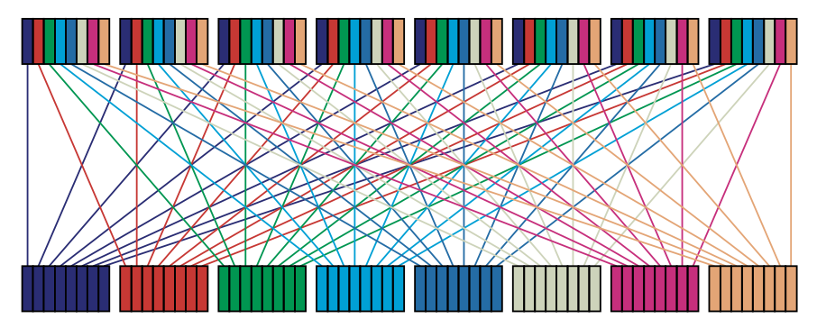

Slide 12
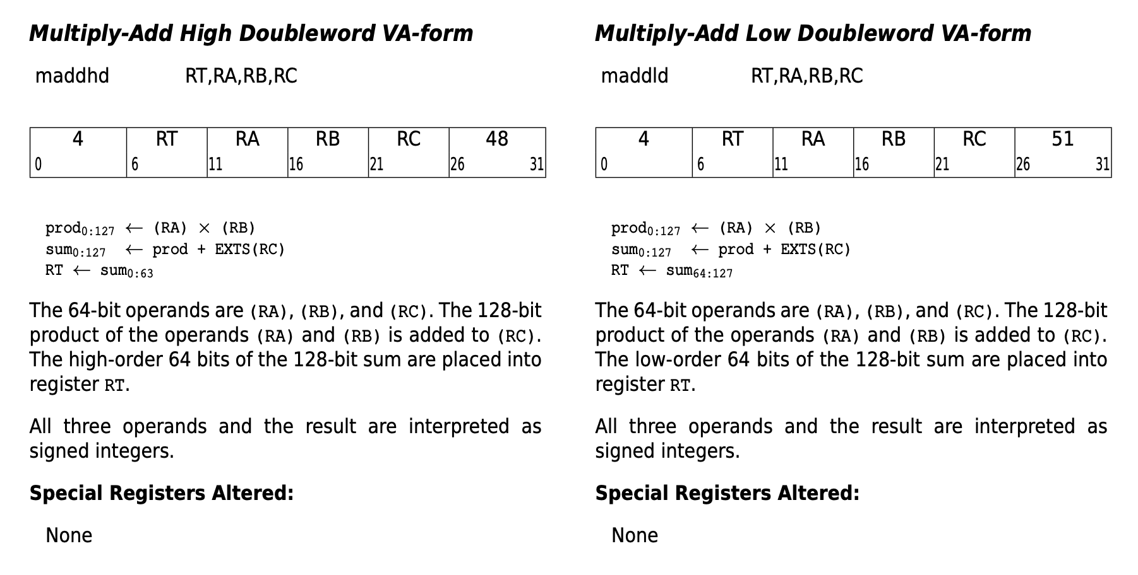
New Instruction Format Modeled after Madd

Slide 13
New custom instructions definition
addbusat RT, RA, RB, RC – add bytes unsigned saturating
Opcode 22, secondary opcode 48
For each i_th byte of RT
RT <- min (255, RA + RB)
subbusat RT, RA, RB , RC – subtract bytes unsigned saturating
Opcode 22, secondary opcode 49
For each i_th byte of RT
RT <- max (0, RB – RA)
maskbu RT, RA, RB, RC – create a mask from unsigned bytes
Opcode 22, secondary opcode 50
For each i_th byte of RT
RT <- ( if RA = “00000000”-> “00000000” else “11111111” )
gbbd RT, RA , RB, RC – gather bits by bytes doubleword
Opcode 22, secondary opcode 51
RT <- Transpose(RA)
Transpose of the bit matrix considering the doubleword as 8x8bits

Slide 14
New and changed files to update design
For each modified file there is a patch file that you can apply to the original vhdl
E.g.
cp decode1.vhdl decode1.vhdl.old
patch decode1.vhdl decode1.vhdl.patch
diff decode1.vhdl decode1.vhdl.old ( should correspond to the Readme )
custom_unit.vhdl ( new )
decode_types.vdhl
predecode.vhdl
decode1.vhdl
decode2.vhdl
execute1.vhdl
Makefile
microwatt.core

Slide 15
See github page for vhdl code

Slide 16
Using the new instructions
Creating your own versions of the toolchain with the new instructions is a lot of work … also to maintain!
Fortunately, defining some macros and functions so that the new instructions can be used with inline assembly in C programs is pretty easy!
Typically custom instructions are used to accelerate some very specific functions, so that is generally a good approach
One small nit … it would be nice if the assembler recognized opcode 22 as a custom instruction

Slide 17
See github page for testing code

Slide 18
Finally
Please use github issues for corrections/questions/suggestions
Including requests for future talks/posts
Likely future topics
Add custom unit at SoC level ( on wishbone )
How to prepare your design for release to manufacturing

