Slide 1
Adding Custom Instructions to the MicroWatt Processor These slides and the accompanying instructions can be found at https://github.com/hofstee-hp/MicroWatt_on_Arty_A7-100T/tree/main/Custom_Ops_Example
H. Peter Hofstee

Slide 2
Today’s talk
Objective: customize MicroWatt with your own opcodes
Double-edged sword …
More performance … but …
… responsible for your own tooling
powerpc architecture is defined with custom extensions in mind
See previous talk ( & https://openpowerfoundation.org/specifications/isa/ )
Opcode 22
We give a specific example just to make the process of adding and using new instructions concrete
What instructions you will want to add will depend on your own use case
For more broadly useful instructions you are encouraged to work with the OpenPower foundation to propose inclusion in future versions of the ISA

Slide 3
Agenda
Motivating example: Spiking Neural Networks
Implementation of New Instructions
Enabling and Testing the New Instructions

Slide 4
Simple Spiking Neural Network
Each neuron is at a certain internal charge represented by a byte (unsigned byte integer)
The neuron produces an output if the internal voltage crosses a threshold
The neuron voltage decreases every cycle by a fixed (leakage) amount and by an additional amount if it fires
When a neuron fires it can either increase or decrease the charge of the neurons it is connected to (by a fixed amount)
ea
es
Inputs-ext
0001 0000 0x10
0100 0000 0x40
0000 1000 0x08
0000 0010 0x0a
0000 0000 0x00
0000 1001 0x09
0000 0000 0x00
0000 0000 0x00
0000 0000 0x00
0000 0000 0x00
0010 0000 0x20
0000 0000 0x00
0000 0000 0x00
0000 0000 0x00
0001 0000 0x10
0000 0100 0x04
…
Inputs-int
0000 0000 0x00
0000 0000 0x00
0000 1000 0x08
0010 0000 0x20
0001 0100 0x14
0100 0000 0x40
0000 0010 0x02
0000 0100 0x04
0000 0000 0x00
0000 0000 0x00
0000 0000 0x00
0000 0000 0x00
0000 0000 0x00
0000 1000 0x08
0000 0000 0x00
0000 0000 0x00
…
ia
is
Neurons
Outputs-int
Outputs-ext

Slide 5
Simple Spiking Neural Network
Each neuron is at a certain internal charge represented by a byte (unsigned byte integer)
The neuron produces an output if the internal voltage crosses a threshold
The neuron voltage decreases every cycle by a fixed (leakage) amount and by an additional amount if it fires
When a neuron fires it can either increase or decrease the charge of the neurons it is connected to (by a fixed amount)
ea
es
Inputs-ext
0001 0000 0x10
0100 0000 0x40
0000 1000 0x08
0000 0010 0x0a
0000 0000 0x00
0000 1001 0x09
0000 0000 0x00
0000 0000 0x00
0000 0000 0x00
0000 0000 0x00
0010 0000 0x20
0000 0000 0x00
0000 0000 0x00
0000 0000 0x00
0001 0000 0x10
0000 0100 0x04
…
Inputs-int
0000 0000 0x00
0000 0000 0x00
0000 1000 0x08
0010 0000 0x20
0001 0100 0x14
0100 0000 0x40
0000 0010 0x02
0000 0100 0x04
0000 0000 0x00
0000 0000 0x00
0000 0000 0x00
0000 0000 0x00
0000 0000 0x00
0000 1000 0x08
0000 0000 0x00
0000 0000 0x00
…
ia
is
Neurons
Outputs-int
Outputs-ext

Slide 6
Simple Spiking Neural Network
ea 0x1040080a00090000
ia 0x0000082014400204
es 0x0000200000001004
is 0x0000000000080000
Each neuron is at a certain internal charge represented by a byte (unsigned byte integer)
The neuron produces an output if the internal voltage crosses a threshold
The neuron voltage decreases every cycle by a fixed (leakage) amount and by an additional amount if it fires
When a neuron fires it can either increase or decrease the charge of the neurons it is connected to (by a fixed amount)
ea
es
Inputs-ext
0001 0000 0x10
0100 0000 0x40
0000 1000 0x08
0000 0010 0x0a
0000 0000 0x00
0000 1001 0x09
0000 0000 0x00
0000 0000 0x00
0000 0000 0x00
0000 0000 0x00
0010 0000 0x20
0000 0000 0x00
0000 0000 0x00
0000 0000 0x00
0001 0000 0x10
0000 0100 0x04
…
Inputs-int
0000 0000 0x00
0000 0000 0x00
0000 1000 0x08
0010 0000 0x20
0001 0100 0x14
0100 0000 0x40
0000 0010 0x02
0000 0100 0x04
0000 0000 0x00
0000 0000 0x00
0000 0000 0x00
0000 0000 0x00
0000 0000 0x00
0000 1000 0x08
0000 0000 0x00
0000 0000 0x00
…
ia
is
Neurons
Outputs-int
Outputs-ext

Slide 7
Simple Spiking Neural Network
Inputs-ext
0
1
1
1
0
1
1
0
ei 0x00FFFFFF00FFFF00
ea 0x1040080a00090000
ia 0x0000082014400204
es 0x0000200000001004
is 0x0000000000080000
…
0
0
0
0
0
0
0
0
Inputs-int
ii 0x0000000000000000
Threshold is 2 for each neuron to fire
-1 every time step ( neuron leakage )
…
0 1 0 0 3 0 1 1
2 0 1 1 1 0 1 1
0 0 0 0 0 0 0 0
Neurons ( ns )
0 0 0 0 0 0 0 0
Outputs-int
Outputs-ext

Slide 8
Simple Spiking Neural Network
Inputs-ext
0
1
1
1
0
1
1
0
…
0
0
0
0
1
0
0
0
Inputs-int
Threshold is 2 for each neuron
-1 every time step
…
0 0 0 0 0 0 0 0
0 0 0 0 2 0 0 0
Neurons
0 0 0 0 1 0 0 0
1 0 0 0 0 0 0 0
Outputs-int
Outputs-ext

Slide 9
Operations
map nonzero input bytes ( neurons ) to “11111111”
broadcast
and
bitwise mirror
count bits in each byte
byte add and subtract ( saturating )
Update neuron state

Slide 10
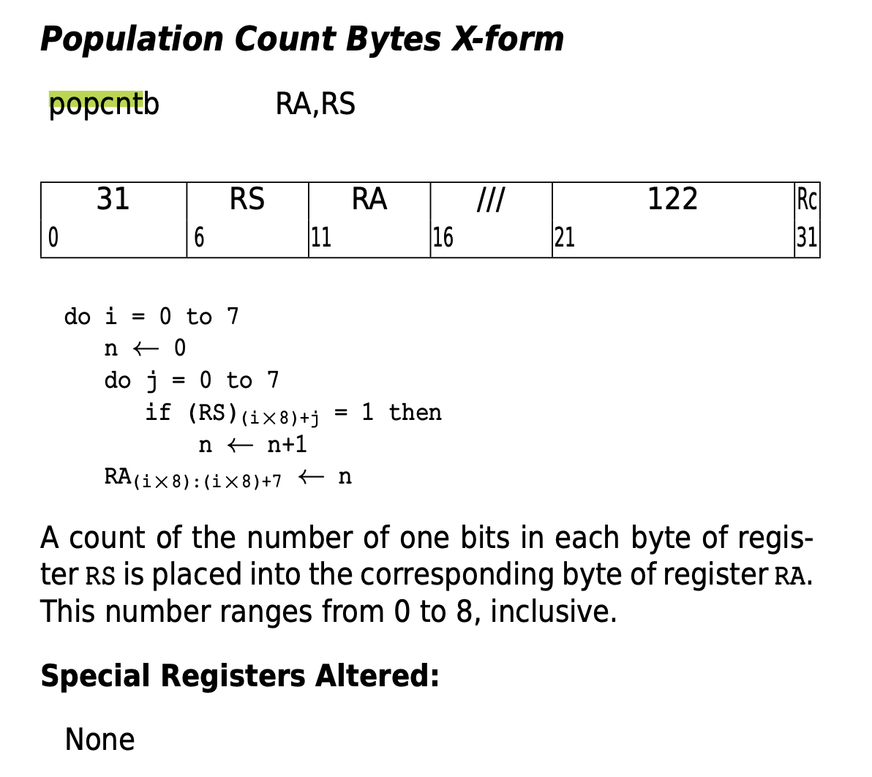

Slide 11
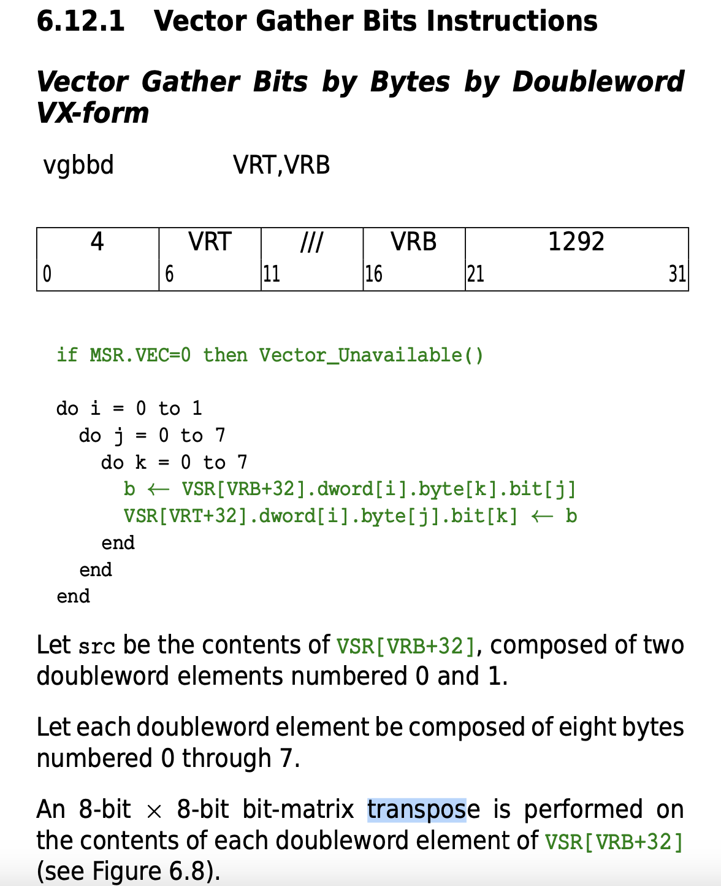
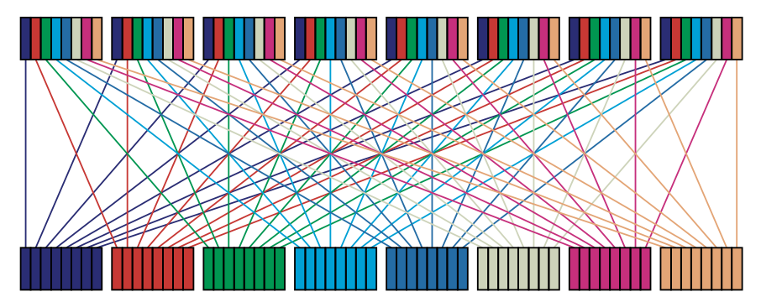

Slide 12
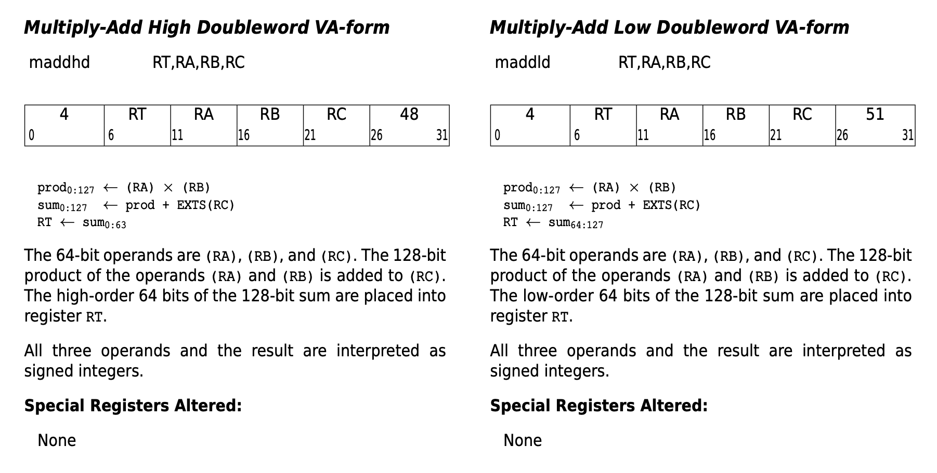
New Instruction Format Modeled after Madd

Slide 13
New custom instructions definition
addbusat RT, RA, RB, RC – add bytes unsigned saturating
Opcode 22, secondary opcode 48
For each i_th byte of RT
RT <- min (255, RA + RB)
subbusat RT, RA, RB , RC – subtract bytes unsigned saturating
Opcode 22, secondary opcode 49
For each i_th byte of RT
RT <- max (0, RB – RA)
maskbu RT, RA, RB, RC – create a mask from unsigned bytes
Opcode 22, secondary opcode 50
For each i_th byte of RT
RT <- ( if RA = “00000000”-> “00000000” else “11111111” )
gbbd RT, RA , RB, RC – gather bits by bytes doubleword
Opcode 22, secondary opcode 51
RT <- Transpose(RA)
Transpose of the bit matrix considering the doubleword as 8x8bits

Slide 14
System overview
Core
JTAG/
debug
Wishbone
arbiter
Address
decoder
L2C/
DRAM
BRAM
I/O decoder
SYSCON
SPI flash
UART
XICS
ENET
SDcard
See prior talk by Paul Mackerras

Slide 15
Pipeline Overview
fetch1
memory
icache
decode1
decode2
PMU
memory
dcache
loadstore1/2
execute1
FPU
execute2
register_file
MMU
writeback
cr_file
See prior talk by Paul Mackerras

Slide 16
Fetch1 and icache
Fetch1 generates a sequence of effective and corresponding real addresses
Increment by 4 each cycle unless redirected by decode1 or writeback
Branches, interrupts, rfid, isync cause redirects
Contains instruction TLB and tiny 2-entry cache of TLB
Contains (optional) Branch Target Cache (BTC)
Stores instruction address, target address and taken indication for executed direct branches
Icache reads and caches instructions from memory
Use of real address for index and tag avoids aliasing problems
Instructions are predecoded into 36-bit form on icache refill
6-bit primary opcode gets replaced by 10-bit instruction index determined from primary and extended opcodes
No support currently from fetching from cache-disabled pages of memory
Icache snoops writes to memory and invalidates corresponding lines
See prior talk by Paul Mackerras

Slide 17
Decode1 and decode2
Decode1 looks up a decode ROM using instruction index
Decode ROM gives control signals used to control operand decoding, ALU function, result selection, etc.
Does static branch prediction for direct branches
Computes register file addresses (GPRs and FPRs) for up to 3 register operands
Decodes SPR (special purpose register) numbers
Decode2 does instruction scheduling and dispatch
Calculates instruction dependencies and stalls until operands are available
Forwards operands from previous instruction results (where available)
Does immediate operand selection and formatting
Operand can come from instruction field, or be the address of the instruction
Computes some control signals for execute stage
See prior talk by Paul Mackerras

Slide 18
Execute1 and execute2
Executes all instructions except load/store and FPU instructions
64-bit integer multiply and integer division are now done by FPU (if present)
Submodules handle shift/rotate instructions, logical instructions, count-bits instructions, 32-bit multiplications
“Main adder” performs add/subtract instructions
Exception detection and interrupt generation
Interlocks to ensure instructions complete in order
Execute1 does most integer computations and forwards results to decode2
Count-bits, multiply, and some move from SPR instructions take 2 cycles to generate their result, so their results are not forwarded from execute1
Execute2 does updating of SPRs, condition-code result generation for dot-form instructions, and forwarding of results.
See prior talk by Paul Mackerras

Slide 19
New and changed files to update design
For each modified file there is a patch file that you can apply to the original vhdl
E.g.
cp decode1.vhdl decode1.vhdl.old
patch decode1.vhdl decode1.vhdl.patch
diff decode1.vhdl decode1.vhdl.old ( should correspond to the Readme )
custom_unit.vhdl ( new )
decode_types.vdhl
predecode.vhdl
decode1.vhdl
decode2.vhdl
execute1.vhdl
Makefile
microwatt.core

Slide 20
See github page for vhdl code

Slide 21
Using the new instructions
Creating your own versions of the toolchain with the new instructions is a lot of work … also to maintain!
Fortunately, defining some macros and functions so that the new instructions can be used with inline assembly in C programs is pretty easy!
Typically custom instructions are used to accelerate some very specific functions, so that is generally a good approach
One small nit … it would be nice if the assembler recognized opcode 22 as a custom instruction

Slide 22
See github page for testing code

Slide 23
Finally
Please use github issues for corrections/questions/suggestions
Including requests for future talks/posts
Likely future topics
Add custom unit at SoC level ( on wishbone )
How to prepare your design for release to manufacturing

