Slide 1
PSY450/650: Data Science in Psych & Neuro
Jeremy Hogeveen, PhD
November 30, 2022 →
Tips for Giving Research Talks

Slide 2



Most important: Communicate knowledge to audience

Slide 3
General suggestions
Have an overarching premise
E.g. “The goal of my final project was XXX”
Each section should help to describe this

Slide 4
General suggestions
Each slide should be a sub-premise
“What am I trying to accomplish with this slide?”
The answer should be obvious, and brief

Slide 5
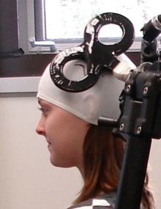
General suggestions
Designing slides:
Don’t create visual interference!
Single TMS pulses delivered over primary motor cortex can demonstrate a muscle-specific and event-related facilitation of corticospinal excitability during passive action observation.
+

Slide 6
General suggestions
Designing slides:
Don’t create visual interference!
Following another person’s gaze signals an understanding that gaze behaviour is driven by an underlying attentional state, thus engaging in joint attention on some external object in the environment, which might then have functional significance for the observer.
Target:
Cookies
Parent’s Gaze
Infant’s Gaze

Slide 7
General suggestions
Designing slides:
Don’t create visual interference!
If it is not possible to make the slide’s point without using text, make sure that you are keeping the text restricted to the most important information. Also, make sure that you read the text as it is written to prevent interference between the slide and your speech.
Where text is the best option…
Be concise
Read it as written before elaborating

Slide 8
Specifics
Length:
10-15 minutes
Practice!

Slide 9
Specifics
Main points I need to see:
Background / intro on the topic
What you did (highlighting data science skills)
How it will help you

Slide 10
Reminders
Upload talk to assignment portal:
https://www.dropbox.com/request/B1EOzfP3KOpV7iBf6gaY
Please include any supplemental files (e.g. code, plots, etc) that will help me *get* what you did.

