Slide 1
DATA ANALYSIS
Team Muchachos

Slide 2
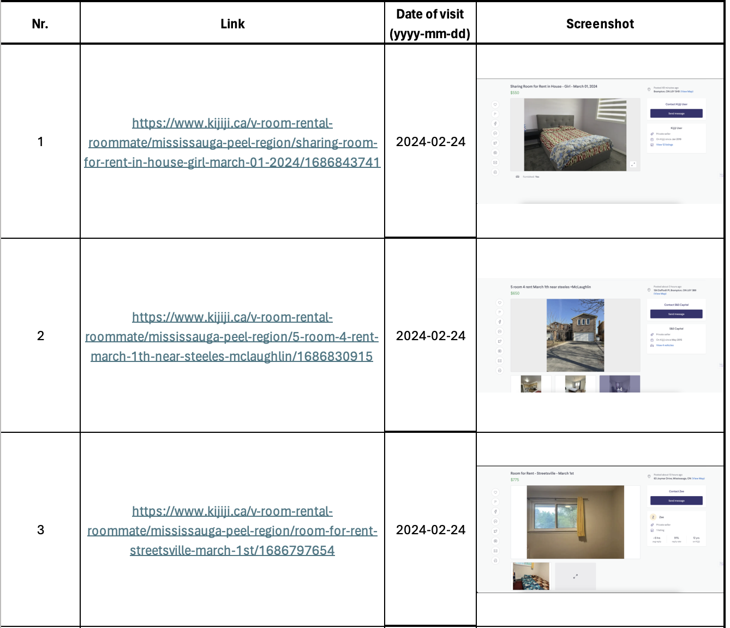
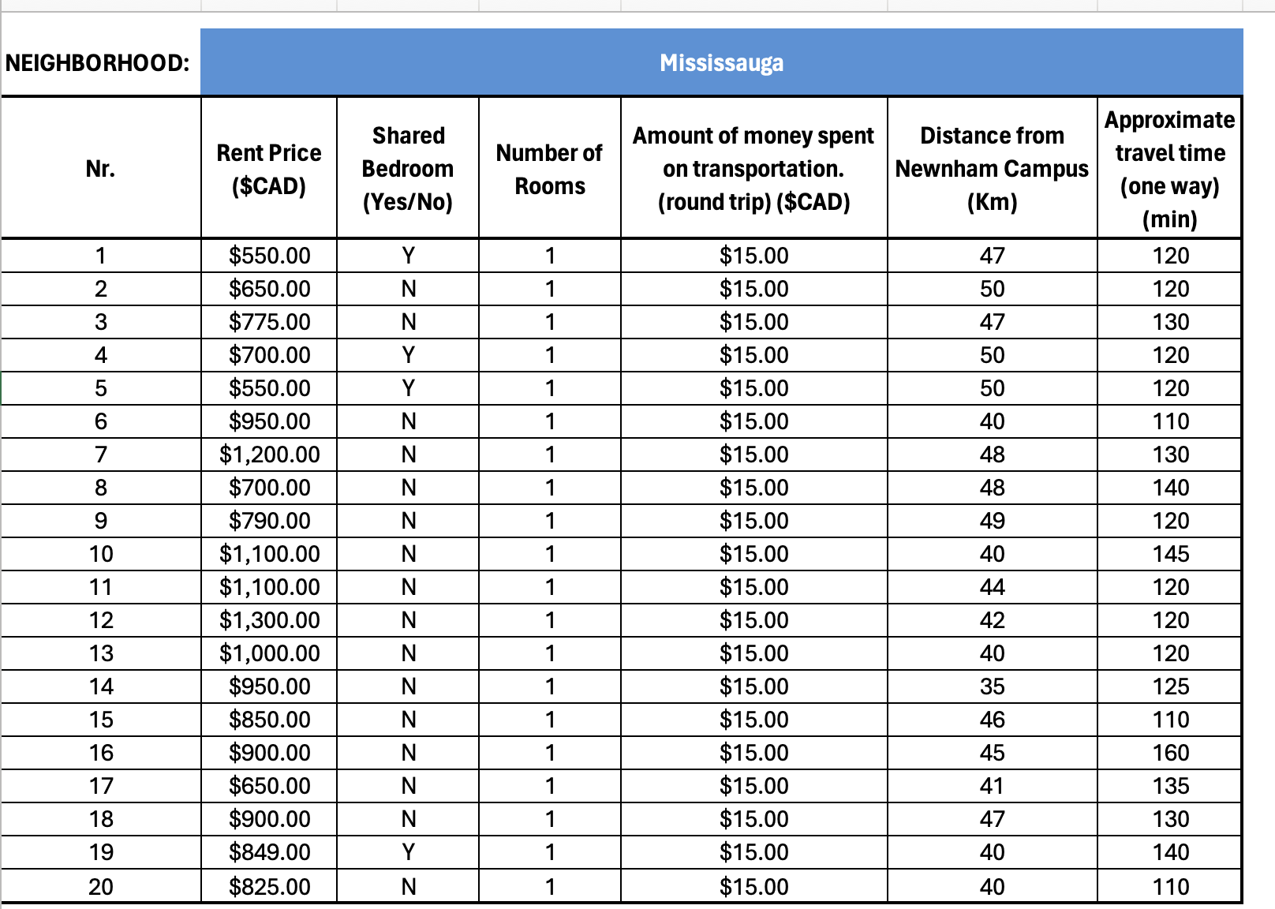
DATA RECOLECTED

Slide 3
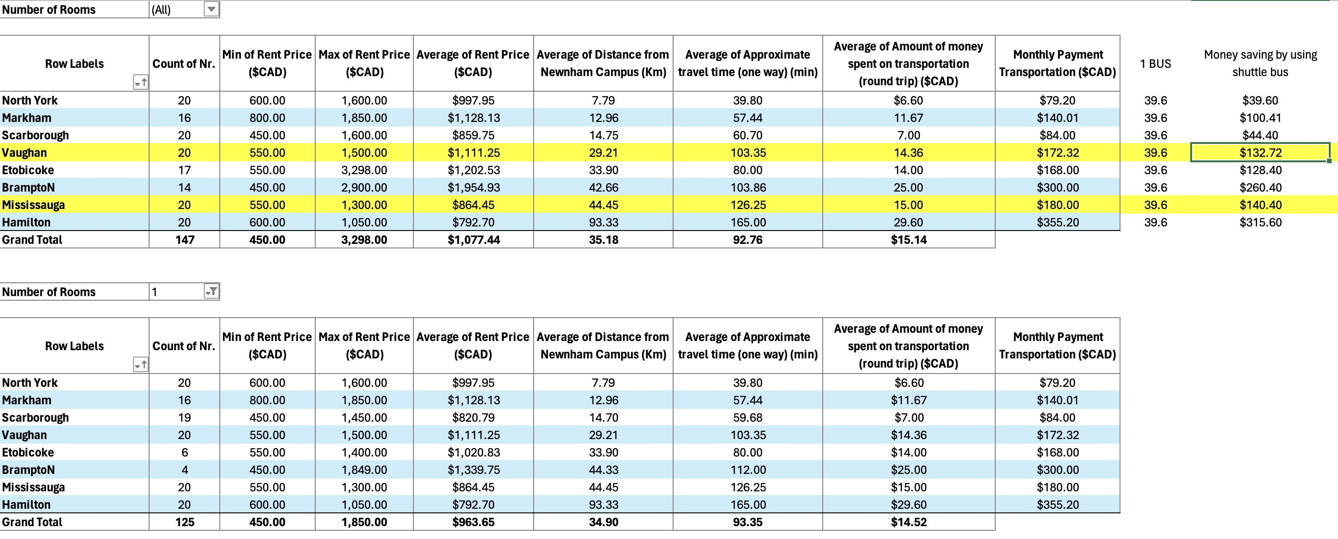
BIG DATA ANALYSIS

Slide 4
BIG DATA ANALYSIS

