Slide 1



Direction Right
X-Axes (IMU LSM9DS1)
Y-Axes (IMU LSM9DS1)
USB
Speed Forward
Speed Backward
Board
Direction Left

Slide 2
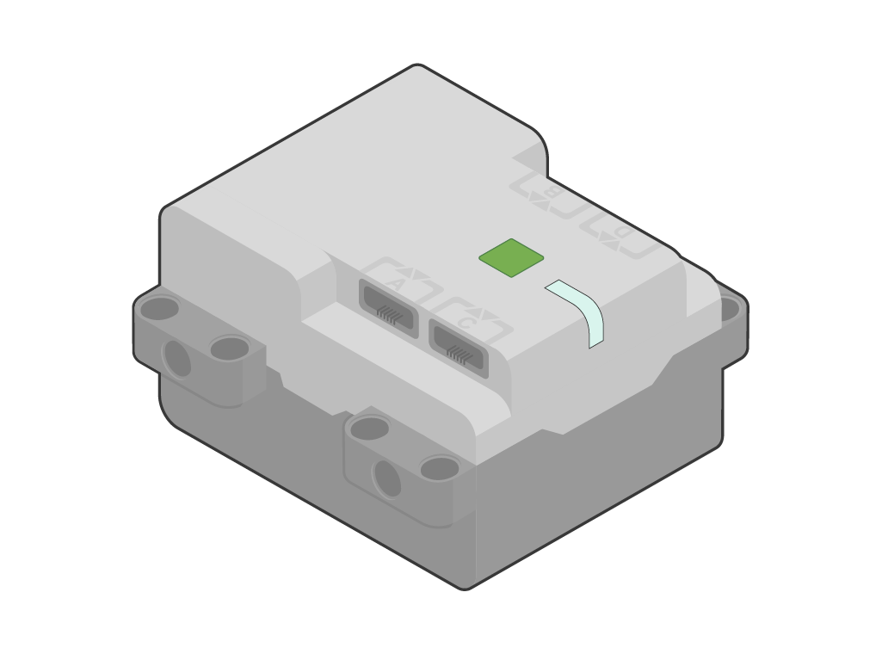

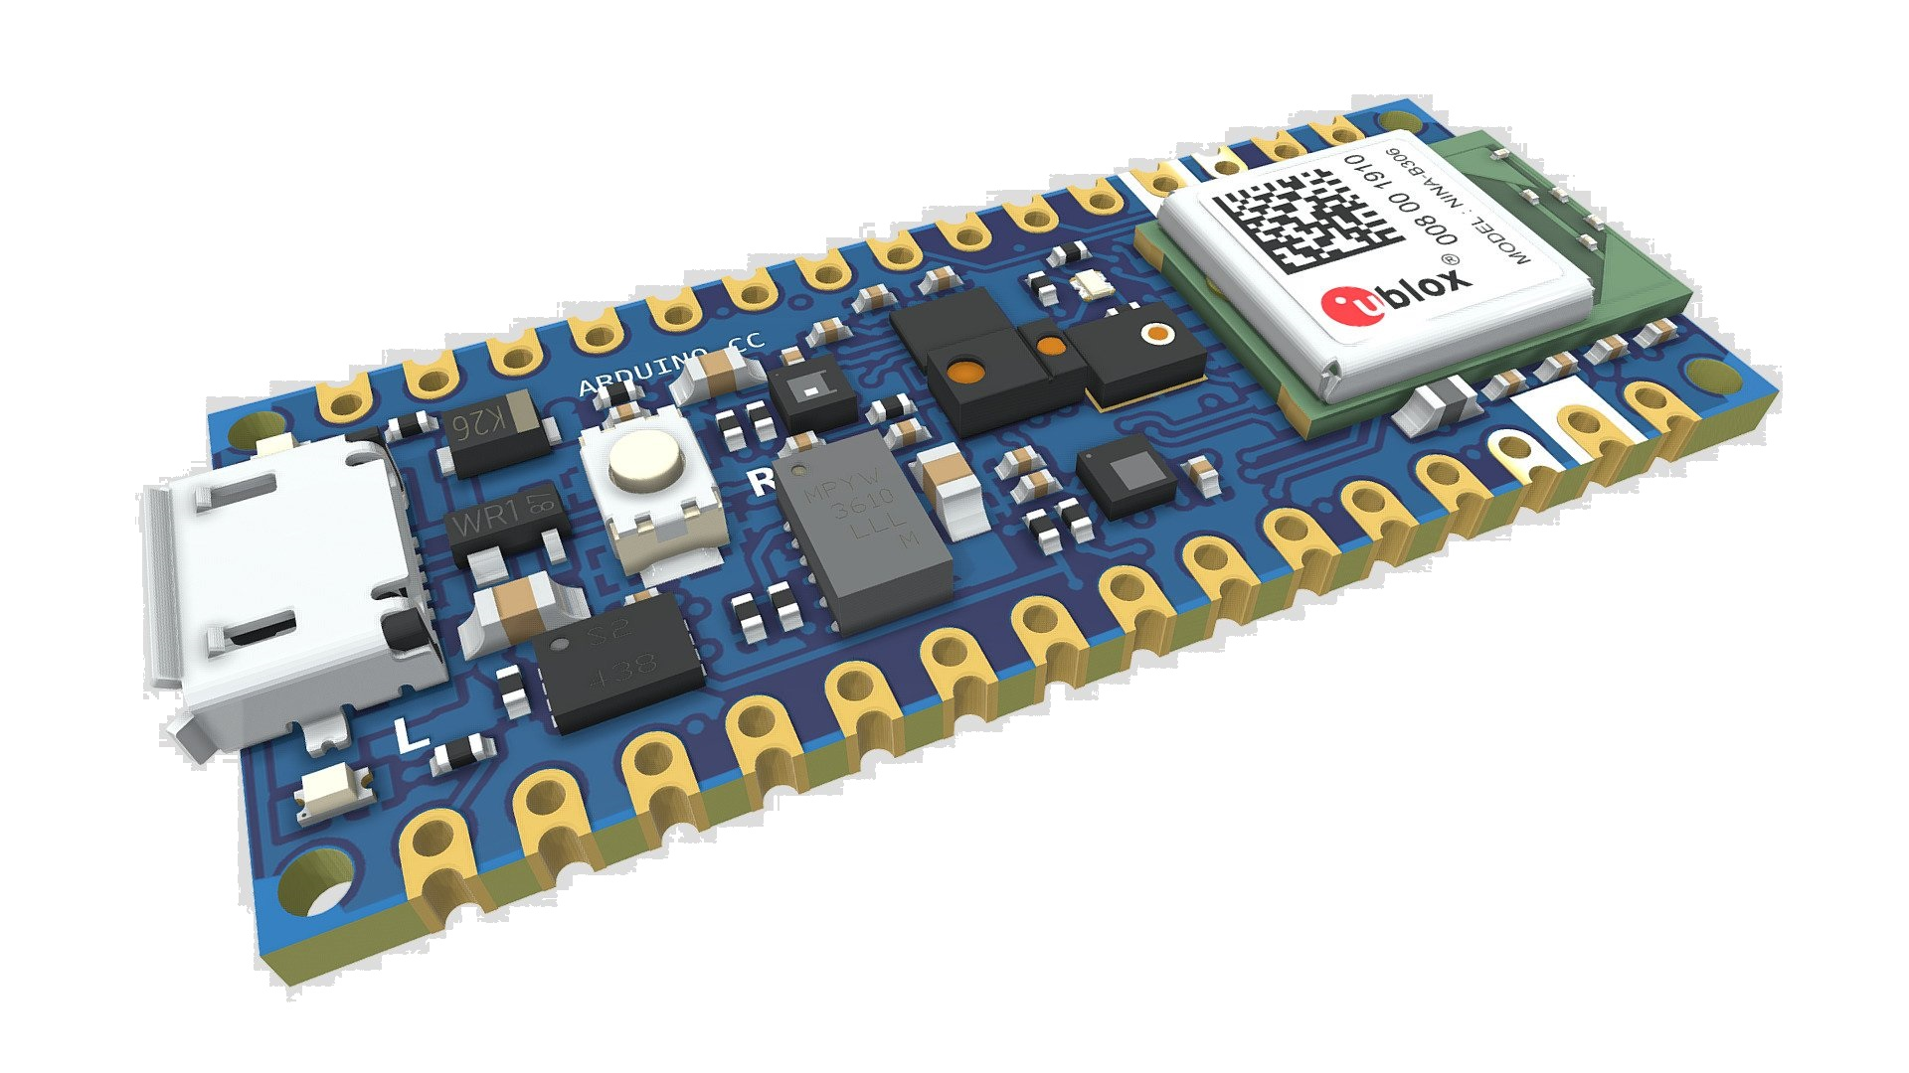
Turn Left
Y-Axes (IMU LSM9DS1)
Move Forward
Board
Turn Right
Move Backward
X-Axes (IMU LSM9DS1)

