Slide 1



Direction Right
X-Axes (IMU LSM9DS1)
Y-Axes (IMU LSM9DS1)
USB
Speed Forward
Speed Backward
Board
Direction Left

Slide 2
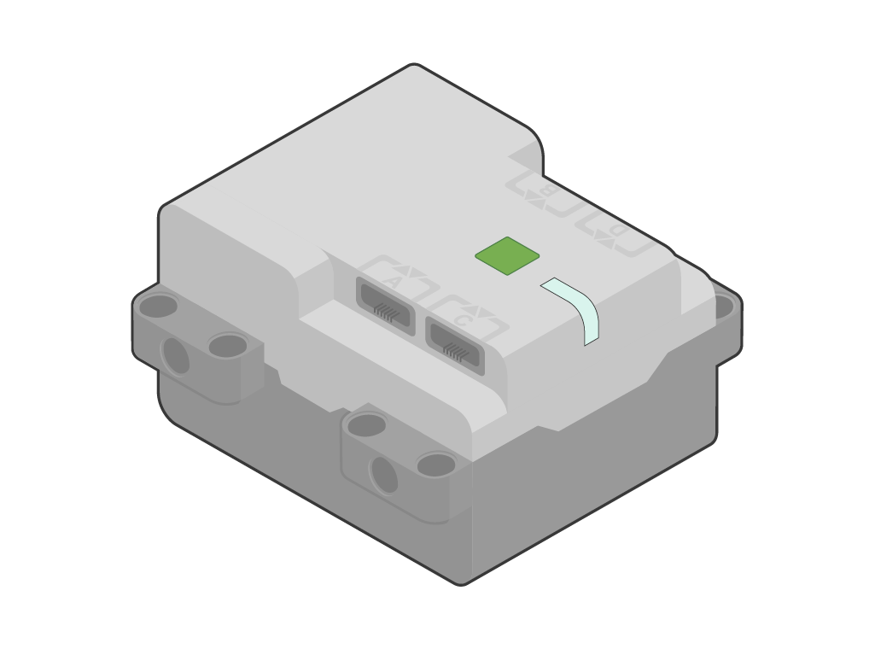

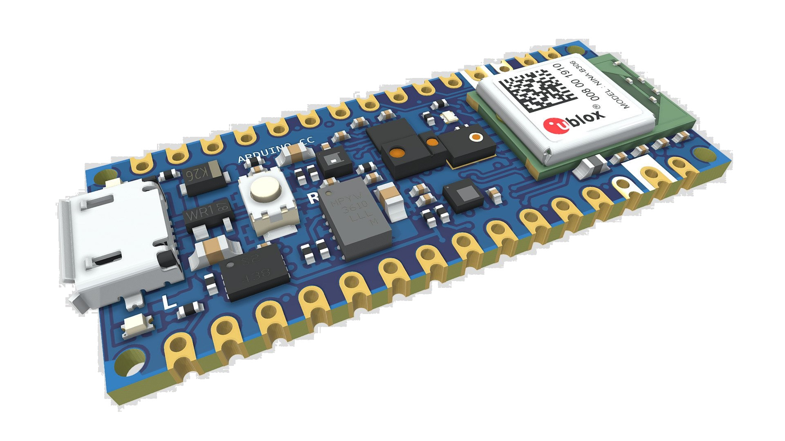
Direction Left
Y-Axes (IMU LSM9DS1)
Speed Forward
Board
USB
Direction Right
Speed Backward
X-Axes (IMU LSM9DS1)

