Slide 1
AI TRANSFORMATION
FRAMEWORK
powered by CRAFT
An iterative framework for AI transformation
in the Software Development Life Cycle
Jan Hohe | Version 1.0 | 2026 | AI Transformation Management

Slide 2
Why AI transformation?
Three developments that reinforce each other
OPPORTUNITIES
URGENCY
RISKS
The opportunities are real
The pressure is now
Inaction is costly
55%
92%
-7,2%
faster task completion
with AI coding assistants
of enterprise developers
use AI coding tools
stability reduction at +25%
AI without process adaptation
GitHub Research 2022
GitHub Survey 2023
DORA Report 2024
>25%
76%
21%
of new Google code
is AI-generated
of all developers use
or plan to use AI tools
haben Workflows redesigned. NUR 21%!
(stärkster EBIT-Faktor)
Google Earnings Q3/2024
Stack Overflow 2024
McKinsey 2025
87%
90%
75%
save mental energy
on repetitive tasks
shadow AI usage
without official approval
der Organisationen sind an der
change saturation point. Provide active change support!
GitHub Research 2022
MIT NANDA 2025
NTT DATA 2024
Jan Hohe | AI TRANSFORMATION FRAMEWORK – CRAFT
2 / 11

Slide 3
THE PROBLEM
Why AI transformations fail
The gap between investment and impact is the core problem. It's not the technology that fails — it's the implementation.
95%
of enterprise AI pilots
without measurable P&L impact
42%
of companies in 2025 have
terminated their AI initiatives
MIT NANDA 2025
S&P Global 2025
80%+
of AI projects fail
(2× more often than non‑AI IT)
88%
of business transformations
miss their targets
RAND Corporation
Bain & Company 2024
Jan Hohe | AI TRANSFORMATION FRAMEWORK – CRAFT
3 / 11

Slide 4
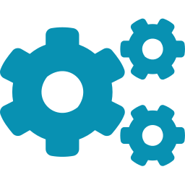



ROOT CAUSES
Not technology problems — transformation problems
Brittle workflows
Missing change enablement
Fragmented approaches
AI is layered onto existing processes instead of redesigning workflows. Only 21% of organisations have adapted workflows.
75% of organisations are at the change saturation point. 45% of employees suffer from change fatigue. Fear: 'Will AI replace me?'
Tool rollouts without process understanding. Maturity assessments without action guidance. Change management without a bridge to technology.
McKinsey / MIT NANDA
NTT DATA
RAND Corporation
McKinsey shows: workflow redesign has the strongest effect on EBIT impact — stronger than tooling, talent or budget.
Jan Hohe | AI TRANSFORMATION FRAMEWORK – CRAFT
4 / 11

Slide 5


OUR APPROACH
Three guiding principles
01
Value Stream First
We don’t start with tools, but with bottlenecks in the value stream. AI interventions are placed where they have the greatest leverage on outcomes.
02
Human-Centric Change
Technology without a change process produces shelfware. Role development, psychological safety and capability building are equal dimensions.
03
Iterative rather than sequential
Complex transformations cannot be planned linearly. 4‑week iteration cycles with readiness gates instead of rigid phase models.
Differentiation: concrete technical implementation + systematic change management across the entire SDLC — orchestrated by the AI Transformation Manager.
Jan Hohe | AI TRANSFORMATION FRAMEWORK – CRAFT
5 / 11

Slide 6
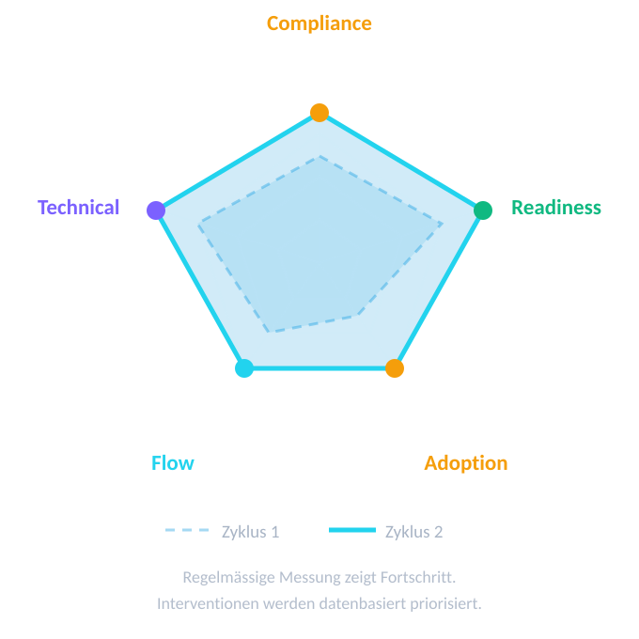
The 5 CRAFT dimensions
Active in parallel, never ‘done’ — and measurable.
Our job: measurably improve the 5 CRAFT dimensions.
C
Compliance & Governance
Regulatory guardrails, policies, EU AI Act, works council involvement
R
Readiness — Human & Cultural
Role development, skill building, psychological safety, champion network
A
Adoption & Usage
Actual day‑to‑day usage, channeling shadow AI
F
Flow & Process Integration
SDLC analysis, bottleneck identification, AI intervention matching
T
Technical enablement
Tool provisioning, IDE integration, LLM deployment
Jan Hohe | AI TRANSFORMATION FRAMEWORK – CRAFT
6 / 11

Slide 7

HOW WE WORK
4‑week iteration cycles
All 5 dimensions every cycle — with shifting focus
WOCHE 1
WOCHE 2–3
WOCHE 4
Orientation &
planning
Execution
Review &
adjustment
Pulse check, review
previous cycle review, goal setting
Tool rollout, workshops,
governance, skill building
Retro, metrics review,
Readiness Gate
READINESS GATE
Expand
Deepen
Consolidate
Adoption > 60%, DORA stable
Adoption < 60%, positive trends
Governance change, resistance
Jan Hohe | AI TRANSFORMATION FRAMEWORK – CRAFT
7 / 11

Slide 8



ORGANIZATION
The AI adoption team
Modelled on Kotter’s guiding coalition — heterogeneous, cross‑functional, with executive sponsorship
AI Transformation Manager
Technical AI Lead
Value Stream Coach
50–100%
50–80%
Orchestrates all 5 dimensions. Bridge between technology, people and process. Key role in the framework.
Tool landscape, infrastructure, AI intervention catalogue
VSM, DORA interpretation, value stream linkage
Change & People Lead
Governance Liaison
50–80%
20–40%
Psychological safety, role development, champion coaching
Data protection, works council, IT security, EU AI Act
Champion network
1–2 people per team as multipliers. At least 20% dedicated capacity. Direct access to the AI Transformation Manager. Kotter’s volunteer army.
AI TRANSFORMATION FRAMEWORK – CRAFT
8 / 11

Slide 9

MEASUREMENT
KPI framework: outcomes over output
Three‑layer architecture — automated, minimal overhead, maximum explanatory power
1
Delivery outcomes
Deployment Frequency · Lead Time · Change Failure Rate · Time to Restore · Cycle Time · Flow Efficiency
DORA + value stream
Automatically from CI/CD, Jira, GitLab
2
AI maturity
C: Compliance · R: Readiness · A: Adoption · F: Flow · T: Technical — each with 5 maturity levels (Exploring to Evolving)
CRAFT model (5 × 5)
Pulse check (quarterly, 15 min) + deep dives
3
Business impact
Velocity change · time‑to‑market · quality change · employee satisfaction
For sponsors
Automatically aggregated from layers 1+2
The only active effort: pulse check — 15 minutes, quarterly, anonymous. Everything else is automated.
AI TRANSFORMATION FRAMEWORK – CRAFT
9 / 11

Slide 10
ROADMAP
From pilot to scale: 24 weeks
CYCLE 1–2
CYCLE 3–4
CYCLE 5–6
1 team
2–3 teams
Organisation
Foundation & pilot
Value stream deep dive
Scaling & institutionalization
Governance basics
First pulse check
Pilot with AI tools
Shadow AI amnesty
Value Stream Mapping
Top 3 AI interventions
Change workshops
Champion network active
Learnings transferred
KPI baseline established
Role model integrated into HR
Measurable progress
Critical: expand step by step with readiness gates — never scale directly from a pilot to 20 teams.
Jan Hohe | AI TRANSFORMATION FRAMEWORK – CRAFT
10 / 11

Slide 11
OFFERING
Our service offerings
Three modular entry offerings — bookable individually, building on each other
DISCOVERY SPRINT
PILOT SUPPORT
EMBED & SCALE
Determine your starting point
Transform one team
Embed in the organization
2–3 weeks | 8–12 person‑days
8–12 weeks | 25–40 person‑days
4–6 months | 50–80 person‑days
✓
CRAFT Maturity Report + Spider-Chart
✓
Value stream map + AI interventions
✓
Scaling playbook (repeatable)
✓
Top 5 quick wins with impact
✓
Configured tooling + champions
✓
Champion network + governance
✓
6‑month transformation plan
✓
Governance policy (context‑specific)
✓
KPI dashboard (automated)
✓
Go/No‑Go recommendation
✓
DORA baseline + trend report
✓
ROI proof + handover documentation
For everyone who wants to know where they stand.
Prove effectiveness, create the basis for scaling.
Scale the transformation to 2–4 teams.
Additional add‑ons: Value stream deep dive | Governance & compliance | Technical enablement | Shadow AI amnesty | Executive alignment
Jan Hohe | AI TRANSFORMATION FRAMEWORK – CRAFT
11 / 11

