Slide 1
Bad Crypto

Slide 2

From Security 1…

Slide 3
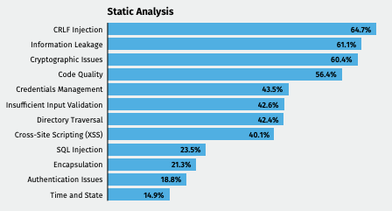
Top software weaknesses discovered by SA
Source: Veracode State of Software Security 2021

Slide 4
Plan
Typical crypto failures (and fixes) in
Symmetric cryptography
Hashing
Asymmetric cryptography
Problem statement
Potential solution

Slide 5
Symmetric Cryptography

Slide 6
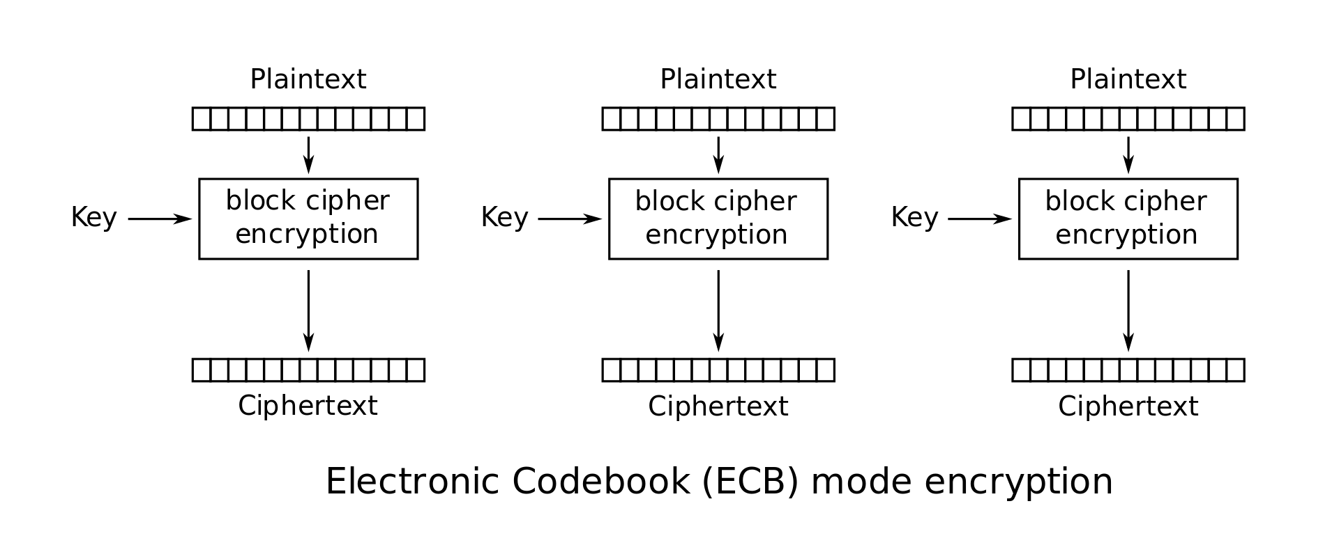


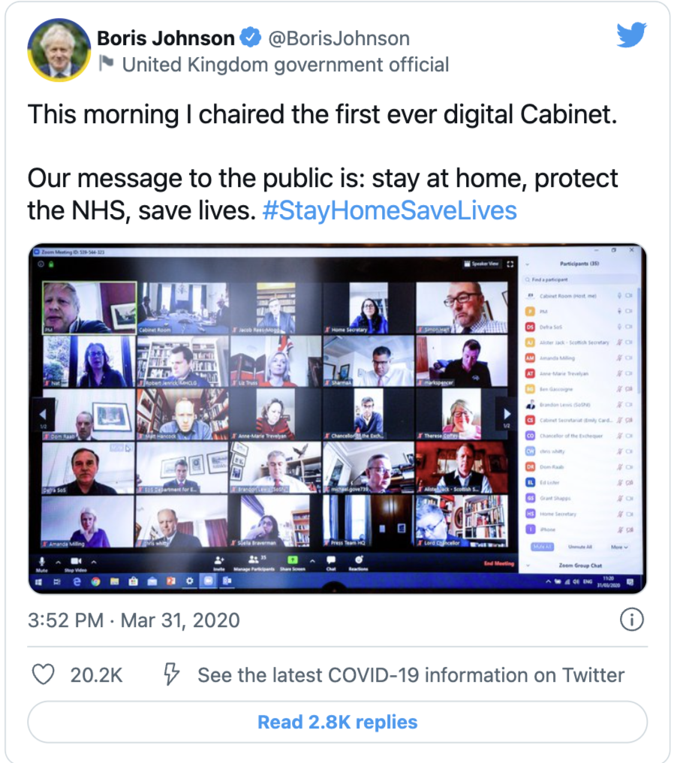
Zoom’s Flawed Encryption
What: Videocalls made until 2020 exposed patterns despite encryption
Why: Data encrypted with ”Zoom transport protocol” which use “military grade crypto” AES-ECB
How: Wireshark + Memory Dump + Mitmproxy
Fix?
Notes:
The disadvantage of this method is a lack of diffusion. Because ECB encrypts identical plaintext blocks into identical ciphertext blocks,
Confusion: make the connection between ciphertext and key as complicated as possible
Diffusion: Flipping a single bit of the plaintext (statistically) produces a flipping of half of the bits in the ciphertext

Slide 7
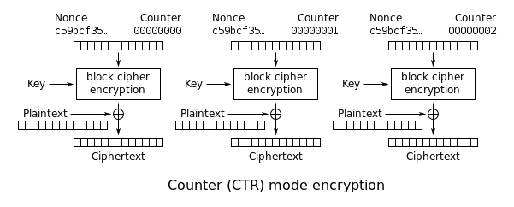
Kamstrup Smart Heat Meters
What: Consumer patterns leaked (2019)
Why: Data encrypted with “home” AES-CTR
How: Packet analysis
Fix?
Notes:
The disadvantage of this method is a lack of diffusion. Because in CTR a flip in a bit in the plaintext flips the same bit in the ciphertext
C xor M = E (nonce, k)

Slide 8
Hashing

Slide 9
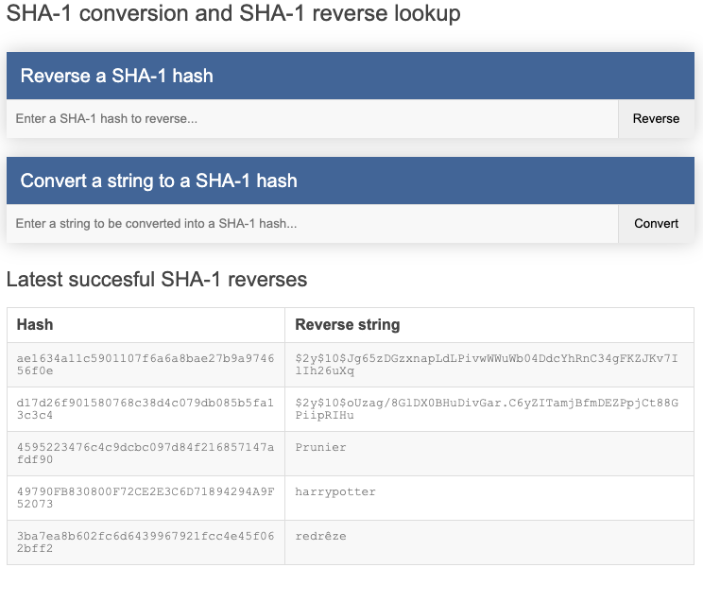
LinkedIn Hack
What: 6.5 million passwords leaked in 2012
Why: No salt when hashing password + SHA-1
How: Rainbow tables (see https://sha1.gromweb.com/)
Fix?

Slide 10
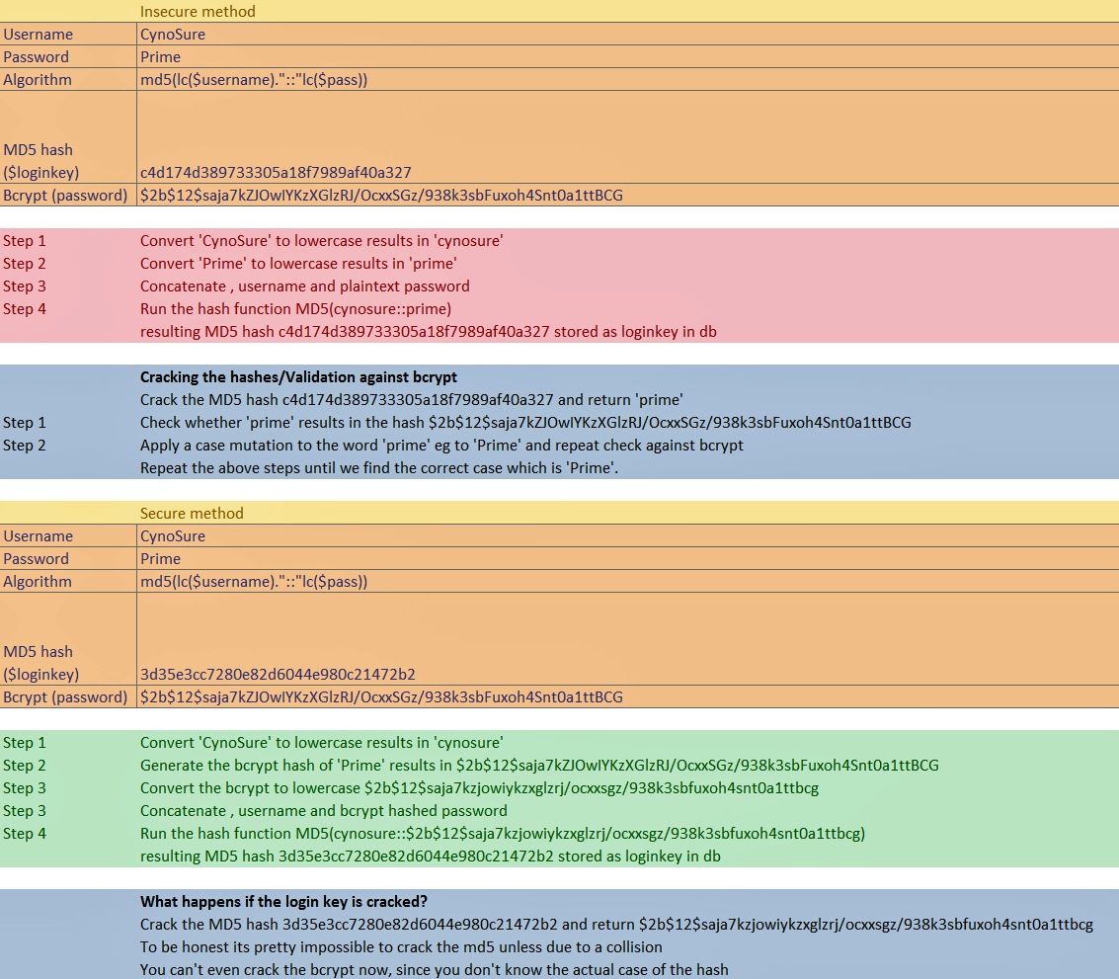
Ashley Madison Hack
What: 60 GB user data + 11) million of password leaked in 2015
Why: MD5 token generated with plaintext password
How:

Slide 11
Ashley Madison Hack
Fix

Slide 12
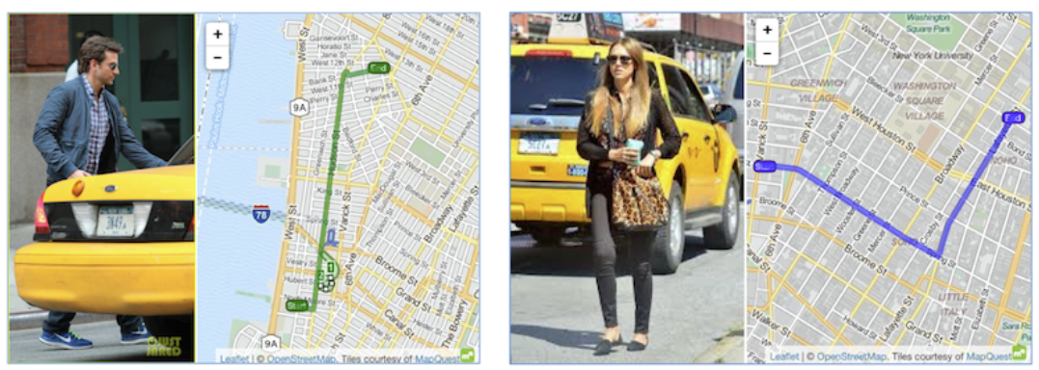
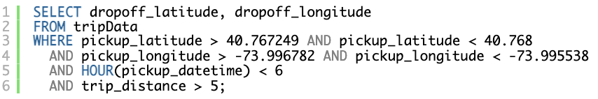
NYC improperly anonymized taxi logs
What: Violating privacy of NYC taxi customers in 2013
Why: Taxi rides data anonymised using MD5
How: Hash Taxis id + Googling “celebrities in taxis in Manhattan in 2013” or dataset queries e.g. pickups at gentlemen’s club
Fix?

Slide 13
Asymmetric Cryptography

Slide 14
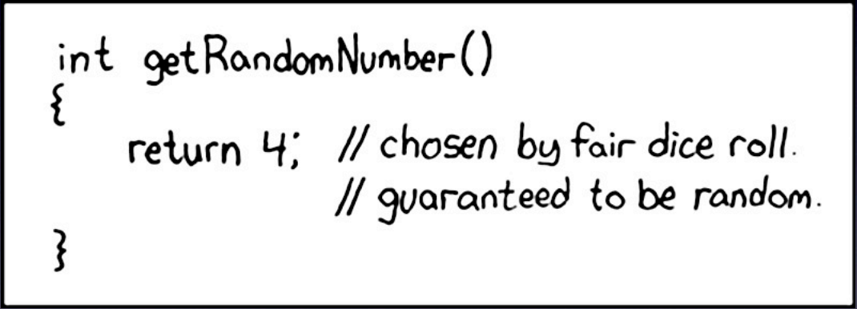
PS3 Hack
What: Unsigned code run on the PS3
Why: Recovered private key of ECDSA used by Sony to sign software
How: Modulo bias
Fix?
More on: https://fahrplan.events.ccc.de/congress/2010/Fahrplan/attachments/1780_27c3_console_hacking_2010.pdf
Notes:
NO COUNTER MEASURE POSSIBLE BY SONY!

Slide 15
Asymmetric Cryptography
Bonus: RSA

Slide 16
Summary
Never implement your own crypto

Slide 17
Summary
Never implement your own crypto
Never implement your own crypto

Slide 18
Summary
Never implement your own crypto
Never implement your own crypto
Never implement your own crypto

Slide 19
Summary
Never implement your own crypto
Never implement your own crypto
Never implement your own crypto
Never implement your own crypto

Slide 20
Summary
Never implement your own crypto
Never implement your own crypto
Never implement your own crypto
Never implement your own crypto
Never implement your own crypto

Slide 21
Summary
Never implement your own crypto
Never implement your own crypto
Never implement your own crypto
Never implement your own crypto
Never implement your own crypto
Never implement your own crypto

Slide 22
Summary
Most of the code usign crypto is neither written nor reviewed by cryptographers
False sense of security: bad crypto worse than no crypto
Dangerous because no feedback when it goes wrong (no auditable)
Hard to implement correctly if don’t understand the finer aspects
Pentesters can’t scrutinize crypto because too demanding
Crypto getting more complicated -> libraries too complex

Slide 23
Fix?
Programmers needs right level of cryptographic knowledge
Cryptographers needs right level of programming knowledge
More skilled pentesters
Train programmers to use it securely
Use high level of crypto libraries (abstraction prevents disasters)

Slide 24
Fix?
Programmers needs right level of cryptographic knowledge
Cryptographers needs right level of programming knowledge
More skilled pentesters
Train programmers to use it securely
Use high level of crypto libraries (abstraction prevents disasters)
Never implement your own crypto

