Slide 1
City Living Quality Evaluation System
Peiyuan Sun - sun.pei@northeastern.edu
Xinzhi Zhang - zhang.xinz@northeastern.edu

Slide 2
Division of Labor
Peiyuan Sun:
Designed the database, and used numbeo to get the city data
Wrote procedures to realize CRUD operations
Xinzhi Zhang:
Designed the web page interaction logic
Wrote HTML&CSS&JS code to construct the web page
Together:
Wrote Python code to link the frontend and the database

Slide 3
Technologies
Host Language:
Python
Database:
MySQL
Frontend:
HTML, CSS, JavaScript
Library:
Pymysql, Flask

Slide 4
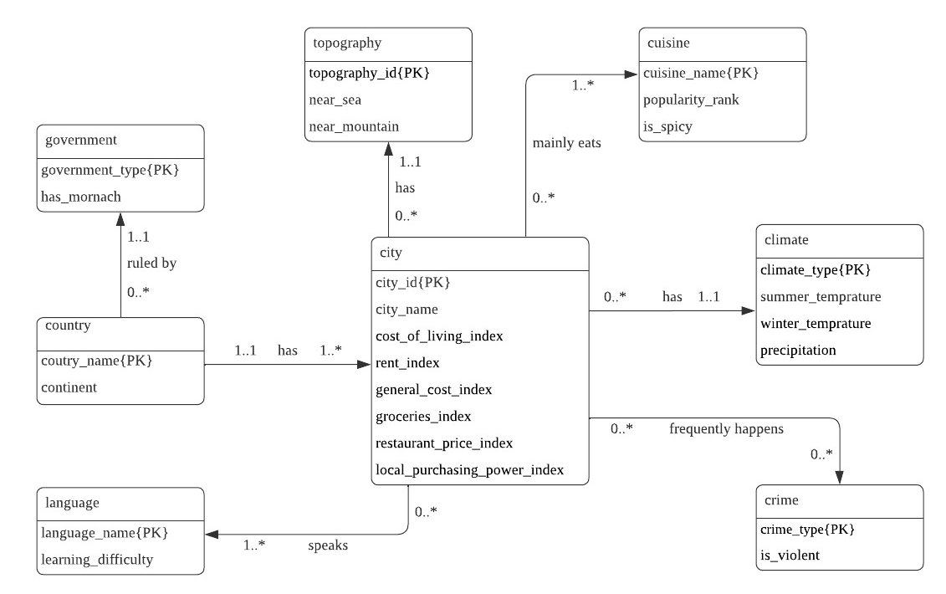
ER Graph

Slide 5
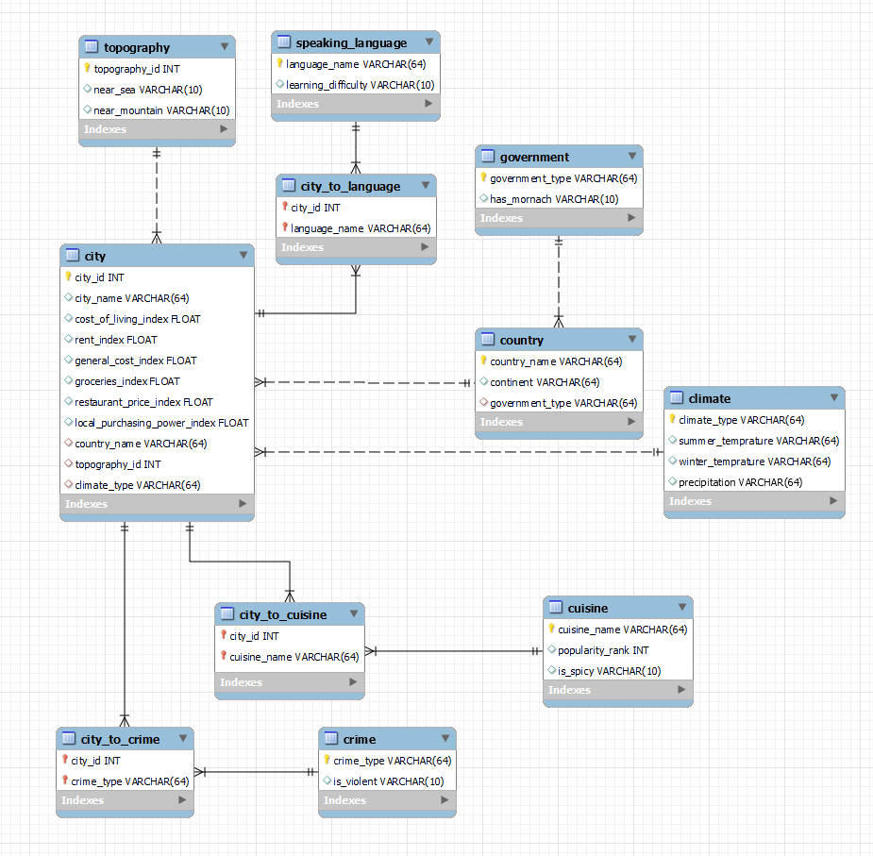
Logic Design

Slide 6
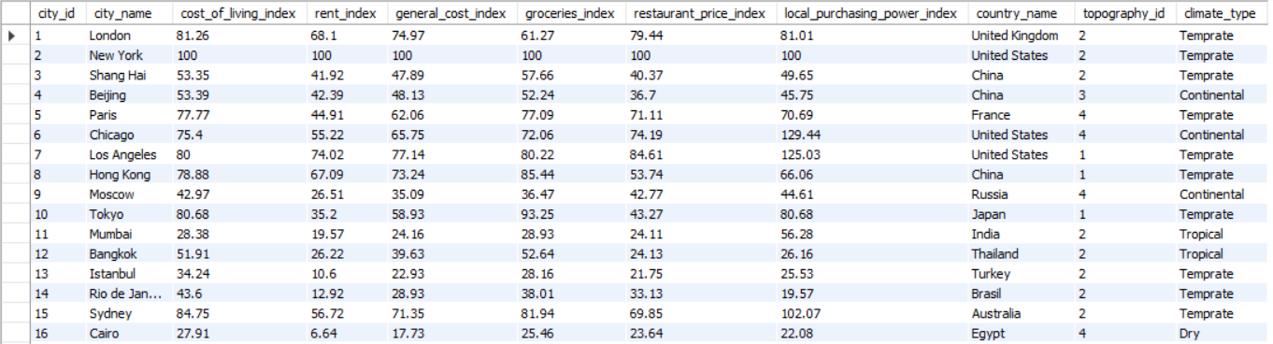
City Table

Slide 7
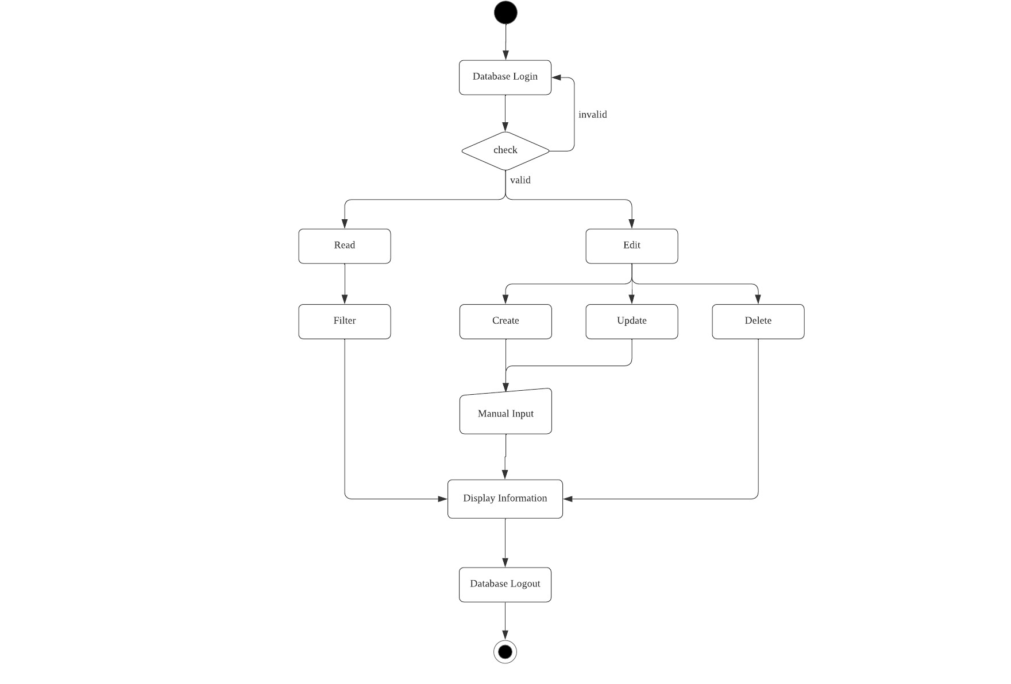
Flowchart

Slide 8
Web Application

