Slide 1

Bridging Advanced Energy Storage
to the World
With expertise spanning sodium-ion, solid-state, flow batteries, and supercapacitors, we connect The World clients with optimal energy storage solutions—backed by deep industry knowledge, direct supply chain access, and local European presence.

Slide 2
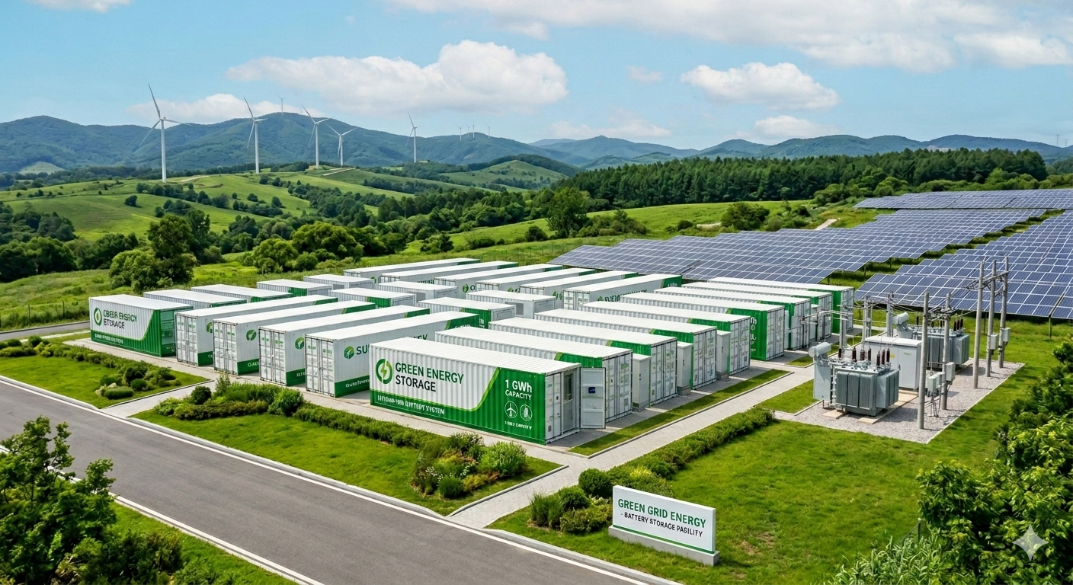

Slide 3
Comprehensive Comparison of Advanced Energy Storage Technologies (For energy storage use)
Technical Indicators | Sodium-ion Battery | Solid-State Battery | Redox Flow Battery | Supercapacitor | Lithium-ion Battery
Cost-Effectiveness
Safety
Wide temperature range | -40-70℃ | -20-60℃ | -10-50℃ | -20-60℃ | -20-60℃
Cycling Life | 8000-10000 | 6000-8000 | ＞15,000 | ＞1 Million | 8000-10000
Energy Density（Wh/kg） | 160-180 | 160-180 | 100-110 | 5-10 | 30-40
Power Density（kW/kg） | 0.1 | 0.05-0.1 | 0.01 | ＞10 | 0.05-0.1
With multi-technology coverage, we identify the optimal eneragy storage solution for each client.
* Note: Each energy storage technology encompasses different chemistries; the parameters shown here are representative of typical products.

Slide 4
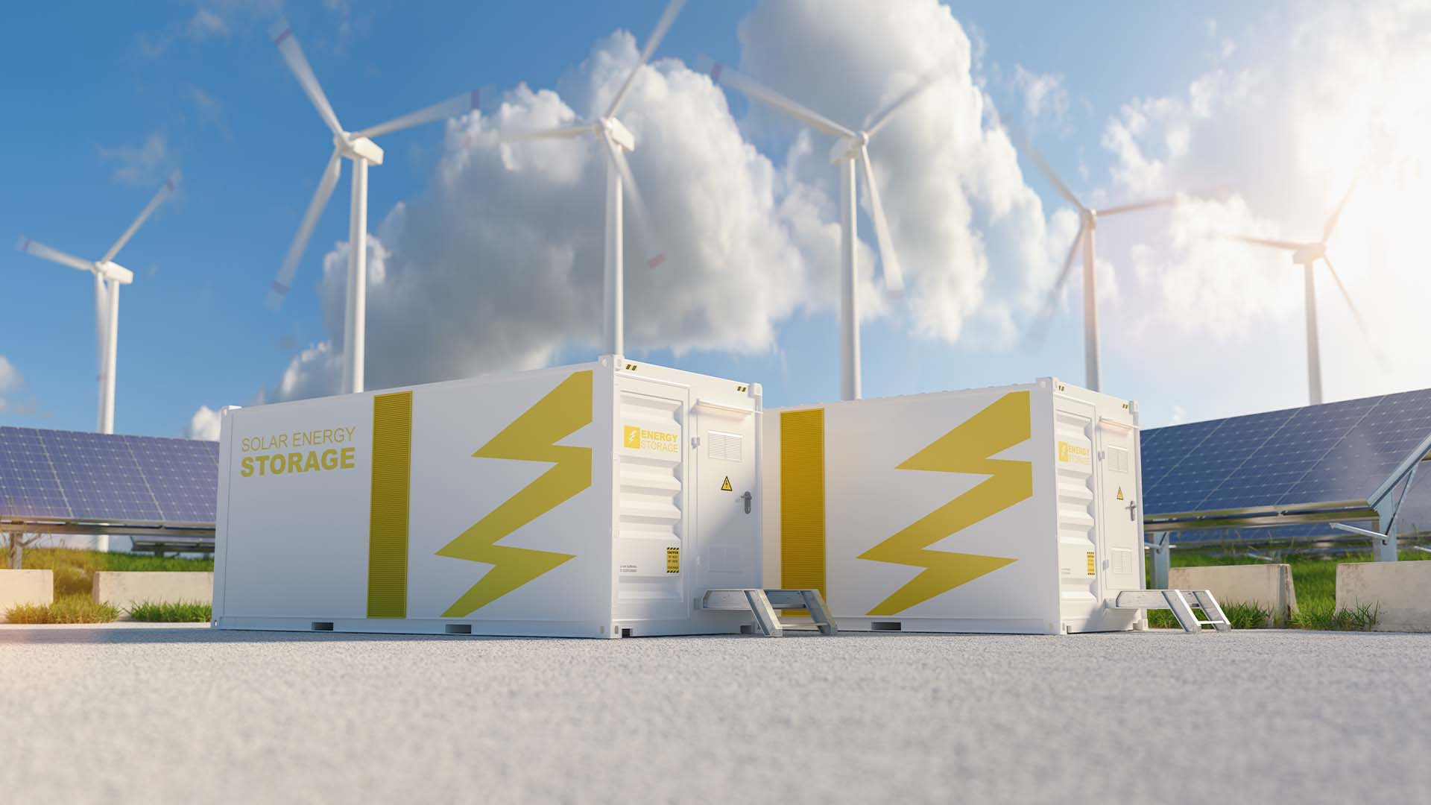
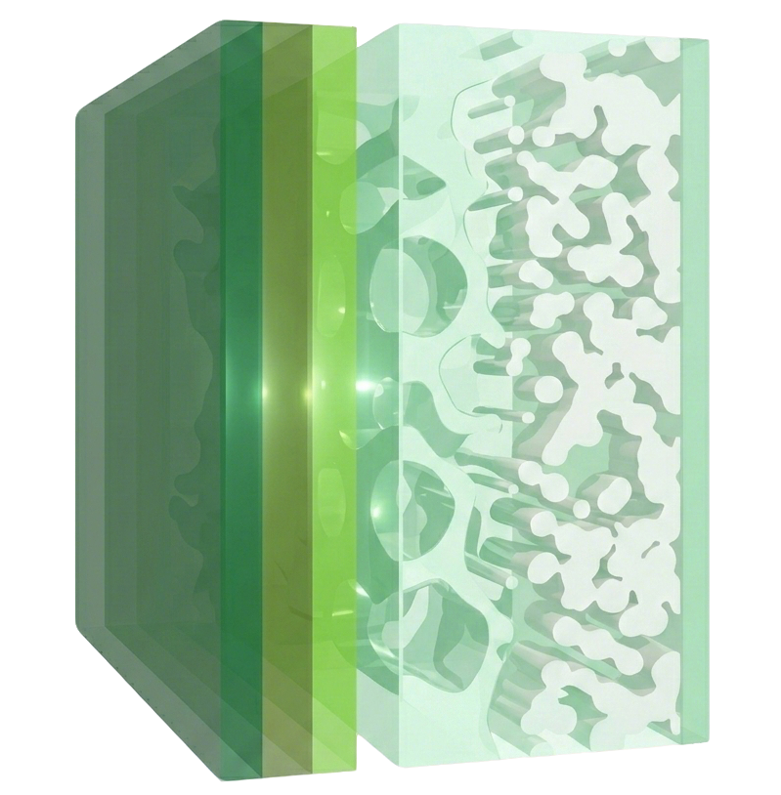


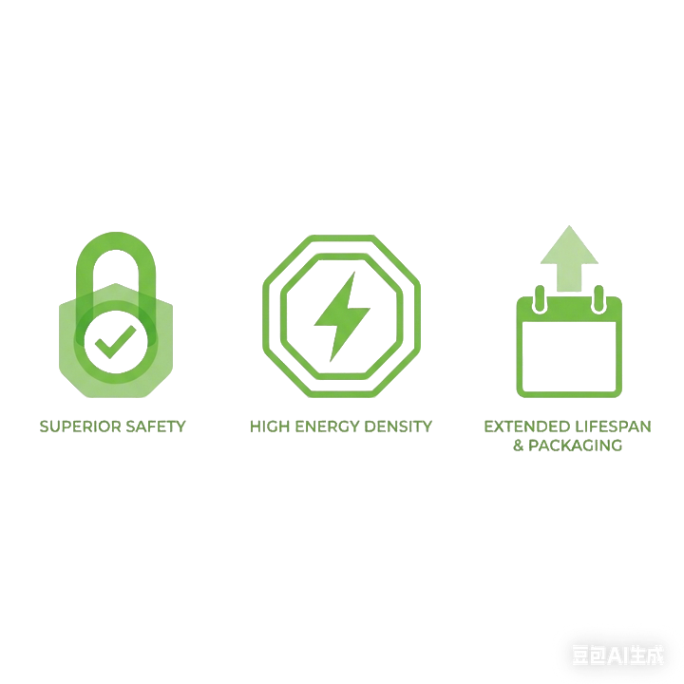


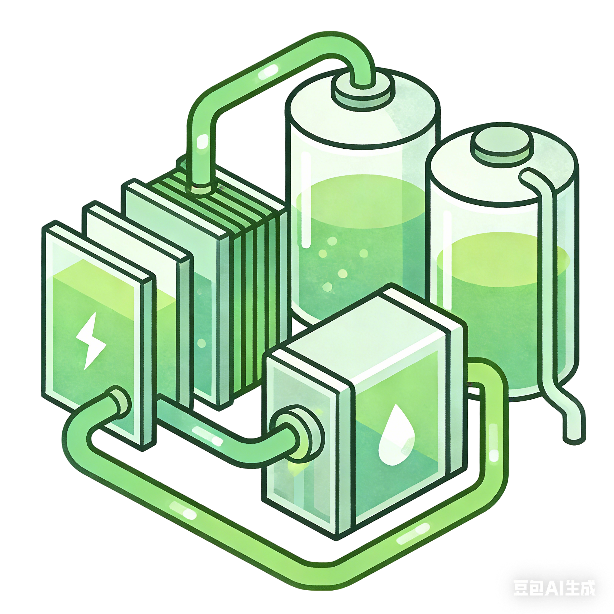
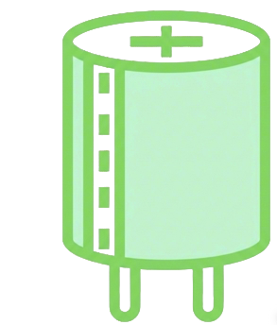



Our Technology Focus
Focusing on the Frontier, Covering Diverse Storage Technologies
Sodium-ion Batteries
—a key complement to lithium ion batteries.
Solid-state Batteries
—the next generation of metal-ion batteries
Abundant Resources
Globally Balanced Distribution
Excellent Wide-Temperature Performance
(-40-70℃)
Superior Safety
Reasonable Cost
Potential for Extremely High Energy Density
Suitable for high/low-temperature base station backup and C&I energy storage
Perfect for high-safety and space-constrained environments like data centers
learn more
learn more
Redox Flow Batteries
Supercapacitors
——instantaneous power support
Intrinsically Safe
Non-Flammable Aqueous Electrolyte
million-cycle life
ultra-high power density
Ultra-fast charge/discharge (<10ms response)
Perfectly matches the requirements of grid frequency regulation and fast-response applications in data centers
Ideal for Grid Peak Shaving and Urban Dense Energy Storage
learn more
learn more

Slide 5
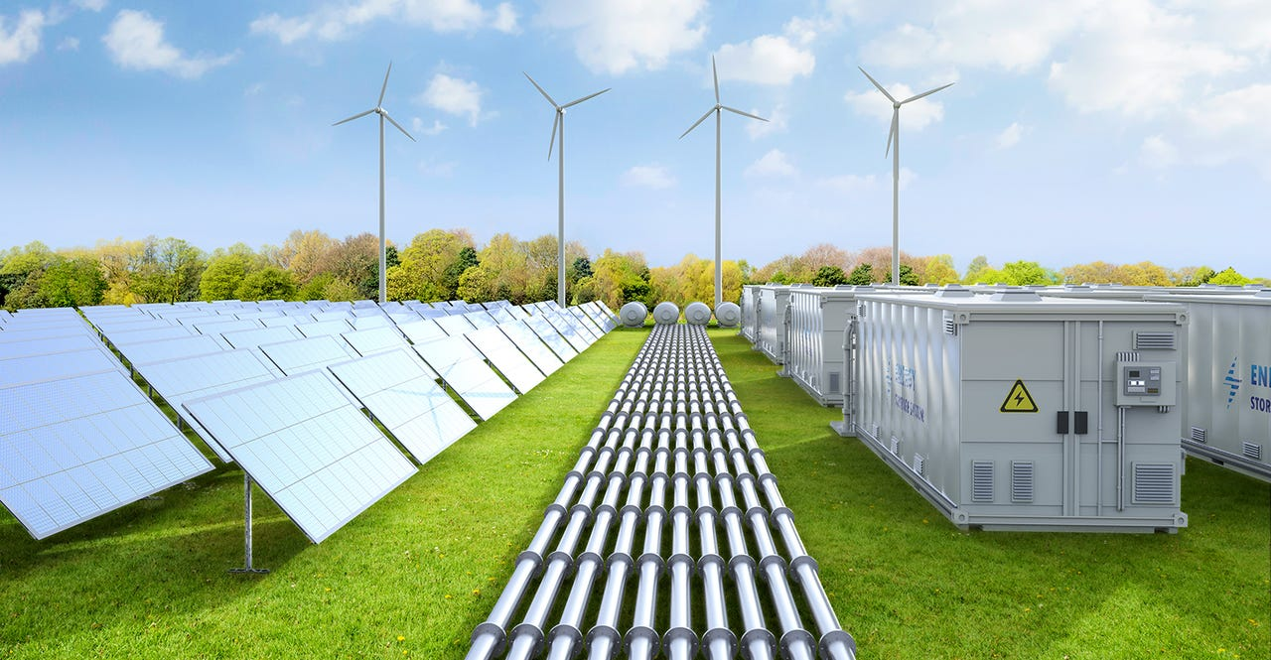
Why StorageLink
Four Key Advantages for More Efficient Collaboration
Multi-technology Coverage
Direct Access to China's Supply Chain
Beyond Lithium. We are also deeply engaged in Sodium-Ion, Solid-State, Redox Flow Batteries, and Supercapacitors, offering objective and diverse technological options. We match the optimal energy storage technology roadmap based on specific customer scenario requirements
We collaborate closely with China's leading battery companies across different technologies, enabling rapid access to high-quality supply chains and the latest innovations to ensure our products remain competitive.
Sodium-ion Batteries
Solid-State Batteries
Redox Flow Batteries
Supercapacitors
Partnerships with Top-Tier Companies
Access to Latest Technologies
Local European Presence
Application-driven Approach
Our German partner brings deep expertise in the European energy storage industry, with years of experience and a comprehensive understanding of the market, technology, and local language. This ensures seamless communication and enables us to provide dedicated local service and support to our customers.
Our core team members have participated in large-scale grid-side energy storage projects in China. This experience enables us to start from real-world application needs and deliver practical, feasible technical solutions to our clients.
German Local Team
Localized Service
Grid Project Expertise
Scenario-Based Solutions

Slide 6
PARTNER WITH US
Partner with
StorageLink
Bridging Advanced Energy Storage to the World
Technical Consulting
Market Connection
Product Introduction

