Slide 1
ECE653 Final Shareout

Slide 2
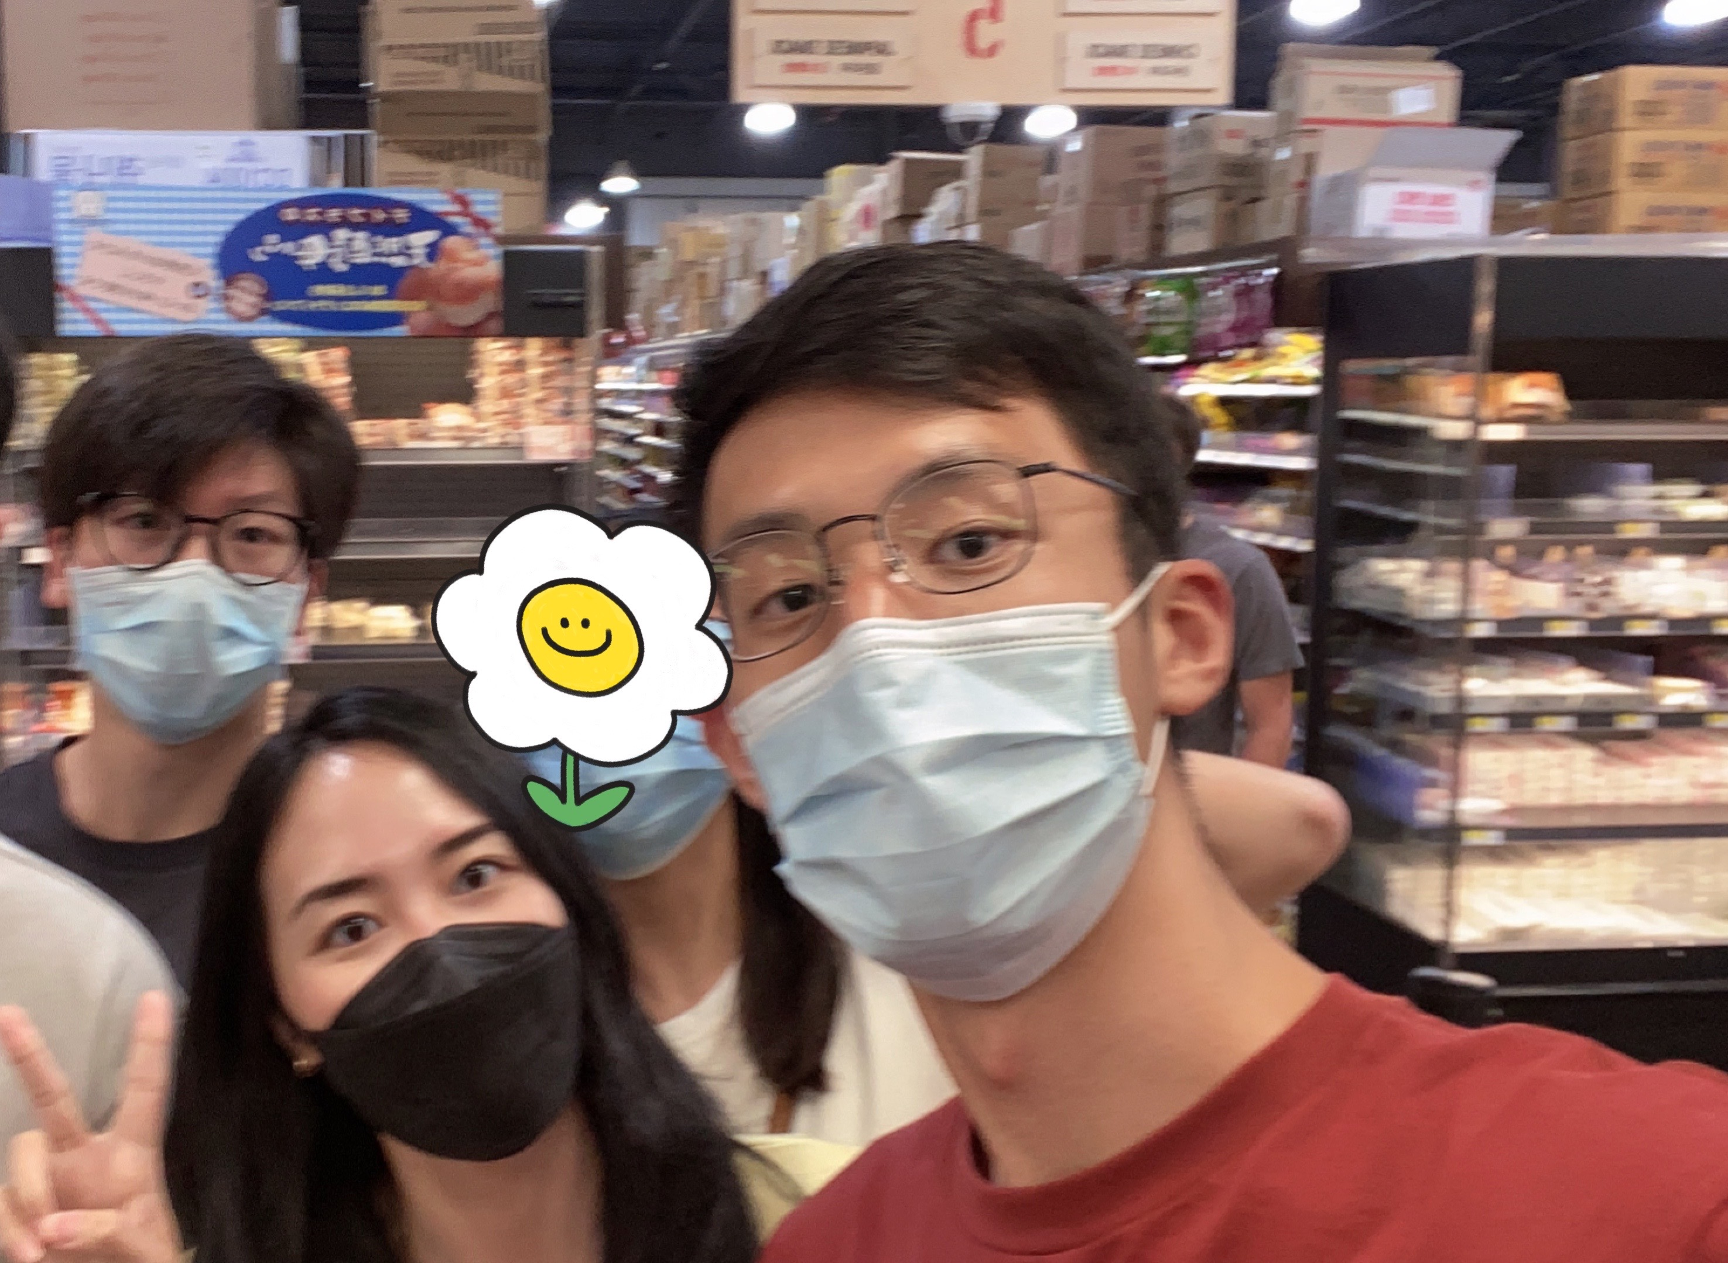
Team-5 Members
Zilin Yin 1st year MSECE
Chang Cao 1st year MSCS
Yutong Zhang 1st year MSECE
We are all interested in:
Software engineering & Mobile app development

Slide 3

Recap of Our Idea
Café N’ Chat is a mobile app that helps arrange a chat for a pair of people on campus, focuses on helping users find similar people to talk to. The time of the talk is usually a cup of coffee’s length.

Slide 4
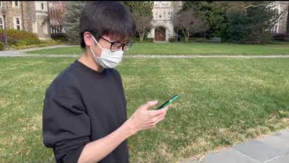
Concept Video

Slide 5
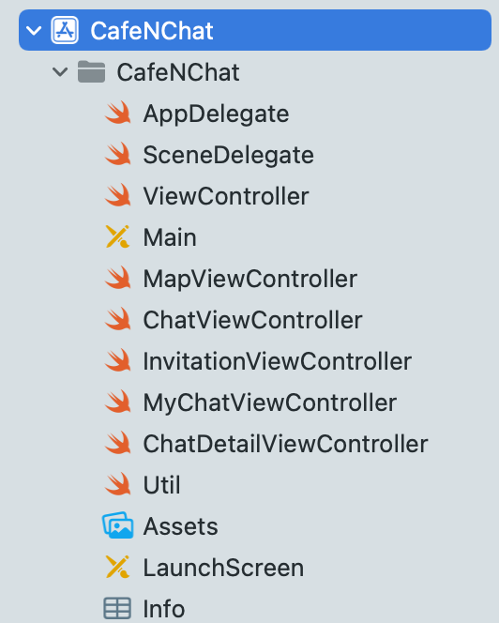
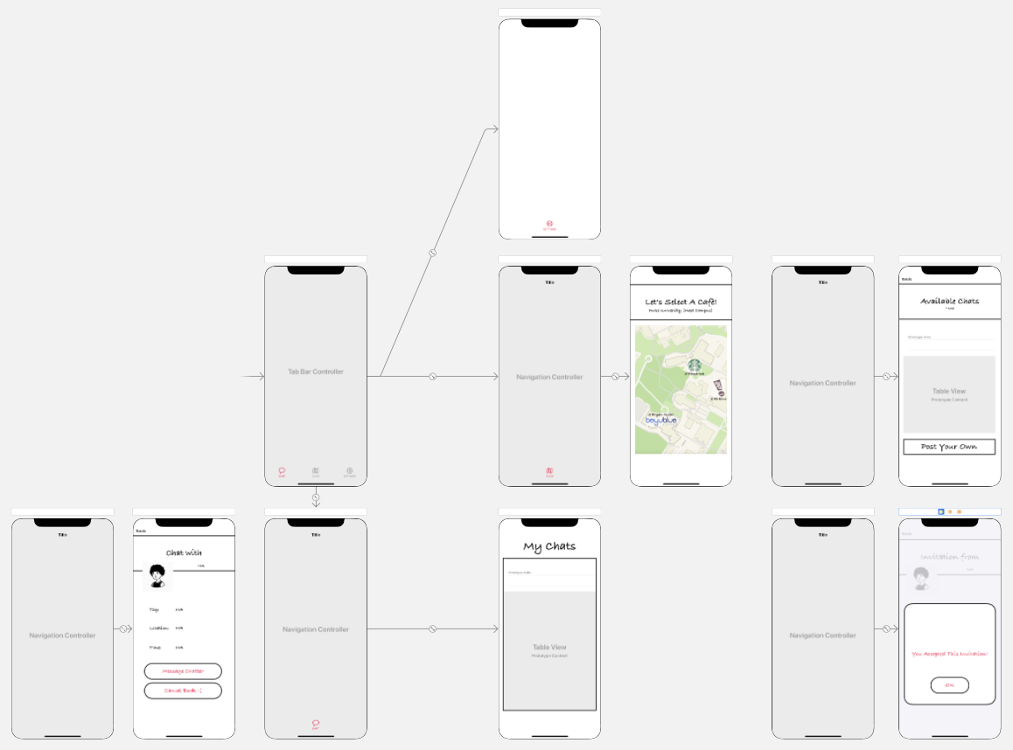
Final prototype
iOS app for iPhone 11
Swift codes and Storyboards in Xcode
Realized tasks:
Check available coffee shops within your current area on a map view.
View and accept other users’ chat invitations.
View your accepted chats in a list.

Slide 6
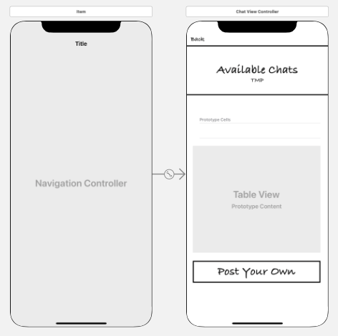
Comparisons
Difference 1
Improved the transition between pages.
From testing with classmates.
Why: This can improve user experience.

Slide 7
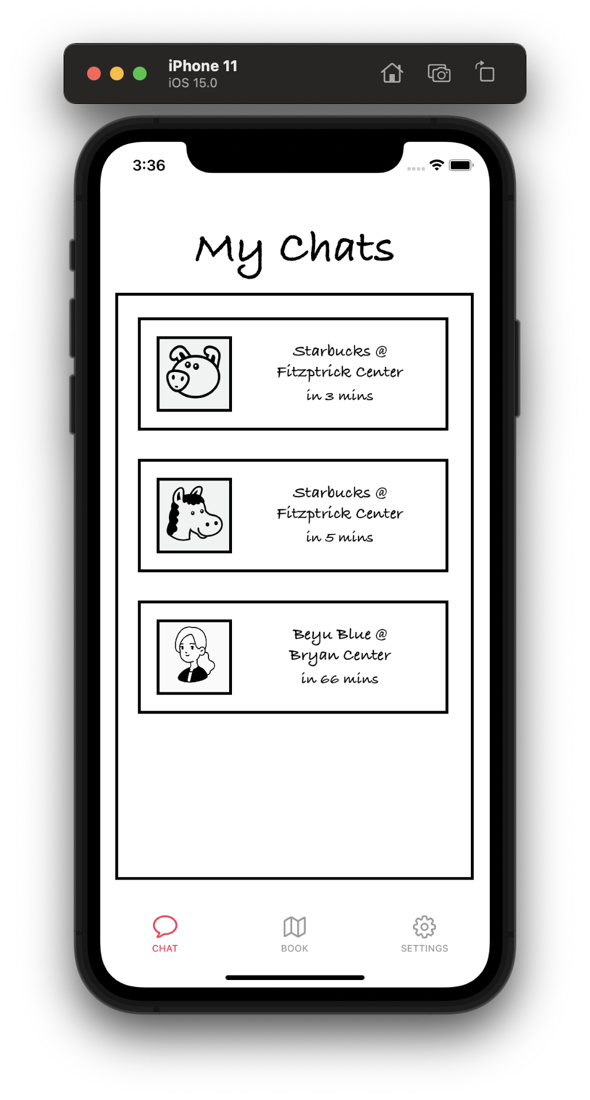
Comparisons Cont.
Difference 2
Revised the tab bar at the bottom of screen.
From group discussions & testing with classmates.
Why: This can make the UI more uniform, and clearer when presented to users.

Slide 8
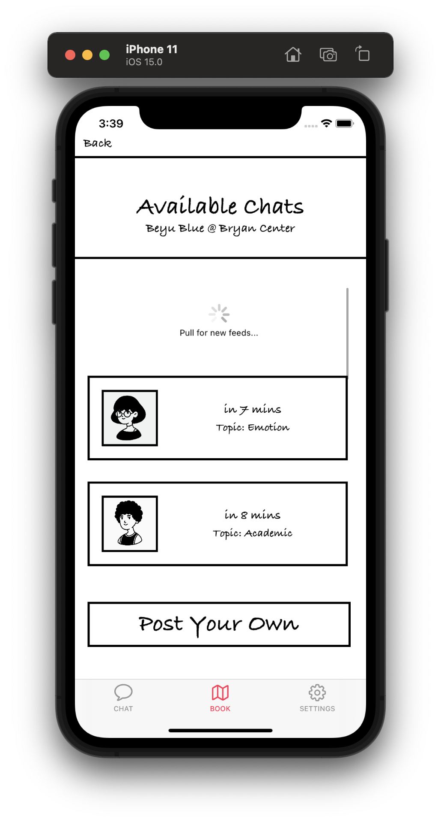
Comparisons Cont.
Difference 3
Added a loading icon when swiping down.
From group discussions.
Why: This serves as an indicator to show what’s going on.

Slide 9

Final Prototype Video

Slide 10
Top 3 Lessons
1
Good design requires interviewing a wide range of people.
2
Design is an iterating process.
3
Feedback from potential clients is essential to UX design.

Slide 11
Thanks!

