Slide 1
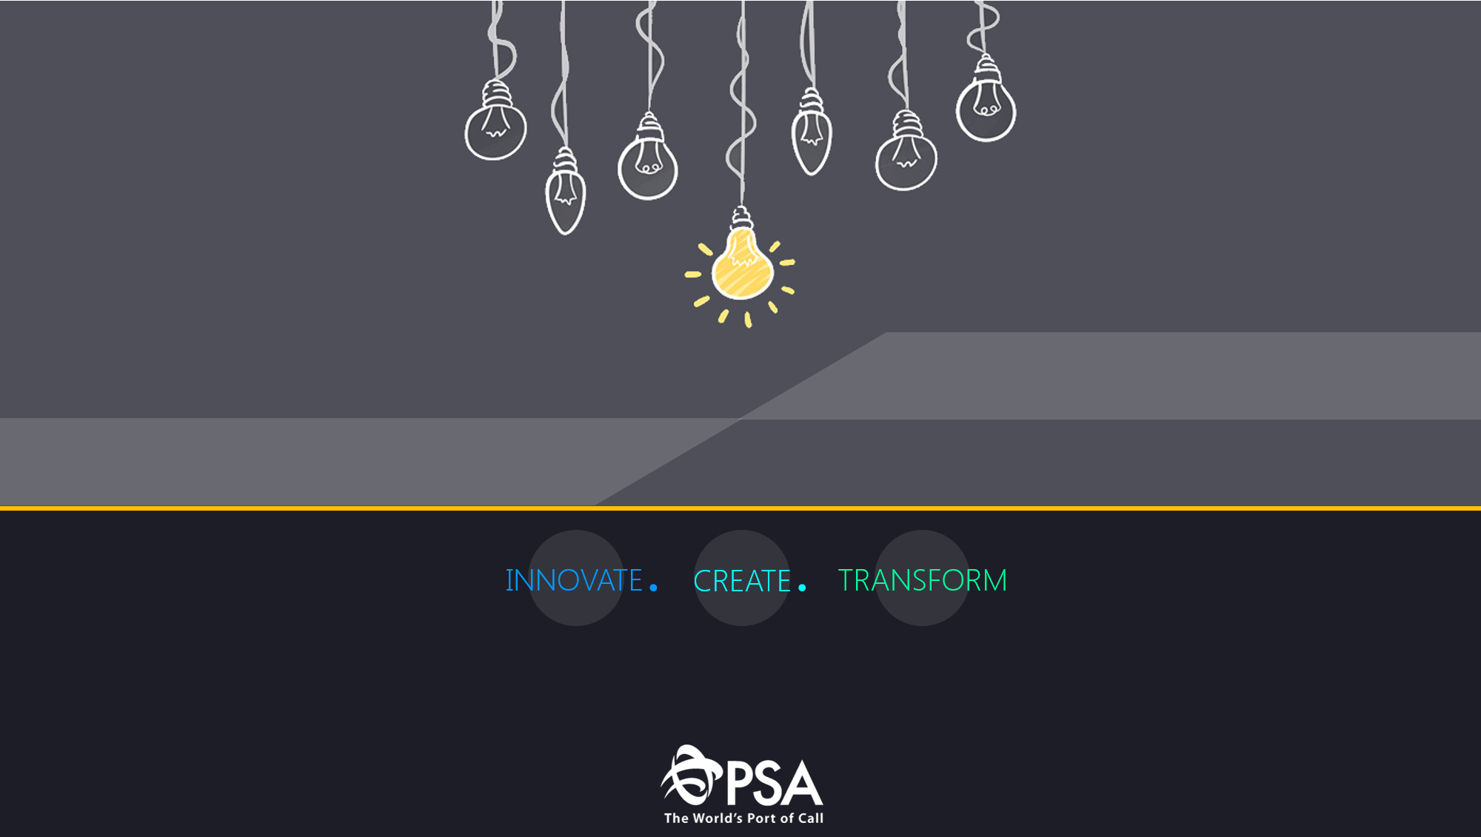


SMART Sentiments
Team FCC

Slide 2
Contents
01
02
03
Motivation
SMART Sentiments
Implementation
04
Summary

Slide 3
Motivation
The current pandemic has been a challenge across the globe. The many lifestyle changes due to the pandemic has taken a toll on the mental well-being of workers in almost all industries. To properly ensure that workers are being cared for, there is a need to revamp the social support networks at PSA.
We set out to develop SMART Sentiments, an innovative product that uses neural network learning to detect workers who are going through mental health issues.

Slide 4
SMART Sentiments
SMART Sentiments can be categorized into three main parts:
To allow workers to complete a questionnaire regarding their daily lives
To classify their mental health using a standardized rating
To allow supervisors to easily monitor the psychological wellbeing of the entire department through a dashboard

Slide 5
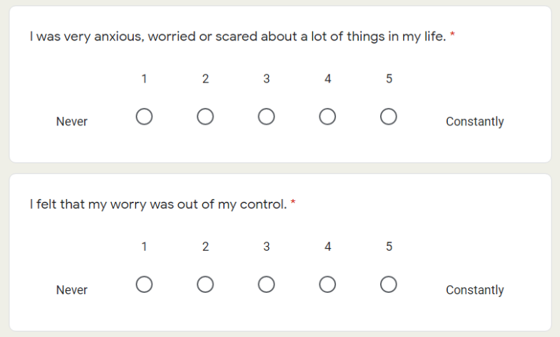
SMART Sentiments
To allow workers to complete a questionnaire regarding their daily lives
This carefully curated questionnaire will contain questions pertaining to their disposition and emotions. The response collected would include multiple choice, as well as short answers.

Slide 6
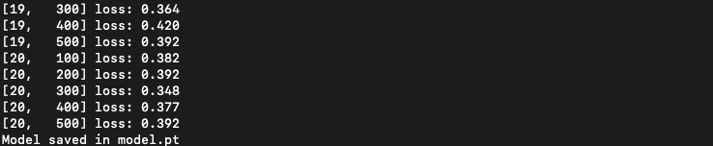
SMART Sentiments
To classify their mental health using a standardized rating
The responses that are collected will be stored in a database and retrieved to be processed. Each response will be modelled as a tensor to be fed into a feed forward neural network in order to obtain a classification for the mental health.

Slide 7
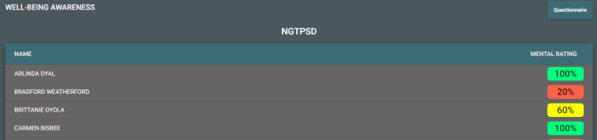
SMART Sentiments
To allow supervisors to easily monitor the psychological wellbeing of the entire department through a dashboard
The psychological health rating of everyone will be reflected on the dashboard so that the department supervisor may identify, and potentially follow up with that particular individual to find our what assistance he or she might require.

Slide 8







Implementation
Dashboard | Server | Model

Slide 9
Summary
Mental wellbeing is often overlooked, but it is an important aspect of an individual’s wellbeing, and consequently their productivity in delivering quality work.
SMART Sentiments aims to accurately identify and connect with at-risk individuals preemptively in order to render assistance as soon as possible.

Slide 10
Thank you!

