Slide 1
Cornell Birdcall Identification
Flying Toasters – Abhinav Sharma, James Byrne, Carlos Capellan, Isaac Law
W251 Deep Learning in the Cloud and at the Edge

Slide 2
Introduction
Kaggle Competition
Identify bird species from birdcall
Bird species is good indicator of environmental pollution
264 bird species with 21,375 audio in original data set
Extensive analysis on 20 bird species and a final training on all 264 species
Develop an edge device for bird classification at flexible locations

Slide 3
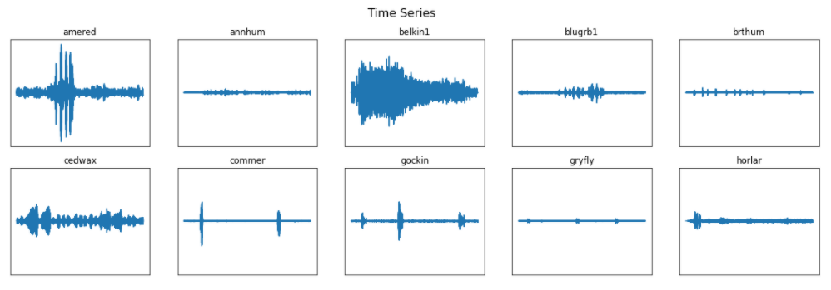
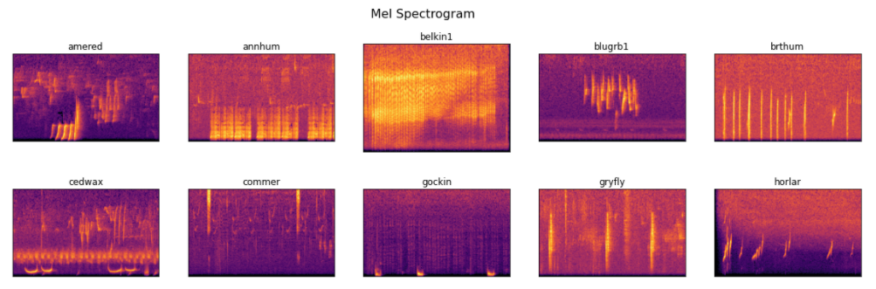
Exploratory Data Analysis

Slide 4
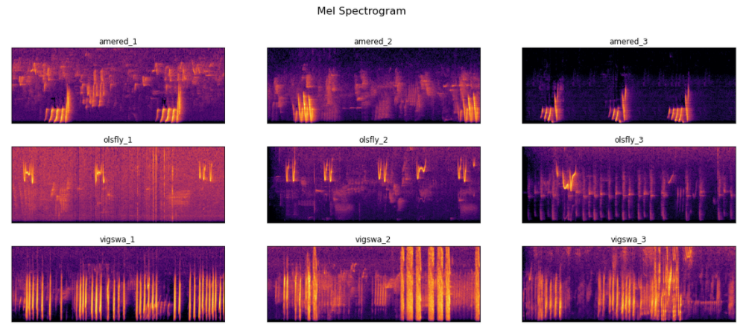
Mel Spectrogram

Slide 5
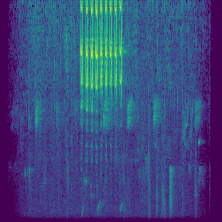

Data Augmentation
Conventional Augmentation
Original
Time Shift
Frequency Shift
Time Stretch
Noise
Convolutional Variational Autoencoder (CVAE)
Encoder
Decoder
Latent
ε
Notes:
Audiomentations Library: similar to imgaug for pictures. - augmented the audio then converted to spectrograms instead of augmenting the spectrograms. Even though we could have operated on the spectrograms, many of the usual image augmentation techniques, including flps and rotations would not be appropriate. For image object identification, a cat is a cat whether it is looking left, right or is upside down. Doing the same to a spectrogram could fundamentally change the characteristics of a birdcall from rising to falling, or turning time into frequency and vice versa.
Four augmentations with varying levels, tuned to give the best results when combined with the unaugmented original data. Gaussian noise, at least at moderate levels was the most successful augmentation vs using just the unaugmented data set, bumping accuracy close to 80% on our trial model when combined with the unaugmented data, but all showed some improvements.
We were inspired by some articles on using AutoEncoders and Variational AutoEncoders as data augmentation tools. In the time available, we were spectacularly unsuccessful. The articles used MNIST digits as the example data set. They llimited data spaces by collapsing the colour channels and quantizing to black/white – just as we did in the homeworks of W207. For the spectrograms however, both colour and intensity are used to show frequency amplitudes. With all but the loudest and most “squawky” calls, this means virtually all info is lost, so we needed to continue with all colour channels intact. In our example, we had 224x224x4x8 bits of information (1.6M bits of information) per image compared with a quantized MNIST digit’s 784 bits. Even using convolutional techniques, we pushed the latent layer up to over 1000 nodes, and still were not able to get more acceptable results than this. More research and probably much larger models than we tried would be needed to do this effectively for these larger images.
Unlike the MNIST digit set that most available examples were based on,

Slide 6
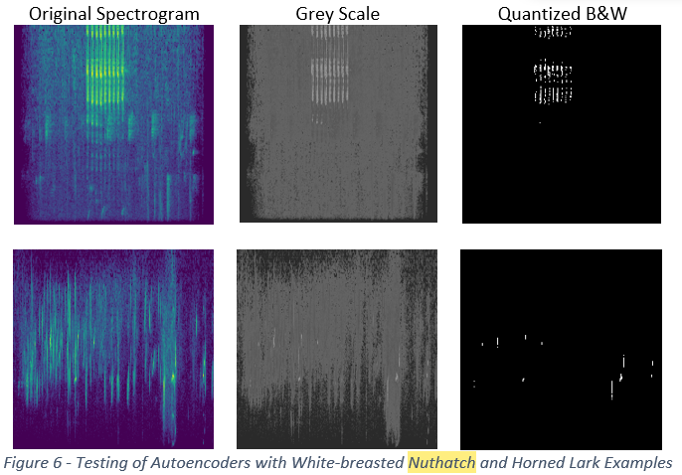
Problems with Quantization

Slide 7
Model Training
Different birds have different patterns exhibited in Mel Spectrograms
Pitch, frequency, intervals between sounds, intensity and amplitude
Train traditional image classifiers for classifying birds given spectrograms
InceptionNet, ResNet, EfficientNet, MobileNet, PNasNet
Generalized headless classifier (Transfer Learning) - testing "robustness"
Training and Inference at the Edge (compact models)

Slide 8
Model Training
Model | Best Validation Accuracy
EfficientNetB1 | 76.81
EfficientNetB2 | 62.21
EfficientNetB3 | 79.23
EfficientNetB4 | 63.86
EfficientNetB5 | 80.47
EfficientNetB6 | 80.63
EfficientNetB7 | 61.02
InceptionNet V3 | 27.94
MobileNet V2 | 48.56
MobileNet V2 140 Layers | 40.37
ResNet V2 152 Layers | 5.69
PNasNet | 6.40

Slide 9
Model Training
Performance Parameter Tuning
1.1. CPU workers
1.2. Batch Size (larger models prone to OOM)
1.3. Optimizer
1.4. Augmentation (live vs offline)
1.5. Trainable Layers
1.6. Image Size
1.7. Epochs and Steps per Epoch

Slide 10
Model Training
Infrastructure Parameters
1.1. VM – Volta vs Tesla
1.2. Location of storage vs compute
1.3. GPU settings – Memory as needed, TF visibility
1.4. CUDNN

Slide 11
Model Training
Larger models tend to overfit (ResNet, PNasNet, InceptionNet V3, EfficientNet B7) given the amount of traning data
EfficientNet is well suited for this task – compound scaling, inverted residual blocks, swish activation
Transfer Learning is fairly robust on headless generalized image classification models
Always keep the compute and data close to each other and limit augmentations during training time!

Slide 12
Edge Inference Demo

Slide 13
Conclusion
Potential Further Work On:
Inference Calibration
Multi-instance and Null Support
LSTM classification based model

Slide 14
Q & A

