Slide 1







Programing Skill Market Analysis
Mr. Dai
Feb 28, 2024

Slide 2



OUTLINE
Executive Summary
Introduction
Methodology
Results
Visualization – Charts
Dashboard
Discussion
Findings & Implications
Conclusion
Appendix

Slide 3

EXECUTIVE SUMMARY
Collecting programming techniques, personal information from various programmers
Wrangling and explore data
Deal with missing, duplicated, outlier data, and normalize data
Find the relation between different features
Analyzing data and identify insights and trends
The top 10 languages
The top 10 database
The popular programming tools
Building a dashboard based on the analysis by cognos analysis

Slide 4

INTRODUCTION
To keep pace of the development of techniques is significant for IT careers
Focus problems
What are the popular programming tools in the present
What are the popular programming tools in the future

Slide 5

METHODOLOGY
Data collecting
Data wrang
Exploratory data analysis
Data visualization
Building a dashboard

Slide 6
RESULTS
Current techniques
Future techniques

Slide 7
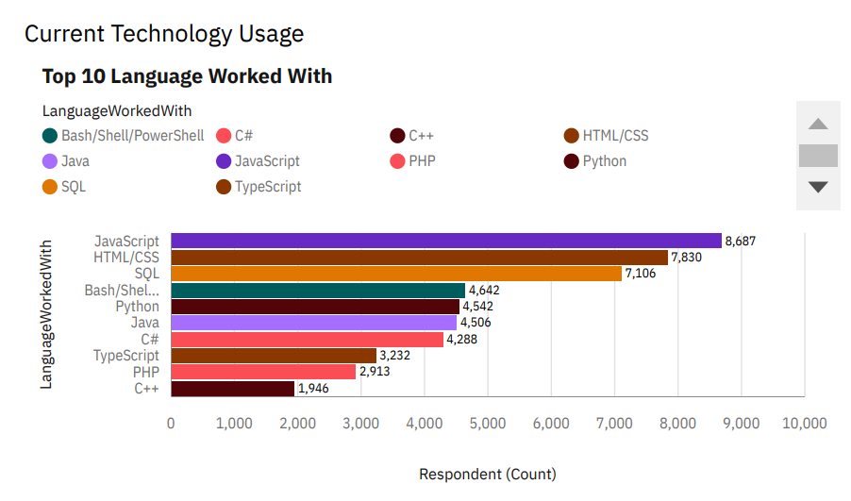
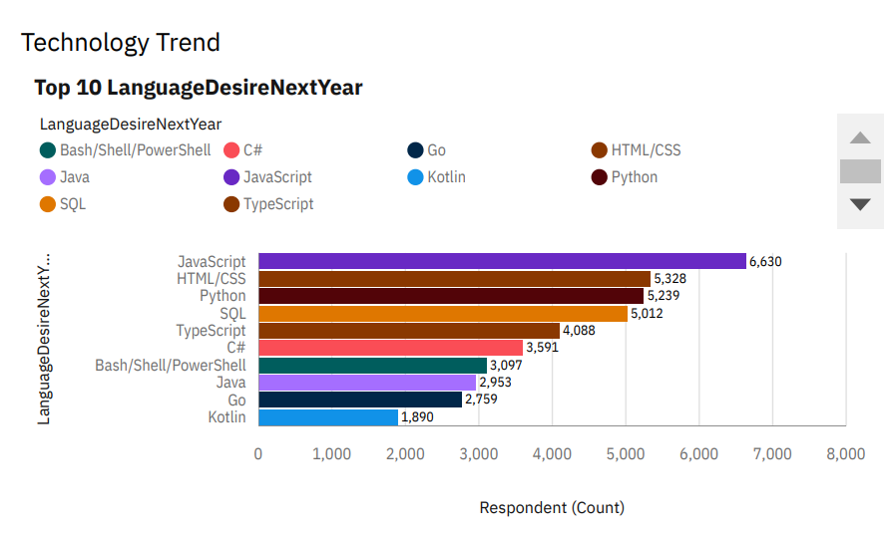
PROGRAMMING LANGUAGE TRENDS
Current Year
Next Year

Slide 8
PROGRAMMING LANGUAGE TRENDS - FINDINGS & IMPLICATIONS
Findings
JavaScript is the most highest number of people working with, following by HTML/CSS for both
The third is replaced by python
Total number of people who are working with top 10 languages decreases in the next year
Implications
JavaScript and HTML/CSS keep the trend
People are more interested in python
People are more interested for other languages

Slide 9
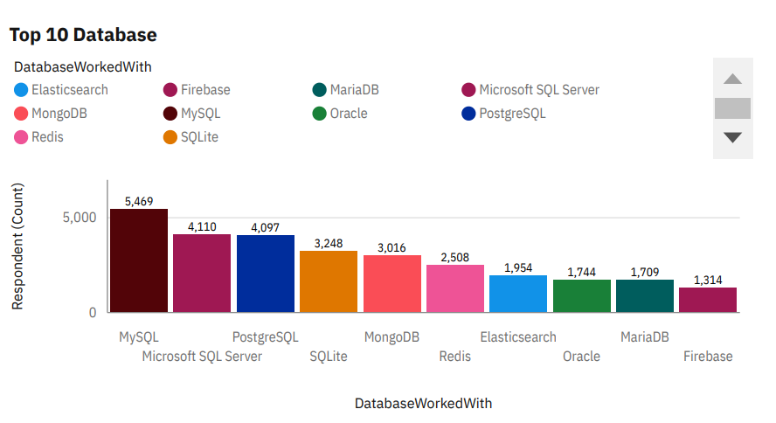
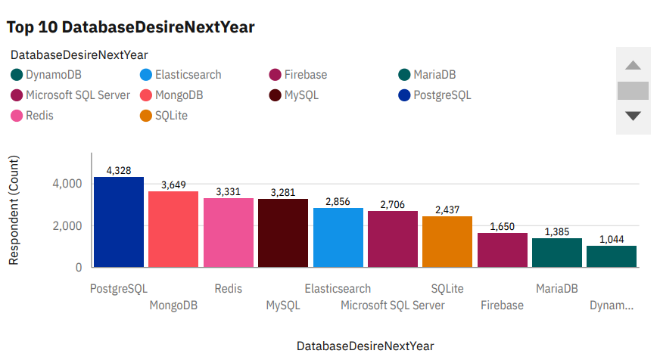
DATABASE TRENDS
Current Year
Next Year

Slide 10
DATABASE TRENDS - FINDINGS & IMPLICATIONS
Findings
PostgreSQL, MongoDB, Redis, ElasticSearch and Firebase will get higher ranking
Oracle will be out, and replaced by DynamoDB
Implications
People are more interested in PostgreSQL, MongoDB, Redis, ElasticSearh and Firebase
People change the attention from Oracle to DynamoDB

Slide 11

DASHBOARD
The link of Cognos Dashboard
Click here

Slide 12
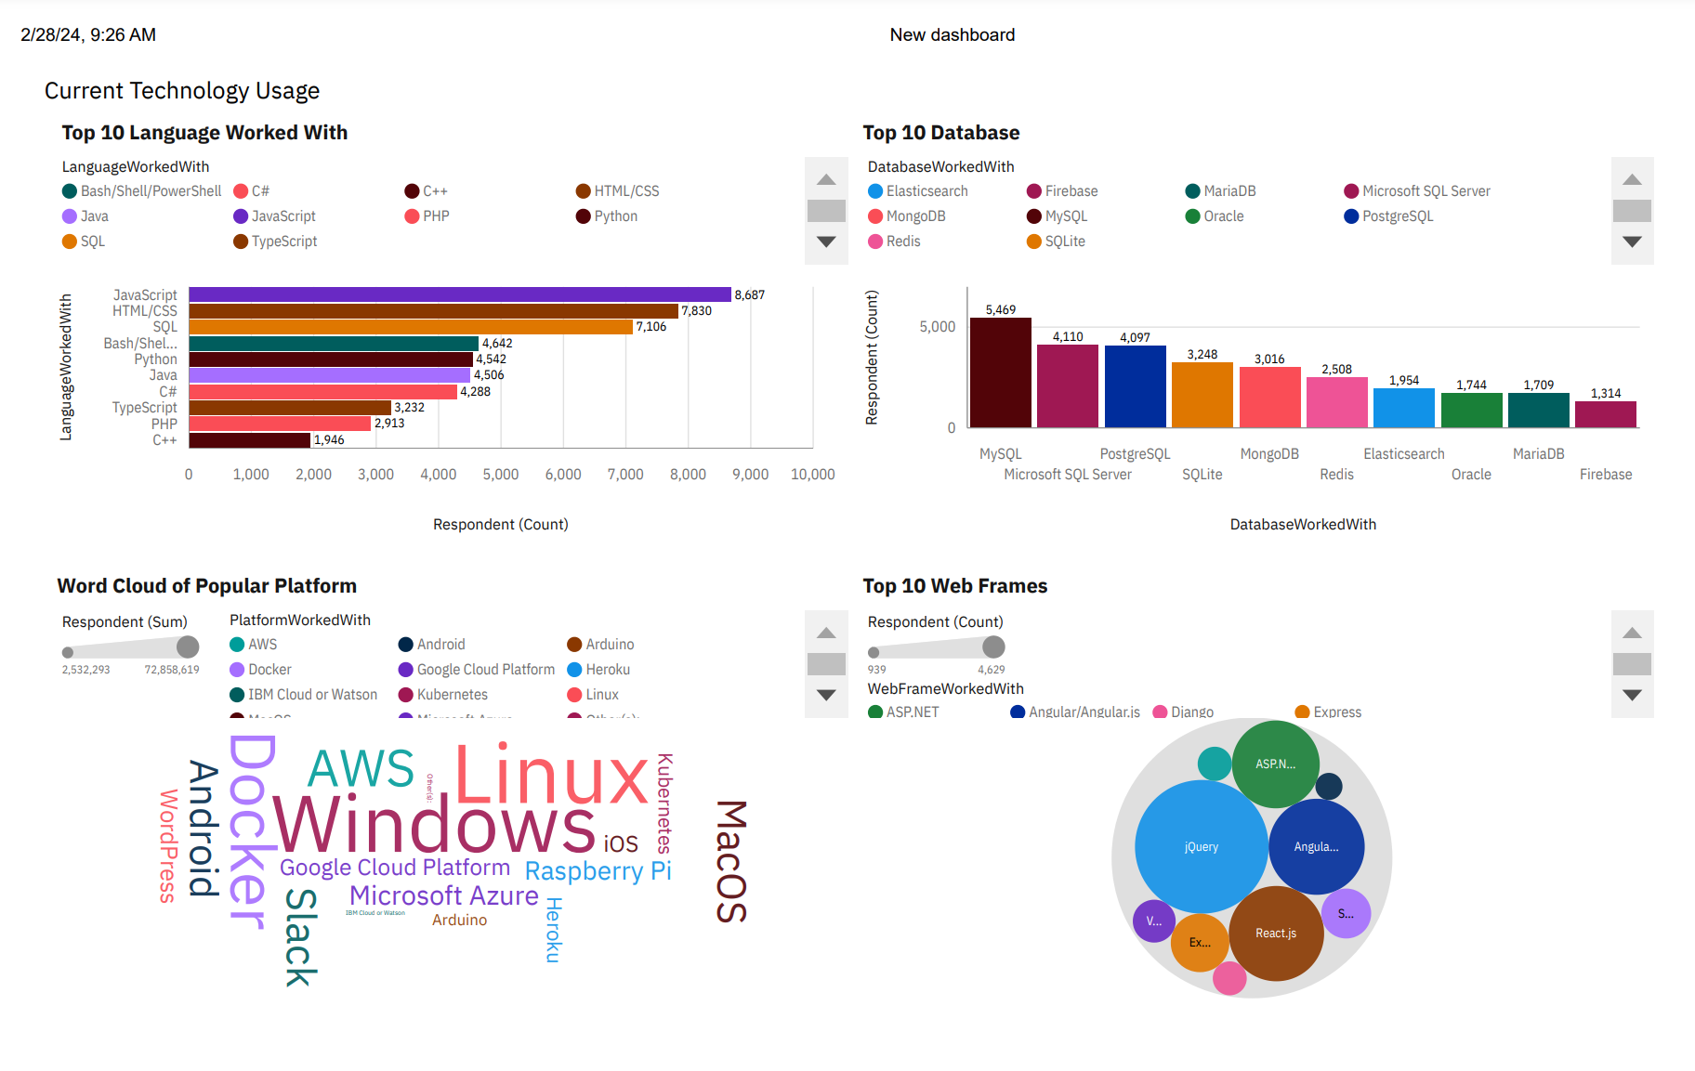
DASHBOARD TAB 1

Slide 13
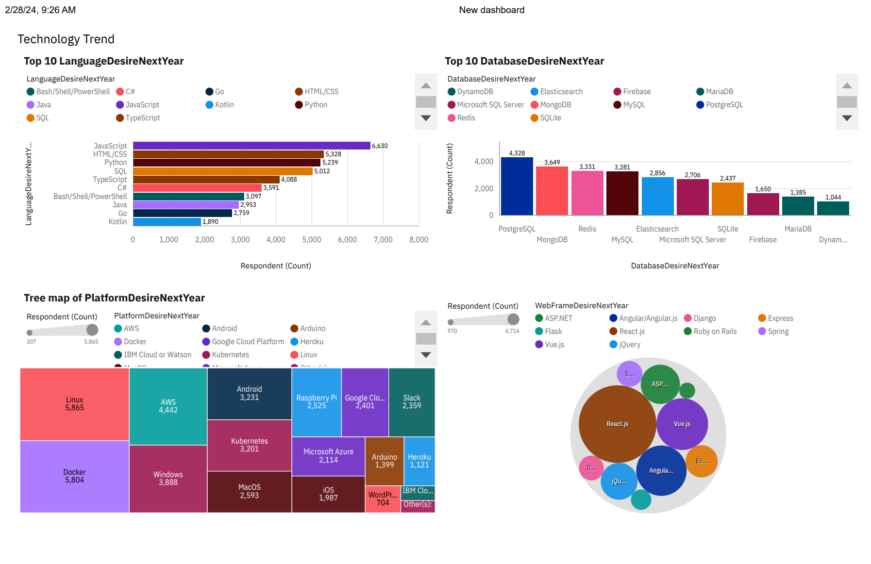
DASHBOARD TAB 2

Slide 14
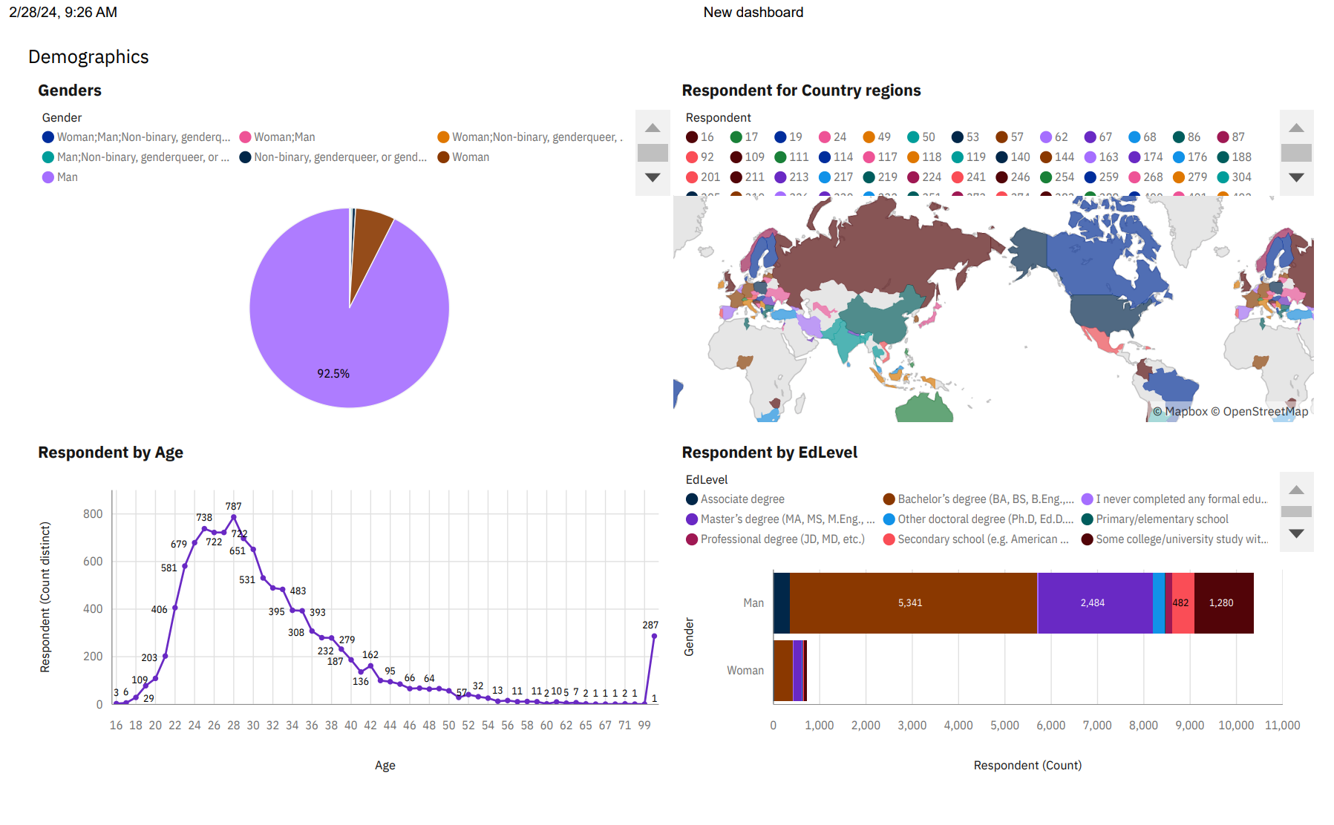
DASHBOARD TAB 3

Slide 15
DISCUSSION
Relations between genders, education levels, locations, ages and the number of Respondents
Popular programming tools and techniques

Slide 16
OVERALL FINDINGS & IMPLICATIONS
Findings
JavaScript is the most highest number of people working with, following by HTML/CSS for both
PostgreSQL, MongoDB, Redis, ElasticSearch and Firebase will get higher ranking
The most of respondents come from EU and NA
Implications
JavaScript and HTML/CSS keep the trend
People are more interested in PostgreSQL, MongoDB, Redis, ElasticSearh and Firebase
People in EU and NA are more interested in IT

Slide 17

CONCLUSION
JavaScript and HTML/CSS keep the trend
People are more interested in PostgreSQL, MongoDB, Redis, ElasticSearh and Firebase
People in EU and NA are more interested in IT

Slide 18

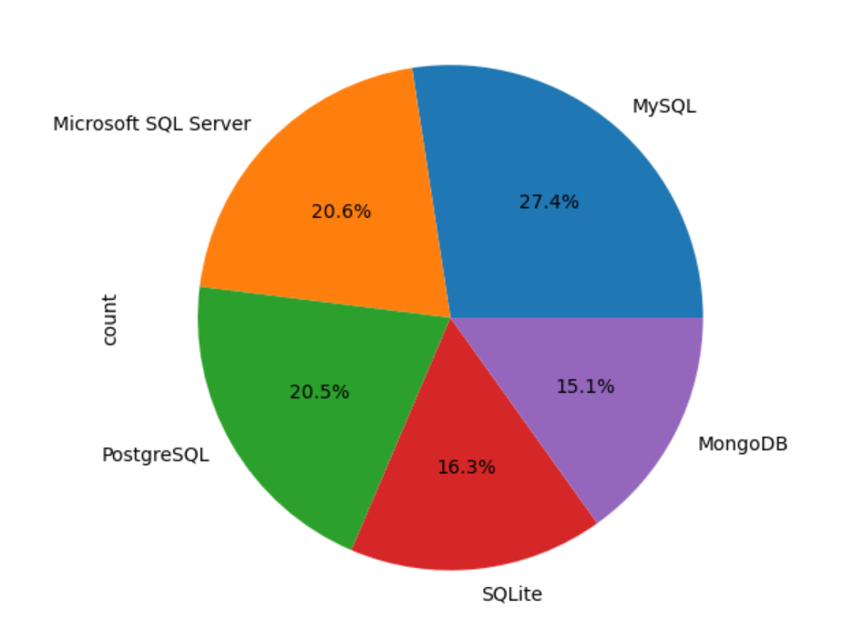
APPENDIX

Slide 19
JOB POSTINGS

Slide 20
POPULAR LANGUAGES

