Slide 1
Using Processing
For data logging, data visualization, and serial communication
Orlando S. Hoilett
Thursday, April 6, 2017

Slide 2
Processing
Graphical User Interface
Open Source
Java
Easy to use

Slide 3
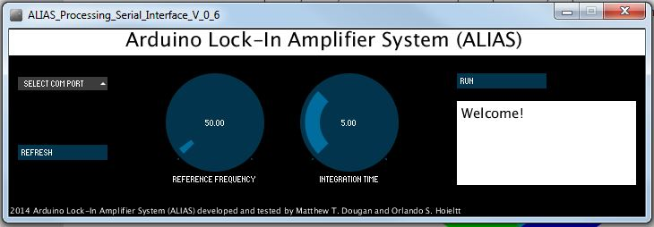

Slide 4
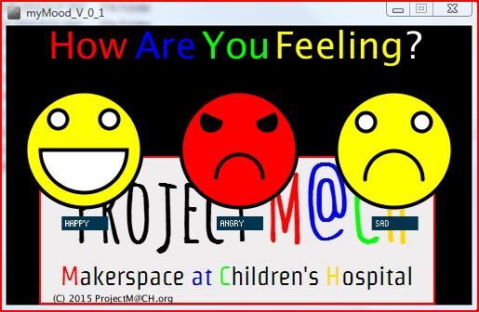

Slide 5
void setup()
Initialize a few standard variables
size(width,height);
background(rgb)
background(r, g, b)
void draw()

Slide 6
Serial Data Transmission
Either enabled through standard serial functions such as:
serial.read(), serial.readStringUntil(), etc.
Also specialized method called
serialEvent()

Slide 7
User Controls Through ControlP5
Buttons, sliders, textboxes, etc
Object-oriented

