Slide 1

Java1
X52.9269
Welcome to the Wonderful world of Java

Slide 2

Java1
X52.9269
Monday
6:00 PM - 9:30 PM
Instructor: Mohammed Ashequr Rahman
( Technical Manager – Global Document Management System, Marsh Inc. )
Email: mohammed.a.rahman@marsh.com

Slide 3

Java1
X52.9269
Course Description
This course provides an introduction to the Java programming language. Topics include:
  Syntax and Semantics of Java
  Classes and objects
  Immutable and Wrapper Classes
  garbage collection
  abstraction
  encapsulation

Slide 4

Java1
X52.9269
Course Description
inheritance
polymorphism
interfaces
packages
exception handling
input/output
serialization
threads
networking

Slide 5

Java1
X52.9269
Course Description
  AWT
  Swing
  Applet
  JDBC
A major emphasis is on object-oriented design principles and techniques.

Slide 6

Java1
X52.9269
Prerequisites
  Introduction to Programming Using Java 52.9238 or equivalent.
  Students must have prior programming experience

Slide 7

Java1
X52.9269
Important Points
This is not a “Introduction to Programming” Class.
No hands-on exercise
lab facility may be available – please check with NYU admin.

Slide 8

Java1
X52.9269
Important Points
Significant amount of homework (9 hws)
Instructor does not have any office hour.
No TA/Tutor is available for the course.

Slide 9

Java1
X52.9269
Important Points
Lots of Sample Code
Class Web-Site
Class Email-List

Slide 10
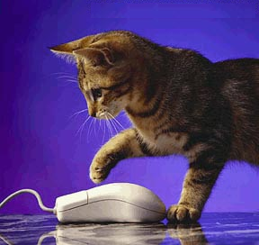
Java1
X52.9269
Course Objectives
  At the completion of this course, the students will be able to :
    Develop professional application programs using Java.
    Utilize Java’s GUI design tools and develop user-friendly desktop applications and web applets with confidence and speed.
    Will be ready to learn server-side programming involving Servlet, JSP, XML, EJB etc.

Slide 11
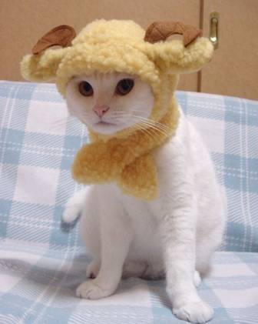
Java1
X52.9269
Recommended Books
[ Available at NYU Book Store ]
Just Java 2, ISBN 0131482114 . by Peter van der Linden, Prentice Hall
Head First Java, ISBN 0596004656, by Kathy Sierra, O'Reilly & Associates
Core Java 2 (Volume I and II) by Gary Cornell
Beginning Java by Ivor Horton
Thinking in Java by Bruce Eckel

Slide 12

Java1
X52.9269
Software
The Java platform is available free of charge from the Java.Sun.Com web site.
You can choose between the Java 2 SDK, Standard Edition (J2SE) for all environments.
Please download the API Documentation as well when you download the Java platform.

Slide 13

Java1
X52.9269
Software
Two Downloads:
Java 2 SDK, Standard Edition (J2SE)
Java 2 Platform, Standard Edition Documentation (J2SE Docs)

Slide 14

Java1
X52.9269
Development Tool
Eclipse (latest version)
Free Download
http://www.eclipse.org/downloads/index.php

Slide 15

Java1
X52.9269
Homeworks & Final Project
Each student should do his/her homework individually. Submission of stolen or copied homework from fellow students is a serious offence.
9 Weekly Homeworks:
    10 X 7 = 70 ( hw1,2,3,4,5,8,9 )
    15 X 2 = 30 ( hw6,7 )
Regular homeworks will be assigned every week starting from the 1st class and will be due on the following week.

Slide 16
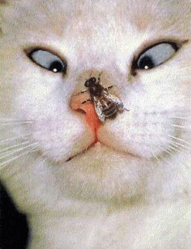
Java1
X52.9269
Homeworks
Homework assignments will be handed in on a floppy disk. You can burn in on a CD too. Emailing homeworks is not acceptable, unless of course, you are unable to attend the class but still want to submit the homework.
No late submission

Slide 17

Java1
X52.9269
Grades
  All students taking this course will default to a letter grade.
  If you would rather be assigned an N (non-evaluated) or be graded on a Pass/Fail basis, you will need to complete a ‘Grading Policy’ form. Grading Policy form can be handed in anytime during the course.

Slide 18

Java1
X52.9269
Class Email List
It is important that you become a member of the class e-mail list. I will send useful tips for homework assignments to the members of the class e-mail list.

Slide 19

Java1
X52.9269
Class Email List
  Should you desire to subscribe to class email list send a blank message to:
  join-javawednesday@forums.nyu.edu

Slide 20
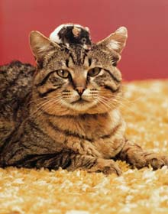
Java1
X52.9269
Class Email List
Once you receive a message from lyris-confirm@forums.nyu.edu asking for confirmation, please reply to that message - your reply will work as a confirmation message.
You will receive a welcome message shortly. Once you receive a welcome message from lyris@forums.nyu.edu, you can send messages to the class email list.

Slide 21
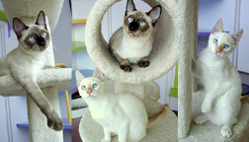
Java1
X52.9269
Class Email List
Once you become a member of the class email list you can send your questions or concerns to :
javawednesday@forums.nyu.edu
All the members of the list will get your message

Slide 22

Class Website http://i5.nyu.edu/~mqr5025/java1

Slide 23

Java1
X52.9269
Class Web Site
http://i5.nyu.edu/~mqr5025/java1
lowercase letters, no "www" and don't miss the "~" sign before "mqr5025" please

