Slide 1

Java 2
X52.9271
Welcome to the Wonderful world of Java

Slide 2

Java 2
X52.9271
Tuesday
6:00 PM – 9:30 PM
Instructor: Mohammed Ashequr Rahman
( Web Development Manager – MSC Industrial Supply Co. )
Email: mar23@nyu.edu
Website: http://i5.nyu.edu/~mar23/Java2

Slide 3
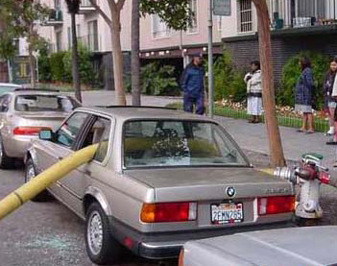
Java 2
X52.9271
Important Points
No hands-on exercise
lab facility may be available

Slide 4

Java 2
X52.9271
Important Points
Homeworks - 9 hws
No office hour.
No TA/Tutor

Slide 5

Java 2
X52.9271
Course Objectives
  Develop desktop and web applications in Java.
  Integrate with other systems using web services.

Slide 6

Java 2
X52.9271
Course Outline:
  Session 1 - Wrapper Classes, Boxing, Generics, Collection Framework, Log4J, ANT, JUnit
  Session 2 - Threads, TCP/IP Socket Programming, Remote Method Invocation
  Session 3 – Database connectivity
  Session 4 – XML Basics– JAXP

Slide 7

Java 2
X52.9271
Course Outline:
  Session 5 – XML Schema – JAXB
  Session 6 – Web Programming Basics
  Session 7 – Advanced Web Programming
  Session 8 – JSP
  Session 9 – Spring, Hibernate, Struts
  Session 10 – Web Services

Slide 8
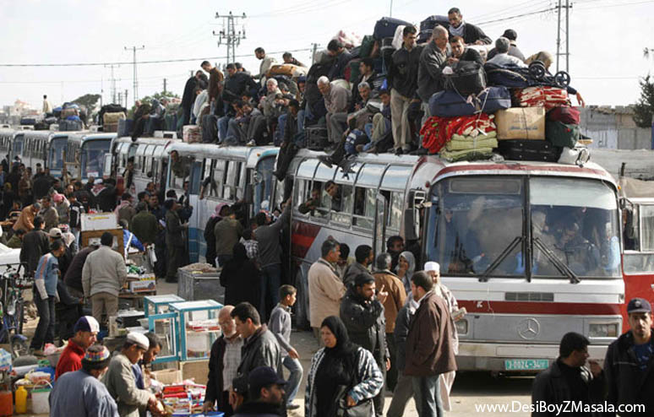
Java 2
X52.9271
Development Tool
Eclipse (latest version)
Free Download
http://www.eclipse.org/downloads/index.php

Slide 9

Java 2
X52.9271
Homeworks
Each student should do his/her homework individually. Submission of stolen or copied homework from fellow students is a serious offence.
9 Weekly Homeworks:
    9 x 10 = 90
    Homeworks will be assigned every week starting from the 1st class and will be due on the following week.

Slide 10

Java 2
X52.9271
Homeworks
Homework assignments will be handed in via email to:
  ananrahman@gmail.com
No late submission

Slide 11

Java 2
X52.9271
Grades
All students taking this course will receive letter grade.

Slide 12
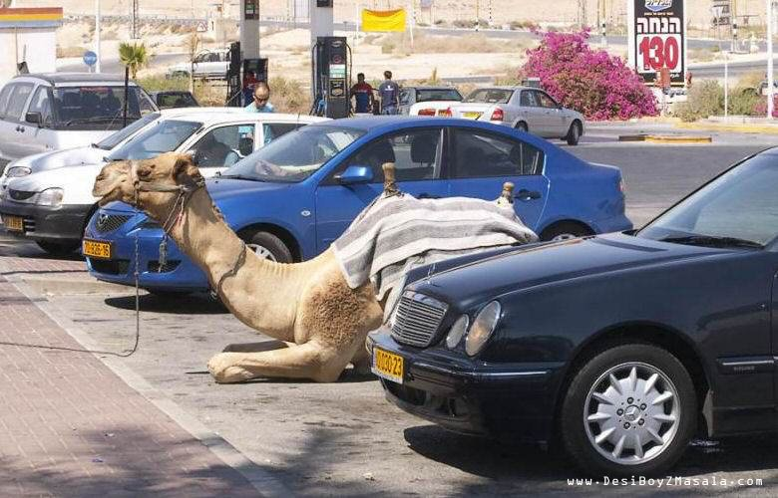
Java 2
X52.9271
Class Email List
It is important that you become a member of the class e-mail list. I will send useful tips for homework assignments to the members of the class e-mail list.

Slide 13

Java 2
X52.9271
Class Email List
  Should you desire to subscribe to class email list send a blank message to:
  join-javawednesday@lists.nyu.edu

Slide 14

Java 2
X52.9271
Class Email List
Once you receive a message asking for confirmation, please reply to that message or click on the link provided- your reply or click will work as a confirmation message.
You will receive a welcome message shortly. Once you receive a welcome message you can send messages to the class email list.

Slide 15

Java 2
X52.9271
Class Email List
Once you become a member of the class email list you can send your questions or concerns to :
javawednesday@lists.nyu.edu
All the members of the list will get your message

Slide 16

Java 2
X52.9271
Class Web Site
http://i5.nyu.edu/~mar23/Java2
lowercase letters, no "www" and don't miss the "~" sign before "mar23" please

