Slide 1
Project Name : Travel Agency
Md.HOJaifa TanvIr (16201079)

Slide 2
Use case for travel Agency
Actor | Use case
Customer | Registration , Log in
Customer | Location
Customer | Amount, Booking
Customer | Payment , Review
Admin | Log in , Data Report(number of person, time schedule)
Transport | Data Report
Hotel | Data Report

Slide 3
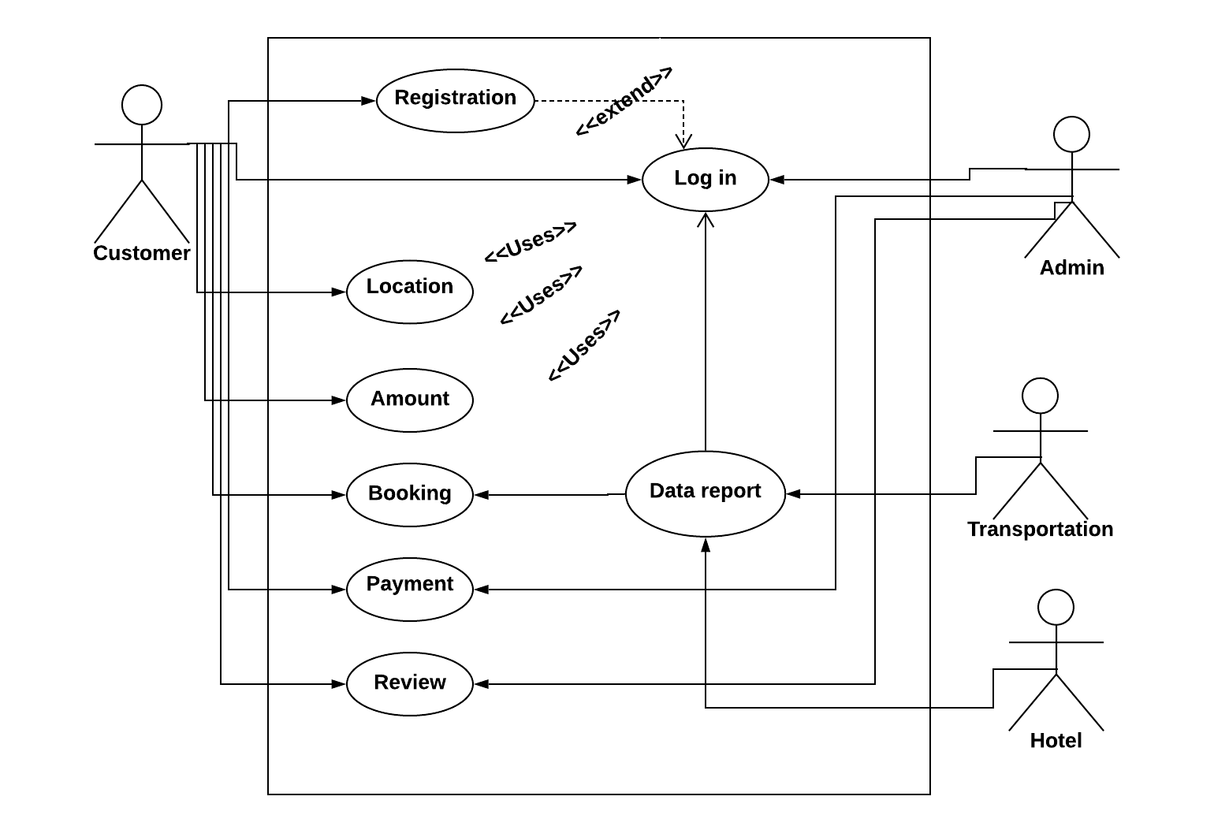
Use case diagram

Slide 4
Use case narrative
name : Travel agency
priority : high
primary actor : user / customer
secondary actor : admin

Slide 5
Use case narrative
User registration with Name and E-Mail.
User Log-in Name and Password .
Then user see the location , amount, offer ect.
User booking their trip easily .
Admin always hear to solve any kind of problem.
And we inform the user any kind of offer in our application(app).

Slide 6
Thank you

