Slide 1
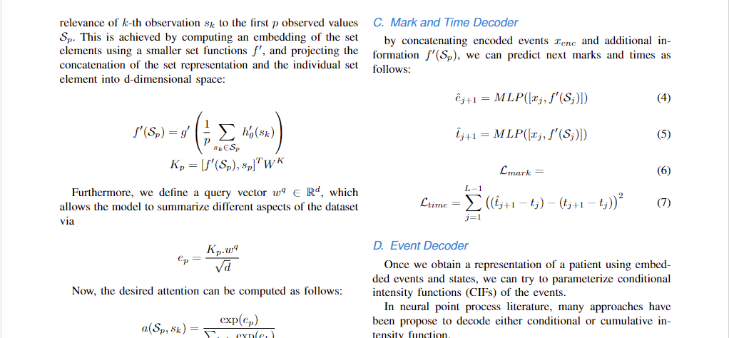
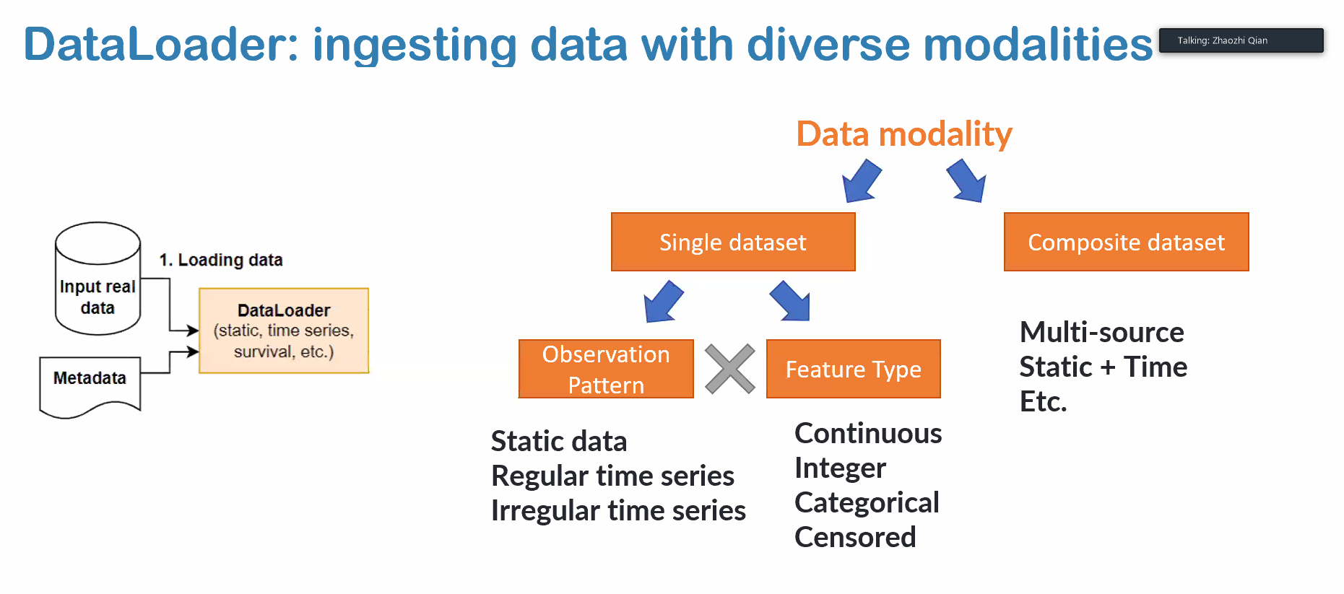

$$λ$$
$$t_{j}$$
$$h_{j}$$
Irregular
TEE
CIF
$$t_{j}$$
$$t_{j+1}$$
DAM
Next Event
$${\hat{e}}_{j+1}$$
Regular
Outcome
$${\hat{y}}_{i}∈[0,1]$$
$$z_{j}$$
When preparing your graphics IEEE suggests that you use of one of the following Open Type fonts: Times New Roman, Helvetica, Arial, Cambria, and Symbol

