Slide 1
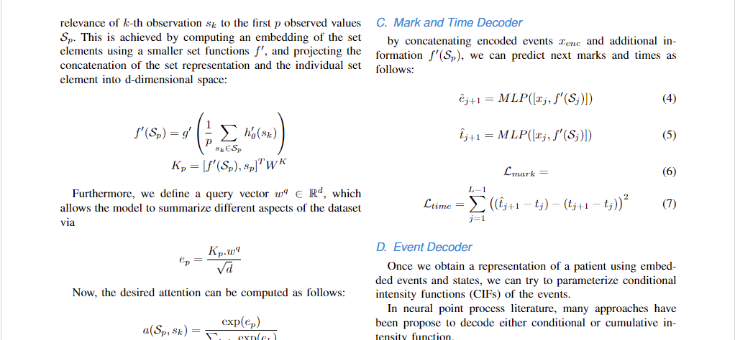
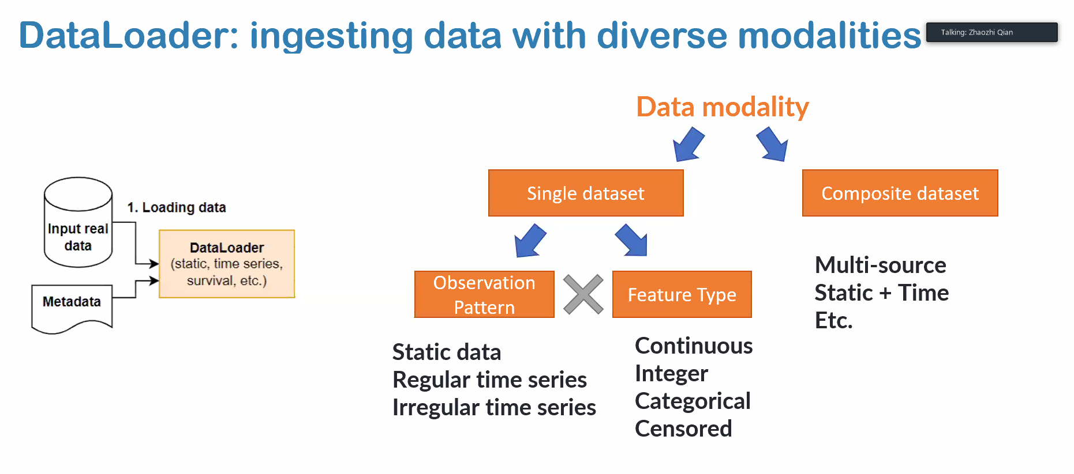

$$λ$$
$$t_{j}$$
$$h_{j}$$
Irregular
TEE
CIF
$$t_{j}$$
$$t_{j+1}$$
DAM
Next Event
$${\hat{e}}_{j+1}$$
Regular
Outcome
$${\hat{y}}_{i}∈[0,1]$$
$$z_{j}$$
When preparing your graphics IEEE suggests that you use of one of the following Open Type fonts: Times New Roman, Helvetica, Arial, Cambria, and Symbol

Slide 2
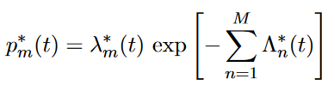
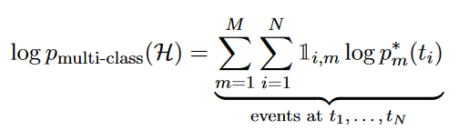
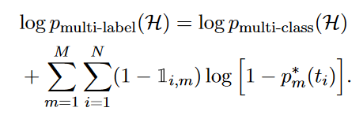








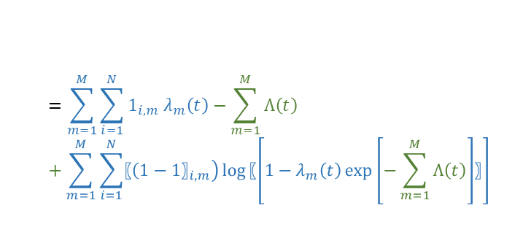
$$λ_{1}$$
$$h_{j}:history until t_{j}$$
$$t_{j}$$
$$t_{j+1}$$
TEE
$$λ_{M}$$
$$t_{j}$$
$$t_{j+1}$$
$$dd$$
$$=\sum_{m=1}^{M}{\sum_{i=1}^{N}{{1_{i,m} λ}_{m}(t)}}−\sum_{m=1}^{M}{Λ(t)}$$
Cross Entropy Loss
$$=\sum_{m=1}^{M}{\sum_{i=1}^{N}{{1_{i,m} λ}_{m}\left(t\right)}}−\sum_{m=1}^{M}{Λ\left(t\right)}+\sum_{m=1}^{M}{\sum_{i=1}^{N}{{〖{(1−1〗}_{i,m})\log{〖[1−λ_{m}\left(t\right)\exp\left[−\sum_{m=1}^{M}{Λ\left(t\right)}\right]〗]}}_{}}}$$
Binary Cross Entropy Loss

Slide 3























$$f({\{(t_{r},e_{r})\}}_{r=1}^{r=j})$$
$$h_{j}$$
$$h_{j}\left(t≤t_{j}\right) \\ all info$$
TEE
$$h_{j+1}$$
$$λ_{1}$$
$$η_{j+1}$$
$$t_{j}$$
$$t_{j+1}$$
$$μ_{j+1}$$
$$η_{M,j+1}$$
$$μ_{M,j+1}$$
$$γ_{M,j+1}$$
$$η_{j+1}$$
$$μ_{j+1}$$
$$γ_{j+1}$$
$$λ_{M}\left(t\right) for t in (t_{j},t_{j+1}]$$
$$λ\left(t\right) for t in (t_{j},t_{j+1}]$$
$$λ_{M}(t_{j+1})$$
$∫λ_{M}(t)$ $in (t_{j},t_{j+1}]$
$$λ(t_{j+1})$$
$∫λ(t)$ $in (t_{j},t_{j+1}]$
$p\left(t\right)=λ\left(t\right)exp⁡(−∫λ\left(t\right))$ $in (t_{j},t_{j+1}]$
$p\left(t\right)=λ_{m}{\left(t_{j+1}\right)}^{}exp⁡(−∫Σλ\left(t\right))$ $in (t_{j},t_{j+1}]$
$p\left(t\right)=λ_{m}{\left(t_{j+1}\right)}^{}exp⁡(−∫Σλ_{m}\left(t\right))$ $in (t_{j},t_{j+1}]$
$$=\sum_{m=1}^{M}{\sum_{i=1}^{N}{{1_{i,m} λ}_{m}(t)}}−\sum_{m=1}^{M}{Λ(t)}$$
$$dd$$
$$=\sum_{m=1}^{M}{\sum_{i=1}^{N}{{1_{i,m} λ}_{m}(t)}}−\sum_{m=1}^{M}{Λ\left(t\right)}+\sum_{m=1}^{M}{\sum_{i=1}^{N}{{{(1−1}_{i,m})\log\left[1−λ_{m}(t\right)exp⁡[−\sum_{m=1}^{M}{Λ\left(t\right)}]] }_{}}}$$
Cross Entropy Loss
Binary Cross Entropy Loss

Slide 4
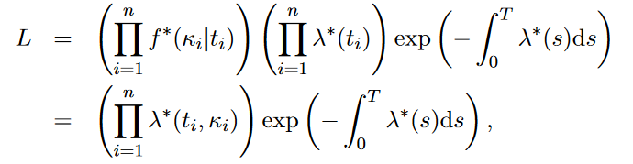
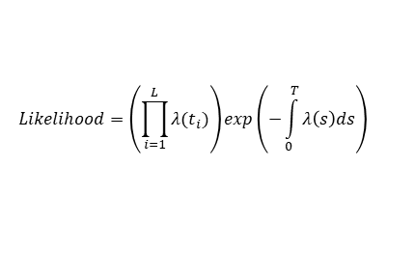




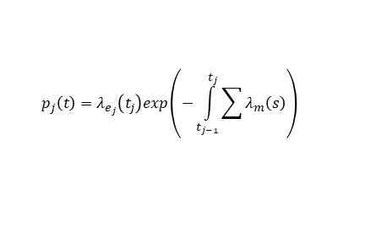


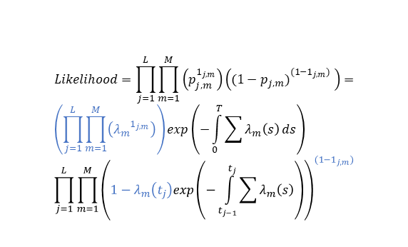
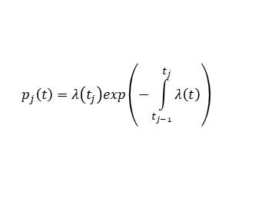


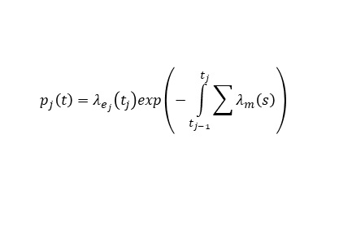

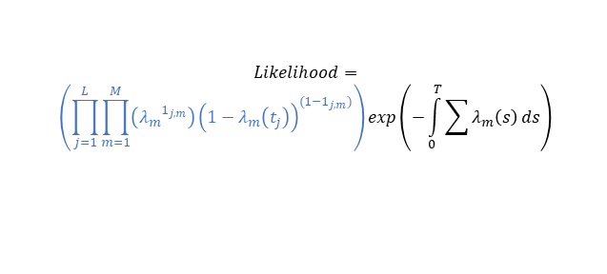

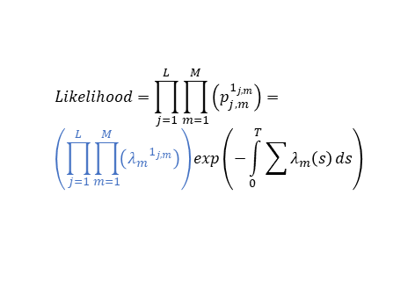
$$m=1$$
$$p_{j}\left(t\right)=λ\left(t_{j}\right)exp\left(−\int_{t_{j−1}}^{t_{j}}{λ\left(t\right)}\right)$$
Unmarked
$$Likelihood=\prod_{j=1}^{L}{p_{j}\left(t\right)}=\left(\prod_{j=1}^{L}{λ(t_{j})}\right)exp\left(−\int_{0}^{T}{λ\left(s\right)ds}\right)$$
$$Likelihood=\left(\prod_{i=1}^{L}{λ(t_{i})}\right)exp\left(−\int_{0}^{T}{λ\left(s\right)ds}\right)$$
$$S_{i}$$
$$(t_{j})$$
Multi-class
$$Likelihood=\left(\prod_{i=1}^{L}{λ_{m}(t_{i})}\right)exp\left(−\int_{0}^{T}{\sum{λ\left(s\right)}ds}\right)$$
$$p_{j}\left(t\right)=λ_{e_{j}}\left(t_{j}\right)exp\left(−\int_{t_{j−1}}^{t_{j}}{\sum{λ_{m}\left(s\right)}}\right)$$
$$Likelihood=\prod_{j=1}^{L}{\prod_{m=1}^{M}{\left(p_{j,m}^{1_{j,m}}\right)}}= \\ \left(\prod_{j=1}^{L}{\prod_{m=1}^{M}{\left({λ_{m}}^{1_{j,m}}\right)}}\right)exp\left(−\int_{0}^{T}{\sum{λ_{m}\left(s\right)}ds}\right)$$
Cross Entropy Loss (ignoring integral)
$$S_{i}$$
$$(t_{j},e_{j})$$
Neural Temporal Point Processes For Modelling Electronic Health Records, 2020
Multi-label
$$p_{j}\left(t\right)=λ_{e_{j}}\left(t_{j}\right)exp\left(−\int_{t_{j−1}}^{t_{j}}{\sum{λ_{m}\left(s\right)}}\right)$$
$$Likelihood=\prod_{j=1}^{L}{\prod_{m=1}^{M}{\left(p_{j,m}^{1_{j,m}}\right)}\left({(1−p_{j,m})}_{}^{(1−1_{j,m})} \right)}=$$
$$\left(\prod_{j=1}^{L}{\prod_{m=1}^{M}{\left({λ_{m}}^{1_{j,m}}\right)}}\right)exp\left(−\int_{0}^{T}{\sum{λ_{m}\left(s\right)}ds}\right) \\ \prod_{j=1}^{L}{\prod_{m=1}^{M}{{\left(1−λ_{m}\left(t_{j}\right)exp\left(−\int_{t_{j−1}}^{t_{j}}{\sum{λ_{m}\left(s\right)}}\right)\right)}^{(1−1_{j,m})}}}$$
$$S_{i}$$
$p\left(t\right)=λ_{m}{\left(t_{j+1}\right)}^{}exp⁡(−∫Σλ\left(t\right))$ $in (t_{j},t_{j+1}]$
$$(t_{j},e_{j})$$
Binary Cross Entropy Loss (ignoring integral)
$p\left(t\right)=λ_{m}{\left(t_{j+1}\right)}^{}exp⁡(−∫Σλ_{m}\left(t\right))$ $in (t_{j},t_{j+1}]$
Seems to be problematic
If we imagine
Marked
$$Likelihood=$$
$$\left(\prod_{j=1}^{L}{\prod_{m=1}^{M}{\left({λ_{m}}^{1_{j,m}}\right){\left(1−λ_{m}\left(t_{j}\right)\right)}^{(1−1_{j,m})}}}\right)exp\left(−\int_{0}^{T}{\sum{λ_{m}\left(s\right)}ds}\right)$$

Slide 5


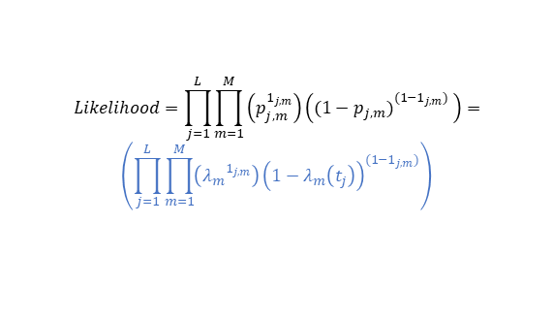



$$λ_{1}$$
$$λ_{2}$$
$$S_{i}$$
$$(t_{j},e_{j})$$
$$(t_{j−1},e_{j−1})$$
$$λ_{1},λ_{2} in (t_{j−1},t_j]$$
$$ℋ_{t−1}={\{\left(t_{r},e_{r}\right)\}}_{r=1}^{j−1}$$
TEE
$$h_{j−1}$$
Ignoring integral (point process)
$$λ_{1}$$
$$Likelihood=\prod_{j=1}^{L}{\prod_{m=1}^{M}{\left(p_{j,m}^{1_{j,m}}\right)}\left({(1−p_{j,m})}_{}^{(1−1_{j,m})} \right)}=$$
$$\left(\prod_{j=1}^{L}{\prod_{m=1}^{M}{\left({λ_{m}}^{1_{j,m}}\right){\left(1−λ_{m}\left(t_{j}\right)\right)}^{(1−1_{j,m})}}}\right)$$
$$λ_{2}$$
$$S_{i}$$
$$(t_{j},e_{j})$$
Binary Cross Entropy Loss (ignoring integral)
$$(t_{j−1},e_{j−1})$$
$$t_{j},e_{j}$$
$${\hat{e}}_{j+1}$$
Irregular
TEE
Auto encoder for predicting next event marks

Slide 6
$$λ_{1}$$
$$λ_{2}$$
$$S_{i}$$
$$(t_{j},e_{j})$$
$$(t_{j−1},e_{j−1})$$
$$λ_{1},λ_{2} in (t_{j−1},t_j]$$
$$ℋ_{t−1}={\{\left(t_{r},e_{r}\right)\}}_{r=1}^{j−1}$$
TEE
$$h_{j−1}$$
Ignoring integral (point process)
$$λ_{1}$$
$$Likelihood=\prod_{j=1}^{L}{\prod_{m=1}^{M}{\left(p_{j,m}^{1_{j,m}}\right)}\left({(1−p_{j,m})}_{}^{(1−1_{j,m})} \right)}=$$
$$\left(\prod_{j=1}^{L}{\prod_{m=1}^{M}{\left({λ_{m}}^{1_{j,m}}\right){\left(1−λ_{m}\left(t_{j}\right)\right)}^{(1−1_{j,m})}}}\right)$$
$$λ_{2}$$
$$S_{i}$$
$$(t_{j},e_{j})$$
Binary Cross Entropy Loss (ignoring integral)
$$(t_{j−1},e_{j−1})$$
$$t_{j},e_{j}$$
$${\hat{e}}_{j+1}$$
Irregular
TEE
Auto encoder for predicting next event marks

Slide 7
$$λ$$
$$t_{j}$$
$$h_{j}$$
Irregular
CIF
$$t_{j}$$
$$t_{j+1}$$
DAM
Next Event
$${\hat{e}}_{j+1}$$
Regular
Outcome
$${\hat{y}}_{i}∈[0,1]$$
$$z_{j}$$
انکودر
+
انکودر
دیکودر
MLP
انکودر
MLP
MLP

Slide 8
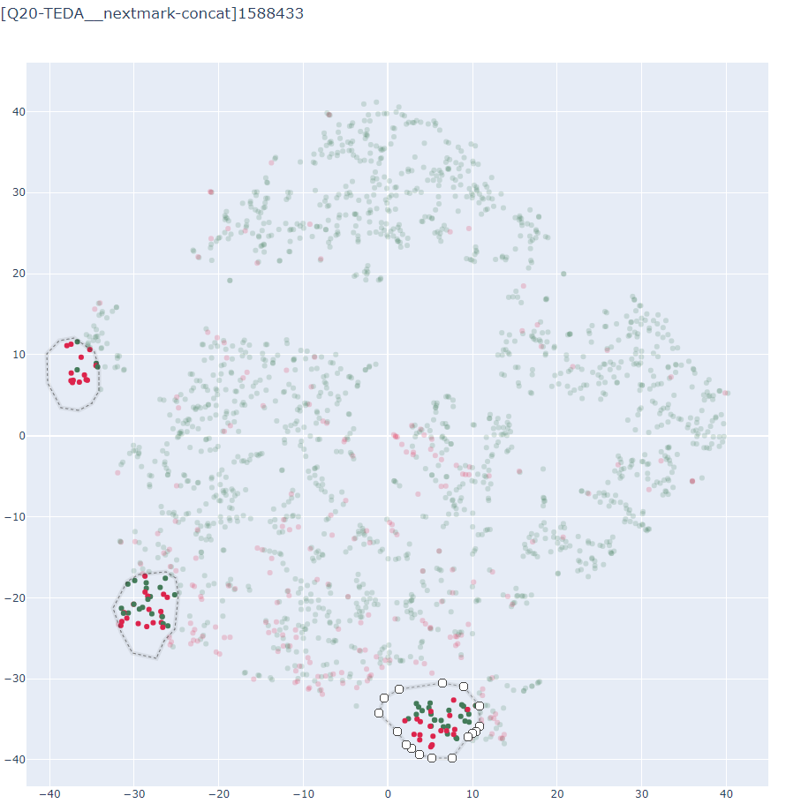

Slide 9








I
MSE Loss
$$x_{c}^{}$$
$$x_{c}^{′}$$
Decoder
$$x_{c}^{rec}$$
+
Encoder
$$ε\sim N(0,0.2)$$
II
Encoder
$$y$$
$$x_{c}^{}$$
MSE Loss
$$x_{d1}^{}$$
MLP
$$\hat{y}$$
MLP
$$x_{d2}^{}$$

Slide 10
